Slide 1
FACULTY PORTAL SYSTEM
BATCH NO:11
Team Members :
22331A0717-K.Jatin
22331A0746-R.Yasodha
22331A0760-U.V.S.Kiran

Slide 2
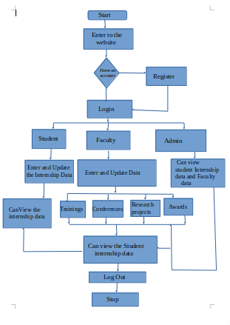
Process Flow
NO

Slide 3
            THANK YOU

