Slide 1
FACULTY CONTRIBUTION PORTAL
Batch.No:11
K.JATIN -22331A0717
R.YASODHA -22331A0746
U.V.S.KIRAN -22331A0760

Slide 2
Introduction:
Faculty Contribution Portal is a centralized platform to record all faculty activities and student activities.
A digital solution is needed for efficient record-keeping and performance evaluation.
It enables easy access to faculty data and student data for department heads, administrators, and accreditation committees.
The Faculty Contribution Portal is a web-based platform developed to record, manage, and monitor all faculty and student activities in a structured manner.

Slide 3
Problem statement:
Faculty members contribute to multiple areas, including teaching, research, administration, and mentorship.
Manual tracking methods are inefficient, error-prone, and time-consuming.
Data is scattered across different sources, making retrieval and report generation difficult.
Difficulty in accreditation processes due to unstructured data management.
No centralized system to monitor faculty contributions efficiently.
A Faculty Contribution Portal that provides an automated, centralized, and structured system for tracking, managing, and analyzing faculty contributions, ensuring efficiency, transparency, and informed decision-making.

Slide 4
System Architecture:
Workflow:
User Authentication – Faculty, Students, and Admins log in with role-based access.
Contribution Submission –Faculty records teaching, research, events, and admin roles.
Students submit projects, research work, participation in events, and academic contributions.
Data Processing – System categorizes and stores faculty and student contributions.
Review & Approval – Admins verify and approve submissions.
Report Generation – Automated reports for faculty & student contributions.
Analytics & Insights – Tracks faculty performance and student participation trends.

Slide 5
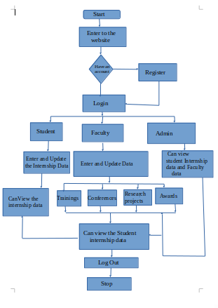
SYSTEM ARCHITECTURE:

Slide 6
Intended Users:
Faculty Members – Submit their contributions in teaching, research, events, and administration.
Students – Record academic projects, research work, and participation in events.
Department Heads – Review and approve faculty and student contributions.
Institutional Administrators – Manage data, generate reports, and oversee faculty & student performance.
Accreditation Committees – Access structured reports for quality assessment (e.g., NAAC, NBA).
Research & Academic Committees – Analyze faculty and student research impact.
University Management – Use data for decision-making, rankings, and institutional development.

Slide 7
Features & Functionality:
User Authentication – Secure login with role-based access (Faculty, Students, Admins).
Contribution Management – Faculty & students submit teaching, research, events,internship data and projects.
Data Storage & Organization – Centralized database for easy retrieval & modification.
Review & Approval – Admins verify & approve contributions before final submission.
Automated Report Generation – Export reports in PDF, Excel, and CSV.
Performance Tracking & Analytics – Dashboard for insights on faculty & student contributions.
Accreditation Support – Structured data for NAAC, NBA, and institutional evaluations.
Notifications & Alerts – Reminders for submissions, approvals, and deadlines.
Search & Filter – Quick search based on faculty, student, department, or category.
User-Friendly Dashboard – Responsive UI for easy navigation & data entry.

Slide 8
Future Enhancements:
AI-Based Analytics – Predict trends & suggest improvements.
Multi-Institution Support – Extend to multiple colleges/universities.
Plagiarism Detection for Research – Identify duplicate or plagiarized research contributions.
Real-Time Notifications – Instant alerts for pending approvals, deadlines, and report updates.
Performance-Based Career Suggestions – AI-driven insights for faculty development and research grants.

Slide 9
Thank You

