Slide 1
Stock prediction using classification techniques
Group 2
Members
Ram Ahuja – 19ucs017
Jatin Dahiya – 19ucs033
Aditya Khandelwal – 19ucs163

Slide 2
INTRODUCTION
We need a profitable stock trading strategy to maximize our profits. One may use techniques like reinforcement learning to train a model to get us the optimal output, but to get the optimal output we need a lot of variable output such as sentimental analysis, a larger dataset and training of a Reinforced learning agent which requires a very large time depending on the size of dataset.
In this project we have taken the stock of ‘APPLE’ and our aim is to use classification techniques like SVM , Logistic Regression and KNN that can help us determine whether we should buy or sell a stock. We compare the results of these different classification techniques and find the one that gives us the most optimal output.

Slide 3

Information about the dataframe df
df.shape – DataFrame stores the number of rows and number of columns as a tuple(number of rows,number of columns).

Slide 4
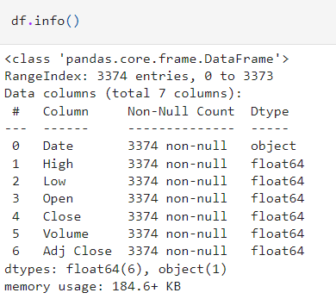
df.info –This method prints information about a DataFrame including the index dtype and column dtypes, non-null values and memory usage

Slide 5
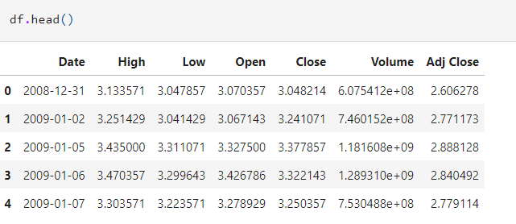
df.head –The head() function is used to get the first n rows. This function returns the first n rows for the object based on position.

Slide 6
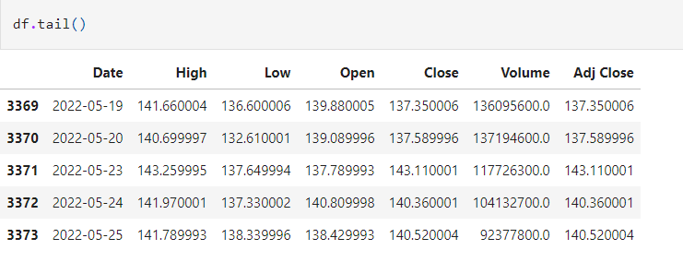
df.tail –The tail() function is used to get the last n rows . This function returns last n rows from the object based on position.

Slide 7
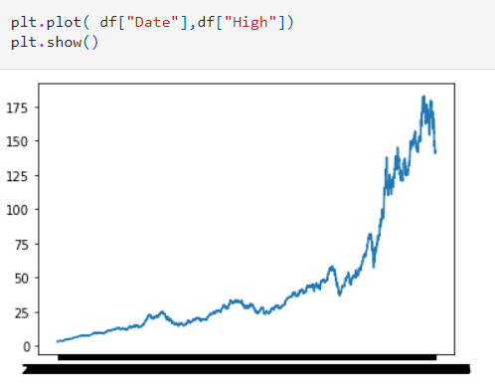
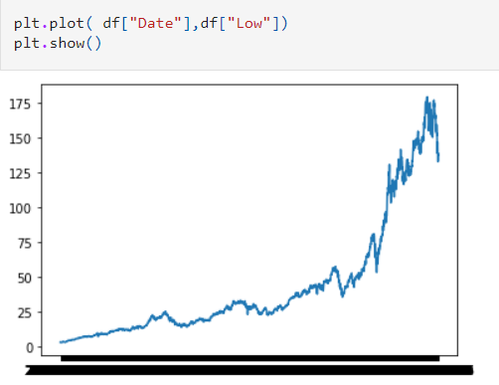
Preparing The Data
Plotting the values of the parameters in the data
Date vs High Date vs Low

Slide 8
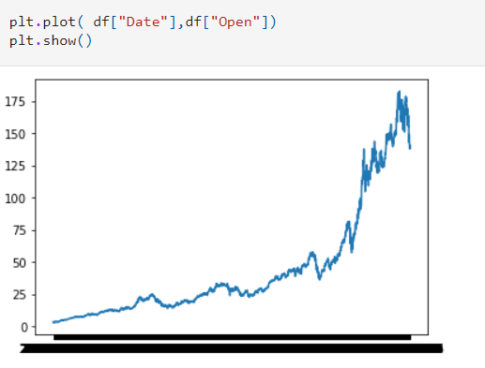
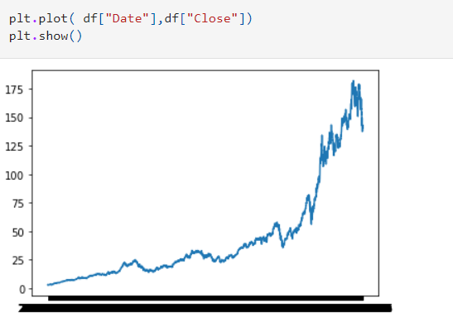
Date vs Open Date vs Close

Slide 9


Removing the unnecessary data and Null values
Calculating High - Low and Close - Open and Plotting Graph

Slide 10
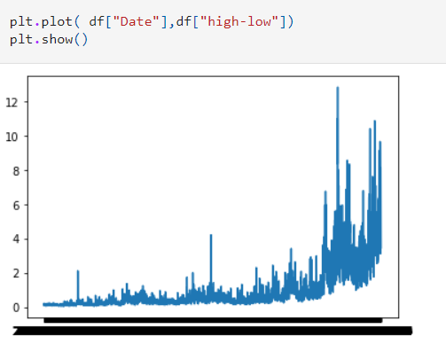
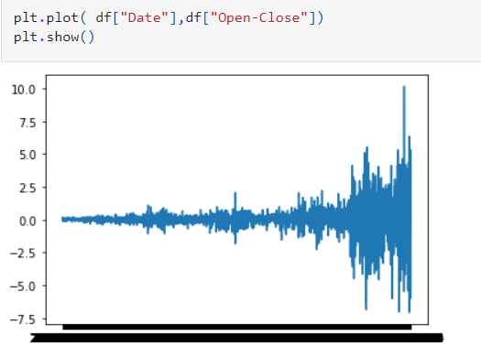
Date vs High-Low Date vs Close-Open

Slide 11
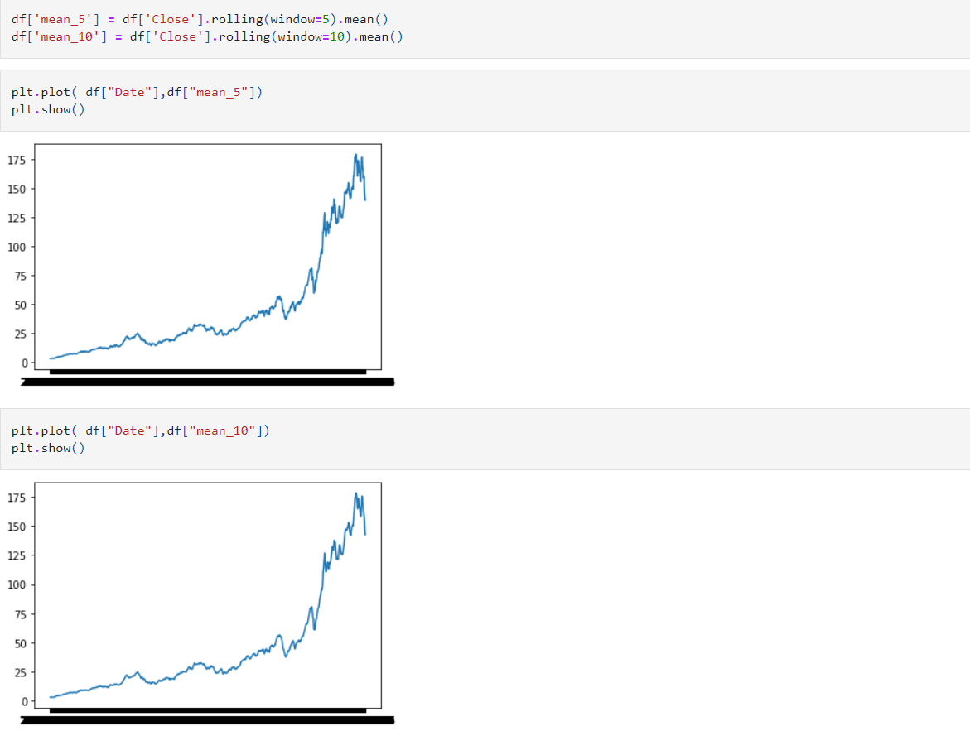
Calculating mean of previous 5 and 10 days and Plotting it .

Slide 12
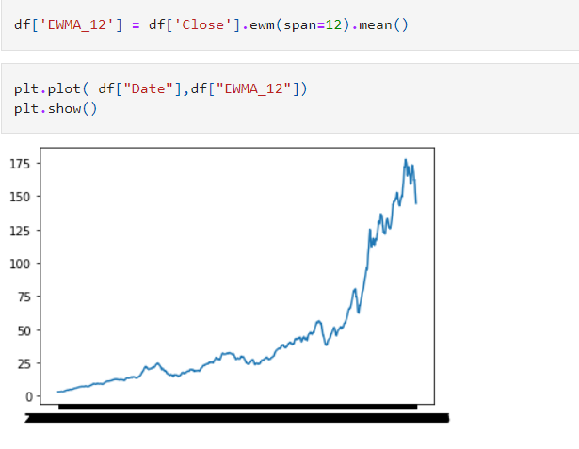
Calculating Exponentially Weighted Moving Average
It is a type of moving average which places a greater weight on the most recent data points.

Slide 13
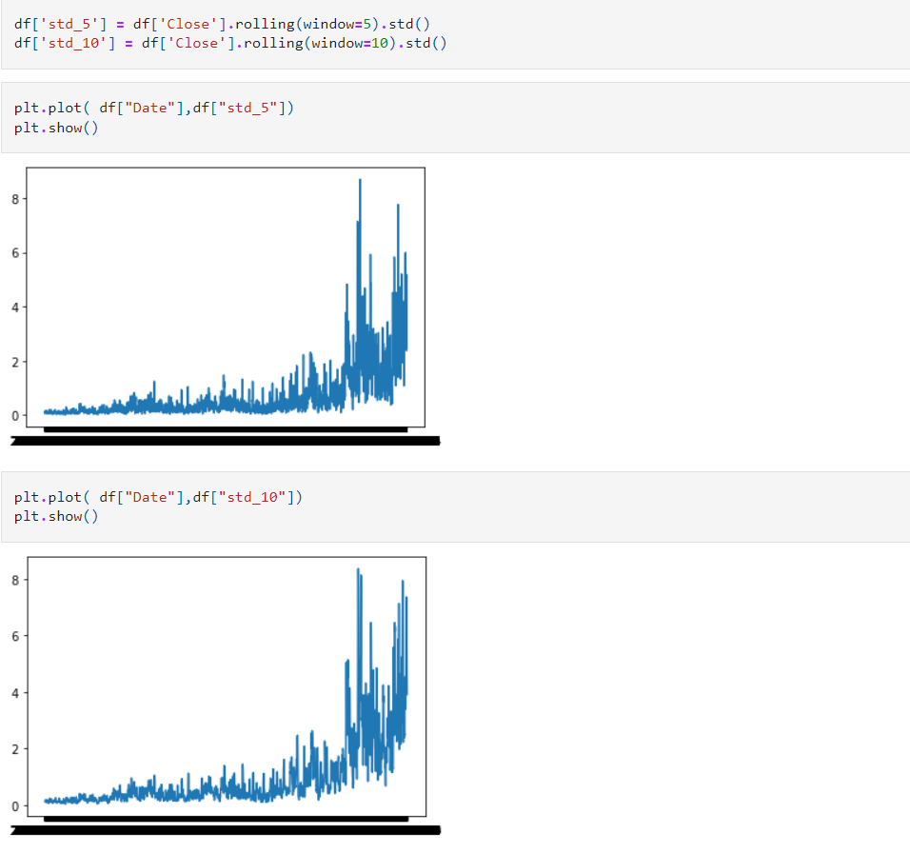
Calculating standard deviation for past 5 and 10 days

Slide 14
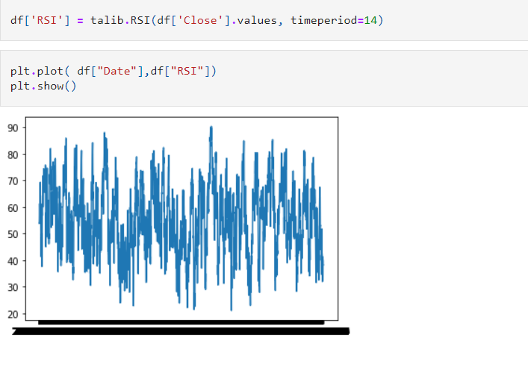
Calculating Relative Strength Index
RSI is a momentum indicator , which ranges between between 0 to 100.
RSI value over 70 is considered Overbought, while a value below 30 is considered Oversold.

Slide 15
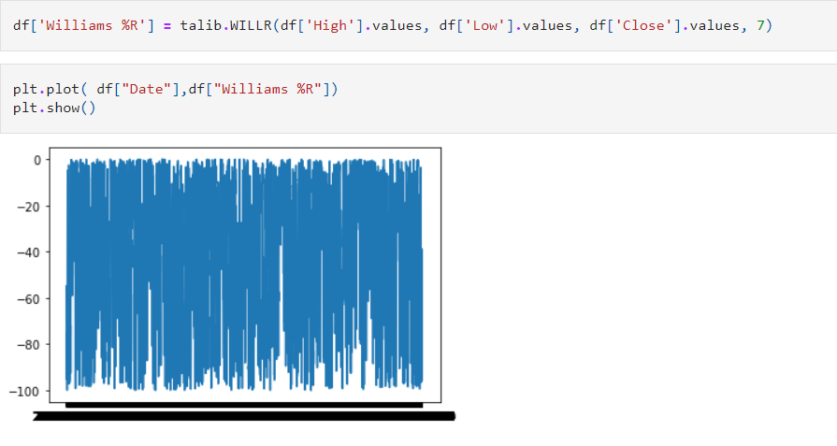
Calculating Williams %R
It is a momentum indicator with values ranging from -100 and 0
Value above -20 is considered overbought and value below -80 is considered oversold.

Slide 16
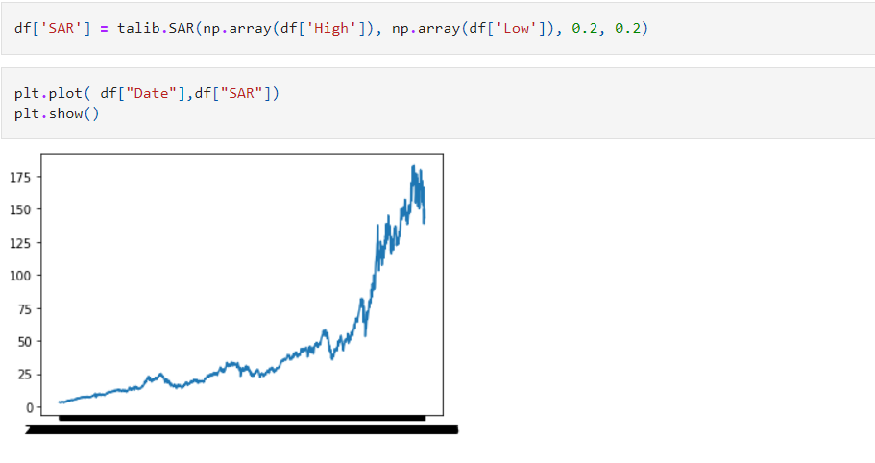
Calculating Parabolic Stop and Reverse for the data
It is used to determine the price action.

Slide 17
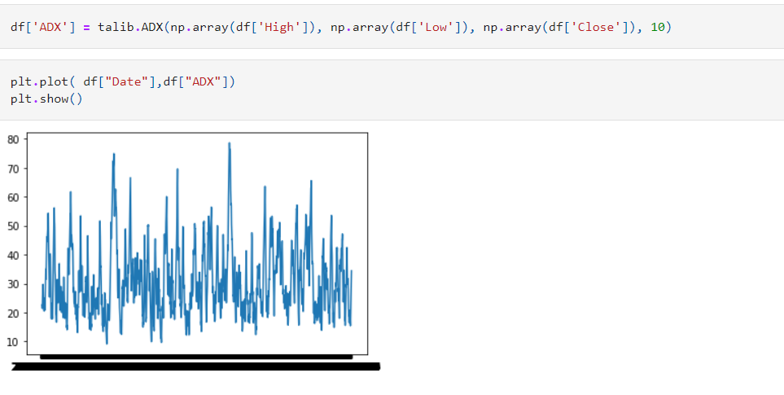
Calculating the Average Directional Index for the data
It is used to determine the strength of a particular trend

Slide 18
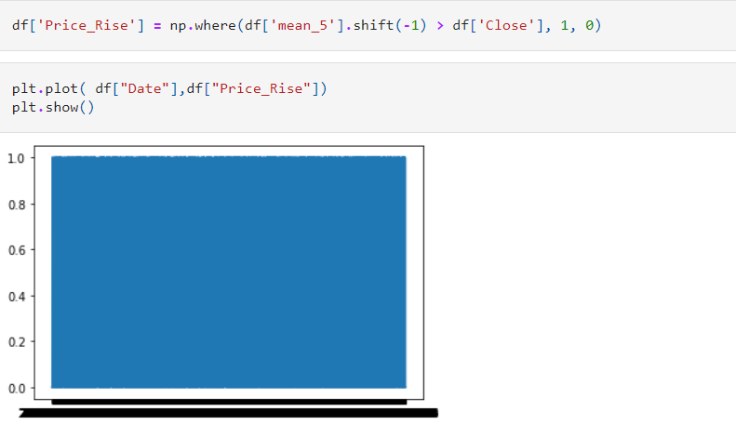
Calculating when to buy or sell stock
When mean of 5 previous day close value is greater than closing of current day , buy the stock.
When mean of 5 previous day close value is less than closing of current day , sell the stock .

Slide 19
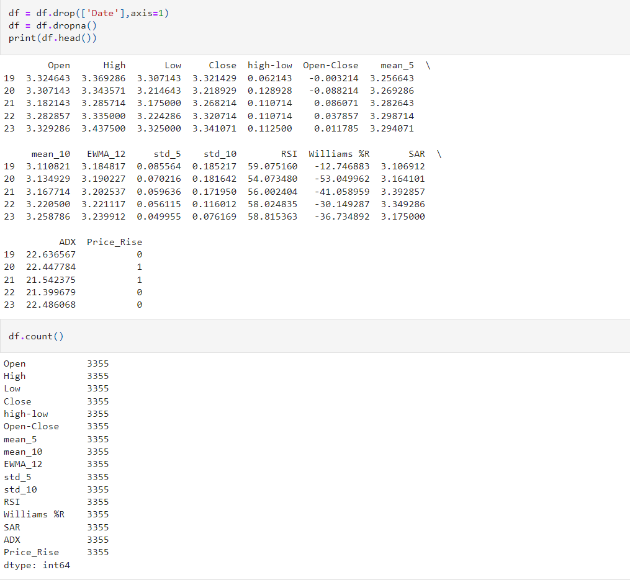
Dropping the Date from the dataframe

Slide 20
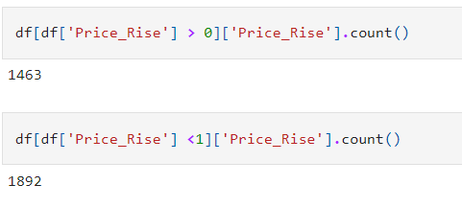
Counting the number of 0 and 1 in Price_Rise
Counting the number of 0 and 1 means counting the total number of times we get buy or sell signals. 0 means buy signal while 1 means sell signal.

Slide 21
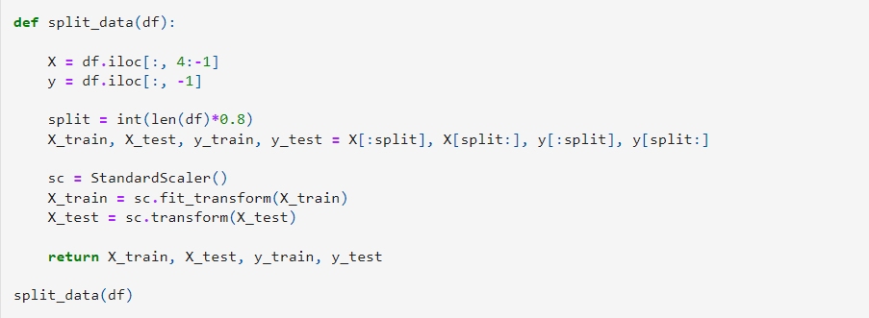
Splitting the data into train and test sets
Splitting the dataset into Training and Testing in which 80% is Training and 20% is Testing.

Slide 22
Training Algorithms
SVM (linear)
SVM (Polynomial)
SVM (Radial Basis Function)
KNN
Logistic Regression

Slide 23
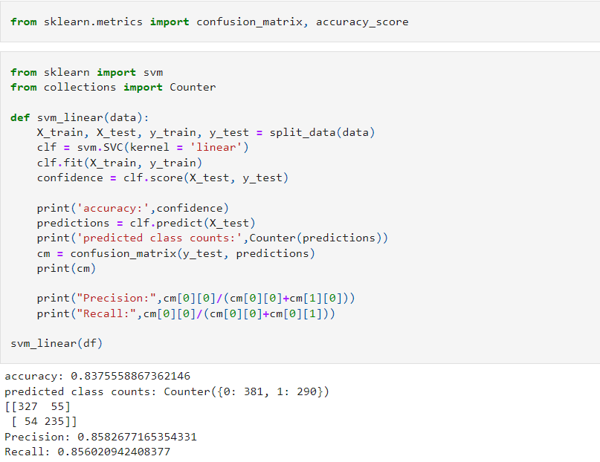
SVM
(Linear)

Slide 24
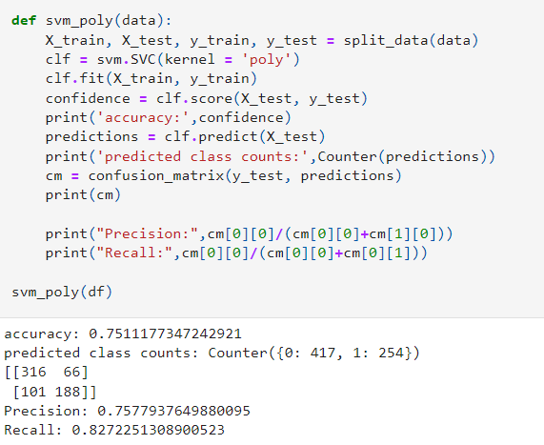
SVM
(Polynomial)

Slide 25
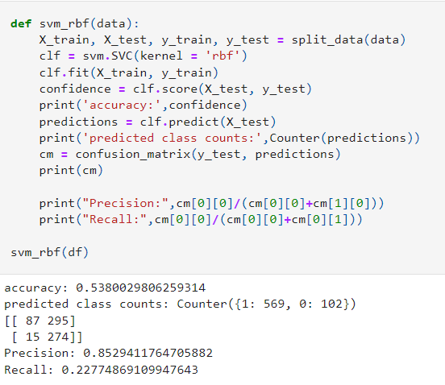
SVM
(Radial Basis
Function)

Slide 26
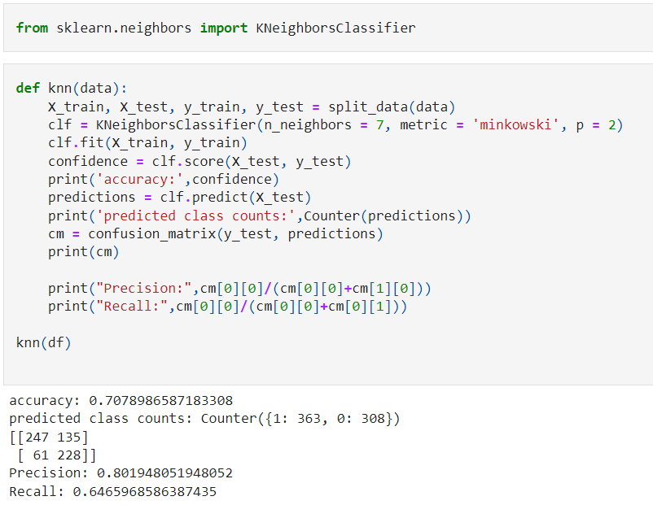
KNN

Slide 27
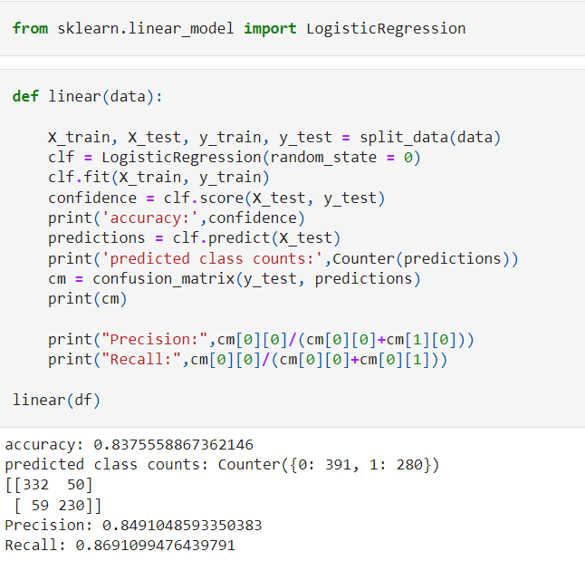
Logistic Regression

Slide 28
CONCLUSION
After analysing the results obtained from different training algorithms we found that the accuracy , precision and recall are best for Linear SVM & Logistic Regression.

