Slide 1


4006CEM - Computer Science Activity Led Learning Project 1 - 2122JANMAY
PYTHON CHATBOT PROJECT
NAME – JATIN GERA
STUDENT ID - 11987480

Slide 2
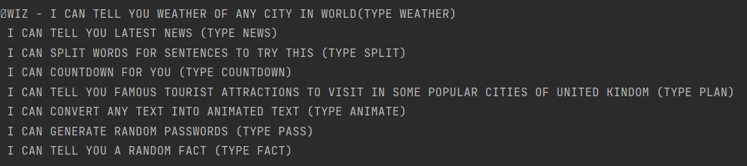
INTRODUCTION OF MY CHATBOT
HELLO,MY CHATBOT NAME IS WIZ AND IT IS BASICALLY A BEGINNER CHATBOT AND MADE FROM BASIC PYTHON COMMANDS BUT IT CAN PERFORM MANY FUNCTIONS –

Slide 3

PLANNING OF THE CHATBOT
It was a group project but in my case I was not able to contact and try to make a chatbot with my team members as they were not ready to make it and I also tried to contact them many times still bad luck , we just had one meeting and then everyone was just busy in their own work.
In the end I decided to make it by myself and I planned to make a very easy to use and basic chatbot which could be more productive and had more functions than a particular chatbot as everyone was making a chatbot which could do tell you about only one topic. I tried studying about API and started seeing tutorial videos to get an idea of what and how to do . I got much help from my programming lectures .

Slide 4
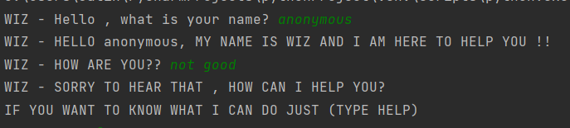
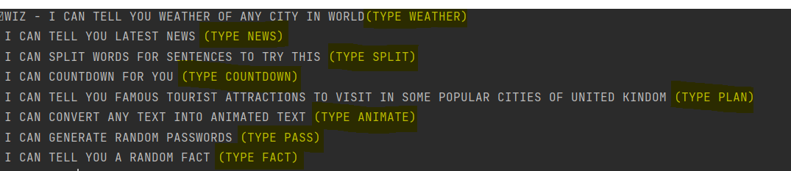
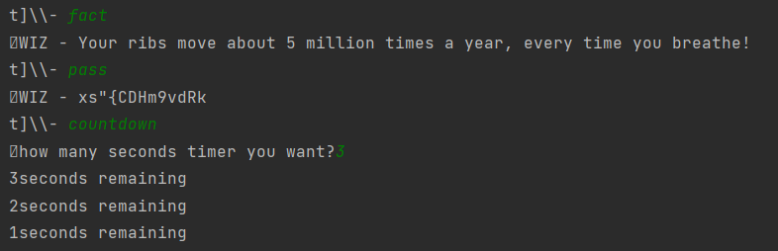
DEMONSTARTION AND EXPLANATION
I started to write my code in PYCHARM , I made a new project in python virtual environment and started writing importing all libraries and packages that could be required in the whole process .
My first challenge was to code my chatbot so that it could give user greetings ,I literally had no idea as I had no experience before but after many hit and trials I went on with if and else statements which I used with list so that my chatbot could respond to every greeting even if it is not in positive way.
Then I started to put a code in which when user types HELP it shows all it functions and what it can do and how to process that functions for which I simply used INPUT statements and IF ELSE
I also used a while loop so that and OS library so that whenever bot give some response , the user can write his/her next input without being interrupted to restart the bot
After this I used print function to write all functions of my chatbot and assigned them a word so that when user input that word chatbot knows what to respond.

Slide 5
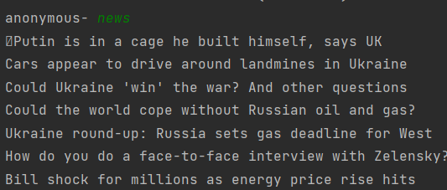
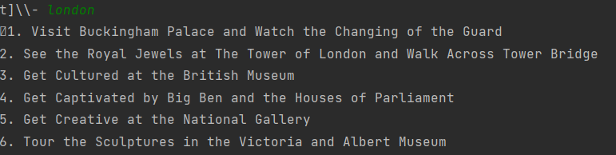
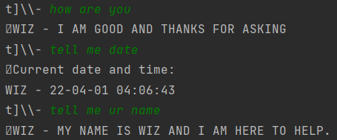
DEMONSTARTION AND EXPLANATION
After that I started putting my code and used conditionals and Booleans so that whenever user writes the function that he/she wants to do chatbot will give response according to that.
I used BEAUTIFULSOUP and REQUESTS so that I can scrape data from websites and print that in terminal For example if someone wants to see news ,chatbot will scrape HEADLINES from news website and ignore everything on that webpage and it is performed by recognizing them from their font sizes and removing unwanted material I got help on this using YOUTUBE and blogs .i also used this method to get top tourist attractions which worked successfully.
For the weather I used an API provided by YAHOO and it can give you weather of any city in world just by typing the name I found this api on RAPIDAPI . I had no hint to how to use API but after spending a lot of them I got to know how I can put them in work.
For other functions of my chatbot I used LOOPS,FUNCTIONS AND SOME COOL PYTHON PACKAGES but mostly IF ELSE statements helped me a lot .
Other than I faced a lot of difficulty as it was so difficult to know to how to put codes in use and I didn’t know a lot about coding in python still I tried to do my best
I made my chatbot a little bit intelligent by coding some general responses like bye , how are you , what is date today , what is your name etc

Slide 6
CONCLUSION
I LEARNED A LOT FROM THIS PROJECT AND IT HELPED ME IMPROVE MY CODING SKILLS . I FACED MANY DIFFICULTIES WHILE CODING MY CHATBOT AS IT WAS SO EARLY TO DO SOMETHING LIKE THAT BUT WHEN I STARTED DOING IT I GOT TO LEARN MANY NEW THINGS LIKE ABOUT API , LIBRARIES AND UNIQUE PYTHON COMMAND .
I THINK I WAS NOT ABLE TO MAKE A GREAT CHATBOT BUT I HOPE THAT IT IS SOMEWHAT AN AVERAGE ONE . I GOT TO KNOW WHERE I WAS LACKING AND I HOPE THAT I CAN DO MUCH BETTER IN FUTURE PROJECTS . THIS PROJECT REALLY HELPED ME TO EVALUATE MY SKILLS AND FAILURES .

