Slide 1
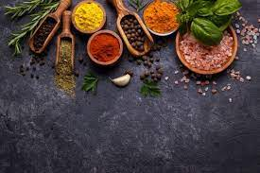
HACKATHON 2K21
FEATURE

Slide 2
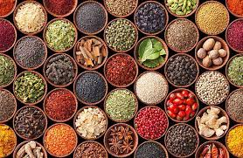

Team memberS
Jatin Jain
Soumili Tapadar
Vanshika Sikarwar
Mansi Jain

Slide 3
Contents
Chapter 1
Project Description
Chapter 2
Summary of work
Chapter 3
Requirements
Chapter 4
Actors of project

Slide 4
Chapter 1
Project Description

Slide 5
Project Description
Main idea behind developing this project is to provide a online solution to create awareness among people regarding miraculous benefits of herbs.
It will run on different screens as it is a static and responsive website and a navbar of categories of herbs .
In this event we are focussing on front-end development part and building a static catalogue site.
Project is made for optimal and sustainable utilization of resources provided by mother nature.

Slide 6
Chapter 2
Summary of work

Slide 7
Summary of work
Created a rough design of the application and also implemented it. It has a catalogue in which we are having herbs in the form of cards
In this application we have designed a toggle button too in order to modify the theme of platform.
Now user can access, navigation bar, header bar, search bar, fir page, footer etc. .

Slide 8
Chapter 3
Requirements

Slide 9
Requirements
Website Details :
*Front End- REACT, HTML, CSS, JAVASCRIPT, BOOTSTRAP
*Platform- Any web browser of suitable compatibility.
*Device- Suitable for all.
* Network Connectivity- Works fine at minimal speed too due to use of React.

Slide 10
Chapter 4
Actors of project

Slide 11
Actors of Project
User: Access a website which has all the varieties of herbs so that
that customers can easily read their benefits along with an add to cart (bucket) where one can add wishlist in that bucket.
Administrator: As, in this time of COVID-19 pandemic , our main focus is on health immunity and promote Ayurveda.
Department: Digitalising the ancient nectar of knowledge for today’s generation.

Slide 12
THANK YOU

