Slide 1

Team name
Method Trace Analyzer
Akatsuki
Jatin Jha
Sakar Jain

Slide 2

Technology Stack:
Java
IBM java method trace
JfreeChart
Github
Eclipse
WindowBuilder
OpenJdk with Openj9

Slide 3
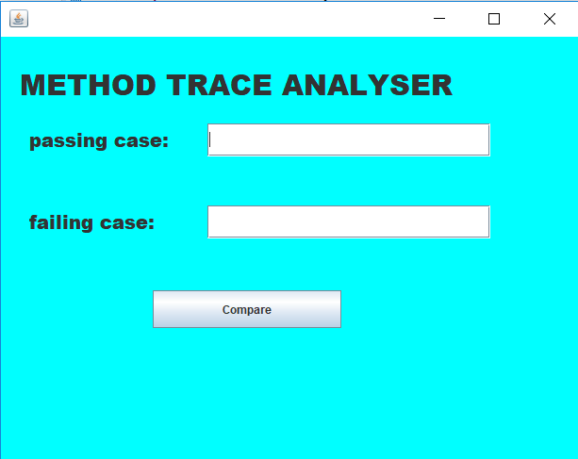
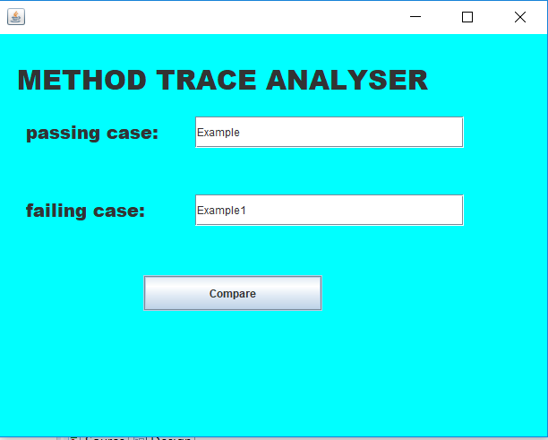

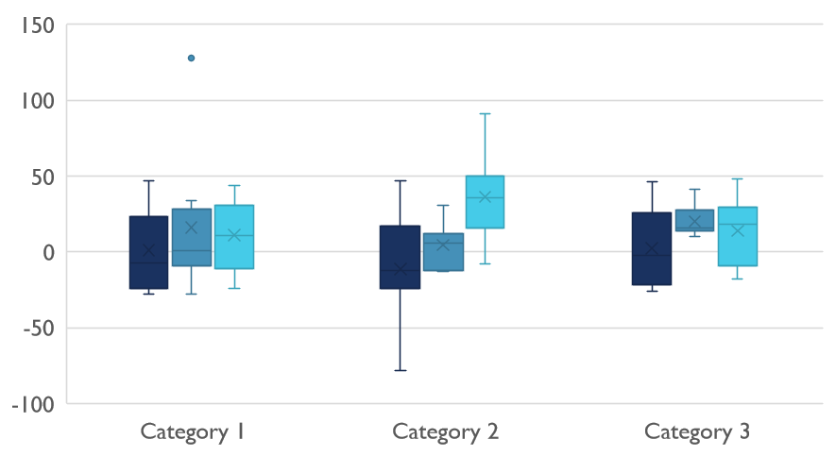
SCREENSHOT OF GUI

Slide 4
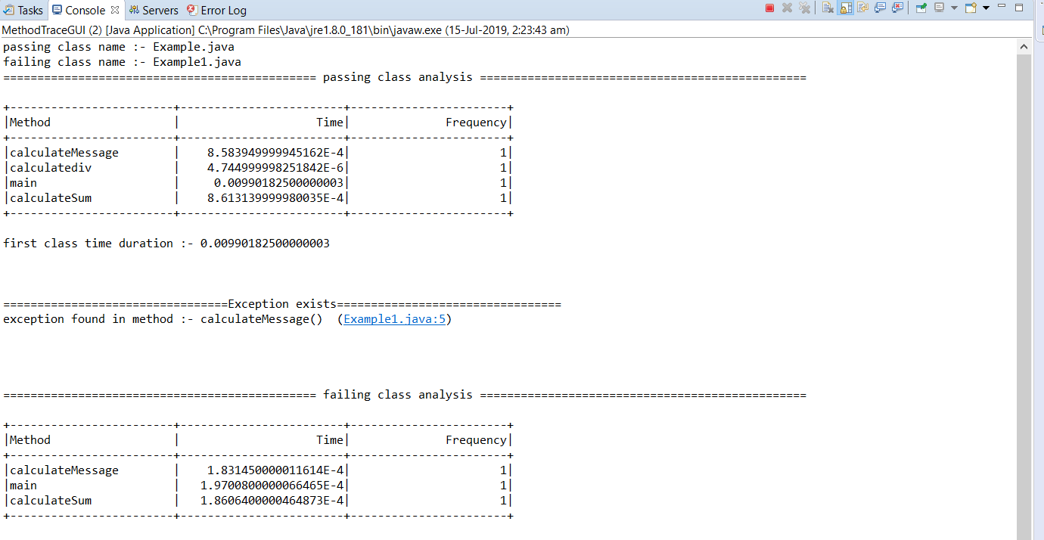
Ouput on console

Slide 5
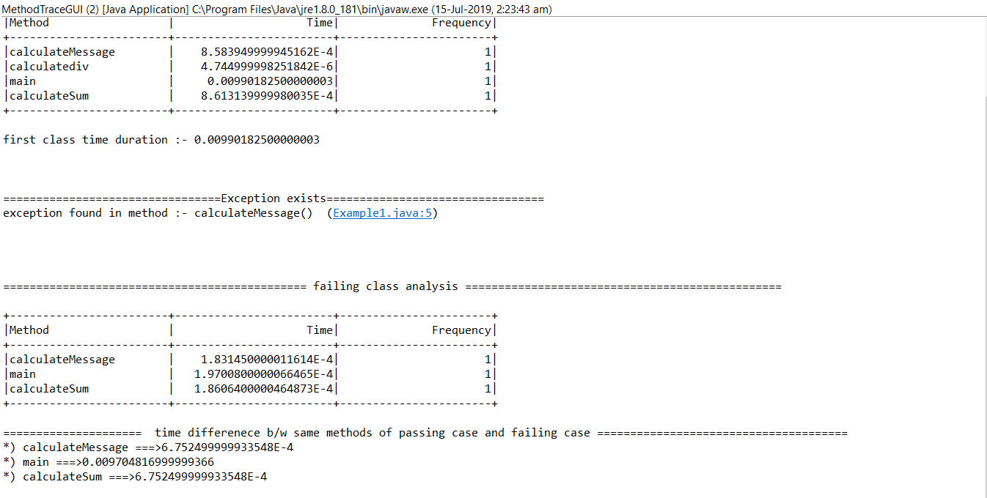
Ouput on console

Slide 6
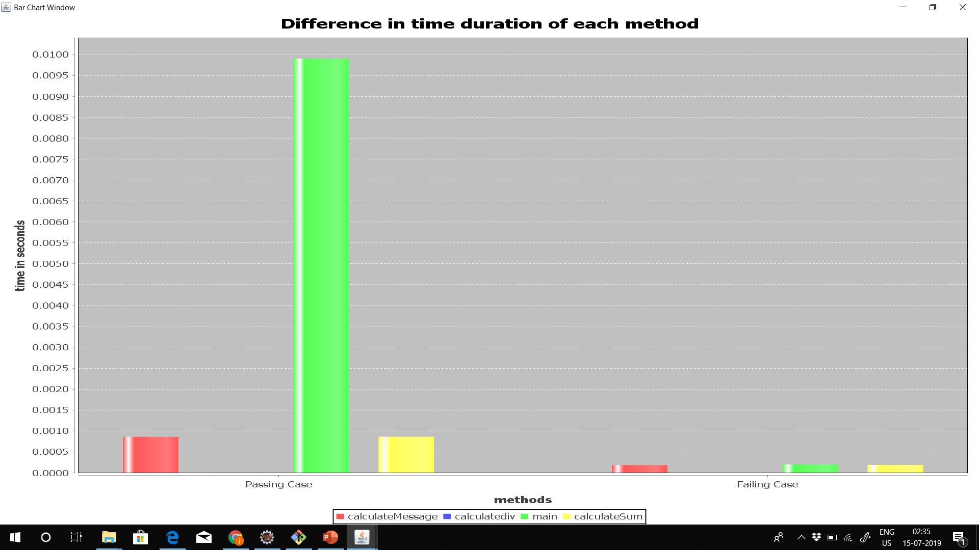
Graphical ouput Of methods Duration

Slide 7

Thank You
For explanation watch video available on github :-
https://github.com/jatinjha/method-trace-analyzer-ibm.git

