Slide 1
ACA Project Introduction to Game theory
Mentor- Prakhar Agarwal
Jatin Jindal, Siddharth Nohria, Siddharth Chinmay,
Anurag Pandey, Yash Choudhary

Slide 2
Index
1. Aim of the project
2. Tic Tac Toe Game
3. Minmax Algorithm
4. Alpha Beta Pruning
5. Heuristic function
6. Implementation
7. Testing
8. References

Slide 3
Aim of the project
To learn the different techniques in Game Theory which includes:
Minmax Algorithm
Alpha Beta pruning
Heuristic function
To build the tic- tac-toe game and connect-4 using these techniques.

Slide 4
Tic-Tac-Toe Game
The tic tac toe game can easily be run by using Brute Force technique because of the few moves in the game.
Brute force is the technique in which at each step we just try out all the possible ways and then just pickup the best result without giving the computer the rational thought to think and also includes the cost of evaluating the same calculations again and again.

Slide 5
Min-Max Algorithm
Minmax Algorithm is an optimization over Brute force technique. We used this algorithm for the zero sum game.
A zero-sum game is a mathematical representation of a situation in which each participant's gain or loss of utility is exactly balanced by the losses or gains of the utility of the other participants.
Hence there are two opponents, you can call them Max and Min. In which max player wants to maximise its score and Min player wants to minimise. So at each level we calculate the best move for the respective player assuming both player play optimally.

Slide 6
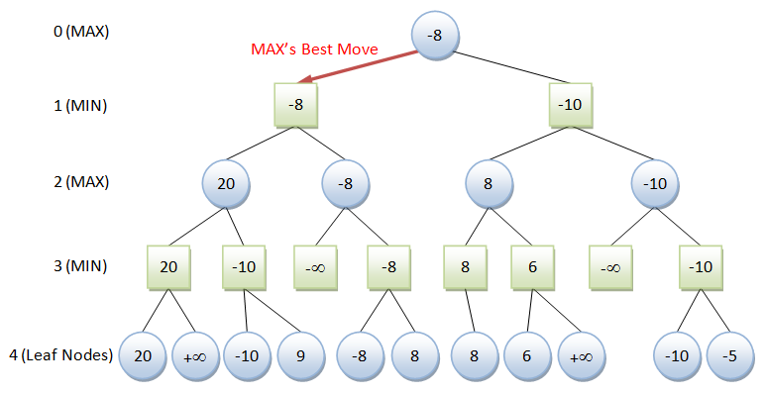

Slide 7
Alpha Beta pruning
Alpha Beta pruning is a search algorithm which is used to reduce the running time of the algorithm and helps it to think at more depth.
Basically, it helps to eliminate the cases in min- max algorithm. It stops completely evaluating a move when at least one
possibility has been found that proves the current move to be worse than a previously examined move. Hence, helping in saving the time to calculates those computations.

Slide 8
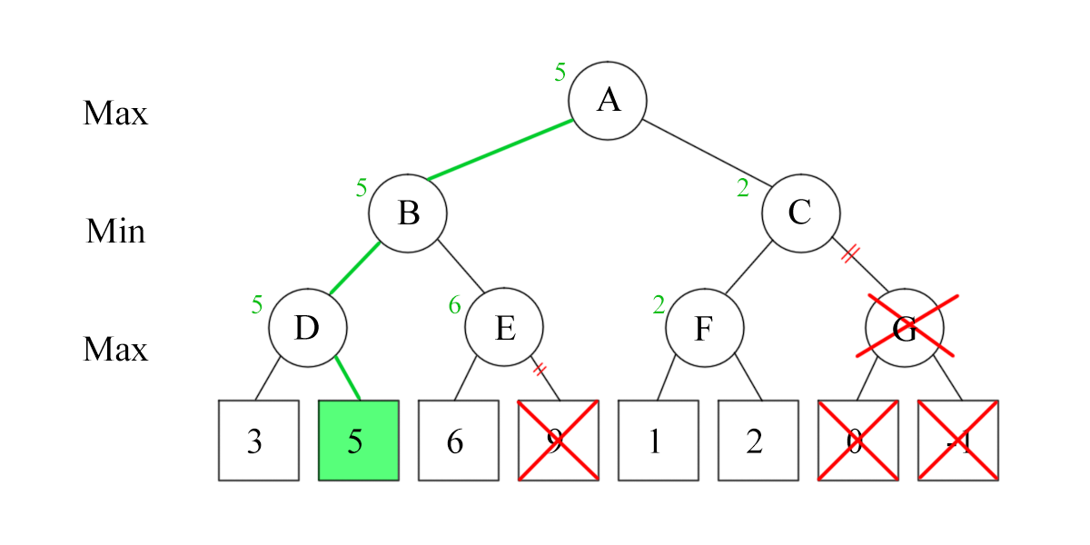

Slide 9
Heuristic Function
Heuristics functions are defined to find the approximate value at a given position of game. Since, it is not possible for an algorithm to search till the game ends, therefore it can search only till a limited no. of depths. Hence, after it reaches that final depth it provides the value on the basis of the given position. It basically tells which of the 2 players is better suited to win from current situation and assigns score accordingly.
For example: In connect 4 game, if the player has a 3 in the row then the corresponding persons gains a certain points which also depends on whether the adjacent places are empty or not. Similarly points are assigned for 2 in a row but it is obviously less than the previous one. The net value is total no. of points gained from that position.

Slide 10
Implementation
The game can be easily implemented in c, c++ , python or any other language. But the main problem during the problem is with the debugging. So, it is recommended to compile the code part by part. Also it will be better to use Git while doing the project.
Git is a version control system for tracking changes in computer files and coordinating work on those files among multiple people.

Slide 11
Testing
The codes can be test against each other using the zeromq library.
Zeromq library provides you a platform to run the two codes against each using push and pull request. The code runs immediately for small depth like 6 or 7 but it takes certain time at the start of the game for depth 9-10. But soon the compilation time of the game reaches to an appropriate level.

Slide 12
Project Links
https://github.com/jatinjindal/ACA-project
https://github.com/siddharthnohria/ACA-Project
https://github.com/schinmay/Game-Theory

Slide 13
Acknowledgement
We would like to thank our mentor Prakhar Agrawal for his guidance throughout the project.
References :-
http://zguide.zeromq.org/page:all
https://en.wikipedia.org/wiki/Minimax
https://en.wikipedia.org/wiki/Alpha–beta_pruning
https://ocw.mit.edu/courses/electrical-engineering-and-computer-science/6-034-artificial-intelligence-fall-2010/lecture-videos/lecture-6-search-games-minimax-and-alpha-beta/

