Slide 1

AI Engineer Applications - Problem Statement - Agentic KPI Builder
Jatin K Rai
+1-618-203-6737
Jatinkrai2002@gmail.com

Slide 2
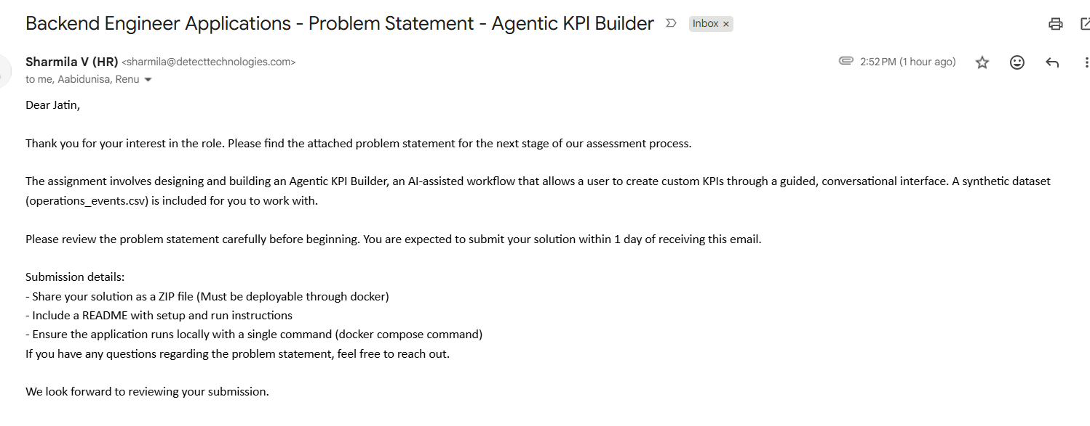
Problem Statement:
Notes:
The assignment involves designing and building an Agentic KPI Builder, an AI-assisted workflow that allows a user to create custom KPIs through a guided, conversational interface. A synthetic dataset (operations_events.csv) is included for you to work with.
Please review the problem statement carefully before beginning. You are expected to submit your solution within 1 day of receiving this email.
Submission details:
- Share your solution as a ZIP file (Must be deployable through docker)
- Include a README with setup and run instructions
- Ensure the application runs locally with a single command (docker compose command)
If you have any questions regarding the problem statement, feel free to reach out.

Slide 3


Slide 4
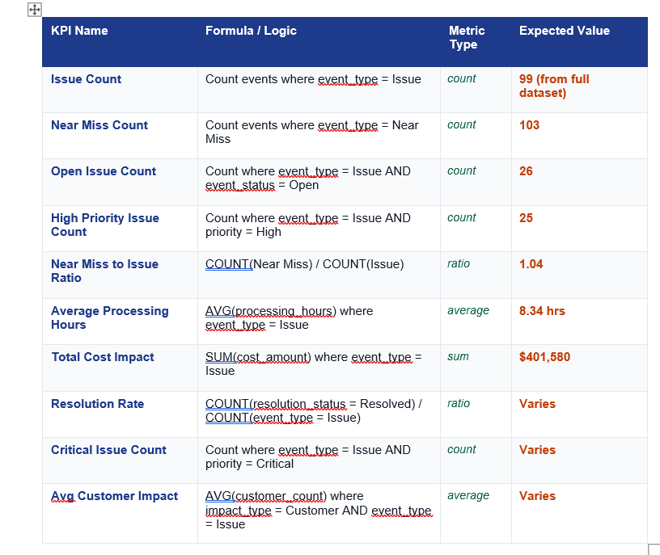
KPI Name:
Analysis:
KPIName➔Formula/Logic ➔ Metric Type➔ Expected Value

Slide 5
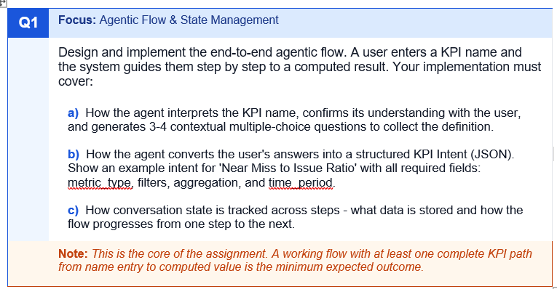
Agentic Flow & State Management:
Analysis:
Assumptions:
pre-defined KPIs name in the memory of Agentic Application.
Each KPIs name with step by step computed result.
a. LLM will be used to generate 3-4 contextual multiple choice questions.
3. b. SQL statement/pyspark python based code with predefined logics.
3. c . Long term memory will be used in database.
To implement an agentic workflow with LangGraph and LangChain primitives (@tool, @static, @prompt), it can model each of your KPI system functions as nodes in a graph. This gives us orchestration, self‑healing, and traceability.

Slide 6
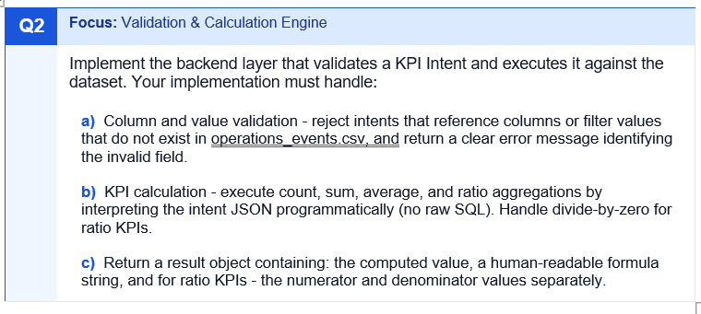
Validation & Calculation Engine:
Analysis:
KPI intent and executes septs in the datasets.
Python code to reject the columns and value validation.
Python code to avoid the divide by zero.
Computed value, human readable using LLMs, etc…

Slide 7
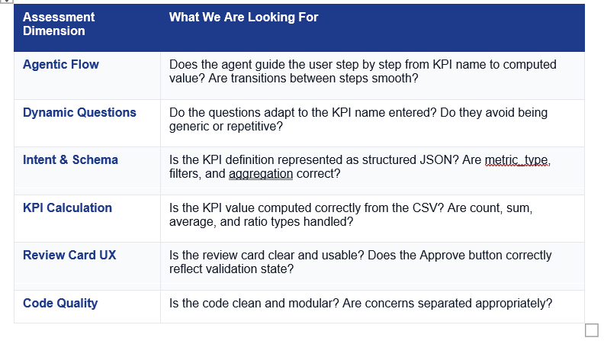

Assessment Criteria
How your submission will be evaluated
Agentic Flow ➔ Approach 2 -- in progress
Dynamic Question ➔ Done
Intent & Schema ➔ Done
KPI Calculation ➔ Done
Review Card UX ➔ Done
Code Quality ➔ Excellent with comments
Notes:
Your submission will be assessed across the following dimensions. Partial credit is available for each. Strong candidates will demonstrate product thinking beyond just technical implementation.

Slide 8
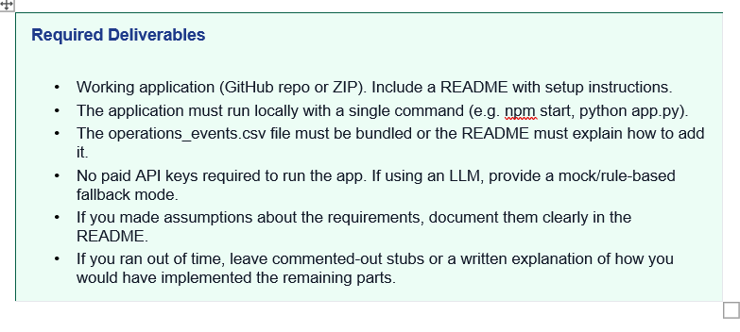
Submission Instructions
What to include and how to deliver
Zip level with deployment script
python -m streamlit run app.py --server.address 127.0.0.1 --server.port 8080
Readme file has instruction.
Env file has the keys.
Assumptions are mentioned.
Approach 2 and 3 of some codes are implemented. But partially.
Notes:
The assignment involves designing and building an Agentic KPI Builder, an AI-assisted workflow that allows a user to create custom KPIs through a guided, conversational interface. A synthetic dataset (operations_events.csv) is included for you to work with.
Please review the problem statement carefully before beginning. You are expected to submit your solution within 1 day of receiving this email.
Submission details:
- Share your solution as a ZIP file (Must be deployable through docker)
- Include a README with setup and run instructions
- Ensure the application runs locally with a single command (docker compose command)
If you have any questions regarding the problem statement, feel free to reach out.

Slide 9

Problem Statement:
Analysis:
As per Rohith – 2 days with simple approach.
Completed with dockerfile
Completed with readme.
Completed with docker compose with AKS also.

Slide 10
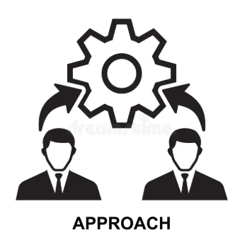

Slide 11
Approach 1:
User provides KPI Name using Conversational UI interface.
KPI Builder System will validate the KPI Name along with pre-defined KPIName in the datasets.
Provide response as Review card Interface.
In case, not found the in datasets, goto Agentic Flow – tool calling method to retrieve the information from LLM and provide response as Review card interface.
Predefined KPIName in datasets
User interface
KPI Builder system
Estimation with Framework
5 working days.
check
found
response
LLM Agentic Flow
Not found then go to LLM as fallback
Notes:
The assignment involves designing and building an Agentic KPI Builder, an AI-assisted workflow that allows a user to create custom KPIs through a guided, conversational interface. A synthetic dataset (operations_events.csv) is included for you to work with.
Please review the problem statement carefully before beginning. You are expected to submit your solution within 1 day of receiving this email.
Submission details:
- Share your solution as a ZIP file (Must be deployable through docker)
- Include a README with setup and run instructions
- Ensure the application runs locally with a single command (docker compose command)
If you have any questions regarding the problem statement, feel free to reach out.

Slide 12
Approach 2:
User provides KPI Name using Conversational UI interface.
KPI Builder System will use that KPI Name with LLM along with predefined dataset.
KPI Builder system will ask more questions from user.
Provide response as Review card Interface.
In case, not found the in datasets, goto Agentic Flow – tool calling method to retrieve the information from LLM and provide response as Review card interface.
LLM with KPIName and datasets
User interface
KPI Builder system
Estimation with Framework
10 working days.
check
found
response
Agentic Tool calling function
LLM Agentic Flow to get data
Accept all information from users
Notes:
The assignment involves designing and building an Agentic KPI Builder, an AI-assisted workflow that allows a user to create custom KPIs through a guided, conversational interface. A synthetic dataset (operations_events.csv) is included for you to work with.
Please review the problem statement carefully before beginning. You are expected to submit your solution within 1 day of receiving this email.
Submission details:
- Share your solution as a ZIP file (Must be deployable through docker)
- Include a README with setup and run instructions
- Ensure the application runs locally with a single command (docker compose command)
If you have any questions regarding the problem statement, feel free to reach out.

Slide 13
Approach 3: MCP and A2A
User provides KPI Name using Conversational UI interface.
KPI Builder System will use that KPI Name with LLM along with predefined dataset.
KPI Builder system will ask more questions from user.
Provide response as Review card Interface.
In case, not found the in datasets, goto Agentic Flow – tool calling method to retrieve the information from LLM and provide response as Review card interface.
Agent 1:
Accept all required information from user
User interface
KPI Builder system
Estimation with Framework
6-8 weeks
check
found
response
MCP and A2A (agent 1 and agent2 communication
Agent 2:
Agent 1 data and return all information as Review card.
Accept all information from users
Notes:
The assignment involves designing and building an Agentic KPI Builder, an AI-assisted workflow that allows a user to create custom KPIs through a guided, conversational interface. A synthetic dataset (operations_events.csv) is included for you to work with.
Please review the problem statement carefully before beginning. You are expected to submit your solution within 1 day of receiving this email.
Submission details:
- Share your solution as a ZIP file (Must be deployable through docker)
- Include a README with setup and run instructions
- Ensure the application runs locally with a single command (docker compose command)
If you have any questions regarding the problem statement, feel free to reach out.

Slide 14


Slide 15
Technologies stack: Agentic KPI Builder
The dataset is provided separately as operations_events.csv.
You may use any language, framework, or LLM integration approach. ➔ Using Python as language
➔ Langchain, Langgraph and LangSmith as framework
➔ Groq as LLM Models
Operation
Events
Conversational Interface
UI
Agentic Implementation
LangGraph
Langchain
LangSmith with LLM
Agentic AI KPI
Builder
Business logics
python
Dataset Reference
Synthetic Business Operations Dataset - 500 rows, 13 columns

Slide 16
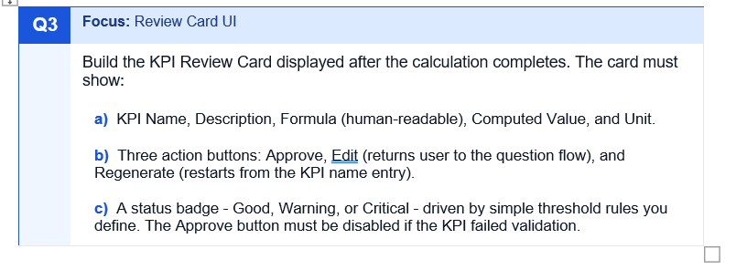
Review Card UI:
KPI Review Card
➔ The Approve button must be disabled if the KPI failed validation.
Notes:
The assignment involves designing and building an Agentic KPI Builder, an AI-assisted workflow that allows a user to create custom KPIs through a guided, conversational interface. A synthetic dataset (operations_events.csv) is included for you to work with.
Please review the problem statement carefully before beginning. You are expected to submit your solution within 1 day of receiving this email.
Submission details:
- Share your solution as a ZIP file (Must be deployable through docker)
- Include a README with setup and run instructions
- Ensure the application runs locally with a single command (docker compose command)
If you have any questions regarding the problem statement, feel free to reach out.

Slide 17

Design

Slide 18
Sequence diagram: (high level)
User
Conversational UI
KPIInputHandler
KPIAgentHandler
KPIOperationalEventLoader
1. KPI Name
2. KPI Name
3. KPI Name
agent interprets the KPI name, confirms its understanding with the user, and generates 3-4 contextual multiple-choice questions to collect the definition
the agent converts the user's answers into a structured KPI Intent (JSON).
conversation state is tracked across steps - what data is stored and how the flow progresses from one step to the next
4. Intent KPI Name
the backend layer that validates a KPI Intent and executes it against the dataset.
4.1
Load dataset from excel file
5. Step by step to a computed result for KPI Name
KPI Review Card displayed after the calculation completes
Notes:
The assignment involves designing and building an Agentic KPI Builder, an AI-assisted workflow that allows a user to create custom KPIs through a guided, conversational interface. A synthetic dataset (operations_events.csv) is included for you to work with.
Please review the problem statement carefully before beginning. You are expected to submit your solution within 1 day of receiving this email.
Submission details:
- Share your solution as a ZIP file (Must be deployable through docker)
- Include a README with setup and run instructions
- Ensure the application runs locally with a single command (docker compose command)
If you have any questions regarding the problem statement, feel free to reach out.

Slide 19
Class Diagram (high level):
KPINameReference
Class
KPI Name should be stored with logics, metric type
ReviewCardGenerator
Class
KPI Review Card Generated
UI should have
Validation methods
Such as
The Approve button must be disabled if the KPI failed validation..
KPI Name, Description, Formula (human-readable), Computed Value, and Unit.
Three action buttons: Approve, Edit (returns user to the question flow), and Regenerate (restarts from the KPI name entry).
A status badge - Good, Warning, or Critical - driven by simple threshold rules you define.
KPIOperationalEventLoader
Class
1. KPI name and steps calculation.
Validation methods
Such as
Near Miss and Opportunity events always have cost_amount = 0 by design.
When a KPI involves a ratio, always verify the denominator is not zero before computing.
The customer_count column is only meaningful when impact_type = Customer or Commercial.

Slide 20
Class Diagram: High level
ConversationalUI
Class
Accept input from the user as KPI Name
Save conversational history.
KPIInputHandler
Class
Verify KPI Name from the KPI Reference and if available return otherwise calculate
KPIAgentHandler
Class
1. KPI name and steps calculation.
2. Store data
3. Maintain short terms and long term history.

Slide 21
Class Diagram: High level
ConversationalUI
Class
Accept input from the user as KPI Name
Save conversational history.
KPIUserFeedbackHandler
Class
Accept User feedback
KPIPromptHandler
Class
1. KPI name with prompt.
2. Store data
3. Maintain short terms and long term history.

Slide 22
Flow Diagram: high level
2. ReviewCardGenerator
4. KPI name entryform with UI.
1. Python app.py
3. AgentHandler
App.py
kpi_agent_handler.py
App.py
review_card_generator.py
Instance of ReviewcardGenerator
Call run_review_card method
Instance of KPINameReference, KPIOperationalEventLoader, KPIInputHandler
Call reference.execute_intent , inputhandler.handle_input
method
Instance of KPIAgentHandler
Call run_flow() method
Notes:
The assignment involves designing and building an Agentic KPI Builder, an AI-assisted workflow that allows a user to create custom KPIs through a guided, conversational interface. A synthetic dataset (operations_events.csv) is included for you to work with.
Please review the problem statement carefully before beginning. You are expected to submit your solution within 1 day of receiving this email.
Submission details:
- Share your solution as a ZIP file (Must be deployable through docker)
- Include a README with setup and run instructions
- Ensure the application runs locally with a single command (docker compose command)
If you have any questions regarding the problem statement, feel free to reach out.

Slide 23
Flow Diagram : High level
2. Generate ReviewCard
4
Return to
5. Load operation_event.xls file
1. Output to the user
6. Execute intent and validate intent
App.py
kpi_loader.py
App.py
kpi_name_reference.py
Return value from Agent handler
Instance of KPIOperationalEventLoader with all provide methods with KPIName, logics and calculation based on data.
Instance of KPINameReference
Call execute() method
Call LLM in case not found to method list.
Notes:
The assignment involves designing and building an Agentic KPI Builder, an AI-assisted workflow that allows a user to create custom KPIs through a guided, conversational interface. A synthetic dataset (operations_events.csv) is included for you to work with.
Please review the problem statement carefully before beginning. You are expected to submit your solution within 1 day of receiving this email.
Submission details:
- Share your solution as a ZIP file (Must be deployable through docker)
- Include a README with setup and run instructions
- Ensure the application runs locally with a single command (docker compose command)
If you have any questions regarding the problem statement, feel free to reach out.

Slide 24
Flow Diagram: High level
2. Generate Review Card
7. Load KPIAgenticToolHandler class
1. Output to the user
4
Return to
kpi_agent_handler.py
App.py
kpi_agentic_tools_handler.py
App.py
Return value from Agent handler
Instance of langchain, langgraph, and langsmith tool invocation with execute and validate intents
Notes:
The assignment involves designing and building an Agentic KPI Builder, an AI-assisted workflow that allows a user to create custom KPIs through a guided, conversational interface. A synthetic dataset (operations_events.csv) is included for you to work with.
Please review the problem statement carefully before beginning. You are expected to submit your solution within 1 day of receiving this email.
Submission details:
- Share your solution as a ZIP file (Must be deployable through docker)
- Include a README with setup and run instructions
- Ensure the application runs locally with a single command (docker compose command)
If you have any questions regarding the problem statement, feel free to reach out.

Slide 25
Logging

Slide 26
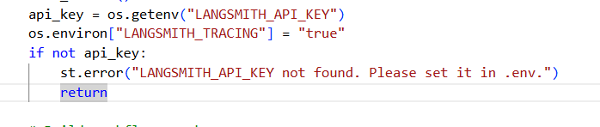

Logging : Used Langsmith
Extend to local logging text file with python log file.
Notes:
The assignment involves designing and building an Agentic KPI Builder, an AI-assisted workflow that allows a user to create custom KPIs through a guided, conversational interface. A synthetic dataset (operations_events.csv) is included for you to work with.
Please review the problem statement carefully before beginning. You are expected to submit your solution within 1 day of receiving this email.
Submission details:
- Share your solution as a ZIP file (Must be deployable through docker)
- Include a README with setup and run instructions
- Ensure the application runs locally with a single command (docker compose command)
If you have any questions regarding the problem statement, feel free to reach out.

Slide 27
Implementation

Slide 28
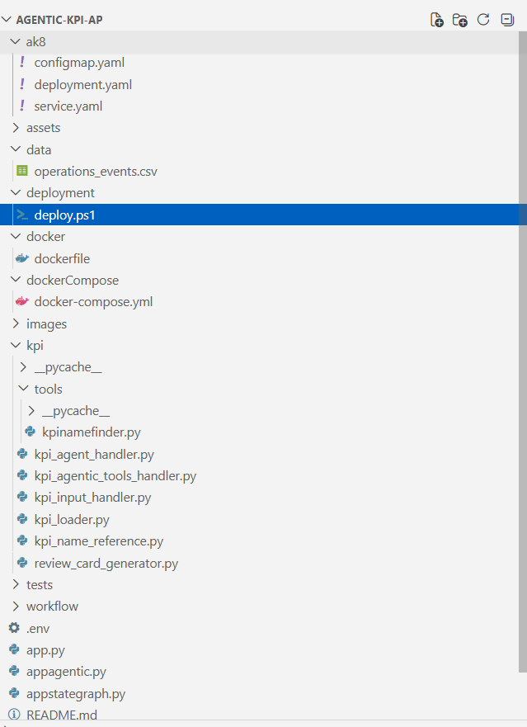
Directory Structure:
Notes:
The assignment involves designing and building an Agentic KPI Builder, an AI-assisted workflow that allows a user to create custom KPIs through a guided, conversational interface. A synthetic dataset (operations_events.csv) is included for you to work with.
Please review the problem statement carefully before beginning. You are expected to submit your solution within 1 day of receiving this email.
Submission details:
- Share your solution as a ZIP file (Must be deployable through docker)
- Include a README with setup and run instructions
- Ensure the application runs locally with a single command (docker compose command)
If you have any questions regarding the problem statement, feel free to reach out.

Slide 29
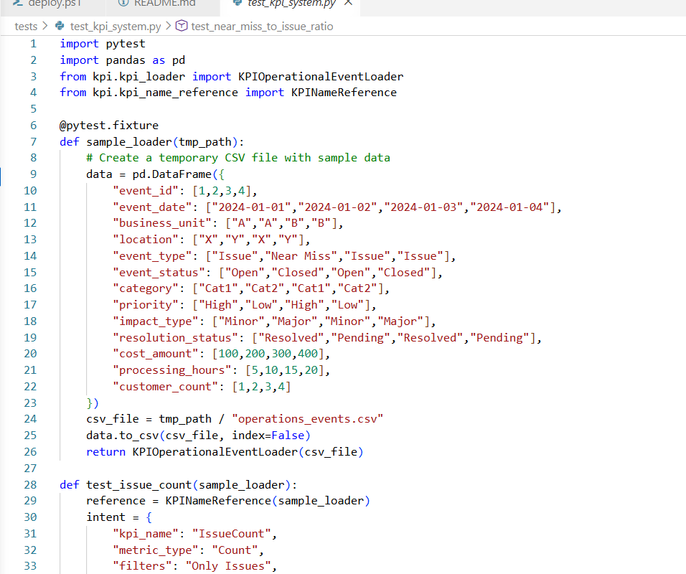

Unit Test case:
Notes:
The assignment involves designing and building an Agentic KPI Builder, an AI-assisted workflow that allows a user to create custom KPIs through a guided, conversational interface. A synthetic dataset (operations_events.csv) is included for you to work with.
Please review the problem statement carefully before beginning. You are expected to submit your solution within 1 day of receiving this email.
Submission details:
- Share your solution as a ZIP file (Must be deployable through docker)
- Include a README with setup and run instructions
- Ensure the application runs locally with a single command (docker compose command)
If you have any questions regarding the problem statement, feel free to reach out.

Slide 30
Integration Test case:
Notes:
The assignment involves designing and building an Agentic KPI Builder, an AI-assisted workflow that allows a user to create custom KPIs through a guided, conversational interface. A synthetic dataset (operations_events.csv) is included for you to work with.
Please review the problem statement carefully before beginning. You are expected to submit your solution within 1 day of receiving this email.
Submission details:
- Share your solution as a ZIP file (Must be deployable through docker)
- Include a README with setup and run instructions
- Ensure the application runs locally with a single command (docker compose command)
If you have any questions regarding the problem statement, feel free to reach out.

Slide 31
Uesr Acceptance Test case:
Notes:
The assignment involves designing and building an Agentic KPI Builder, an AI-assisted workflow that allows a user to create custom KPIs through a guided, conversational interface. A synthetic dataset (operations_events.csv) is included for you to work with.
Please review the problem statement carefully before beginning. You are expected to submit your solution within 1 day of receiving this email.
Submission details:
- Share your solution as a ZIP file (Must be deployable through docker)
- Include a README with setup and run instructions
- Ensure the application runs locally with a single command (docker compose command)
If you have any questions regarding the problem statement, feel free to reach out.

Slide 32
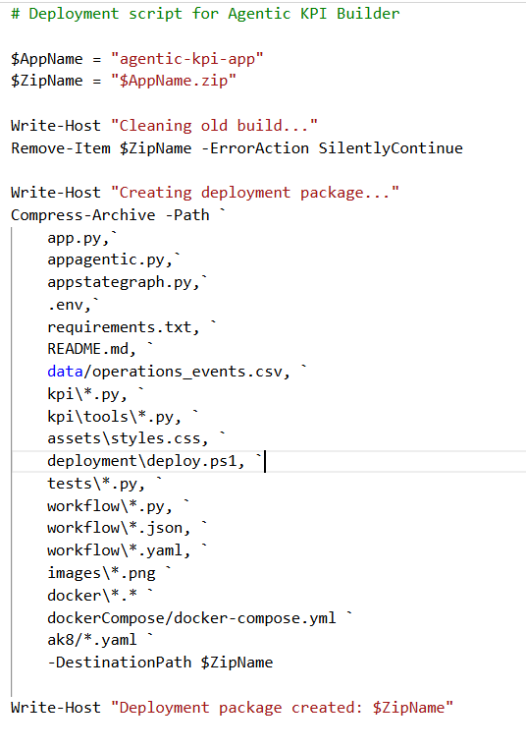
Deployment script:

Slide 33
Production check:

Slide 34
Post Production support:

Slide 35
Approach 2:

Slide 36
Approach 3:

Slide 37

Thanks:

