Slide 1
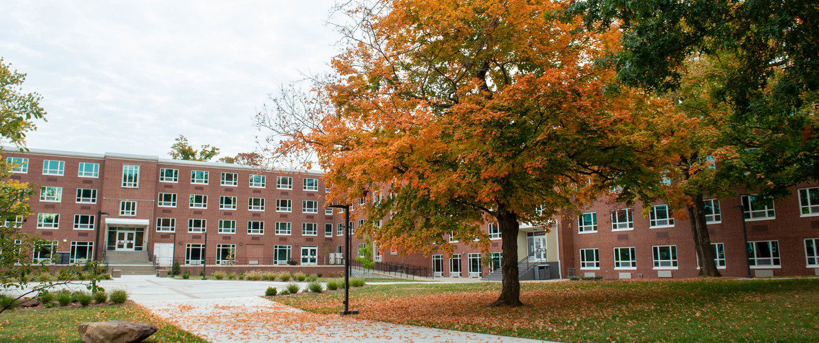

Project:- Automated Retinal Image Analysis for Disease Detection Pattern Recognition (CS-586-001))
Jatin K Rai
Dawg tag: 856581905

Slide 2
Problem Statement:-
Title: Automated Retinal Image Analysis for Disease Detection
Aim: The aim of this project is to develop a deep learning-based system for automated analysis of retinal images to detect and classify various eye diseases, such as diabetic retinopathy, glaucoma, and age-related macular degeneration. The system will provide accurate and efficient disease detection, aiding ophthalmologists in early diagnosis and treatment.
Eye Diseases
Processing
Automate Retinal Image Analysis for Disease Detection
Deep Leaning AI tools
Images
output
Input
Or
Image not detected errors

Slide 3
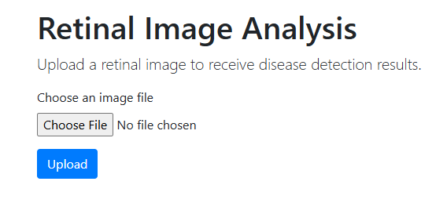
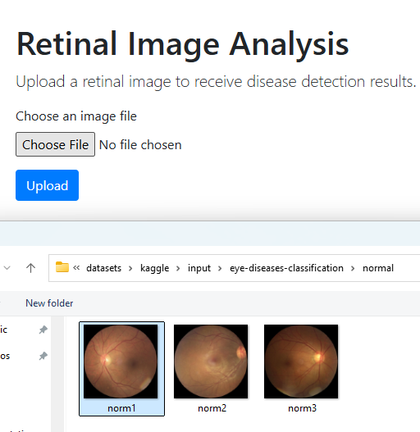
User interface for the User to input image and see the results processed.
Click Choose File button and select image file as Input file to process

Slide 4
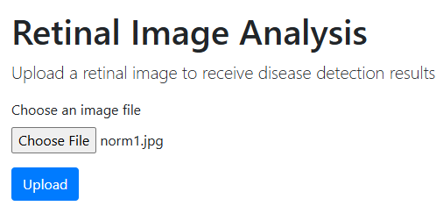
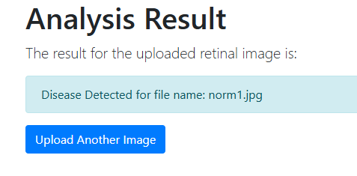
User interface for the User to input image and see the results processed.
Press Upload button once file selected
Uploaded image “norm1.jpg” analysed by
CNN and KNN based trained model and provided results based on prediction.

Slide 5
Image File :- upload worklow
User input image
Uploaded image will be in upload folder
After process
Pass
Fail
Success Folder
Failed Folder

Slide 6
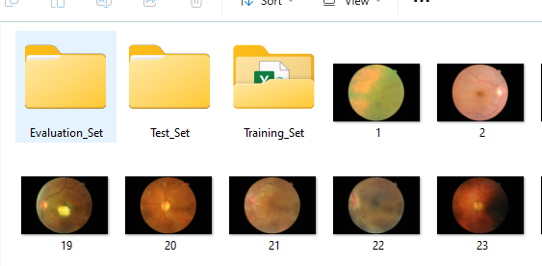
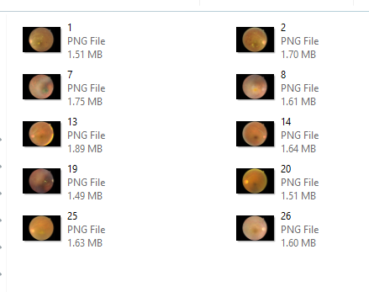
Component#1: Data Processing
Collect and preprocess the retinal images from the selected datasets. This includes resizing, normalization, and augmentation to enhance the robustness of the model.
Used below libraries.
cv2
numpy as np
tensorflow.keras.preprocessing.image import ImageDataGenerator
Prepare for CNN (datasets/images)
Prepare for KNN (Training folder)

Slide 7
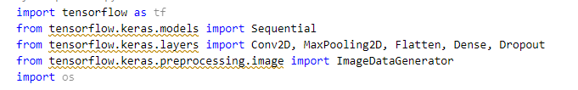
Component#2: Model Development:
Convolutional Neural Networks (CNNs): Implement CNNs for feature extraction and classification of retinal images. CNNs are well-suited for image analysis due to their ability to capture spatial hierarchies in images.
The CNN model includes additional convolutional and pooling layers to better capture spatial hierarchies in retinal images. The Dropout layer helps prevent overfitting by randomly setting a fraction of input units to 0 during training.
This structure allows the model to learn more complex features at different levels of abstraction, which is crucial for accurate image analysis and disease detection.
Notes:
C:\JatinkRai\patternmatch\projects\UpdatedCode\ModelCNN\SIUProjCNNSpatilaHier.py

Slide 8
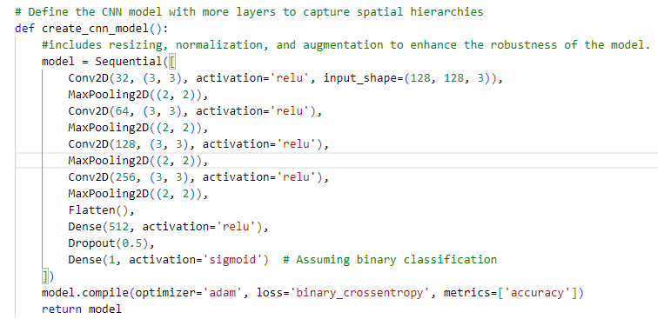
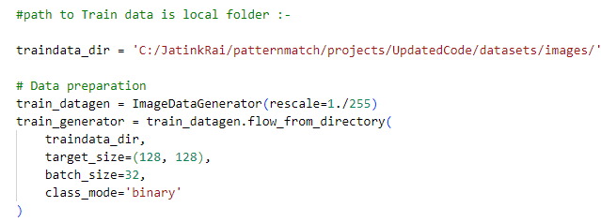
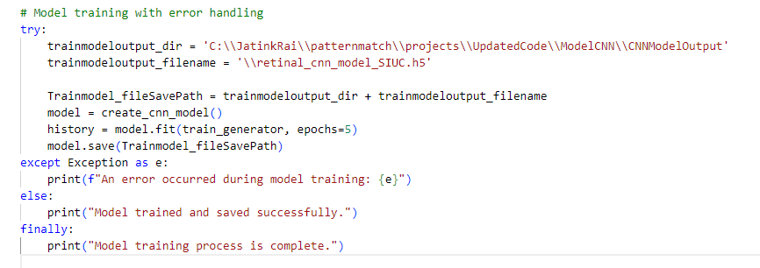
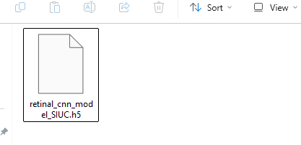
Component#2: Model Development: CNN
Notes:
C:\JatinkRai\patternmatch\projects\UpdatedCode\ModelCNN\SIUProjCNNSpatilaHier.py

Slide 9
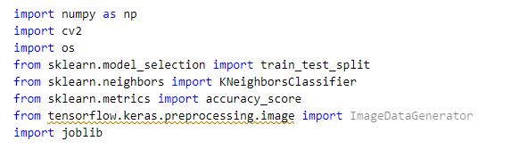
Component#2: Model Development:
K-Nearest Neighbor (K-NN): Implement K-NN for initial classification tasks and compare its performance with CNNs.

Slide 10
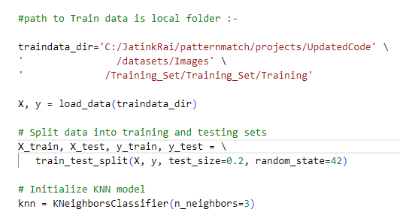
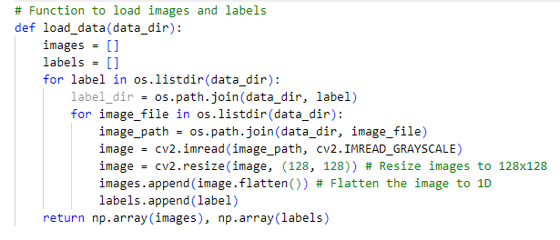
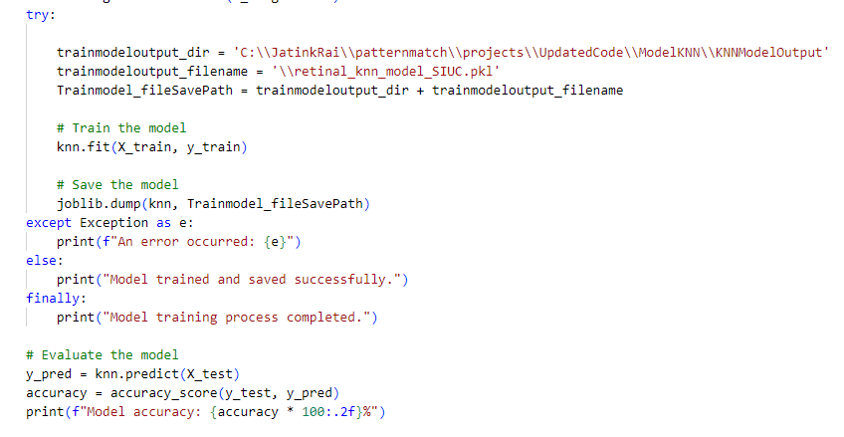
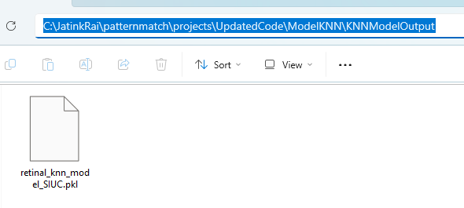
Component#2: Model Development: KNN
Notes:
C:\JatinkRai\patternmatch\projects\UpdatedCode\ModelCNN\SIUProjCNNSpatilaHier.py

Slide 11
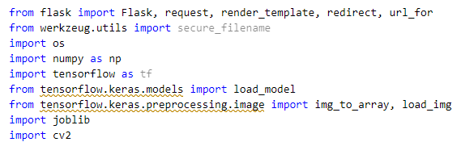
Components: Application in App Building using python framework
The project will culminate in the development of a web application that allows users to upload retinal images and receive disease detection results. The web app will be built using Flask, a lightweight web framework for Python. The app will integrate the trained deep learning models and provide a user-friendly interface for retinal image analysis.

Slide 12
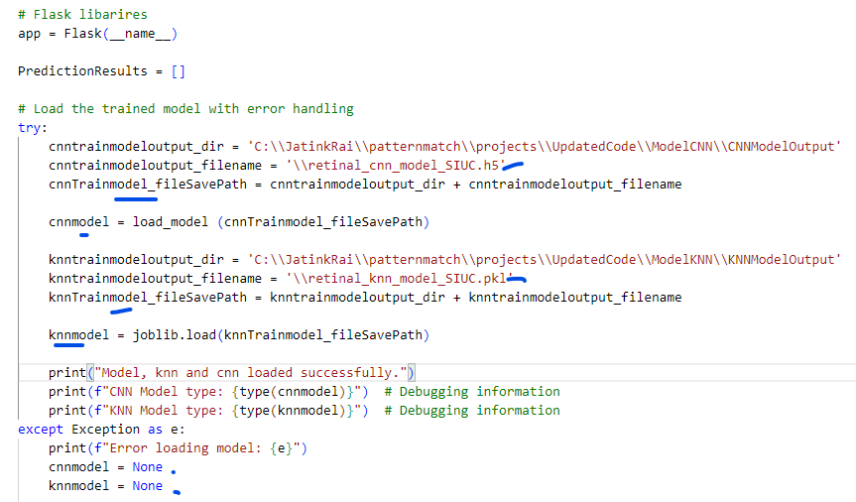
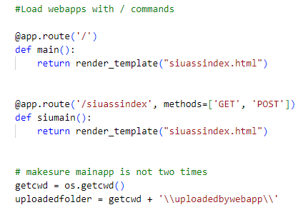
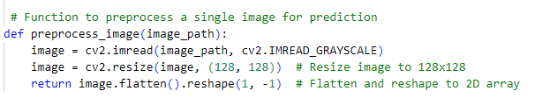
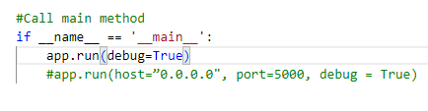
Application in App Building
Notes:
C:\JatinkRai\patternmatch\projects\UpdatedCode\ModelCNN\SIUProjCNNSpatilaHier.py

Slide 13
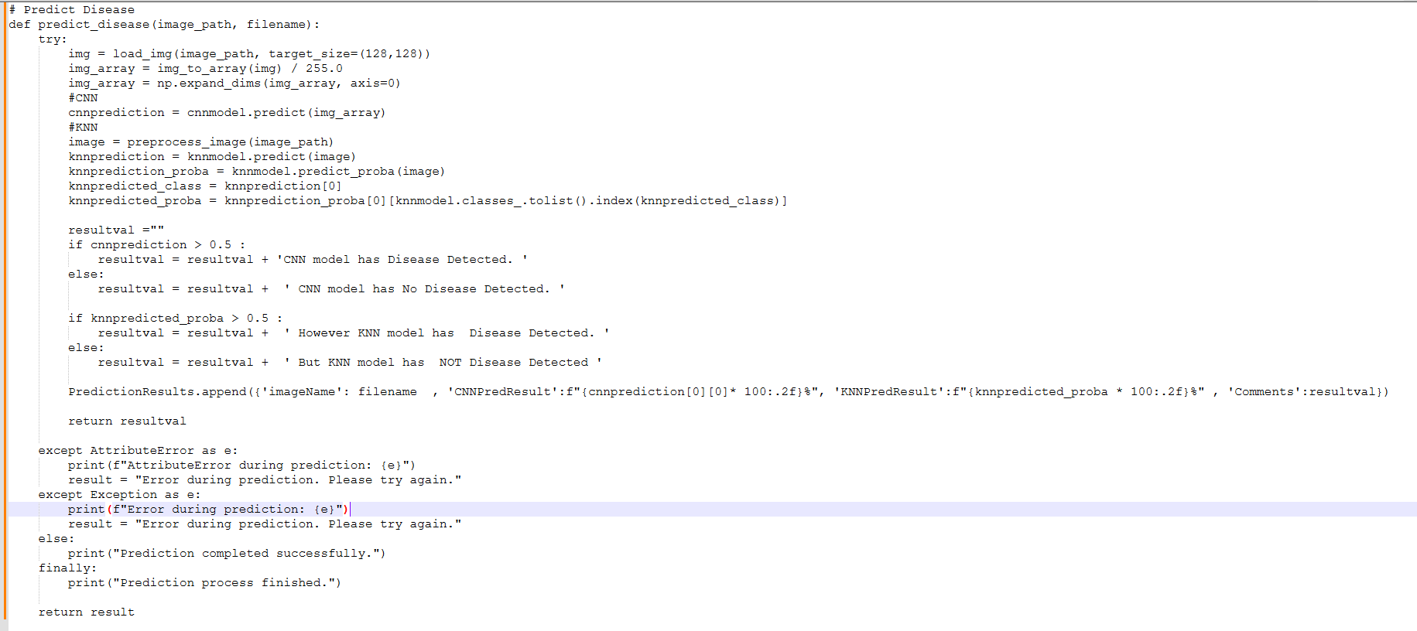
Application in App Building
Notes:
C:\JatinkRai\patternmatch\projects\UpdatedCode\ModelCNN\SIUProjCNNSpatilaHier.py

Slide 14
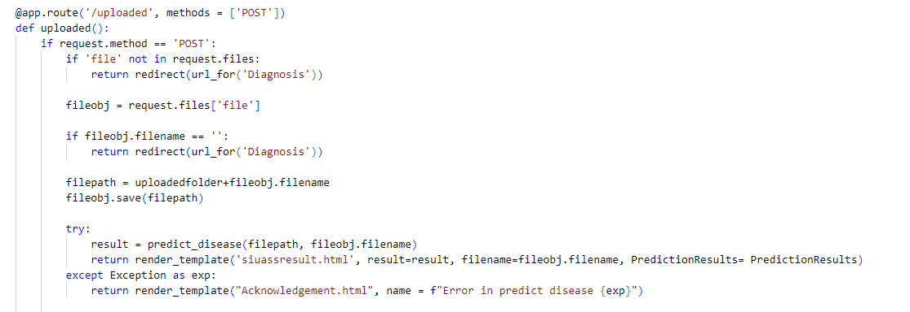
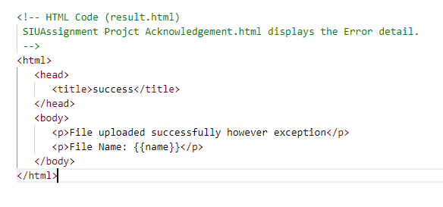
Application in App Building
Notes:
C:\JatinkRai\patternmatch\projects\UpdatedCode\ModelCNN\SIUProjCNNSpatilaHier.py

Slide 15
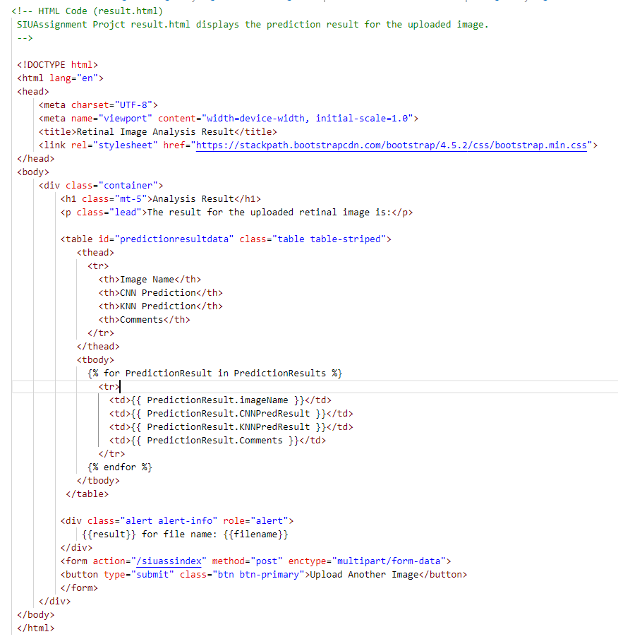
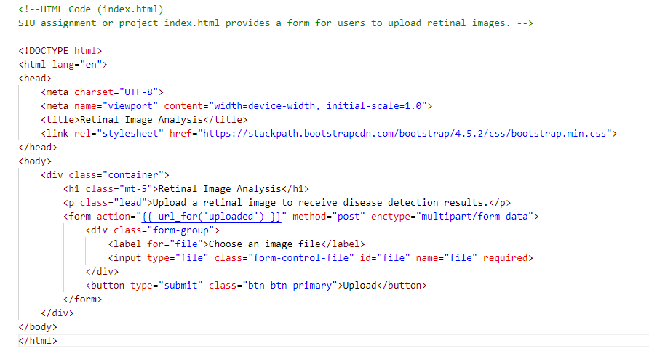
Application in App Building – html template
Notes:
C:\JatinkRai\patternmatch\projects\UpdatedCode\ModelCNN\SIUProjCNNSpatilaHier.py

Slide 16
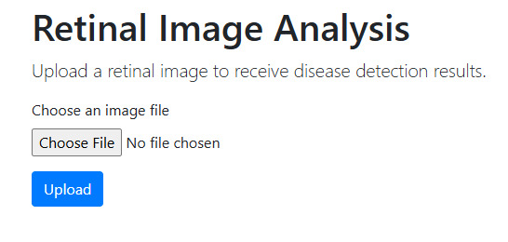
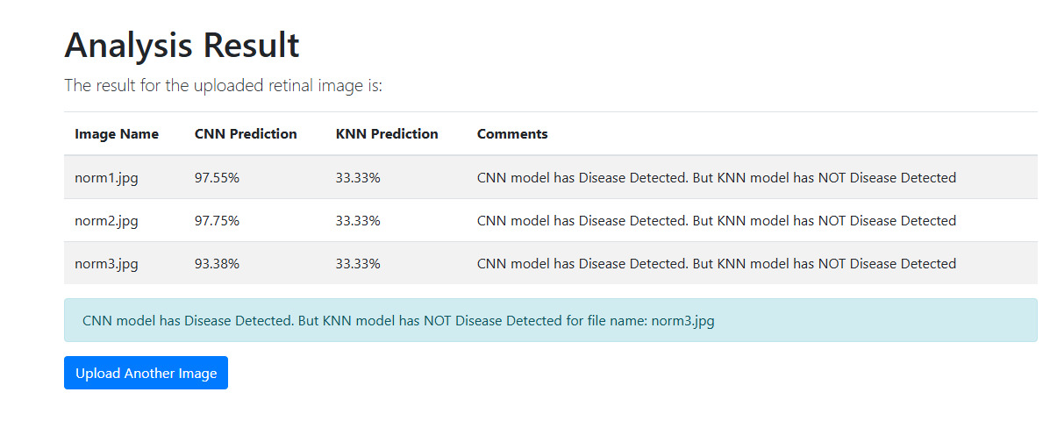
Application in App Building – html template with Result
Notes:
C:\JatinkRai\patternmatch\projects\UpdatedCode\ModelCNN\SIUProjCNNSpatilaHier.py

Slide 17
Component#3: Training and Evaluation:
Train the models on the training dataset and evaluate their performance on the test dataset using metrics such as accuracy, precision, recall, and F1-score.
Analysis of Results:
CNN Model: The CNN model is expected to perform better in terms of ROC AUC due to its ability to capture complex spatial hierarchies in images. The ROC AUC scores for each class will provide insights into the model's performance across different disease categories.
K-NN Model: The K-NN model may have lower ROC AUC scores compared to the CNN model, especially for complex image classification tasks. However, it can still provide valuable baseline performance metrics.
By comparing the ROC AUC scores, you can determine which model performs better for retinal image analysis and disease detection. The ROC curves will visually demonstrate the trade-offs between sensitivity and specificity for each model.

Slide 18
Component#4: Hyperparameter Tuning:
Optimize the model parameters to achieve the best performance.
Also use ROC AUC as evaluation metric of your models and compare their performance and analysis the results.
ROC - (Receiver Operating Characteristic)
AUC – (Area Under the Curve) as an evaluation metric for your models and compare their performance.

Slide 19
Components: Application-Oriented using Healthcare domain
The project will focus on a practical application in the field of healthcare. The web app will serve as a diagnostic tool for ophthalmologists, enabling them to quickly and accurately detect eye diseases from retinal images. This application-oriented approach will demonstrate the real-world utility of the developed image analysis techniques.

Slide 20
Components: Tools: Instructions
Python, PyTorch, TensorFlow, OpenCV, Flask and python based model libraries
Create folders under C: \ Drive of your laptop
Make sure Visual Studio code is installed.
Make sure latest version of python is installed.
Create folder – ModelCNN, Model KNN, mainapp and datasets/Images under c:\drive
Download codes from the github - https://github.com/jatinkrai2002/PatternMatching/tree/main/ModelCNN
https://github.com/jatinkrai2002/PatternMatching/tree/main/ModelKNN
https://github.com/jatinkrai2002/PatternMatching/tree/main/mainapp
https://github.com/jatinkrai2002/PatternMatching/tree/main/images
6. modify the location of image files under the CNN and KNN files. Please refer slide#8 and Slide#10 files.

Slide 21
Components: Sample Dataset:
Retinal Image Databases - medicmind - oDocs Eye Care

Slide 22
Development method:
Requirement:
2. Specification:
Design – High level design, detailed level design.
4.Coding/Build/Implement
5. Testing
Also use ROC AUC as evaluation metric of your models and compare their performance and analysis the results.
6. Go Live
Notes:
use the ROC AUC (Receiver Operating Characteristic - Area Under the Curve) as an evaluation metric for your models and compare their performance.

Slide 23
Agile Development method:
Requirement – Implement Use case stories/Use case diagram
Actor: End user
functionalities:-.
2. Design :- Implement Sequence diagram, Class diagram, component diagram
.
3. Coding/Build/Implement –
4. Testing –
5. Go Live –.

Slide 24
Components:

Slide 25
Components:

Slide 26
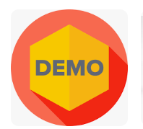
Components:

Slide 27

Thank You Questions?

Slide 28
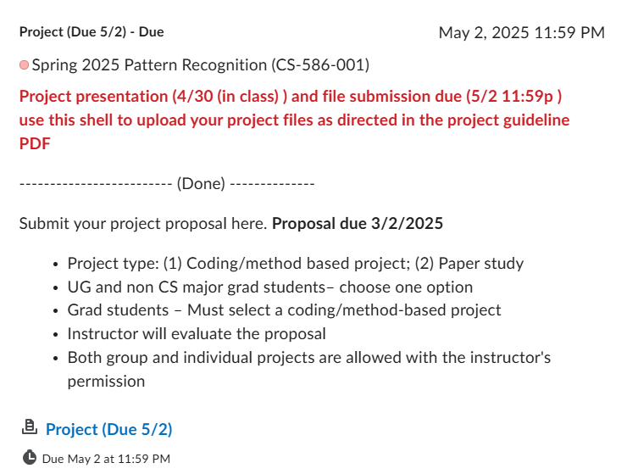
Notes:
The less you know more believe

Slide 29
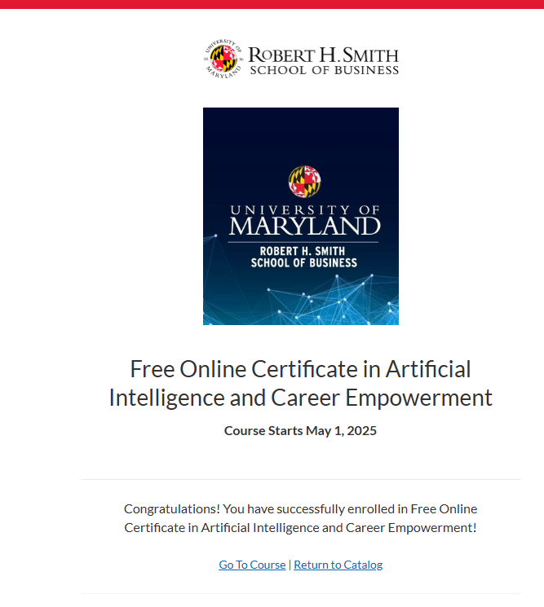
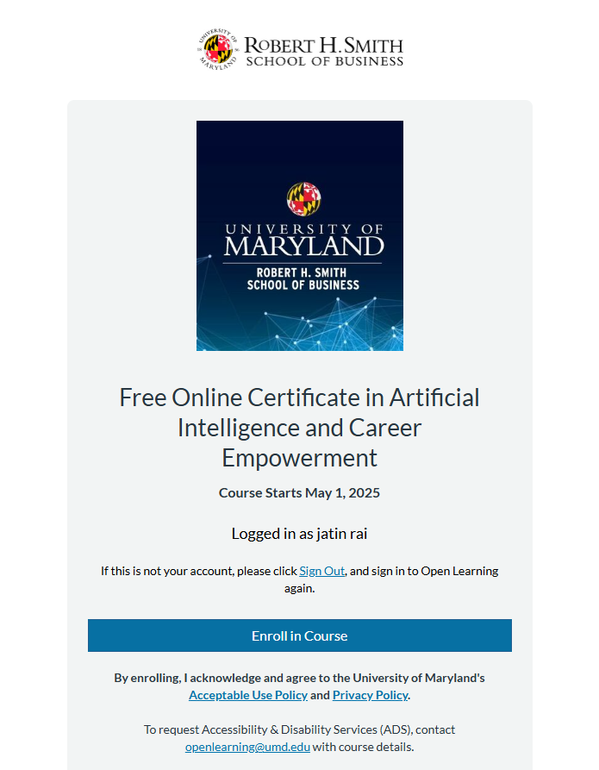
Components:
Notes:
https://www.azonetwork.com/go/?ruid=c4e68652b0d74a0787a698246ea461dc&nirid=e8b4ae87b3da4533a39402ab9d9cead1
https://www.rhsmith.umd.edu/programs/executive-education/learning-opportunities-individuals/free-online-certificate-artificial-intelligence-and-career-empowerment

