Slide 1
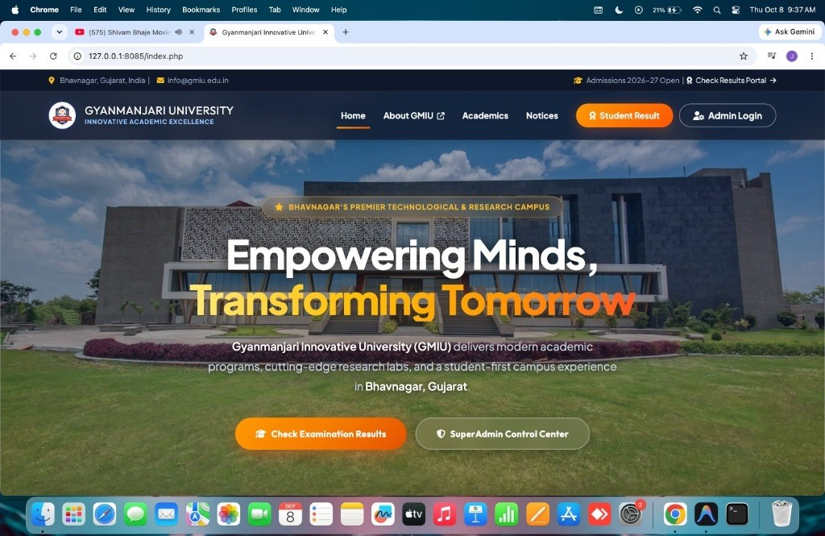
Student Result Management System
ALA-5 • SKILL BUILDING TASK
An Automated Three-Tier Web Examination Management & Dynamic Marksheet Generation Portal
PHP 8
MySQL
Bootstrap 5
JATIN LAKHANI
ER No: 240503020028 • BCA Sem 5 (Class A)
Cyber Security • PHP & Web Application Development
Gyanmanjari Innovative University • Bhavnagar, Gujarat
Notes:
Introduce yourself and the project. SRMS is an automated three-tier web portal for exam management and marksheet generation, built individually for ALA-5.

Slide 2










The Problem We Solve
Manual Mess
SRMS Fix
Transcription & formula errors
Automated server-side grading
Weeks of result delay
Sub-second result retrieval
Physical visits to see marks
Public web portal, 24x7
No instant verification
Roll-ID verified transcripts
Paper ledgers: tamper & loss risk
Central MySQL + prepared queries
Notes:
Manual ledgers and spreadsheets cause errors, delays, and security risks. SRMS replaces them with a centralized, automated, secure web system.

Slide 3



Project at a Glance
100%
<120ms
3-Tier
8 / 8
Calculation fidelity
Search on 10,000 records
Client-server architecture
Test cases passed
Role segregation
AJAX marks entry
Printable transcript
Admin control vs public student queries
Auto-loads subjects, blocks duplicates
One-click print-ready marksheet
Notes:
Key numbers: 100% calculation fidelity, under 120 ms search on 10,000 mock records, three-tier architecture, and all 8 test cases passed.

Slide 4




Technology Stack
PHP 8.x
MySQL (InnoDB)
PDO
Server-side logic & sessions
Relational data, FK & ACID
Prepared statements, no SQLi
Bootstrap 5
HTML5 • CSS3 • JS
AJAX
Responsive cross-device UI
Validation & print styles
Dynamic class → subjects load
Notes:
PHP 8 with PDO on the backend, MySQL InnoDB for the database, Bootstrap 5 with HTML5/CSS3/JS on the front end, and AJAX for dynamic marks entry. All open source.

Slide 5


Three-Tier Architecture
Presentation
Application
Data (MySQL)
HTML5, CSS3, JavaScript
Bootstrap 5 responsive UI
Print stylesheets
Handles GET / POST requests
Session authorization
PDO business logic
Normalized tables (3NF)
PK / FK constraints
ACID transactions
DFD LEVEL 1 PROCESSES
1.0 Authenticate User
2.0 Master Data
3.0 Student Enrollment
4.0 Process Marks
5.0 Compile Transcript
Notes:
Presentation tier handles UI, application tier runs PHP business logic and sessions, data tier is MySQL. DFD level 1 splits the system into five processes.

Slide 6
Database Design
tblclasses
tblstudents
tblresult
tblsubjects
id (PK)
ClassName
ClassNameNumeric
Section
CreationDate
StudentId (PK)
StudentName
RollId
StudentEmail
ClassId (FK)
Status
id (PK)
StudentId (FK)
ClassId (FK)
SubjectId (FK)
marks
UpdationDate
id (PK)
SubjectName
SubjectCode
1NF
Atomic values
2NF
No partial dependency
3NF
No transitive dependency
Notes:
Schema normalized to 3NF. tblresult links students, classes and subjects through foreign keys. Indexes on ClassId+RollId and StudentId+SubjectId keep lookups fast.

Slide 7
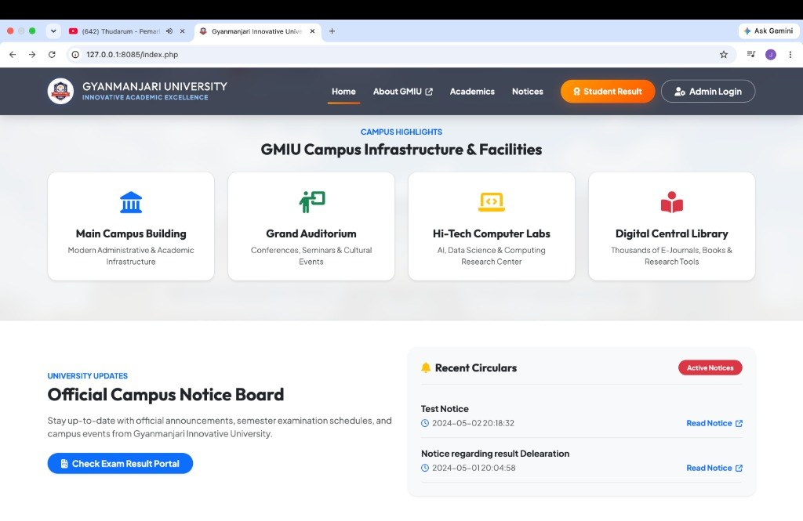
Public Portal & Notices
1
2
University Landing Portal
Campus Highlights & Notice Board
Student Result and Admin Login entry points; session-aware header.
Dynamic circulars via PDO: SELECT … ORDER BY id DESC LIMIT 5.
Notes:
Landing page with hero, campus highlights and a live notice board that queries tblnotice (latest 5).

Slide 8
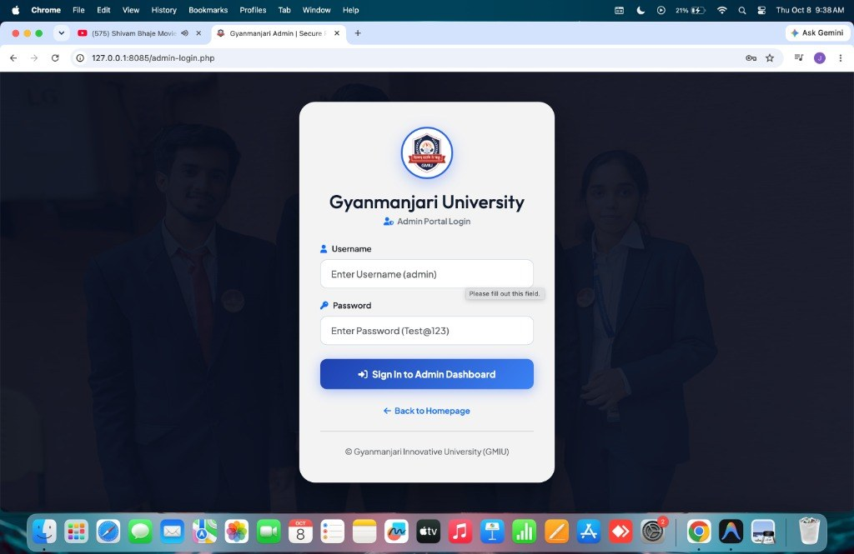
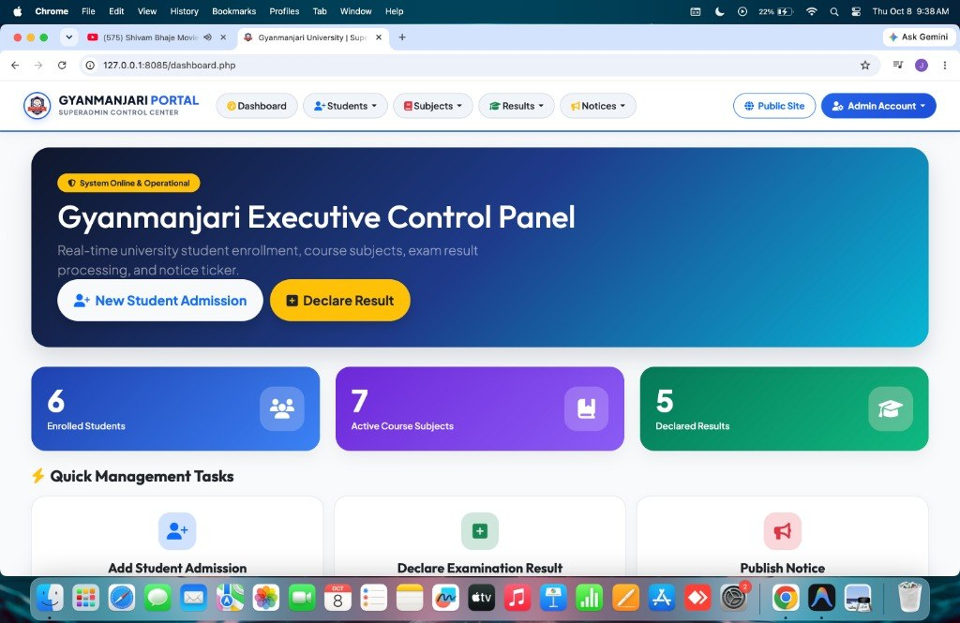
Admin Gateway & Dashboard
3
4
SuperAdmin Login
Executive Control Panel
Prepared query + session_regenerate_id(true) stops session fixation.
Live KPI cards: students, subjects, classes and declared results.
Notes:
Login uses a PDO prepared query and session_regenerate_id. Dashboard shows live KPI counts from four COUNT queries.

Slide 9
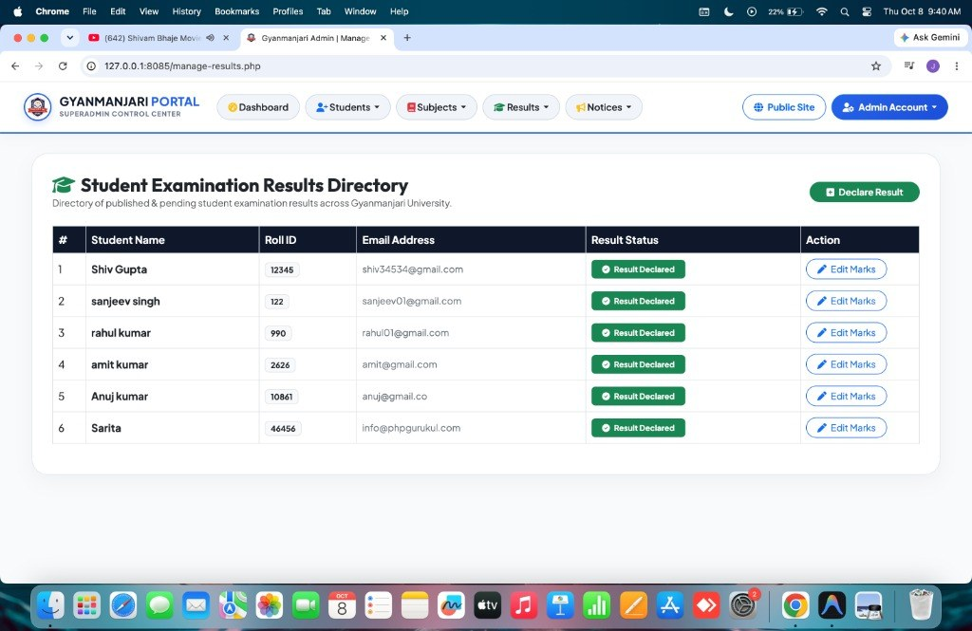
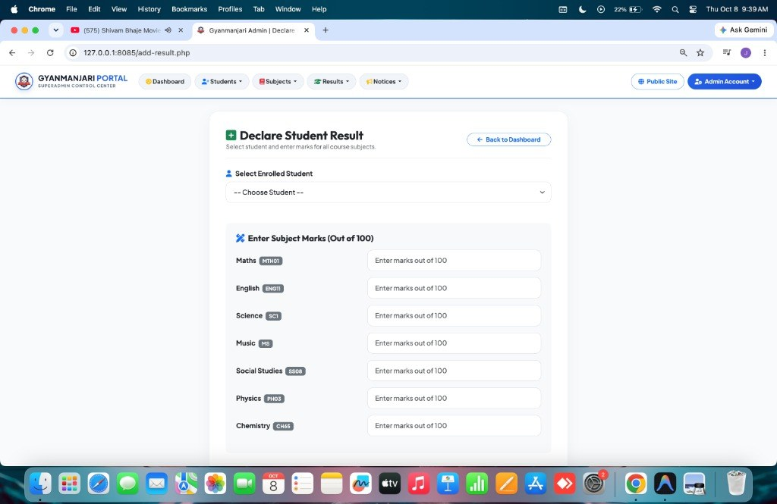
Results & Marks Entry
5
6
Results Directory
Dynamic Marks Entry (AJAX)
Joined view of results with one-click Edit Marks and audit timestamps.
Class-bound subjects load instantly; marks validated 0–100.
Notes:
Results directory lists declared results with Edit Marks. Add Result loads class subjects via AJAX and blocks duplicate entries.

Slide 10
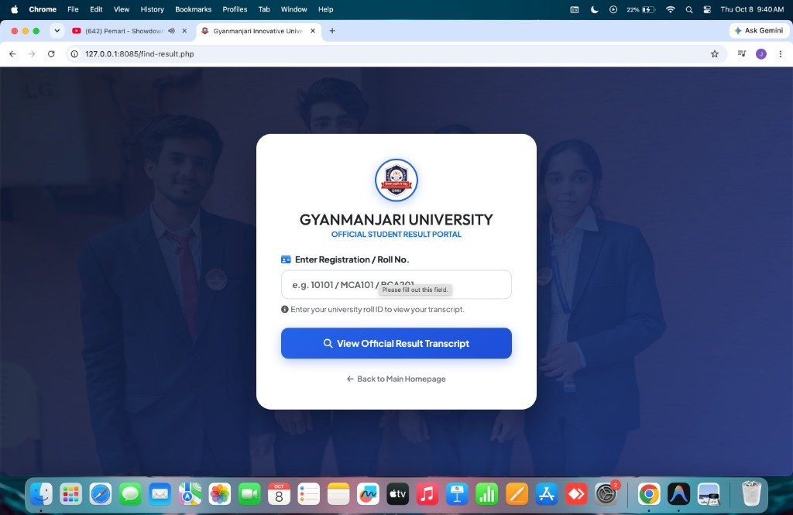
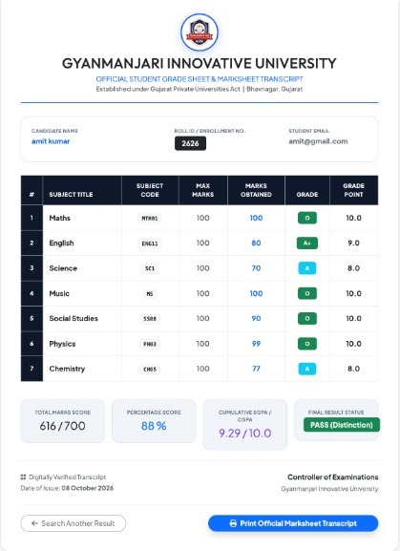
Student Marksheet Portal
616 / 700
Total marks
88 %
Percentage
9.29 / 10
Cumulative SGPA
PASS
Roll ID Verification Search
HTML5 + server-side validation, parameter-bound query.
Distinction
Notes:
Student enters roll ID, input is sanitized and bound as a parameter, and the system generates a printable marksheet: 616/700, 88 percent, SGPA 9.29, Pass with Distinction.

Slide 11


Grading Engine in Code
PHP • result.php
Prepared JOIN query
// prepared, parameter-bound query
$stmt = $dbh->prepare($query);
$stmt->execute([
':rollid' => $rollid,
':classid' => $classid
]);
$results = $stmt->fetchAll();
foreach ($results as $row) {
$totalobtained += $row->marks;
}
$percentage = ($totalobtained
/ $totallabel) * 100;
tblresult + tblstudents + tblsubjects + tblclasses
Aggregate & percentage
Total, % and Distinction / First Class / Pass
Grade points → SGPA
O = 10, A+ = 9, A = 8
Notes:
result.php runs a prepared JOIN query, sums marks, computes percentage, and maps grade points O=10, A+=9, A=8 to get SGPA. Classification: 75+ Distinction, 60+ First Class, else Pass.

Slide 12



Security Hardening
SQL Injection
Cross-Site Scripting
100% PDO prepared statements, zero raw query concatenation
htmlspecialchars() encoding on all dynamic output
Broken Access Control
Cryptographic Failures
Session check on every admin page; redirect if not logged in
Hashed admin credentials; bcrypt / Argon2id upgrade planned
Also: session regeneration • input whitelisting • generic public error messages
Notes:
Mapped to the OWASP Top 10: SQL injection, XSS, broken access control, cryptographic failures. Be ready to say password hashing currently uses MD5 and bcrypt/Argon2id is the planned upgrade.

Slide 13
Testing & Quality
ID | Scenario | Expected result | Status
TC-01 | Admin valid login | Redirect to dashboard | PASSED
TC-02 | Admin wrong password | Invalid credentials alert | PASSED
TC-03 | SQL injection ' OR '1'='1 | Input sanitized, no leak | PASSED
TC-04 | Dynamic subject AJAX | Subjects load for class | PASSED
TC-05 | Duplicate result entry | Database rejects duplicate | PASSED
TC-06 | Valid student search | Correct marksheet shown | PASSED
TC-07 | Non-existent roll ID | Student not found | PASSED
TC-08 | Print transcript | Clean print preview | PASSED
8 / 8 tests passed
<120 ms search, 10k records
4 browsers verified
Notes:
All 8 functional and security test cases passed. Search stayed under 120 ms with 10,000 mock records, tested on Chrome, Firefox, Safari and Edge.

Slide 14





Future Roadmap
01
02
03
04
05
QR Verification
SMS & WhatsApp
Blockchain Credentials
AI Analytics
Multi-Tier Grading
Signed QR on each marksheet for instant checks
Alerts the moment marks are published
Tamper-proof transcript hashes
Predict weak subjects before finals
Professor entry with HOD approval
Notes:
Planned upgrades: QR code verification, SMS/WhatsApp alerts, blockchain-backed credentials, AI analytics, and multi-tier grading with HOD approval.

Slide 15

Conclusion & Thank You
Automated, error-free grading with 100% fidelity
Questions?
Jatin Lakhani
ER No: 240503020028
BCA Sem 5 • Cyber Security
Secured with prepared statements and session control
Instant, printable transcripts for every student
GitHub: github.com/jatinlakhani0596-create/student-result-management-system
Notes:
Wrap up: SRMS replaces manual ledgers with a secure, automated, three-tier system. Share the GitHub link and invite questions.

