Slide 1
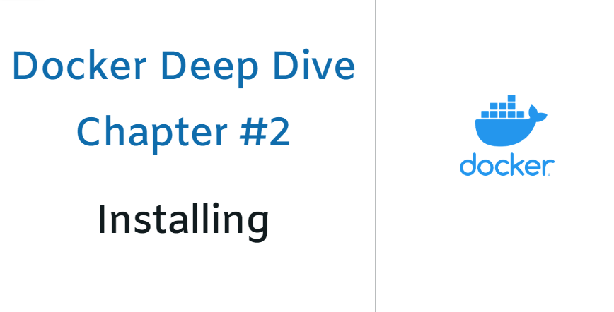

Slide 2
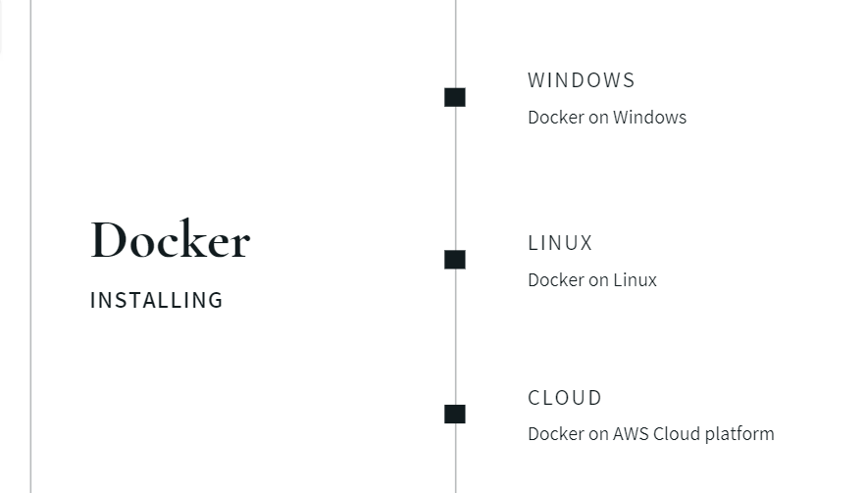
Installation

Slide 3
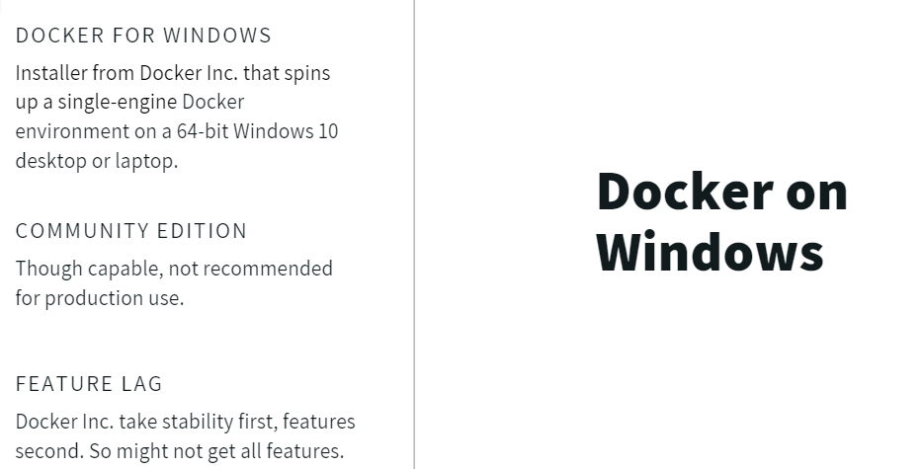
Docker on WINDOWS

Slide 4
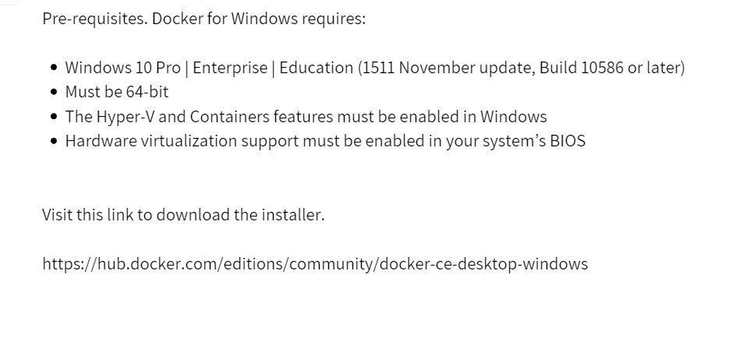
Prerequisites

Slide 5
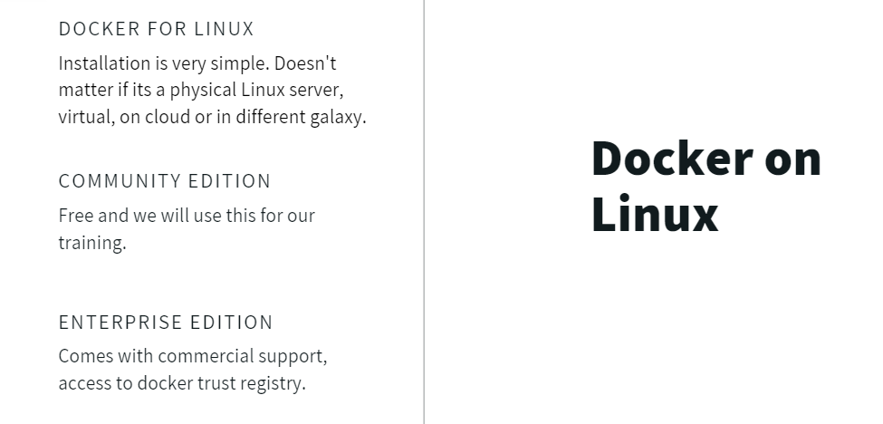
Docker on LINUX

Slide 6
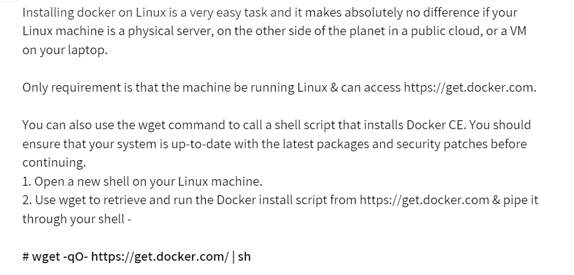
Docker for LINUX

Slide 7
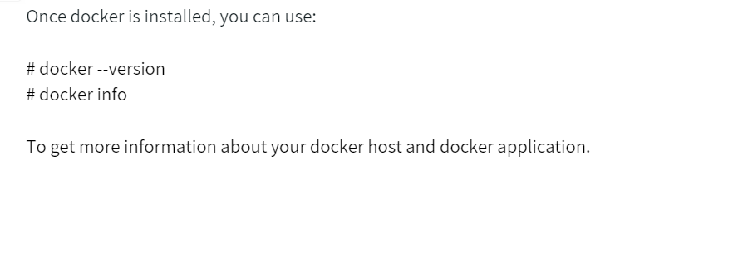
We have DOCKER installed

Slide 8
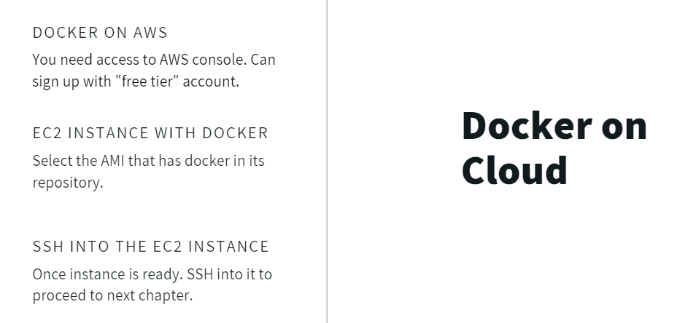
Docker On CLOUD

Slide 9

Conclusion

