Slide 1
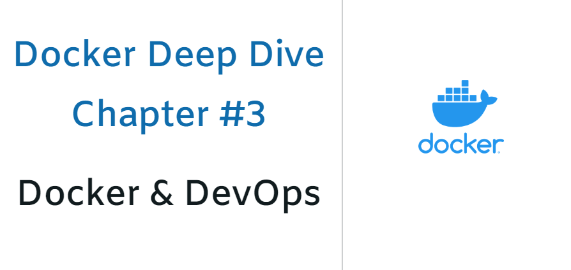

Slide 2
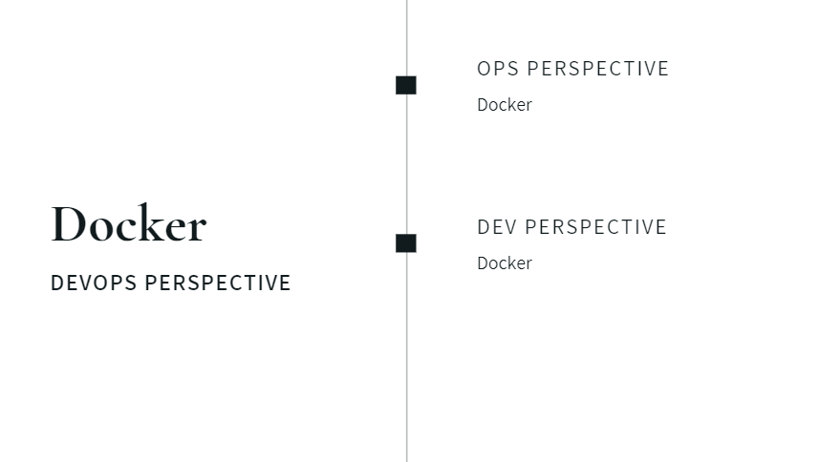
Docker: DEVOPS PERSPECTIVE

Slide 3
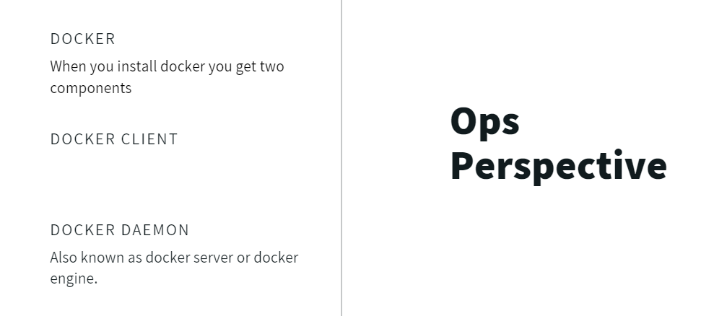
OPS Perspective

Slide 4
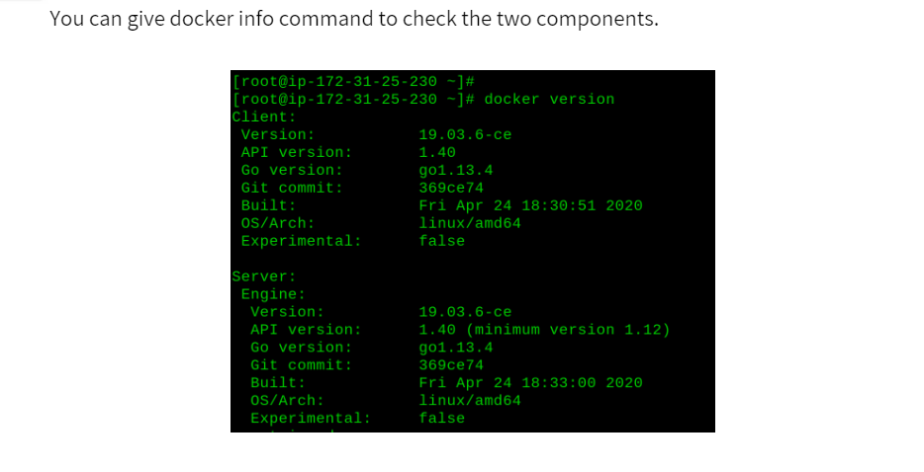
Let’s try it out

Slide 5
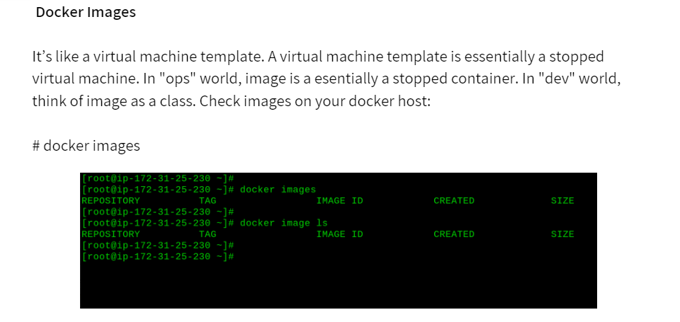
Docker Images

Slide 6
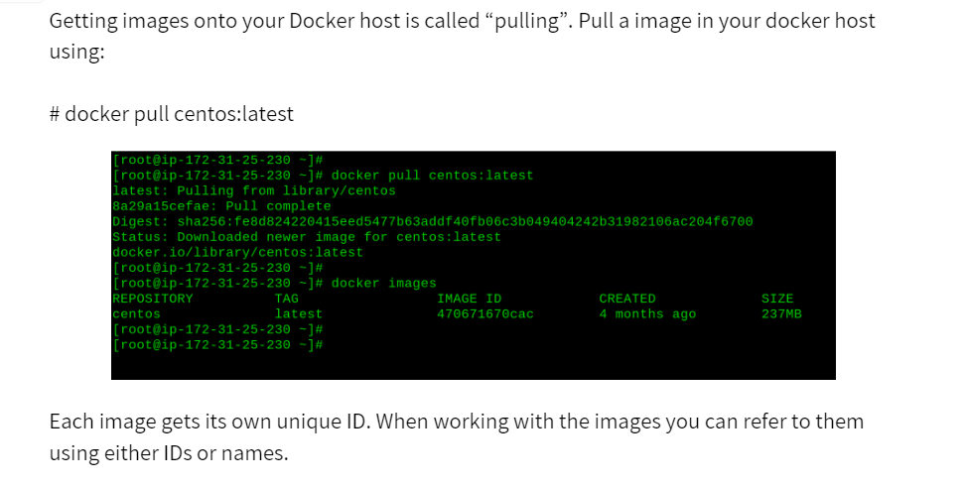
Docker pull

Slide 7
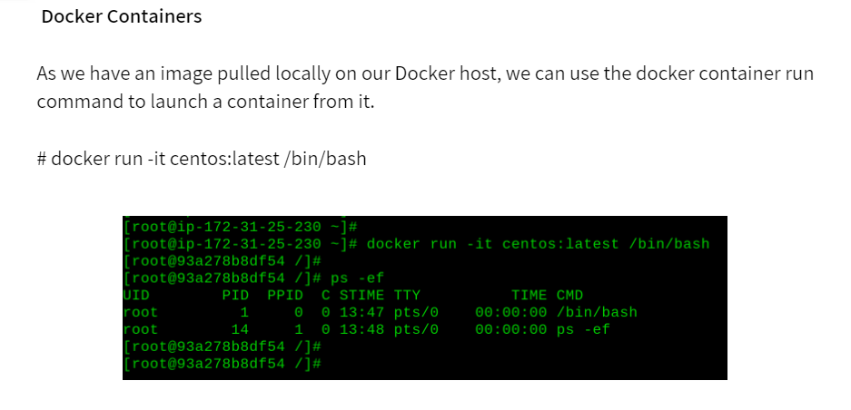
Docker Containers

Slide 8
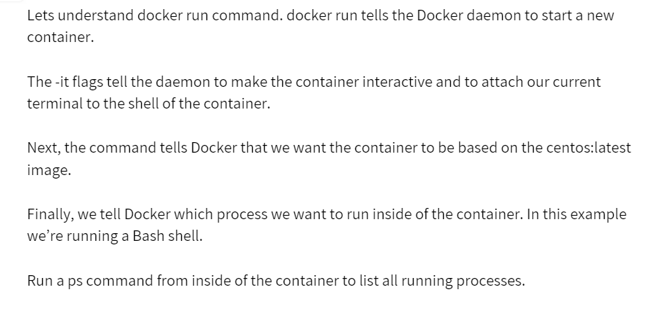
Docker run

Slide 9
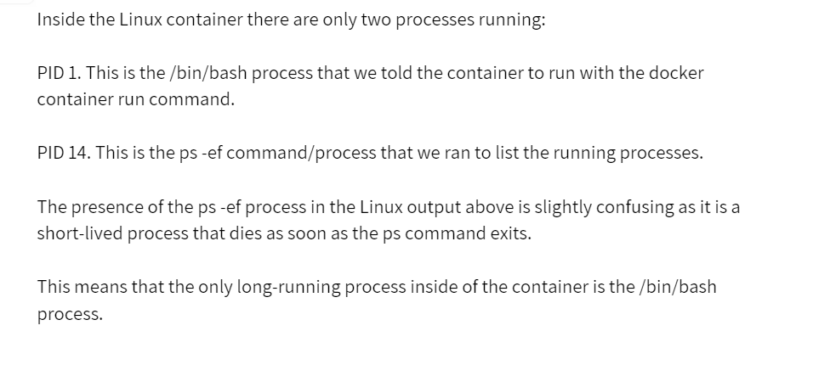
A Running Container

Slide 10
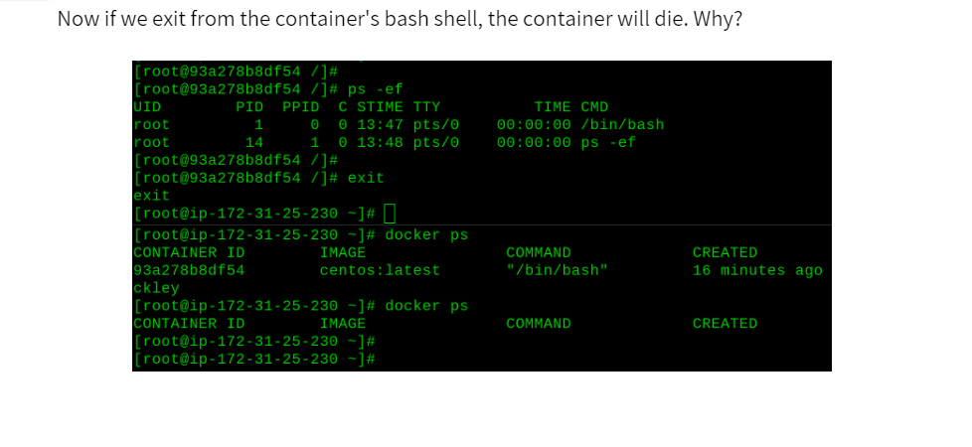

Slide 11
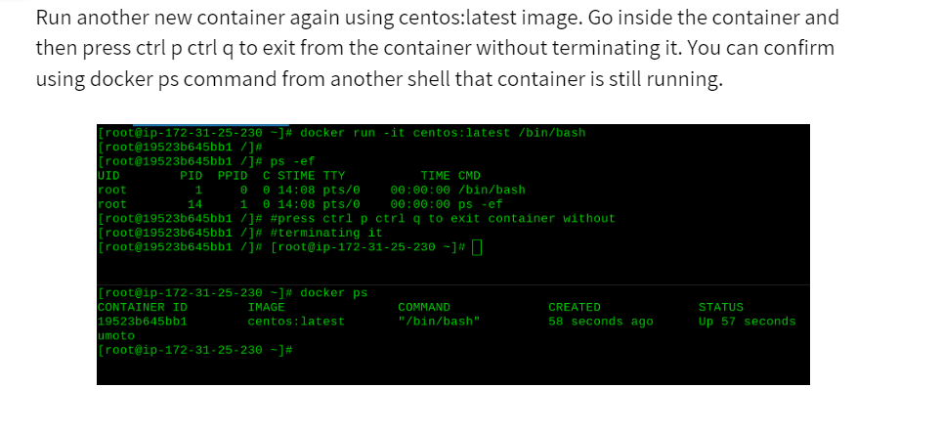

Slide 12
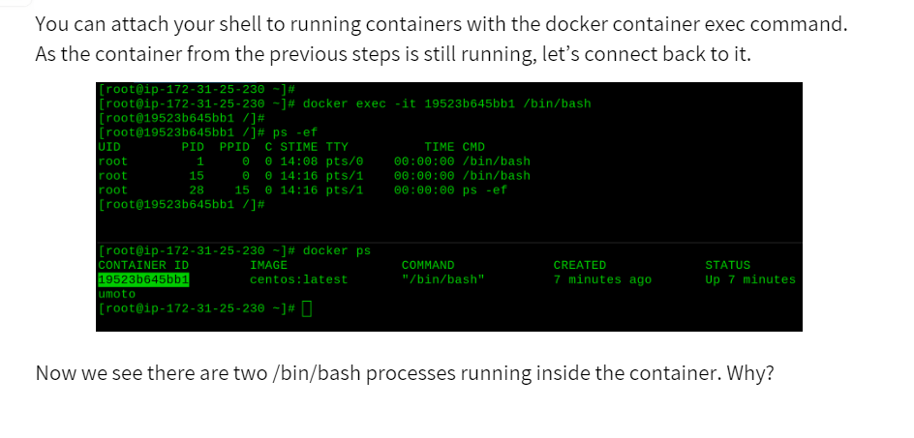

Slide 13
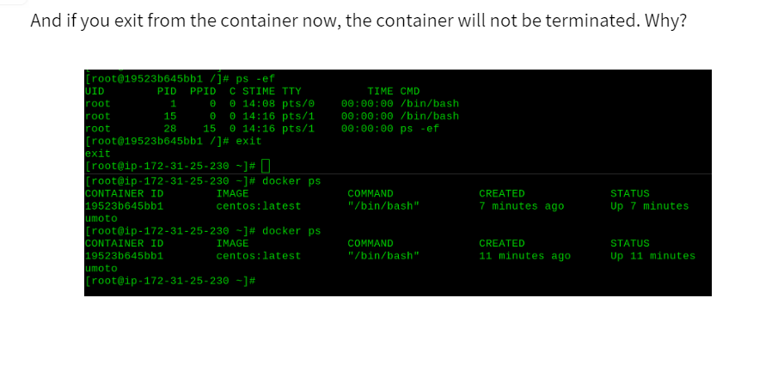

Slide 14
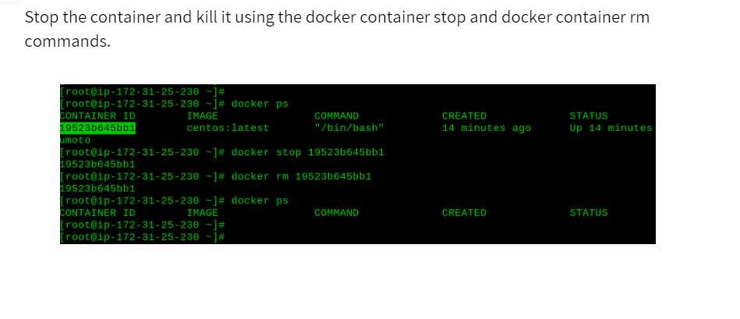

Slide 15
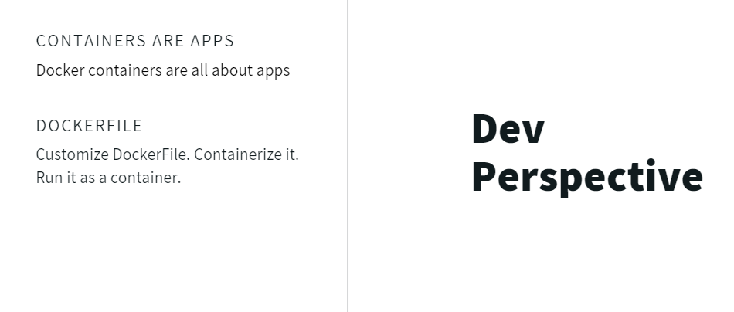
Dev Perspective

Slide 16
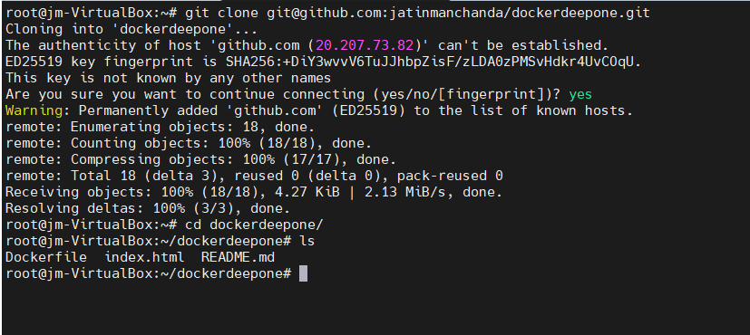
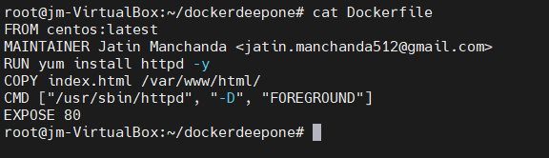
A simple Linux app can be downloaded from :
https://github.com/jatinmanchanda/dockerdeepone.git
Use the git clone command to download the application into your docker host. install git if required.
Move inside dockerdeepone directory and check the contents of Dockerfile.
We will discuss Dockerfile in details going forward.

Slide 17
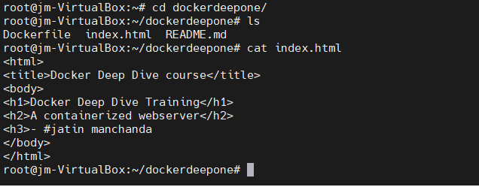
Also check the contents of index.html file. In the next section we will be creating docker file.

Slide 18
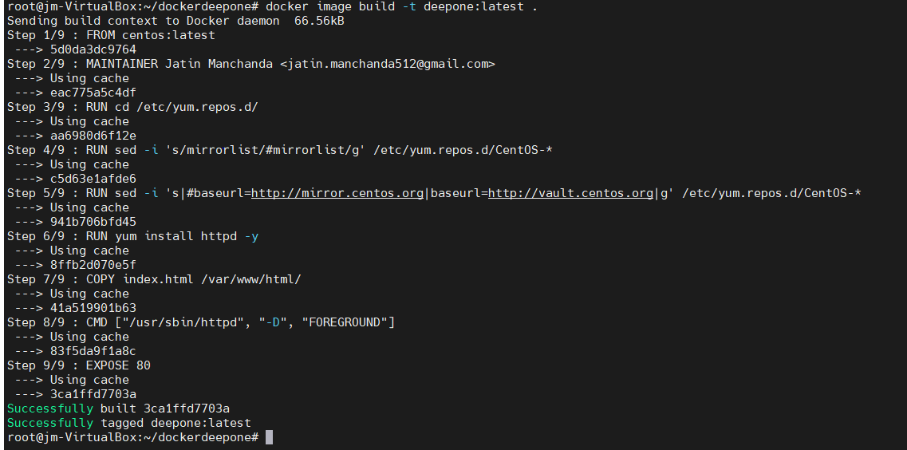
Currently we have pulled some application code from Jatin manchanda’s git repo.
We also have a Dockerfile containing instructions that describe how to create a new docker image with the application inside.
Use the docker image build command to create new image using the instructions contained in the Dockerfile. We will create a new docker image called deepone: latest.
Be sure to perform this command from within the directory containing the appcode and Dockerfile.

Slide 19
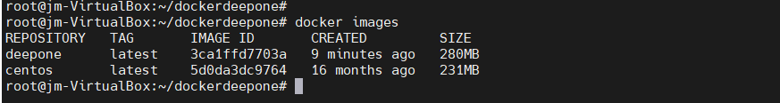
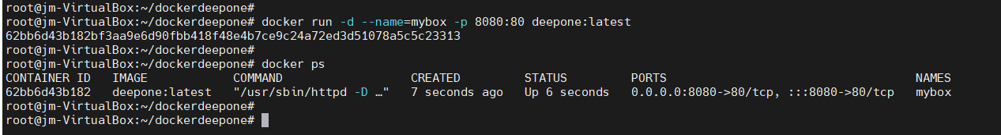
This process may take sometime. Once it is done, you can use docker images command to see your new application image available on your docker host.
run a container from deepone:latest image and test the app.

Slide 20
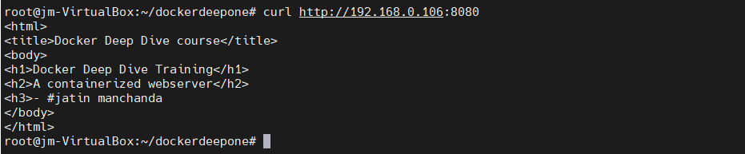
open a web browser and navigate to the DNS name or IP address of the host that you are running the container from and point it to port 8080.

Slide 21
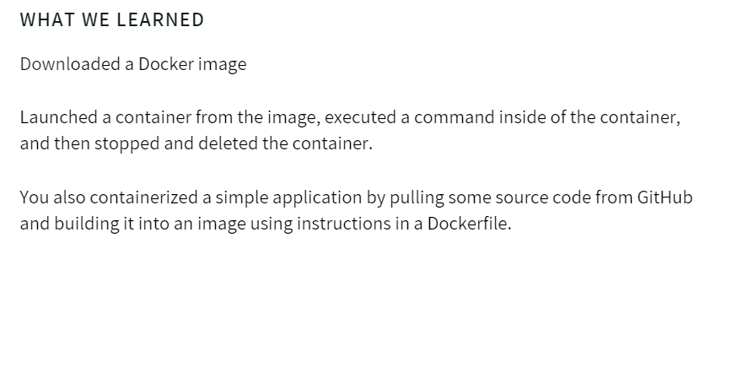
Conclusion

