Slide 1
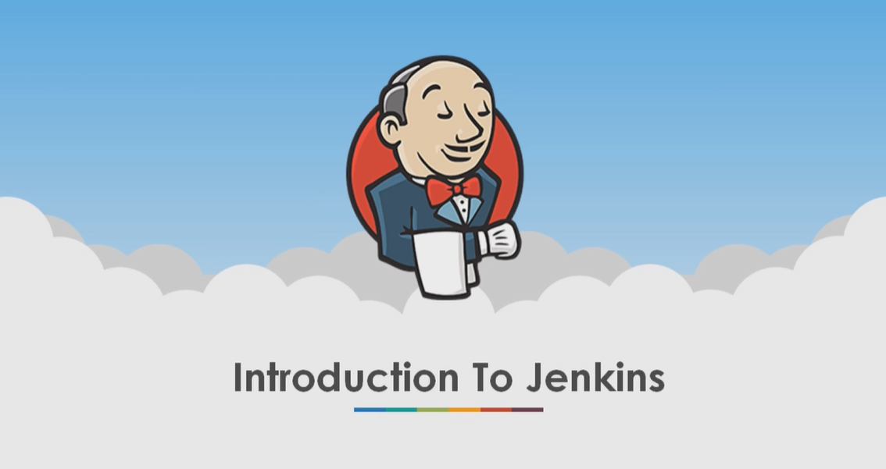

Slide 2
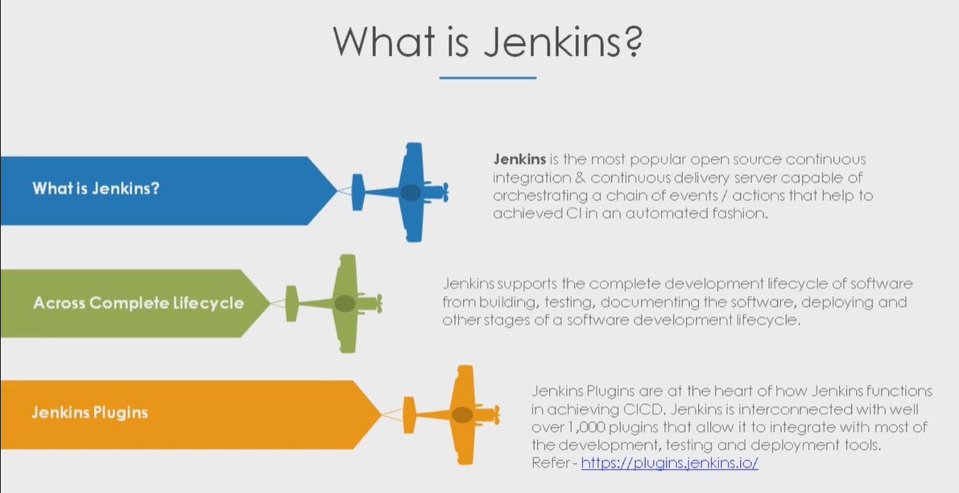
What is Jenkins ??

Slide 3
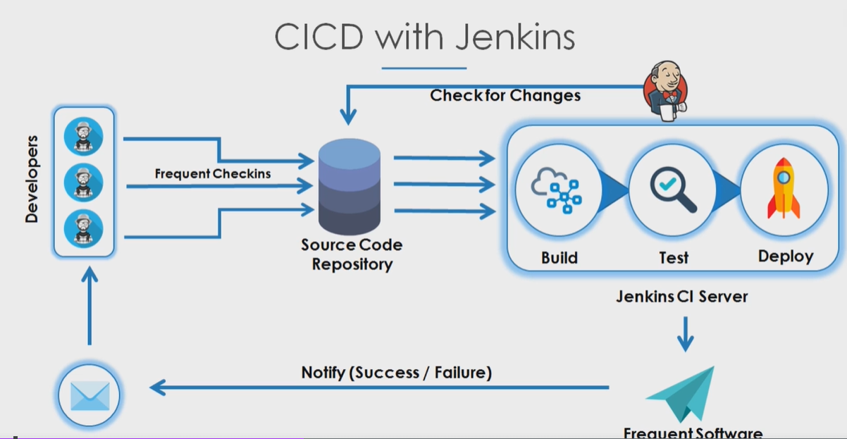
Continuous Integration with Jenkins

Slide 4
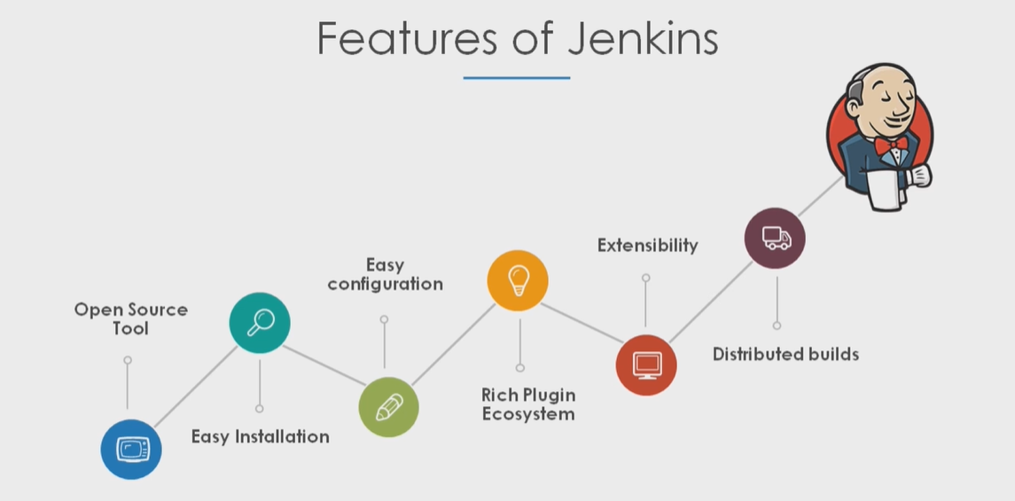
Features

Slide 5
A Few Jenkins Terms
Job/Project : Runnable tasks that are configured in Jenkins
Node: Each machine that is part of Jenkins Grid.
Executor: Thread or slot for execution of jobs
Build: Result obtained after executing a job
Plugins: Software that extends the core functionality of Jenkins

Slide 6
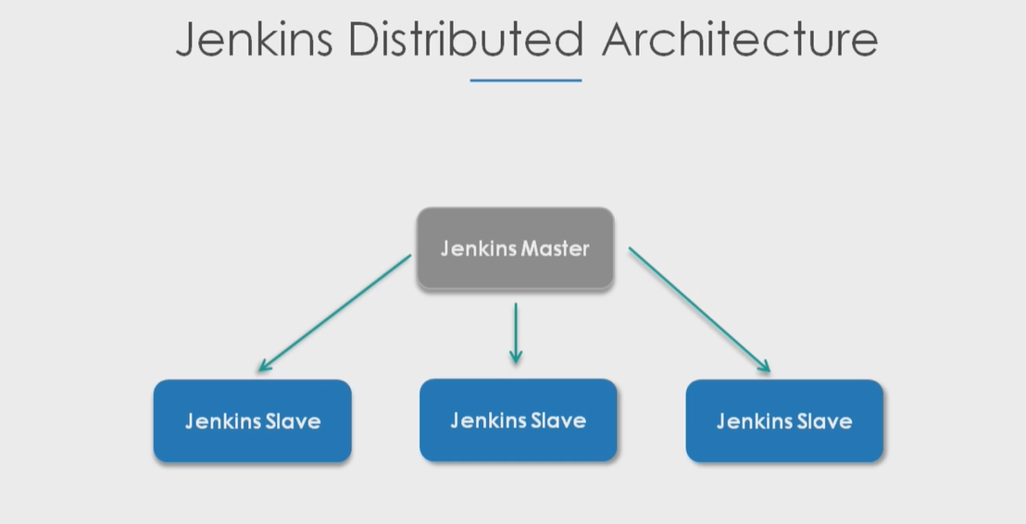
Architecture

Slide 7
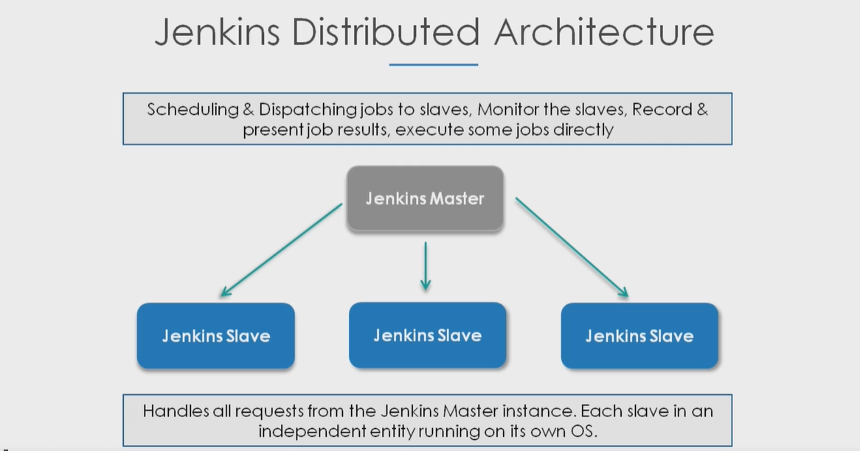
Continue

Slide 8
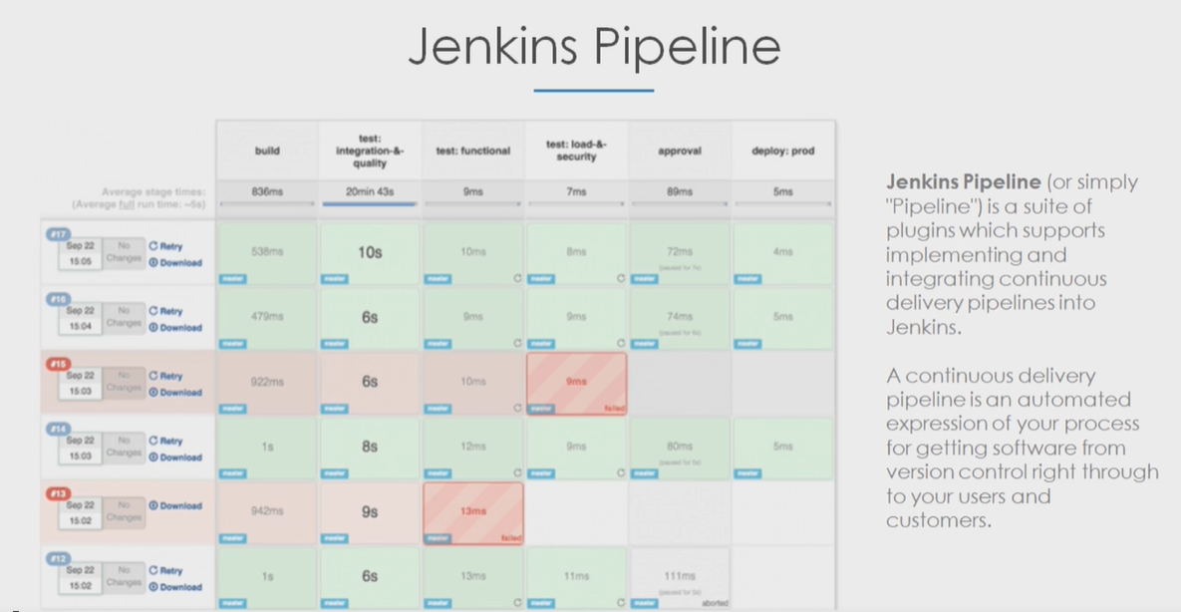
Jenkins Pipeline

