Slide 1
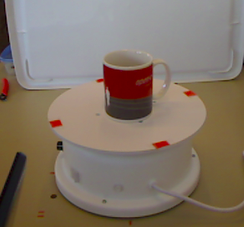
Occluded Object Detection Using Segmentation
Approach: The whole idea of the project is to detect an object whether it is covered by any obstacle or clearly visible. We propose a solution using a combination of Deep-Mask and YOLOv2.
Known Issues:
- Traditional methods include object detection based on region-proposals and localization but they fail if object is occluded.
- Using only Mask-RCNN for object detection may lead to multiple detection of same object.
Obstacle
Obstacle
Two Cups detected!

Slide 2
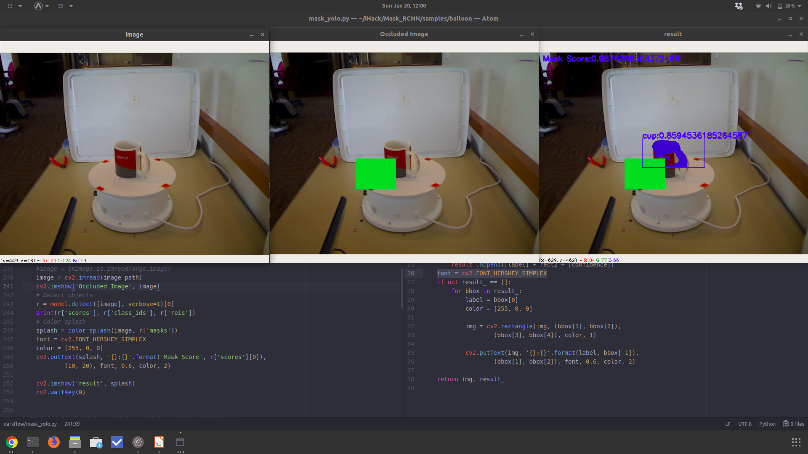
Solution
YOLOv2 or such similar networks are good for complete object detection, whereas Mask-RCNN model is good in segment detection, therefore a combination of these can be used for detection of an occluded object.
Mask-RCNN Model
Object
Segments
YOLOv2 Model
Region
Proposals
Incase where multiple objects exists overlapping each other, Depth images can be used to find which object is on top/front of another object.

Slide 3
Demo

Slide 4
Solution
Dataset
Mask-RCNN and YOLOv2, both networks were trained on Microsoft Kinet RGB-D dataset containing 548 images of a Coffee Cup.
Applications
- Relative distance of object from each other (3D Estimation)
- Object Detection (Person detection) in crowded scenarios
- Estimation of object count (For example how many people have attended an event based on crowd images)
Future Work
- Improvement of both models with proper and diverse dataset
- Improving run-time by introducing parallelization and multi-threading
- Relative distance estimation

