Slide 1
Designing & Building
Production-Ready Agents
with OpenClaw on AWS
Jatin Mehrotra · Developer Advocate, AWS
Community Day 2026
Notes:
Welcome to Community Day. I am Jatin, Developer Advocate at AWS. Today we cover how to take OpenClaw agents from prototype to production on AWS. Three live demos, practical takeaways, and a look at what is next with multi-agent.

Slide 2
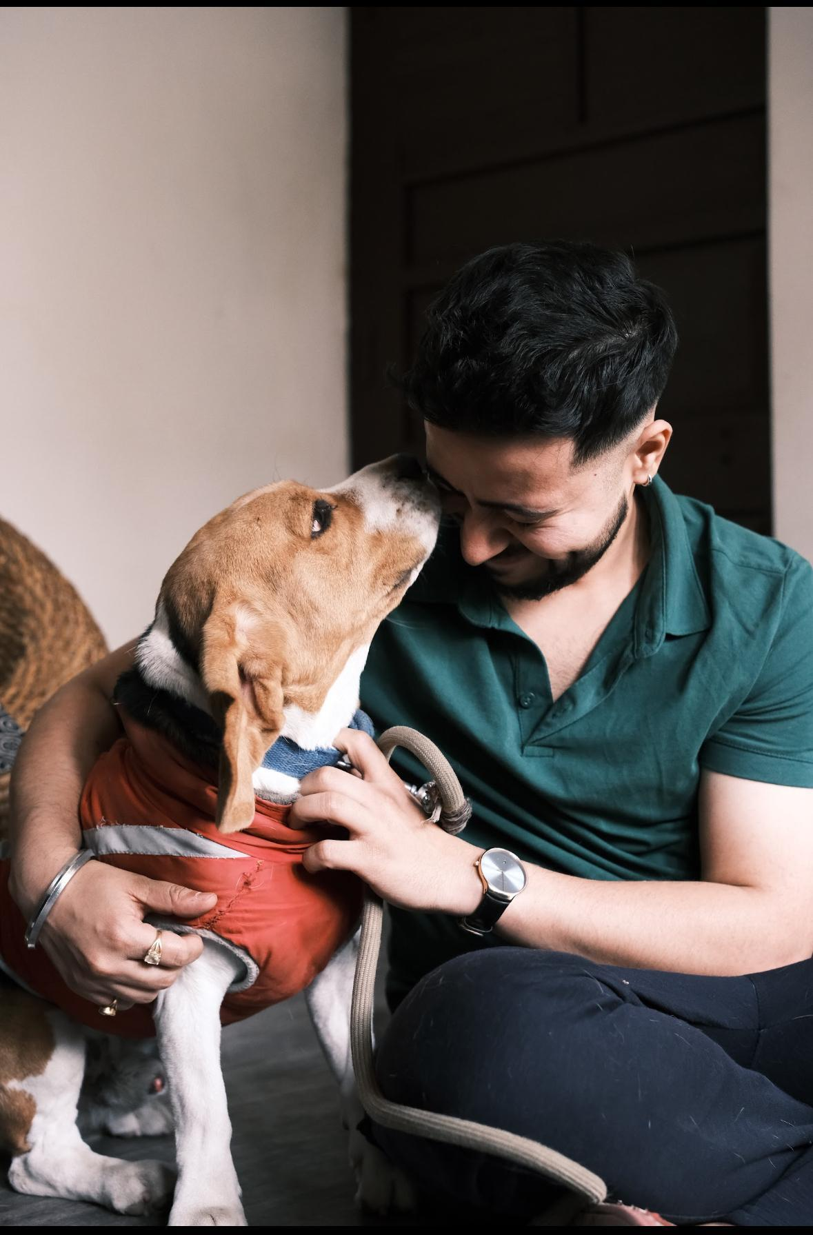
Jatin Mehrotra
Developer Advocate, AWS
5+ years building on AWS
Previously: DevOps & Platform
Engineer for Japanese companies
Building infra for developers,
SaaS teams, now focused on GenAI
Outside work: I lift, hike & enjoy saunas 🏋️‍♂️🏔️♨️
Notes:
Five plus years building on AWS. Started in DevOps and Platform Engineering for Japanese companies, so I know the pain of running infra at 3am. Now I focus on helping developers adopt GenAI. When I am not at a keyboard I am lifting weights, hiking mountains, or sitting in a sauna.

Slide 3
Agenda
1
What is an Agent & Agentic Systems
2
AWS Bedrock & AgentCore
3
What is OpenClaw
4
Building: Lightsail → EC2 → AgentCore
5
What breaks at scale
6
Securing with AgentCore
7
What is Next: Multi-Agent
Notes:
Here is our roadmap. We start with agent fundamentals, move to AWS services, then three demos that get progressively more production-ready. We end with multi-agent which is the next frontier. Feel free to interrupt with questions at any point.

Slide 4
What is an Agent?
LLM + Reasoning + Memory + Tools = Agent
LLM
(Brain)
Tools
(Hands)
Memory
(Context)
Orchestration
(Workflow)
Notes:
Think of your last ChatGPT session. You asked, it answered. Now imagine if it could actually open your email, compose a reply, and send it. That shift from generating text to executing real actions is what defines an agent. Four components make this work: the LLM reasons, tools let it act, memory keeps context, and orchestration manages multi-step workflows.

Slide 5
The Agent Loop
Perceive → Reason → Plan → Act → Observe
Perceive
Observe
Reason
Act
Plan
Notes:
This loop is what makes agents autonomous. They perceive input, reason about what to do, plan the steps, execute an action, then observe the result. If the task is not done, they loop again. No human clicking next at each step. This is fundamentally different from prompt-response.

Slide 6
From LLMs to Agentic Systems
L1 Chat
prompt → response
L2 RAG
grounded answers
L3 Tool Use
calls APIs
L4 Agent
autonomous execution
L5 Multi-Agent
collaboration
Notes:
Quick show of hands: who uses Copilot or Claude daily? Most of you are at Level 3 or 4 already. The difference is Level 4 agents run autonomously without you supervising each step. Level 5 is multiple agents working together. Today we make Level 4 and 5 production-ready on AWS.

Slide 7
AWS Services for Agentic AI
Bedrock
AgentCore
Lightsail
EC2 / EKS
Foundation
models
as a service
Serverless
agent
runtime
One-click
OpenClaw
blueprint
Full control
enterprise
scale
Notes:
Quick landscape of AWS services for agents. Bedrock gives you models with IAM auth so no API keys to leak. AgentCore is the serverless runtime we will go deep on. Lightsail is the one-click option for getting started. EC2 and EKS give full control when you need it.

Slide 8
The AgentCore Ecosystem
Serverless · Framework-agnostic · Pay-per-use
Runtime
Memory
Browser
Tools
Identity
Firecracker
microVMs
~200ms
S3-backed
Headless
automation
Code exec
& search
SSO/IdP
Cedar
Notes:
AgentCore is the production star of this talk. Five components: Runtime uses Firecracker microVMs which is the same technology that powers Lambda. Memory gives sub-200ms retrieval. Browser enables headless web automation. Tools handle code execution. Identity integrates SSO and Cedar policies. And you only pay when your agent is actually computing, not when it is waiting.

Slide 9
What is OpenClaw?
Fastest growing open-source AI agent
230K+
10,000+
15+
GitHub Stars
Community Skills
Channels
Notes:
OpenClaw launched November 2025 and hit 230K GitHub stars by February 2026. Nothing in open source history has grown this fast. Over 10,000 community-built skills, 15 plus messaging channels. What makes it special: it actually does things. Files, terminal commands, browser control, calendar management. People are running entire businesses with one laptop and OpenClaw.

Slide 10
Why OpenClaw + AWS?
No API keys — IAM-authenticated Bedrock
No open ports — SSM Session Manager
Scale from 1 to 1000s users
Notes:
Three reasons to put OpenClaw on AWS instead of your Mac Mini. First, no API keys anywhere because Bedrock uses IAM. Second, no open ports because SSM handles access. Third, it scales. Start with one instance for yourself, scale to thousands for your company. Same agent code, different infrastructure underneath.

Slide 11
Deployment Options
Lightsail
EC2
AgentCore
EKS
Target
Individual
Startups
Enterprise
Enterprise
Cost
~$17/mo
~$30/mo
~$12/mo
~$50+/mo
Deploy
Blueprint
CFN
CDK
K8s
Isolation
None
None
microVM
Container
Scaling
Manual
Manual
Serverless
Auto
Notes:
This table is your decision cheat sheet. Take a photo. Key insight: Lightsail is simplest to start at 17 dollars a month. EC2 gives more control at 30 dollars. AgentCore is actually the cheapest at scale AND gives you built-in security at 12 to 15 dollars per user. EKS is for teams already on Kubernetes.

Slide 12
Architecture: OpenClaw on Lightsail
One-click · Pre-configured · ~$17/mo
You
(Browser)
Lightsail
(OpenClaw)
IAM
Role
Bedrock
(Models)
→
→
→
Notes:
Simplest possible architecture. Four components in a line: your browser connects to Lightsail, Lightsail has OpenClaw pre-installed, it uses an IAM role to call Bedrock for model inference. The blueprint handles all installation. Total cost around 17 dollars a month plus whatever tokens you use. One click to deploy.

Slide 13
▶
DEMO
OpenClaw on Lightsail
Notes:
Switching to live demo. I will deploy OpenClaw on Lightsail from scratch. Open the console, select the blueprint, SSH in to pair my browser, run one script for Bedrock access, then send a message. Watch the timer. Under five minutes from nothing to a working AI agent.

Slide 14
What Just Happened
LIGHTSAIL
✓ VM with OpenClaw pre-installed
✓ IAM role grants Bedrock access
✓ All channels ready to connect
✓ Single-user, no isolation
Notes:
What Lightsail created: a VM with OpenClaw pre-installed and running. Device pairing means only my browser can access it. The CloudShell script created an IAM role granting Bedrock access. All messaging plugins are ready to configure. Limitation: this is one instance for one person. If your team needs access, you need multiple instances at multiple times the cost. Cannot share securely.

Slide 15
Architecture: OpenClaw on EC2
CloudFormation · Graviton · SSM · ~$30/mo
Messaging
Channels
EC2
(Graviton)
SSM +
CloudTrail
Bedrock
(Models)
→
→
→
Notes:
EC2 deployment uses CloudFormation. One YAML template creates everything: a VPC with proper networking, a Graviton instance that is 20 to 40 percent cheaper than x86, SSM configuration so no SSH key is ever needed, and CloudTrail for automatic auditing. Eight minutes from command to running agent. More AWS integration than Lightsail.

Slide 16
▶
DEMO
OpenClaw on EC2
Notes:
Switching to demo. I will run one CloudFormation command. While it creates resources I will briefly show the YAML template. Then I will use SSM to access the dashboard without any passwords or SSH keys. Notice: no ports opened, no credentials typed anywhere.

Slide 17
What Just Happened
EC2
✓ Graviton = 20-40% cheaper
✓ SSM = no SSH ports exposed
✓ IAM = zero API key mgmt
✓ Still single-user, always-on
Notes:
What CloudFormation built: VPC, subnet, Graviton EC2, IAM role, SSM config. Your security team will love this because there is nothing exposed to the internet. But two limitations remain: it is still a single-user architecture and it runs 24/7 whether the agent is active or idle. You are paying for compute even when the agent is just waiting for an LLM response.

Slide 18
What Breaks at Scale
Isolation
Security
Data leaks
across users
Agents inherit
all permissions
Observability
Cost
No tracing of
tool calls
Paying for
idle compute
Notes:
Here is where it breaks at scale. Isolation: on a shared instance, Customer A files are visible to Customer B. Security: agents inherit full permissions and there are thousands of unvetted plugins. Observability: no way to trace which agent called which tool. Cost: EC2 runs around the clock but agents spend 90 percent of their time waiting. These four problems define what production-ready means.

Slide 19
Production Deployment Paths
Path A
Path B
Path C
Path D
Local
Dev
Rapid
Cloud
Self-
Managed
Agent
Core
RECOMMENDED
Notes:
Four paths to choose from. Path A and B are what we just demoed, great for learning and PoC. Path C is self-managed on ECS or EKS which gives maximum control but requires 3 to 5 engineers working 2 to 4 months just on isolation and security. Path D is AgentCore which gives you all of that out of the box in hours. That is where we are going next.

Slide 20
Containers vs Firecracker
Containers
Firecracker microVMs
Shared kernel
Escape risks
No fs isolation
Hardware isolation
Dedicated CPU/mem
Zero residual state
Notes:
The most important technical slide. Containers share a Linux kernel. CVE-2024-21626 was a real container escape that made headlines. Firecracker microVMs give actual hardware-level isolation using KVM. Each user session gets dedicated CPU, memory, and filesystem. When the session ends everything is destroyed. Zero residual state. This is the same technology running billions of Lambda invocations.

Slide 21
Security & Governance
Cedar policy engine
SSO / IdP identity
STS scoped credentials
Bedrock Guardrails
Notes:
Security is layered. Cedar is a policy engine that looks like JSON. You write rules like: marketing group cannot call finance APIs. STS scopes credentials per user session so even if an agent runs shell commands, it can only see its own data. Bedrock Guardrails filter content on every single API call. Three independent layers. An attacker would need to bypass all three.

Slide 22
Cost Efficiency
Up to
End-to-end tracing
Pay-per-use only
$30/user → $9/user
83%
cost savings
Notes:
Let this number sit for a moment. 83 percent cost savings. The reason: agents spend most of their time waiting for LLM responses. EC2 charges you for that wait time. AgentCore only charges when the agent is computing. For a team of 100 users, that is 3000 dollars a month on EC2 versus 900 on AgentCore. For a 50-person startup that is 1500 saved monthly. Or one extra engineer hire.

Slide 23
Architecture: OpenClaw on AgentCore
CDK deploys 7 production components
API
Gateway
Router
Lambda
Dynamo
DB
Agent
Core
Bedrock
S3
Persist
Event
Bridge
Notes:
Production architecture. CDK creates seven coordinated components in one deploy: API Gateway receives webhooks, Router Lambda resolves user identity, DynamoDB stores user mapping, AgentCore provides isolated microVMs, Bedrock handles inference, S3 persists workspaces, EventBridge enables scheduled tasks. This is what production-ready looks like.

Slide 24
Architecture: OpenClaw on AgentCore
Production deployment with CDK
REQUEST FLOW
Telegram
API Gateway
Router
DynamoDB
AgentCore
Bedrock
User message
HTTP API
Lambda
Identity
Firecracker VM
Claude + Guards
AGENT SERVICES
S3 Bucket
STS
Secrets Mgr
CloudWatch
EventBridge
Files + workspace
Per-user creds
API keys
Logs + metrics
Cron scheduler
INFRASTRUCTURE
VPC + Private Subnets
NAT Gateway
KMS
SNS
Cognito
Outbound
Encryption
Alarms
Service identity

Slide 25
▶
DEMO
Production OpenClaw on AgentCore
Notes:
Final demo. I will deploy via CDK and show three things: first, that two users on the same system cannot access each other files. Second, that if I kill a session and restart, the conversation history persists from S3. Third, that Bedrock Guardrails actually block unsafe requests in real time.

Slide 26
Request Flow
How a message travels through the system
User sends message via Telegram
↓
API Gateway receives webhook
↑ back to User
↓
Router Lambda resolves identity (DynamoDB)
Response
↓
InvokeAgentRuntime
↓
AgentCore microVM (per-user Firecracker)
↓
Contract Server → Proxy → Bedrock (Claude)

Slide 27
What Just Happened
AGENTCORE
✓ 15+ resources deployed
✓ Per-user Firecracker microVM
✓ STS scoped credentials
✓ S3 workspace persistence
Notes:
What CDK deployed: over 15 AWS resources working together. Each user in their own hardware-isolated microVM. STS credentials scoped per session. Workspace syncing to S3 every five minutes. Guardrails active on every API call. Ask yourself: could your team build this in a week? The answer is no. That is why managed services exist.

Slide 28
AgentCore = Production-Ready
vs. 3-5 engineers × months to build yourself
Isolation + Security + Observability + Cost
All built-in. All managed.
Notes:
Summary: AgentCore gives you four things at once. Hardware isolation with Firecracker. Security with Cedar plus STS plus Guardrails. Observability with end-to-end tracing. And cost efficiency with pay-per-use. All managed. No custom infrastructure engineering needed.

Slide 29
✅ Hardware-level isolation
Firecracker microVMs — not containers

Slide 30
✅ Identity + Policy + Gateway
Cedar · STS · Guardrails

Slide 31
✅ Pay-per-use, up to 83% savings
No idle compute · CPU + memory hours

Slide 32
✅ Native observability
End-to-end tracing · Evaluation · Real-time
Notes:
When your agent makes a wrong decision today, how do you debug it? Most people restart and hope for the best. That is not production. AgentCore gives you end-to-end tracing. You see exactly which agent invoked which tool, what data was passed, what the result was. You can catch quality regressions over time with built-in evaluations.

Slide 33
What is Next: Multi-Agent Systems
Orchestrator
Email
Agent
DB Monitor
Agent
Report Gen
Agent
Notes:
Looking ahead. Single agents hit a ceiling when context fills up. The orchestrator plus sub-agent pattern solves this. One orchestrator holds the big picture and delegates. Sub-agents are focused and disposable. Each gets its own workspace and permissions. OpenClaw supports this natively with sessions_spawn. Think of it like a manager who delegates to specialists.

Slide 34
Multi-Agent on AWS
Available today
OpenClaw: sessions_spawn()
AgentCore: Supervisor → sub-agents
Strands SDK: Python decorators
Notes:
This is not future tech. Three ways to do it today. OpenClaw has sessions_spawn for native multi-agent. AWS has a full guidance repository showing Supervisor plus sub-agents on AgentCore. And Strands Agents SDK lets you build multi-agent systems with Python decorators in minimal code. The customer support example has four agents coordinating: personalization, orders, recommendations, and troubleshooting.

Slide 35


Resources & Next Steps
EC2 repo
github.com/aws-samples/
sample-OpenClaw-on-AWS-with-Bedrock
github.com/aws-samples/
sample-host-openclaw-on-amazon-bedrock-agentcore
AgentCore repo
Notes:
Here are the repositories you need. I will give you 15 seconds to scan the QR codes. The EC2 repo has the CloudFormation template. The AgentCore repo has the full CDK stack. These are your starting points after today.

Slide 36

Q&A
LinkedIn
Let's discuss!
Developer Advocate, AWS
Notes:
Thank you everyone. Let me open the floor for questions. Common ones I get: pricing is about 5 cents per CPU-hour. Cold start is around 5 seconds with warm pools. Yes it is model-agnostic, you can use Claude, Nova, GPT-4, or open-source models. Migration from local OpenClaw to AgentCore is handled by the CDK repo.

