Slide 1
Same Skills, New Superpower: Building Cloud Infrastructure with Code
Jatin Mehrotra
Developer Advocate, AWS
Notes:
Welcome everyone. Let's jump in.

Slide 2

Jatin Mehrotra
5+ years building on AWS
Previously: DevOps, Platform Engineer for Japanese companies
Build Infrastructure for Developers, SaaS product teams
I’ve clicked through the console. I’ve written the YAML. I have done it all three ways
Notes:
I'm Developer Advocate at AWS.
Before this role, I was a devops, platform engineer at Tokyo and have been building on AWS for 5 years.
I've set up infrastructure by hand, written thousands of lines of CloudFormation, I've used CDK and Terraform in production. So what I'm sharing today isn't theory — it's what I've lived. And I started exactly where you might be right now — knowing how to write code but not knowing how to get it into the cloud reliably. That's what today is about.

Slide 3
Agenda
Why Infrastructure as code matters
CloudFormation, CDK & Terraform — explained
Live demo — same task, three tools, built with Kiro
How to choose + Q&A
No deep AWS knowledge required. If you can read code, you’re good
Notes:
Here's what you'll get out of the next 30 minutes: you'll understand what Infrastructure as Code is, you'll know the difference between CloudFormation, CDK, and Terraform — and when to reach for each — and you'll see how to get started today.
First, I'll show you why IaC exists through a scenario you'll probably recognize.
Then we'll look at the three tools.
Then the fun part — a live demo where I use Kiro, an AI-powered IDE from AWS, to generate and deploy infrastructure using all three.
We'll wrap with how to choose and your questions.
And just so we're clear — you don't need deep AWS knowledge for this. If you can read code, you'll follow along fine.

Slide 4
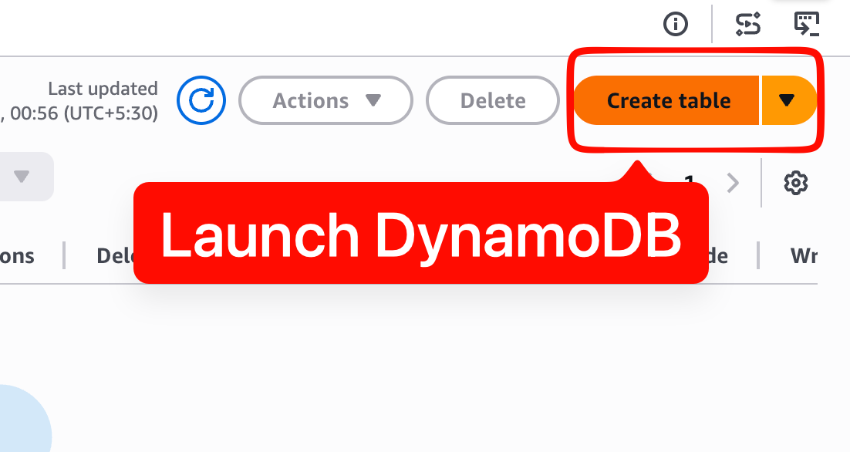
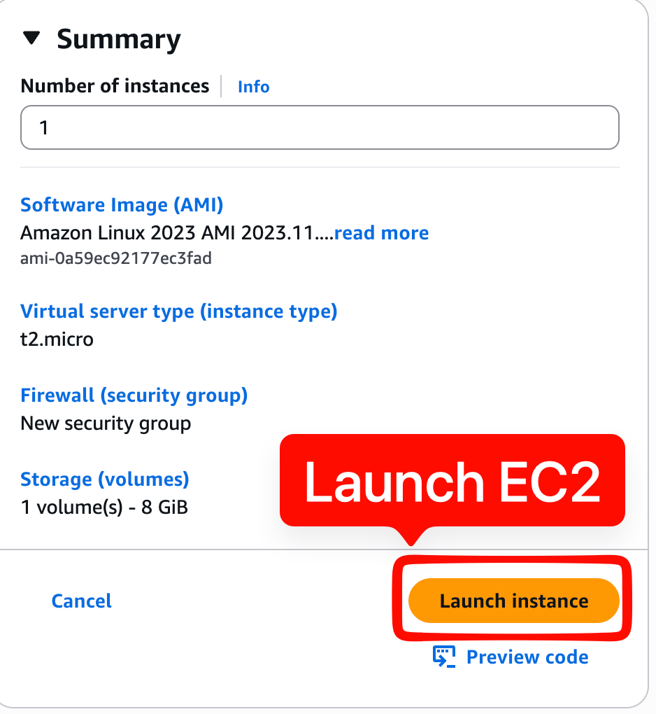
You built an app. It works locally
Click…click…click
Notes:
Let's start with something familiar.
You've built your app. It runs great on your machine.

Slide 5
This was exactly my fingers when I started
Click…click…click
Notes:
Let's start with something familiar.
Now you need to get it into the cloud. So you log into the console, you create a server, you set up a database, you configure networking, you attach permissions. Lots of clicking. And it works! ...for now.

Slide 6
Can you set up the same thing for staging?
What changed since last week?
Who deleted the security group?
Notes:
Then day 2 happens.
Your manager asks for a staging environment.
A teammate asks what changed.
Something breaks and nobody knows who touched what. Sound familiar? This is the exact same problem we solved in application development years ago. We solved it with version control, code review, and automation. Infrastructure just hasn't caught up yet — until now.

Slide 7

As developers, you already:
Write code in files
Use version control (git)
Review changes (pull requests)
Automate repetitive tasks (CI/CD)
What if infrastructure worked the same way?
Notes:
Here's the thing — you already know how to solve this.
You write code in files.
track changes with git. Y
review each other's work through pull requests.
automate with CI/CD.
What if your infrastructure worked exactly the same way? That's Infrastructure as Code. It's not a new skill — it's your existing skills applied to a new domain.

Slide 8
IaC: Define your cloud resources in files, deploy them with a command.
Notes:
Infrastructure as Code in one sentence: you define your cloud resources in files, and deploy them with a command.
That's it. Instead of clicking through a console, you describe what you want in a file — a server, a database, a network — and a tool creates it for you. Reproducibly. Every single time.

Slide 9
Without IaC | With IaC
Manual setup | Automated
"It was working yesterday” | Git blame
Snowflake environments | Identical copies
Documentation gets stale | Code is the documentation
Notes:
Let me make this concrete.
Without IaC, setup is manual and error-prone. With IaC, it's automated and repeatable. Without IaC, when something breaks you're guessing. With IaC, you git blame and see exactly what changed.
Without IaC, every environment is a unique snowflake. With IaC, staging is a carbon copy of production.
And the best part — your code IS your documentation. It never gets stale because it's what's actually deployed.

Slide 10



Three Tools, One Goal
AWS CloudFormation — YAML/JSON templates
AWS CDK — Your programming language (TypeScript, Python, Java...)
Terraform — HCL, multi-cloud.
All three: file → deploy → infrastructure exists
Notes:
On AWS, you have three main options for IaC.
CloudFormation uses YAML or JSON templates — it's AWS-native and has been around the longest.
AWS CDK lets you use your actual programming language — TypeScript, Python, Java, Go — and generates CloudFormation under the hood.
And Terraform uses its own language called HCL and works across multiple cloud providers.
All three follow the same core idea: you write a file, you run a command, infrastructure exists.

Slide 11
AWS CloudFormation

Slide 12
The OG of AWS IaC
📄 YAML/JSON → ☁️ AWS Resources
Notes:
Let's start with CloudFormation — the original. It's been around since 2011 and it's what powers everything else on AWS under the hood.

Slide 13
1. You write a template (YAML or JSON)
2. You submit it to CloudFormation
3. CloudFormation creates a **stack** (your resources)
4. Change the template → update the stack
5. Delete the stack → resources cleaned up
```yaml
Resources:
MyBucket:
Type: AWS::S3::Bucket
```
Notes:
The mental model is simple. You write a template — that's your file describing what you want.
You submit it to CloudFormation, and it creates what's called a stack — that's your collection of resources.
Want to change something? Update the template, submit again.
Done with everything? Delete the stack and all resources get cleaned up. No orphaned resources.
Here's the simplest possible example — an S3 bucket in 3 lines of YAML.

Slide 14
CloudFormation – Strengths & Trade-Offs
❤️ Native to AWS — no extra tools
Handles rollback automatically
Tracks every resource it creates
😧
YAML can get verbo
No loops, limited logic
Learning curve for complex templates
Notes:
CloudFormation's biggest strength is that it's native — nothing extra to install, AWS manages the state for you, and if something fails mid-deploy it rolls back automatically.
The trade-off is that YAML gets verbose fast. You can't write a for-loop. For simple infrastructure it's great. For complex setups with lots of repetition, you'll feel the friction.
And that's exactly why CDK was created.

Slide 15
AWS CDK

Slide 16
Infrastructure in your language
🧑‍💻 TypeScript/Python/Java → 📄 CloudFormation → ☁️ AWS
Notes:
Enter the AWS CDK — the Cloud Development Kit. The idea is simple: what if you could define infrastructure using the same language you write your app in?

Slide 17
1. Write infrastructure in TypeScript, Python, Java, Go, or C#
2. CDK synthesizes it into a CloudFormation template
3. CloudFormation deploys it
```typescript
new s3.Bucket(this, 'MyBucket');
```
Notes:
CDK sits on top of CloudFormation. You write code in your language — TypeScript, Python, whatever you prefer. CDK compiles that into a CloudFormation template — this step is called synthesis. Then CloudFormation deploys it like normal.
So you get the full power of a programming language — loops, conditionals, abstractions, type checking — but CloudFormation still handles the actual deployment.
Look at that — one line of TypeScript, and you get an S3 bucket with sensible defaults.

Slide 18
CDK – Strengths & Trade-Offs
❤️ Loops, functions, classes
High-level constructs (smart defaults)
IDE autocomplete & type safety
😧
Adds a layer of abstraction
Still CloudFormation under the hood (same limits)
Need to understand what it generates
Notes:
CDK shines when you want to use real programming constructs.
Need 10 similar resources? Write a loop. Want reusable patterns? Write a class. Your IDE gives you autocomplete and catches errors before deploy.
The trade-off is that it's an abstraction layer. When something goes wrong, you might need to look at the generated CloudFormation to debug. And CloudFormation's limits still apply — like the 500 resource cap per stack.
But for most teams, the productivity gain is massive.

Slide 19
Terraform

Slide 20
One tool, any cloud
📄 HCL → ☁️ AWS / Azure / GCP
Notes:
Now let's talk about Terraform — built by HashiCorp. Terraform takes a different approach. It's not tied to any single cloud provider.

Slide 21
1. Write a `.tf` file in HCL (HashiCorp Configuration Language)
2. `terraform plan` — preview what will change
3. `terraform apply` — make it happen
4. State file tracks what exists
```hcl
resource "aws_s3_bucket" "my_bucket" {
bucket = "my-unique-bucket"
}
```
Notes:
Terraform uses its own language called HCL. It's declarative, purpose-built for infrastructure. The workflow has a killer feature: plan before apply. You run terraform plan and it shows you exactly what will be created, changed, or destroyed — before anything happens. Then terraform apply makes it real.
Terraform keeps a state file that tracks what it's managing, so it always knows the difference between what you want and what exists.

Slide 22
Terraform – Strengths & Trade-Offs
❤️ Multi-cloud
`plan` before `apply
Huge ecosystem & community
😧
State file needs to be managed
New language to learn (HCL)
slight lag on new services
Notes:
Terraform's superpower is multi-cloud. If your team uses AWS and Azure, or might switch later, one tool covers both. The plan command gives you confidence — you see exactly what's about to happen. And the community is enormous — there are providers for almost everything. T
he trade-offs: you need to manage a state file (usually in S3 or Terraform Cloud). HCL is a new language to learn, though it's simple. And since it's third-party, brand new AWS services might take a few weeks to get Terraform support.

Slide 23
 | CloudFormation | CDK | Terraform
Language | YAML/JSON | TypeScript, Python, | HCL
Scope | AWS only | AWS only | Multi-cloud
State | Managed by AWS | Managed by AWS | You manage it
Best for | AWS-native | Devs who want real code | Multi-cloud teams
Notes:
Here's the quick comparison. CloudFormation is YAML, AWS-only, state managed for you — great for straightforward AWS setups.
CDK is your programming language, still AWS-only under the hood, but way more expressive — ideal if you're a developer who thinks in code.
Terraform is HCL, works across clouds, but you manage state yourself — best if you're multi-cloud or want one tool for everything.
There's no wrong answer here. It depends on your team, your stack, and your preferences.

Slide 24
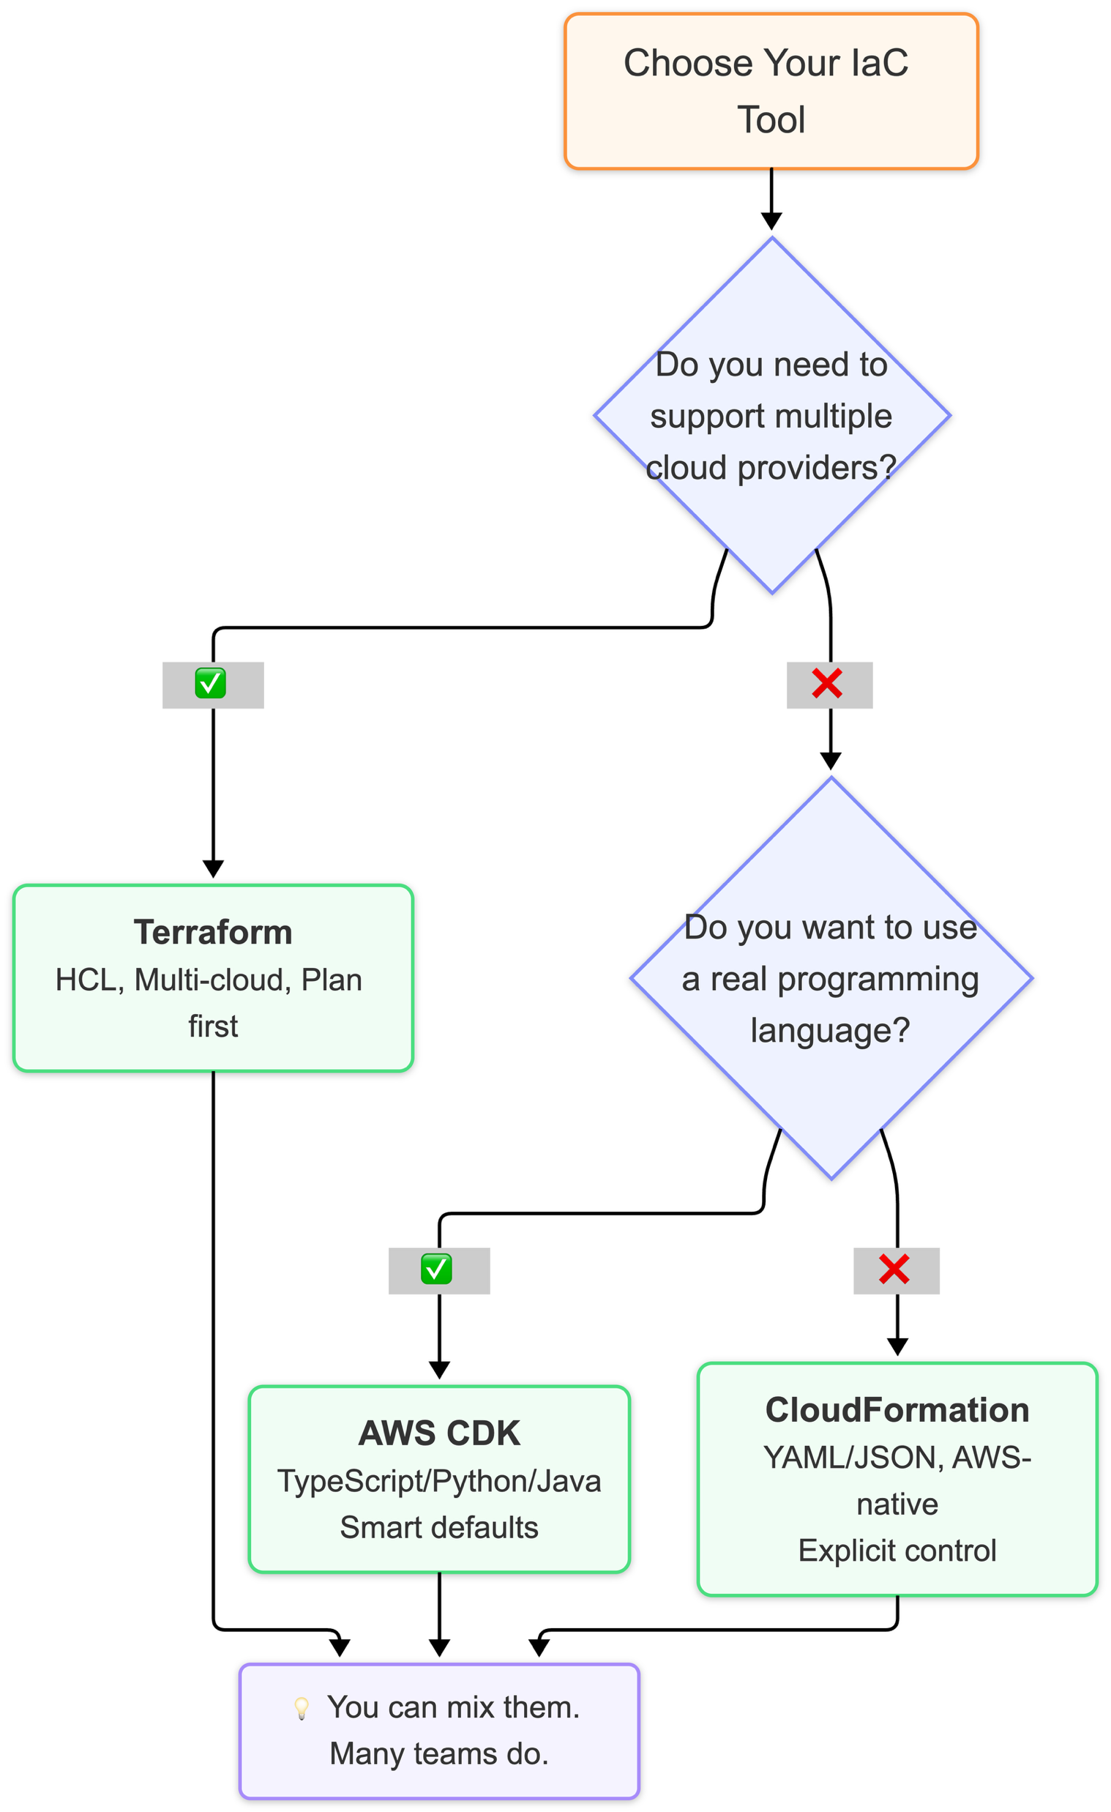
Which one should I pick?
Notes:
The question I always get: which one should I pick? Here's my honest answer. If you're comfortable with YAML and want minimal tooling, CloudFormation works great.
If you're a developer who wants loops, types, and IDE support, CDK will feel like home.
If you're multi-cloud or your team already uses Terraform elsewhere, stick with Terraform. And here's a secret — many teams use more than one. CDK for app infrastructure, Terraform for shared platform stuff.
There's no rule that says you pick one forever.

Slide 25
Demo with Kiro
Using Kiro to generate & deploy:
CloudFormation → CDK → Terraform
Notes:
Alright, demo time. I'm going to create the same infrastructure three ways — but I'm not writing code from scratch. I'm using Kiro, an AI-powered IDE from AWS. You describe what you want in natural language, Kiro generates the code, and you deploy it right from the same environment. Think of it as pair programming with an AI that knows AWS. Let me switch over.

Slide 26
CloudFormation + Kiro
“Create a CloudFormation template with an S3 bucket and a Lambda function”
Notes:
Okay, I have Kiro open. I'll prompt: "Create a CloudFormation template with an S3 bucket and a Lambda function with Python 3.12 runtime that returns Hello from CFN." There — full YAML template generated. Bucket, Lambda, IAM role, permissions — all correct. I didn't have to remember the resource type syntax or the role trust policy. Now I'll ask Kiro to deploy it. It runs the CLI command in the integrated terminal. Stack created. Prompt to deployed in under a minute.

Slide 27
CDK + Kiro
"Create a CDK stack with an S3 bucket and a Lambda function"
Notes:
Same task, CDK. Prompt: "Create a CDK stack in TypeScript with an S3 bucket and a Lambda function that returns Hello from CDK." Notice how much shorter the generated code is — Kiro knows CDK conventions, uses high-level constructs, skips what CDK handles automatically. The IAM role? Implicit. Type safety? Built in. "Deploy this CDK stack." Kiro runs `cdk deploy`, synthesizes to CloudFormation, deploys. Same result, less code, guardrails included.

Slide 28
Terraform + Kiro
"Create Terraform config with an S3 bucket and a Lambda function"
Notes:
Finally, Terraform. Same prompt pattern: "Create a Terraform configuration with an S3 bucket and a Lambda function." Kiro generates the HCL — and it's more explicit: IAM role, policy attachment, provider block all included. Kiro knows Terraform requires these. "Run terraform plan." Look — 4 resources will be created, nothing happened yet. "Run terraform apply." Done.
Same task, three tools, all generated and deployed through Kiro. You saw the differences in verbosity, explicitness, and workflow — but in every case, Kiro handled the syntax so you could focus on what you actually need built.

Slide 29
IaC = your dev workflow applied to infrastructure
CloudFormation = declarative YAML, AWS-native
CDK = your language, smart defaults
Terraform = multi-cloud, plan-before-apply
Start with any one. You can't go wrong.
Notes:
Let's wrap up. You already have the skills for this — version control, code review, automation — that's IaC. CloudFormation gives you a solid AWS-native foundation. CDK lets you use the language you already love. Terraform gives you multi-cloud flexibility.
And tools like Kiro accelerate your inner development loop — you describe what you need, get working IaC code, and validate it by deploying to a dev or sandbox account in seconds.
Once it works, you commit it and let your CI/CD pipeline handle staging and production with proper reviews and gates.
Kiro gets you to "ready to commit" faster — it doesn't replace your deployment pipeline.
Pick whichever IaC tool feels natural, start small, and you'll never want to go back to clicking.

Slide 30

Jatin Mehrotra
Notes:
Thank you, Always feel free to reach out to me on linkedin if you are stuck, would be happy to help

