Slide 1
Our team members
Harshdeep Singh UE223035
Jashanpreet Singh UE223045
Jatin Dhiman UE223047
Khushmita Kapoor UE223051
Maitri UE223056

Slide 2
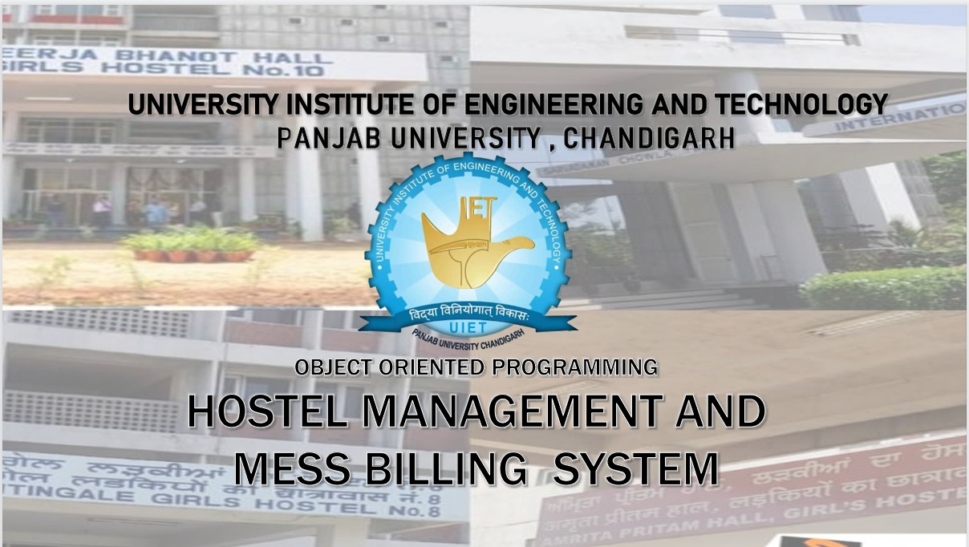


OBJECT ORIENTED PROGRAMMING
HOSTEL AND MESS BILLIING MANAGEMENT SYSTEM

Slide 3
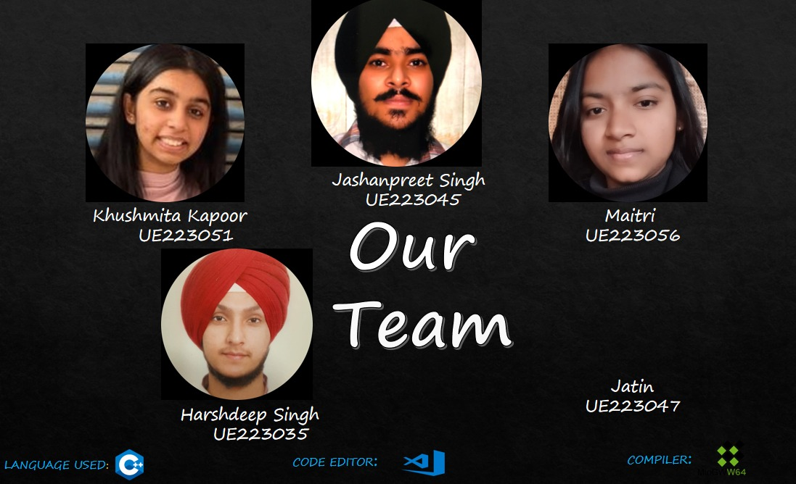


Slide 4
WHY HOSTEL MANAGEMENT AND MESS BILLING SYSTEM ?
To Avoid a Lot of Paper work
To Be Time Efficient
To Give Complete and Correct Information regarding mess and other facilities at hostel
To Avoid Confusions Related to Mess and Canteen Bills

Slide 5
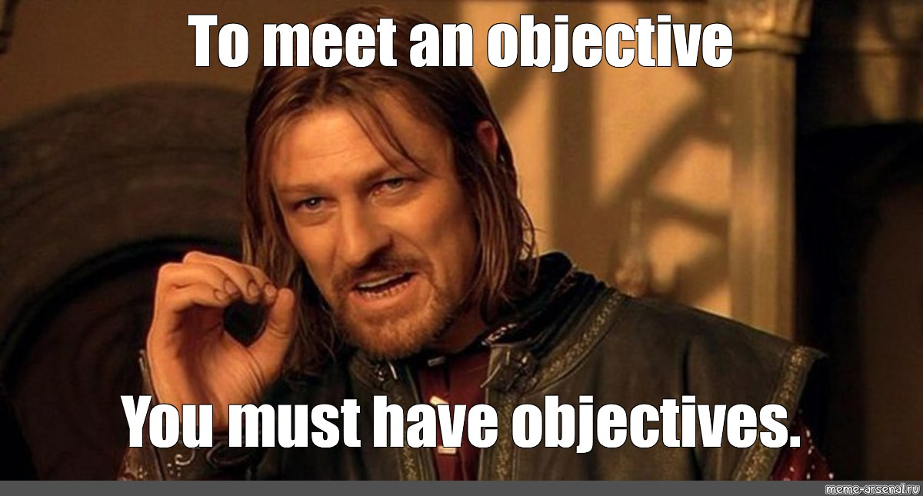
OBJECTIVES OF OUR PROJECT:
Automization of mess Bills
Registration of New Candidates
Maintenance of Records
Providing Info Related to Mess and Other Facilities
Minimizing Errors

Slide 6
Concepts Used
File Handling
Inheritance
MAIN Concepts
Exception Handling
IOS functions and Manipulators
Static Functions

Slide 7
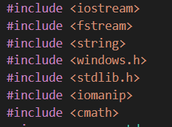
Here is the list of all the header files we have used in our program

Slide 8


We have made the home page of our Project using a default constructor of class software

Slide 9
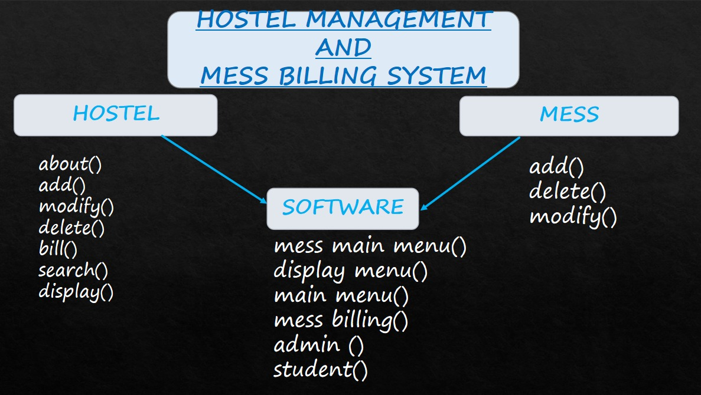

Slide 10


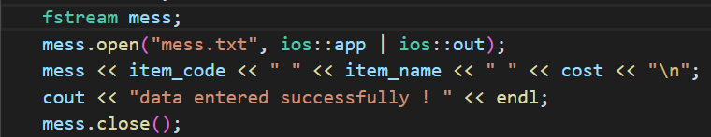
Pure virtual function(in student and hostel class)
Multiple inheritance
File Handling (Writing in a file)

Slide 11
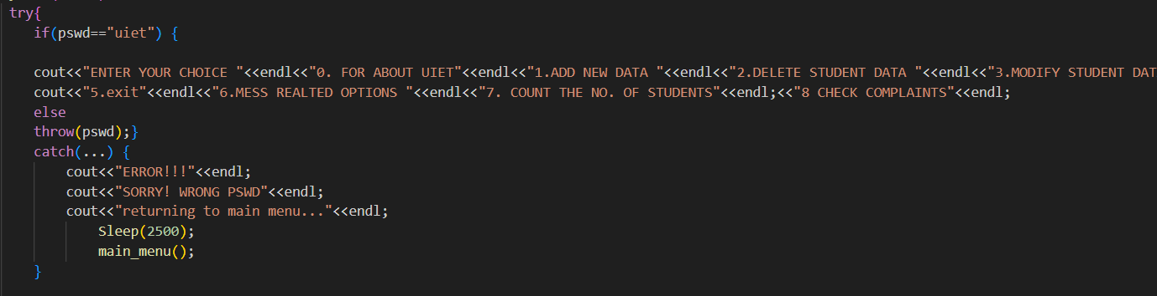

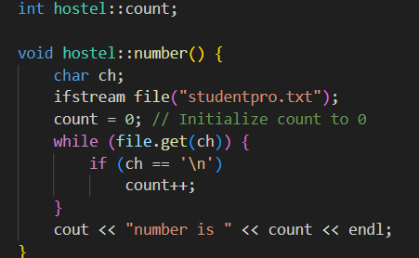
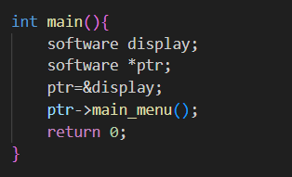
Exception Handling
Ios Functions and Manipulators
Static Function
Pointer
.

Slide 12


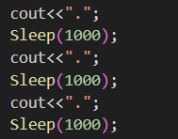

.
Extra functions
Friend functions
Static Binding
.

Slide 13
CLASS HOSTEL
CLASS MESS
CLASS SOFTWARE

Slide 14
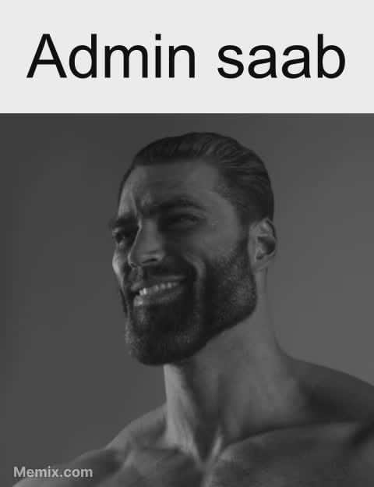
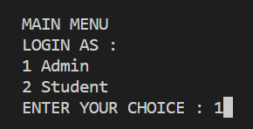
Admin Section
Admin is member function of class Software
Admin function called

Slide 15
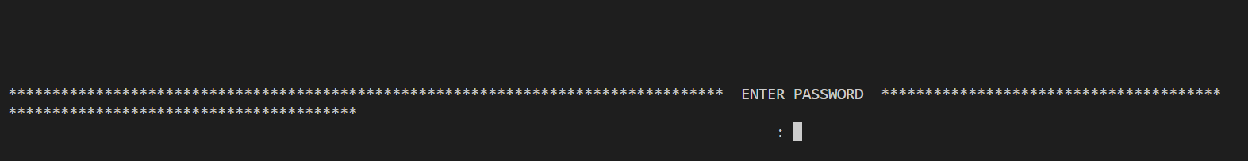

ENTER THE PASSWORD FOR LOGGING IN AS ADMIN
IF ThE PASSWORD ENTERED IS WRONG THIS IS WHAT HAPPENS:

Slide 16
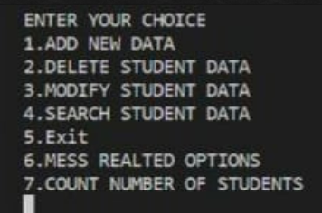
.
Admin Interface
MAIN FEATURES :
Add New Data
Modify Student Data
Search Student Data

Slide 17
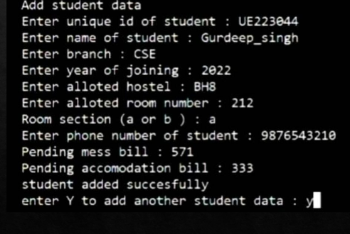
Add Student Data
We can add New student using add student data option
Admin need to enter ID, Name, Branch, Year of joining, Allotted hostel,Alloted room number, Room Section, Phone number.
.

Slide 18

Delete Student data
.

Slide 19
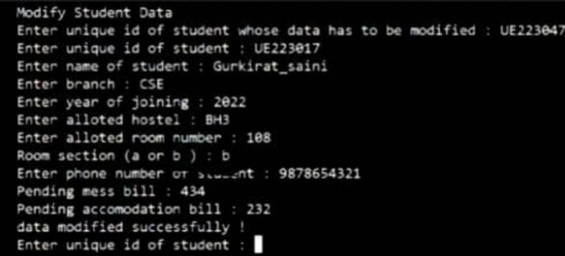
Modify Student data
,

Slide 20
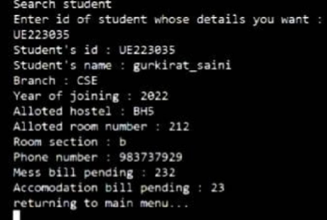
Search Student data
.

Slide 21

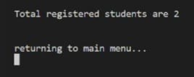
Count number of students
We have used the concept of Static member function to count the number of the students
.

Slide 22


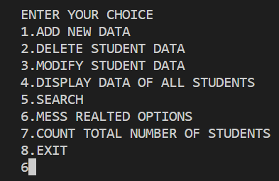
Mess Section
We have called the mess section in a switch case while defining the admin function which is a member function of class software
MESS SECTION

Slide 23
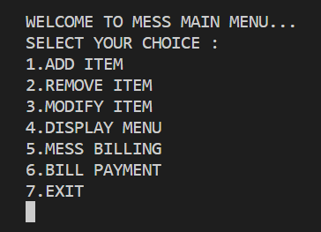
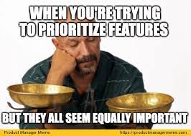
ADMIN INTERFACE OF MESS

Slide 24
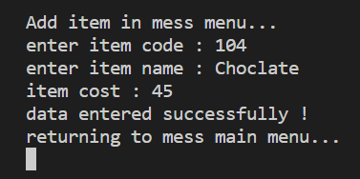
Add Item

Slide 25
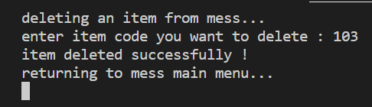
Remove Item

Slide 26
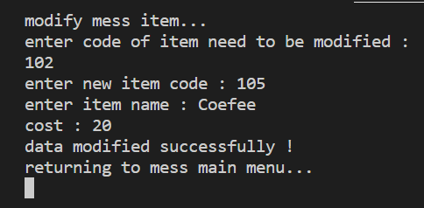
Modify Item

Slide 27
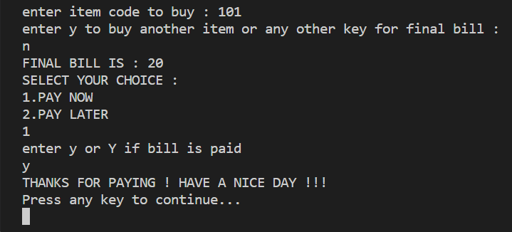
Mess Billing

Slide 28
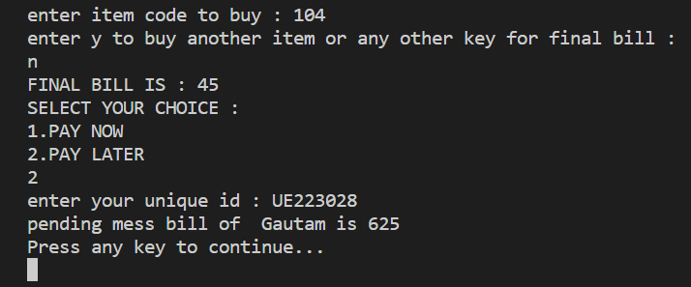
Mess Billing

Slide 29
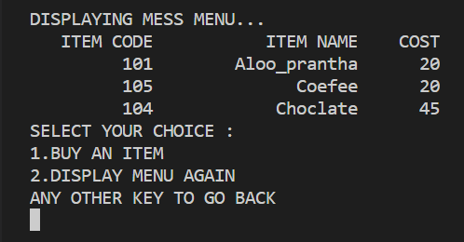
Display Menu

Slide 30
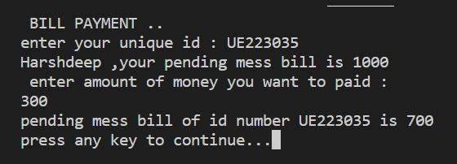
Bill Payment

Slide 31

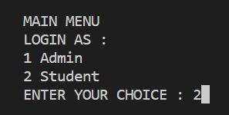
Student Section
Student is a member function of a class software which is inherited from two base classes Hostel and mess publicly.
STUDENT FUNCTION Invoked

Slide 32
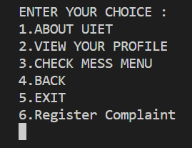
MAIN FEATURES :
View your Profile
Check mess menu
Register complaint
STUDENT INTERFACE

Slide 33

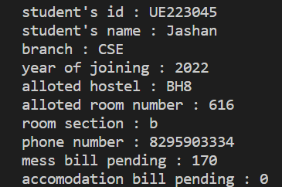
View your profile
Student need to enter their id to view their profile
If ID matches our record Student profile will be displayed !!
Student can also Request the admin to modify their profile

Slide 34
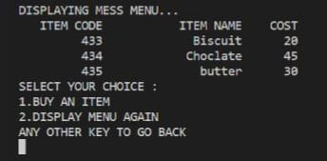
Check Mess Menu
Students can the check menu added by the admin and buy the item accordingly..
Students can also opt the regular menu for lunch, breakfast etc. with a certain Item code 🙂👍

Slide 35
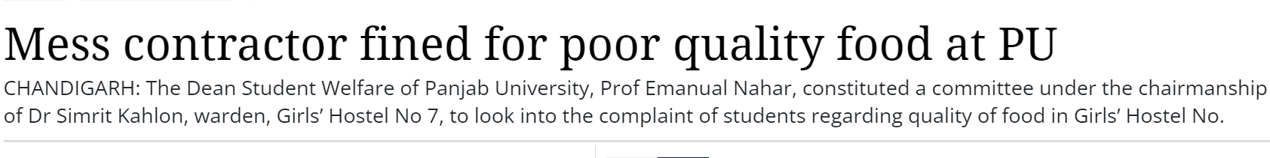
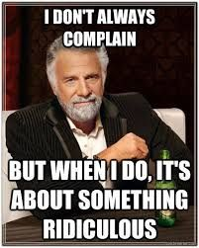
Register Complaint
jan 18, 2018 01:46 AM (IST)
To keep the quality of food in check and to hear, to the complaints of the students we have a “Register complaint ” option.

Slide 36
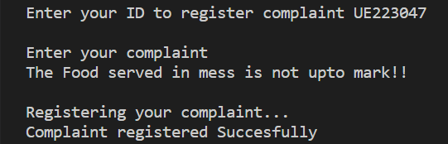
Students can register their complaints by entering their ID.
Complaints can be Mess related or anything regarding hostel

Slide 37

Complaint done vro

