Slide 1
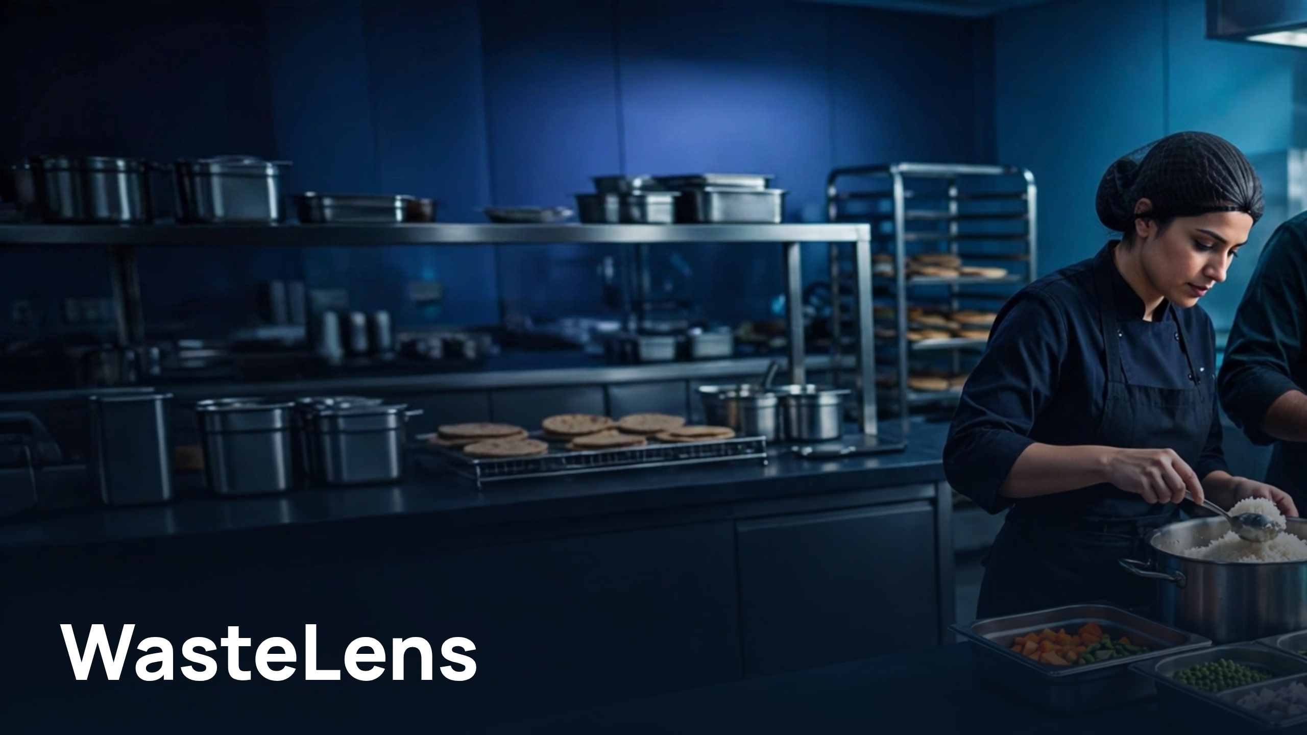
Notes:
WasteLens

Slide 2
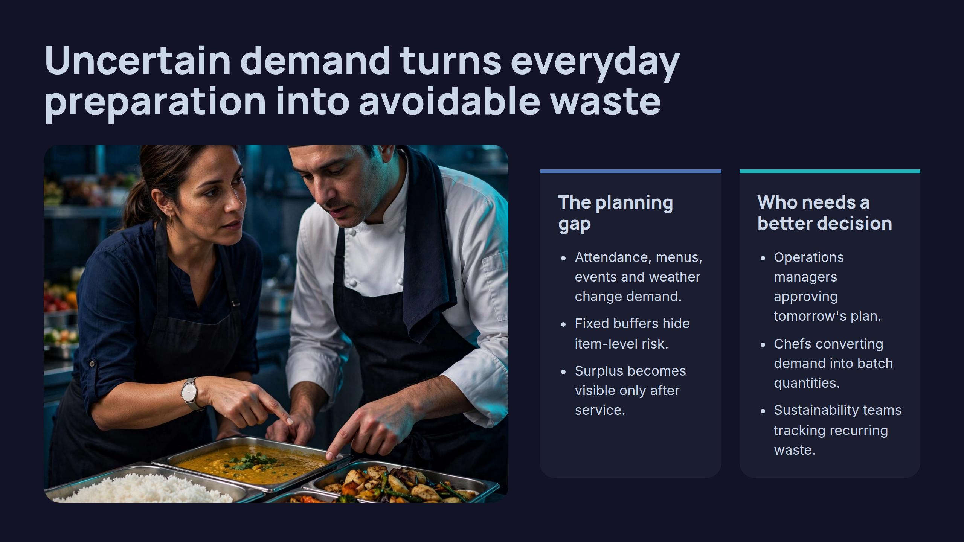
Notes:
Uncertain demand turns everyday preparation into avoidable waste

Slide 3
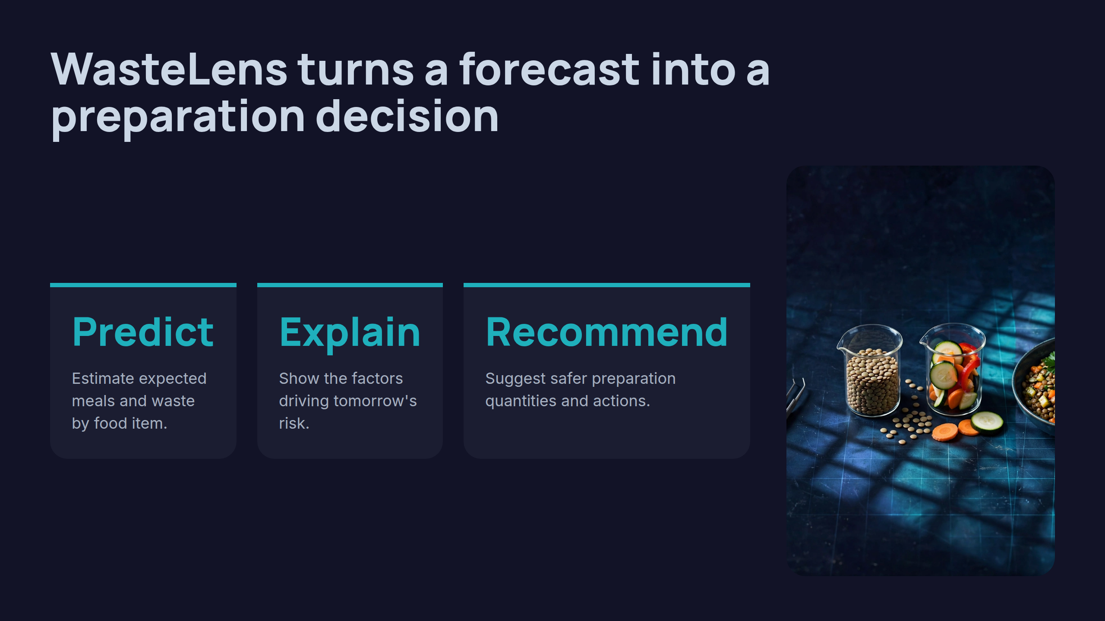
Notes:
WasteLens turns a forecast into a preparation decision

Slide 4
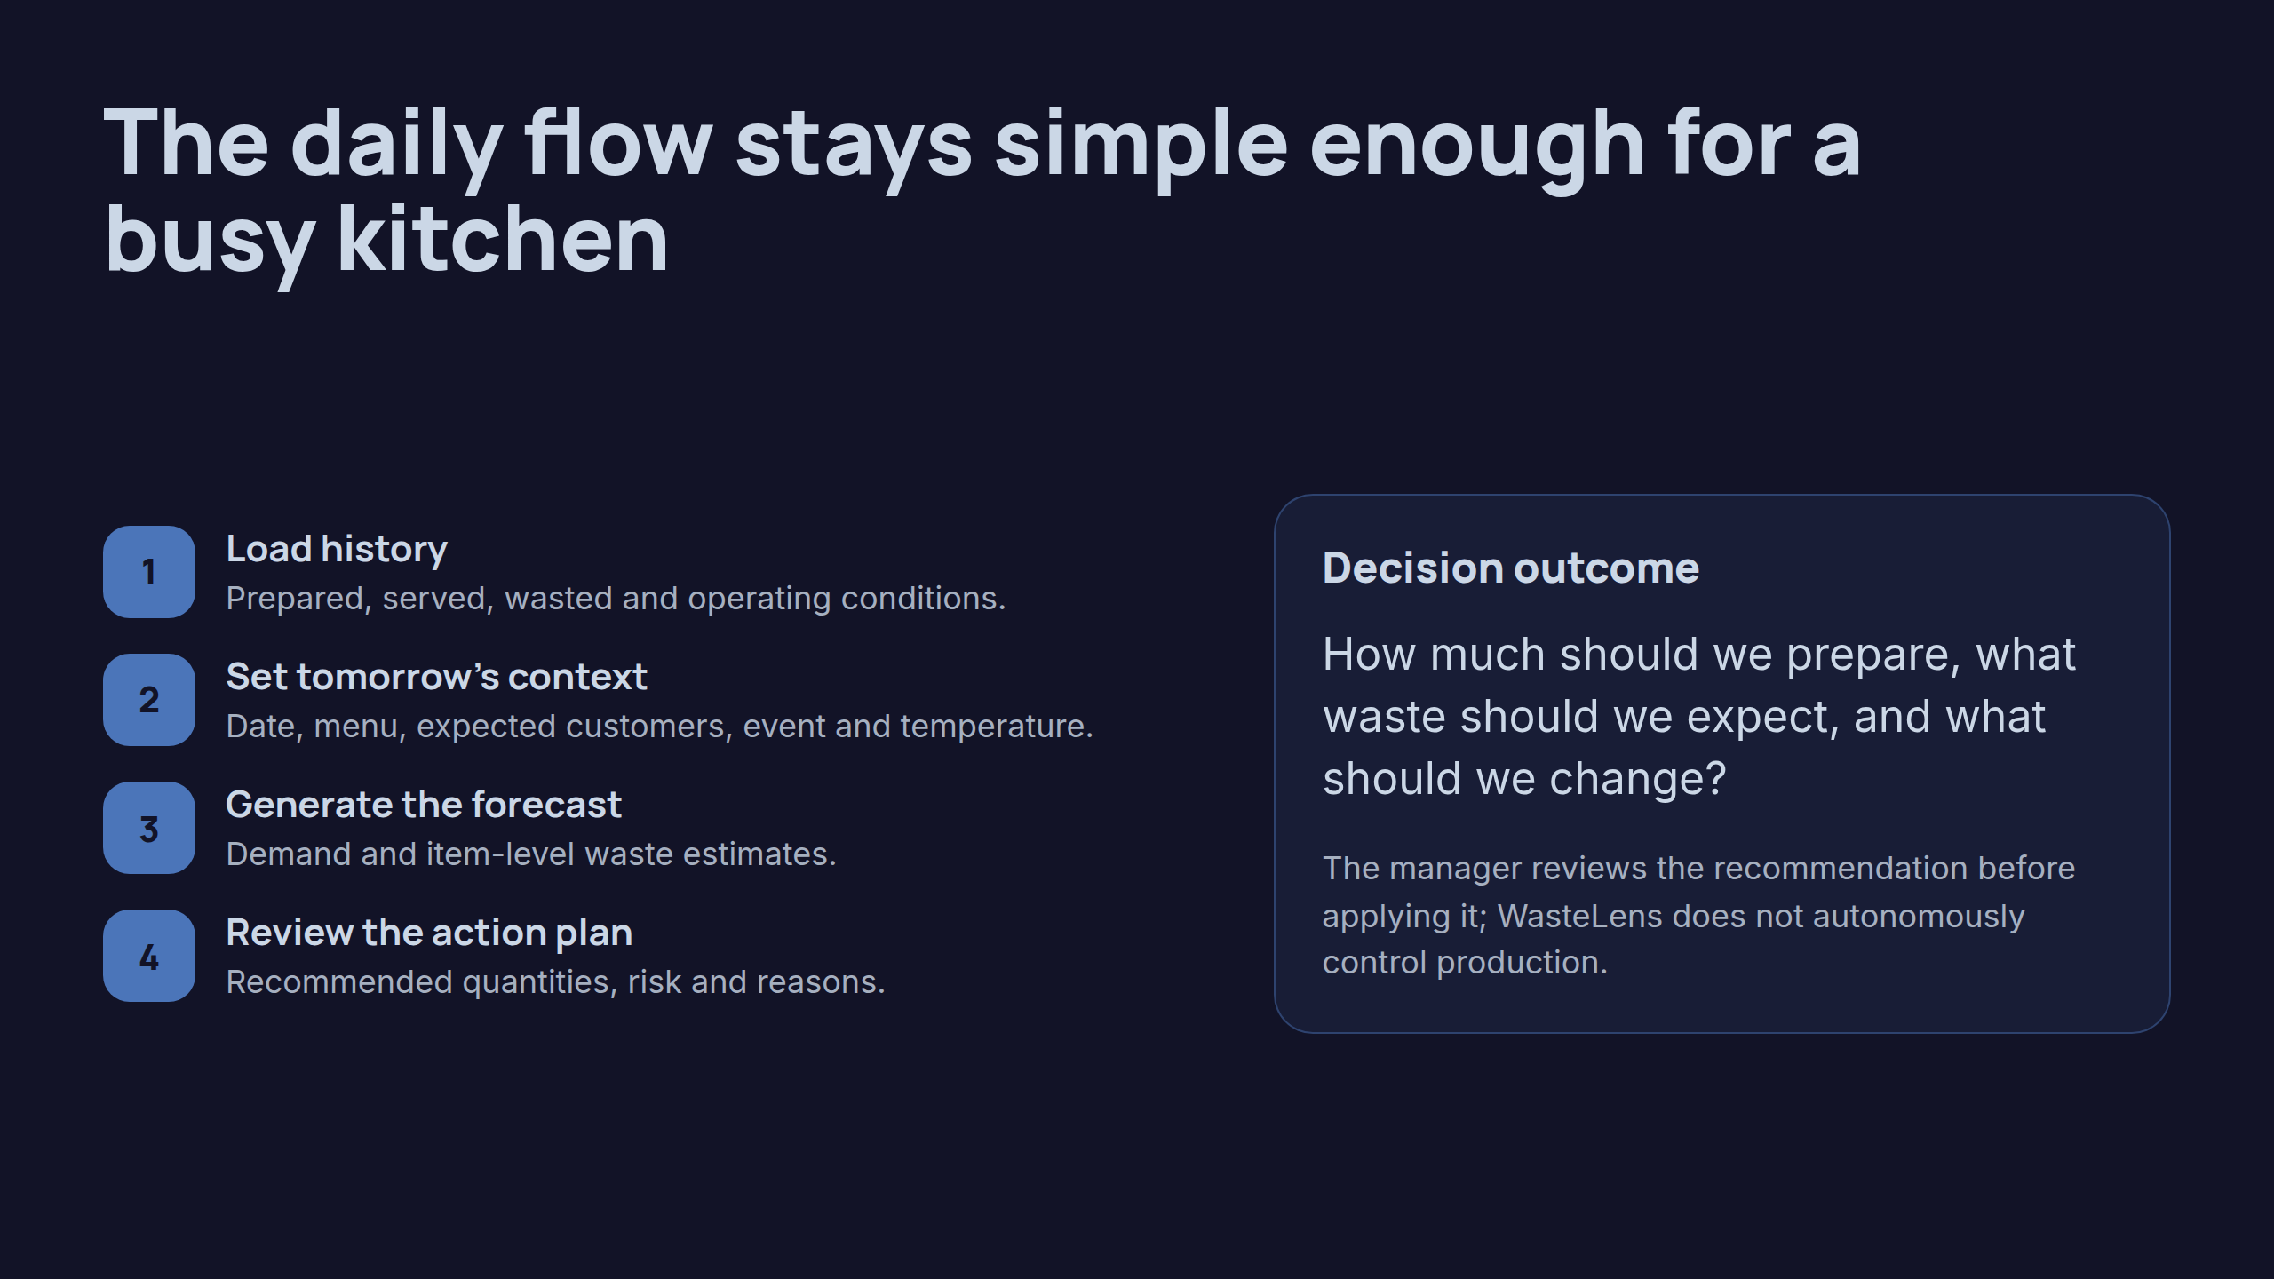
Notes:
The daily flow stays simple enough for a busy kitchen

Slide 5
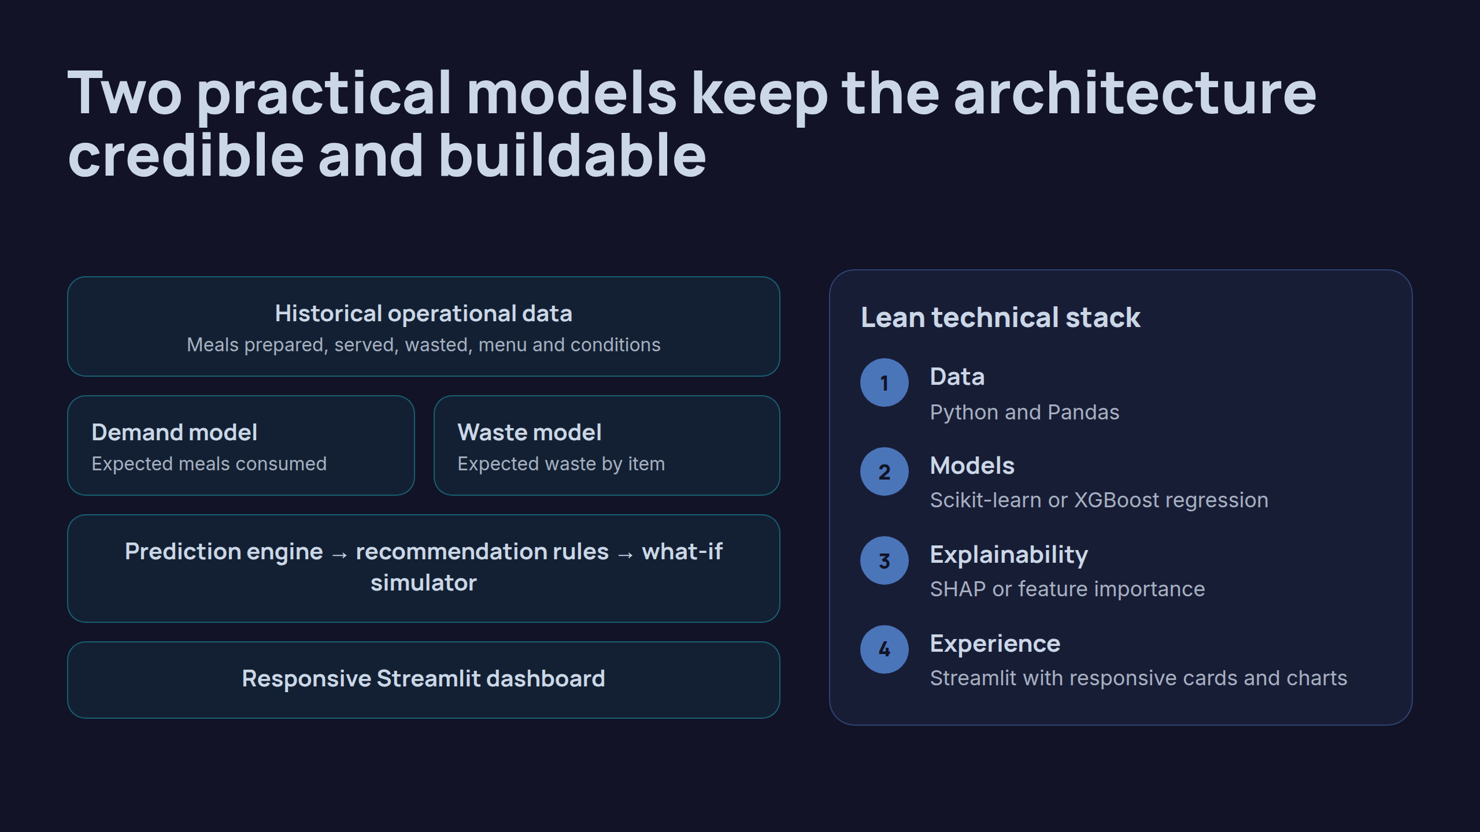
Notes:
Two practical models keep the architecture credible and buildable

Slide 6
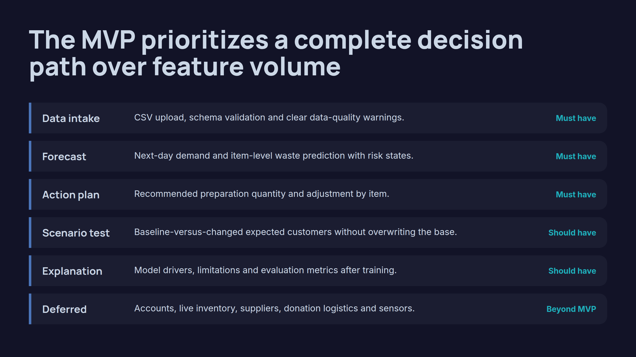
Notes:
The MVP prioritizes a complete decision path over feature volume

Slide 7
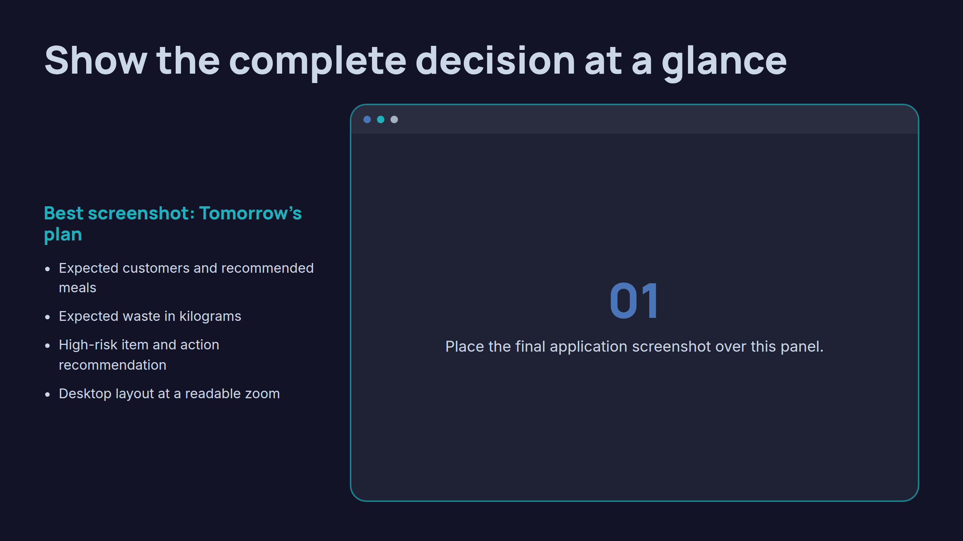
Notes:
Show the complete decision at a glance

Slide 8
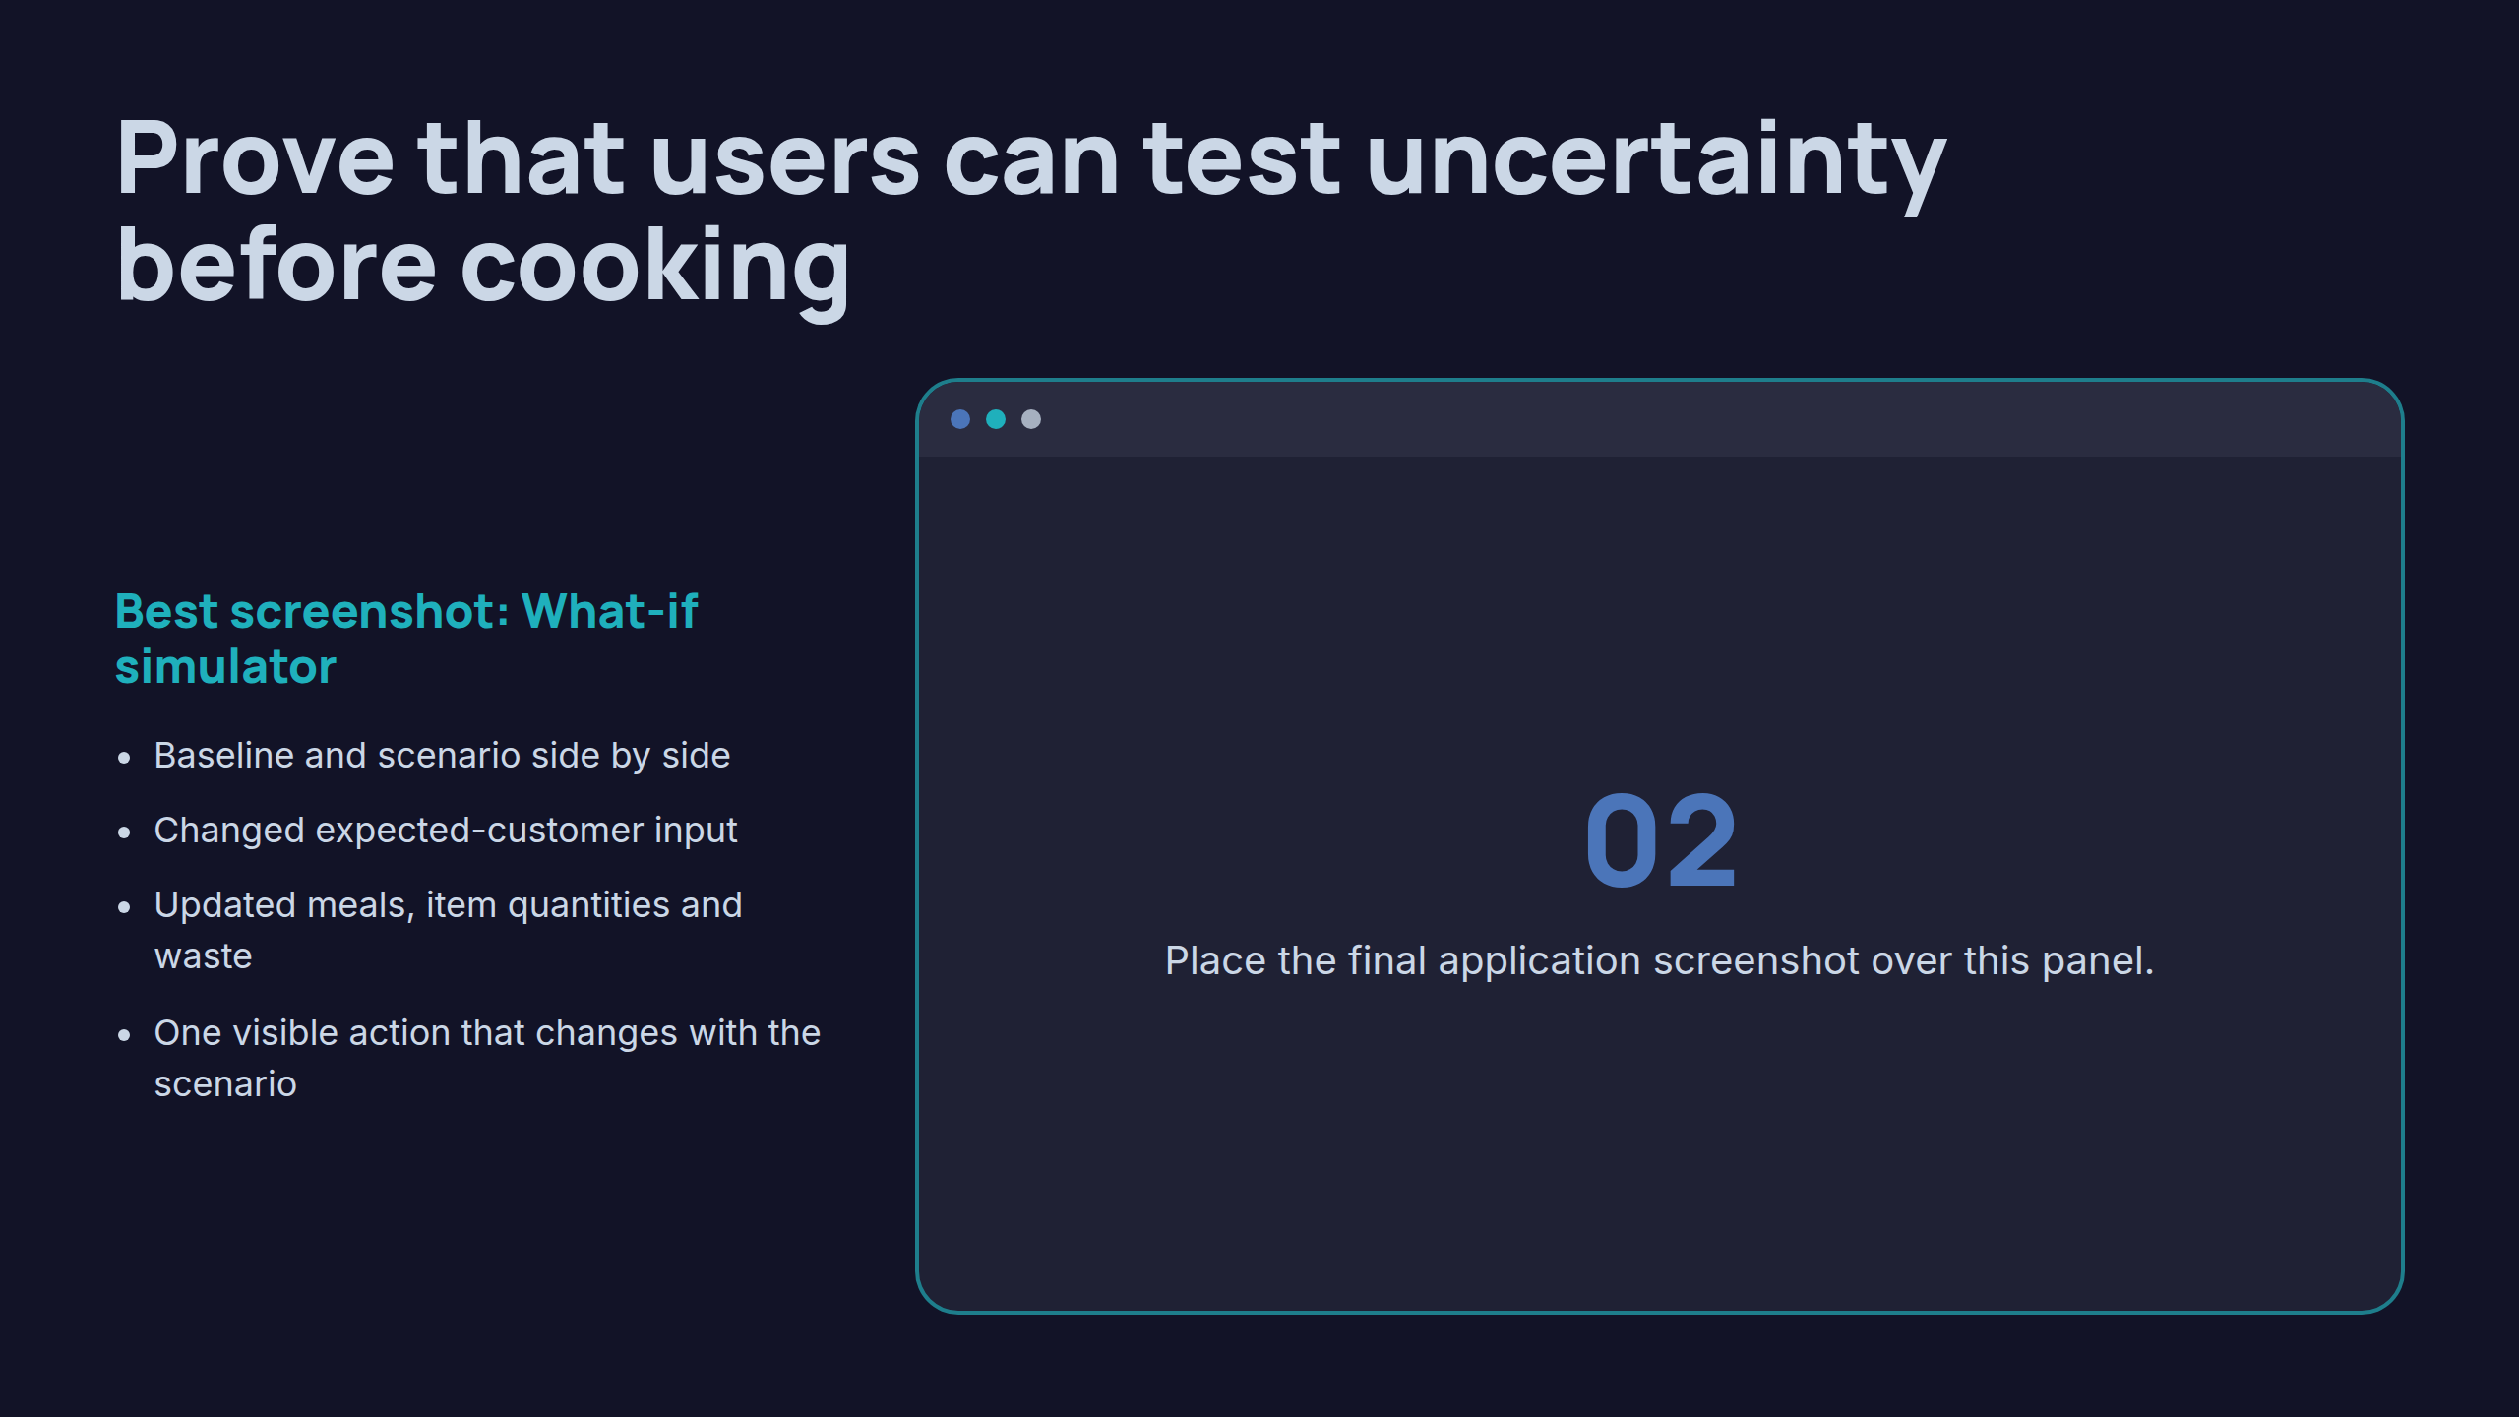
Notes:
Prove that users can test uncertainty before cooking

Slide 9
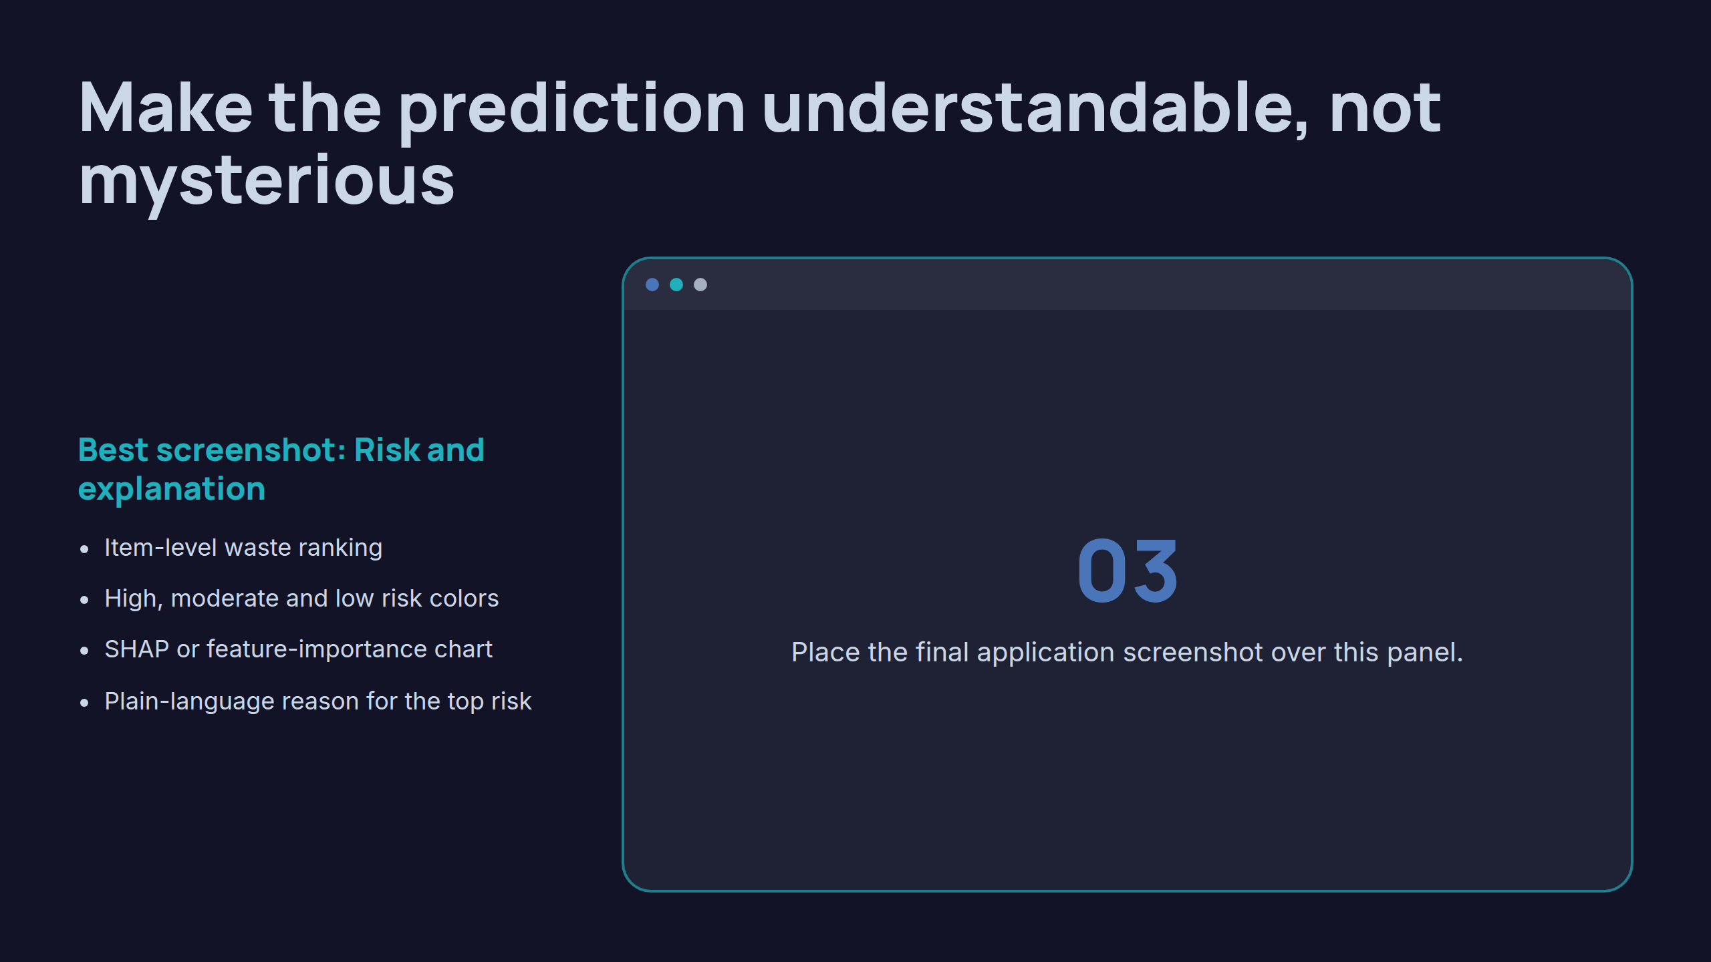
Notes:
Make the prediction understandable, not mysterious

Slide 10
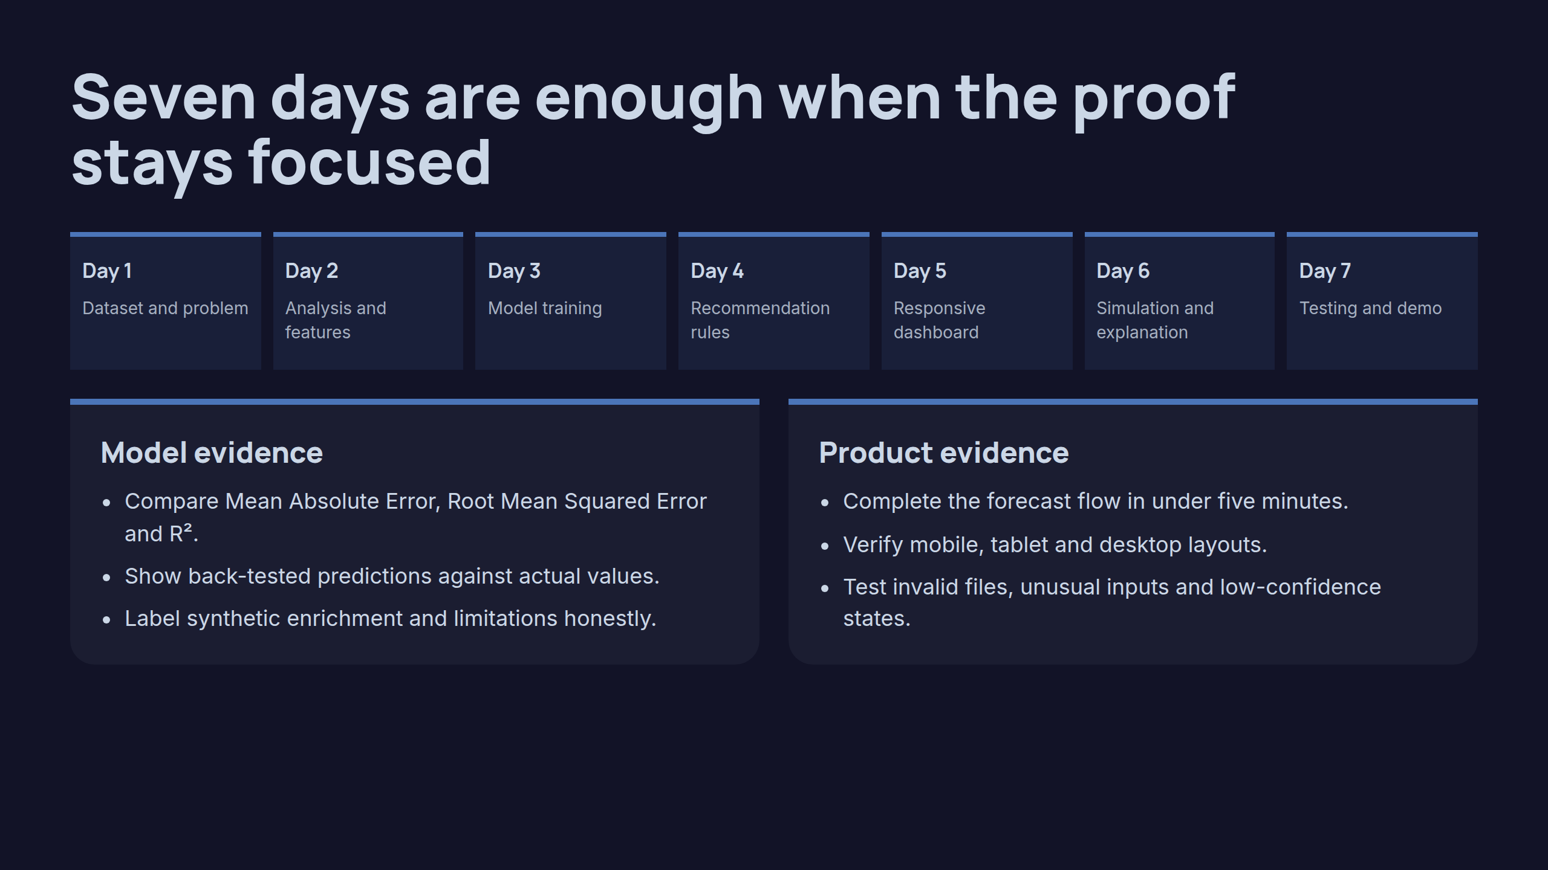
Notes:
Seven days are enough when the proof stays focused

Slide 11

Notes:
Thank you

