Slide 1
Brain Tumor Detection Model
Jatinpreet Singh 229310178
3A AIML
NAME OF SUPERVISOR : MR. SAURABH RANJAN SRIVASTAVA

Slide 2
Outlines
INTRODUCTION
LITERATURE
METHODOLOGY
DIAGRAMS
PROPOSED METHODOLOGY
RESULTS & DISCUSSION
CONCLUSION
REFRENCES

Slide 3
Introduction
Revolutionizing Healthcare with Brain Tumor Detection
A web integrated app powered by Gradio on which a patient can upload a picture of their Brain CT scan and get result regarding the Tumor.
With the help of TensorFlow’s Transfer Learning we can leverage the power of state of the art models and use it for our benefits.
And with help of Gradio we can create web integrated app for our model.
The significance of early detection in brain tumor cases:
Early Detection of brain tumor is important and can help save a patient’s life and help them from financial crisis.

Slide 4
Literature
EfficientNet: Rethinking Model Scaling for Convolutional Neural Networks Authors: Mingxing Tan, Quoc V. Le Published in: arXiv, 2019 Discusses the EfficientNet architecture, which is widely used for image classification tasks. You can refer to this paper to explain the architecture you adopted in your model.
Transfer Learning with Convolutional Neural Networks for Brain Tumor Classification Authors: Tanvi Verma, Avinash Sharma, and V. S. Tripathi Published in: Procedia Computer Science, 2018 Provides insights into the application of transfer learning in brain tumor classification, which can support your model's approach.
Gradio: Hassle-Free Sharing and Testing of ML Models in the Wild Authors: Abubakar Abid, Aaradhya Goel, et al. Published in: arXiv, 2021 Introduces Gradio as a tool for deploying machine learning models in web applications. You can reference this paper when discussing the integration of Gradio into your model's web application.

Slide 5
DEMAND ANALYSIS: The demand for brain tumor detection is high and is expected to grow in the coming years.
The increasing prevalence of brain tumors. According to the American Cancer Society, there were an estimated 24,850 new cases of primary brain tumors and 18,730 deaths from brain tumors in the United States in 2023.
(source https://www.cancer.net/cancer-types/brain-tumor/statistics)
So there needs to be a web app used to detect the brain tumor based on the ct scan so that it can help people globally and that too free of cost .
(*NOT TO BE REPLACED BY PERSONAL MEDICAL HELP AND SUPPORT , THIS WEB APP IS USED ONLY FOR GIVING A REFERENCE TO PATIENTS)

Slide 6
Feasibility Analysis: It would be easily available to the public without any cost so it is quite feasible. Manpower Analysis: Can be done and implemented by a single person. Technical Analysis: Any modern PC/Mobile with decent processor and a good internet connection to upload pictures.
Financial Analysis: This project requires no financial investment for development at small scale , but for a larger scale financial investment might be required to access data center / cloud based GPUs. Requirement Analysis: Requirements for development includes a skilled Machine Learning / Deep Learning developer, google colab to create the project , and a PC.

Slide 7
Methodology
Introduction: Our project aims to revolutionize healthcare through the early detection of brain tumors.
Data Collection: Used Kaggle for data collection , it contained MRI data and images were already split into training and testing data. It has four subfloders (https://www.kaggle.com/datasets/sartajbhuvaji/brain-tumor-classification-mri)
Data Preprocessing: The dataset was already in training/testing format and since we were using EfficientNet Models for training no need for preprocessing images.
Model Development: Model Architecture: We adopted the state-of-the-art EfficientNet model for feature extraction.
Transfer Learning: Transfer learning was applied by feature extracting the pre-trained model for our specific task.
Model Training and Evaluation: Model Training: The model underwent training with categorical_crossentropy loss functions and Adam optimization.
Model Evaluation: Key evaluation metrics such as accuracy, Loss Curves were employed to assess the model's performance.

Slide 8
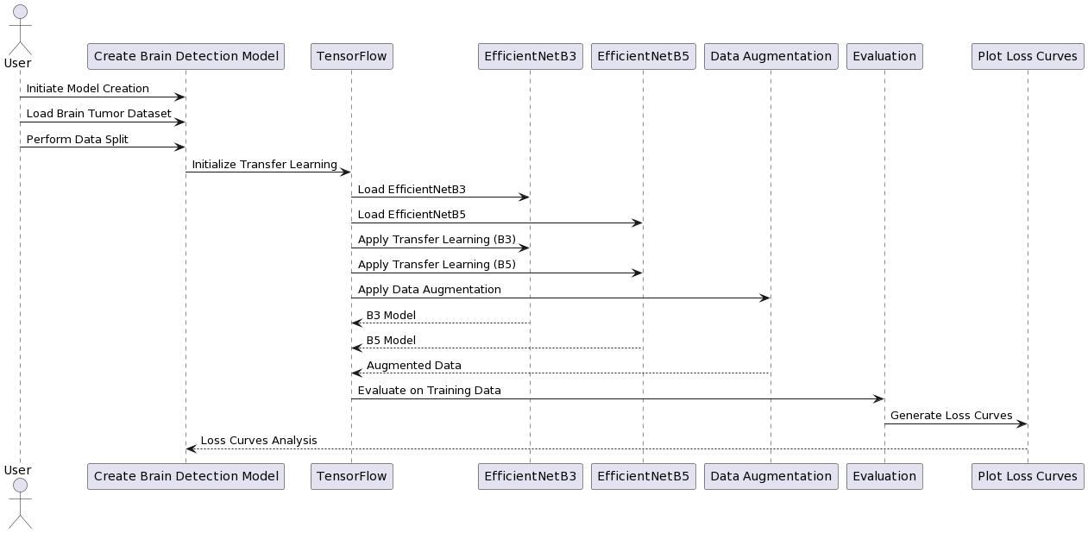
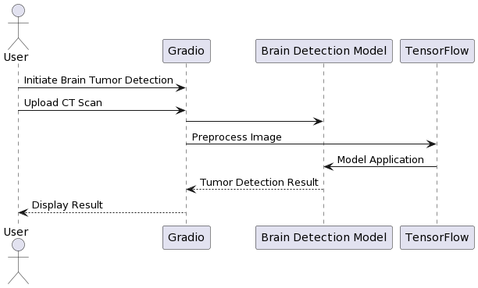
Sequence Diagram
MODEL CREATION SEQUENCE DIAGRAM
User Interaction Sequence Diagram

Slide 9
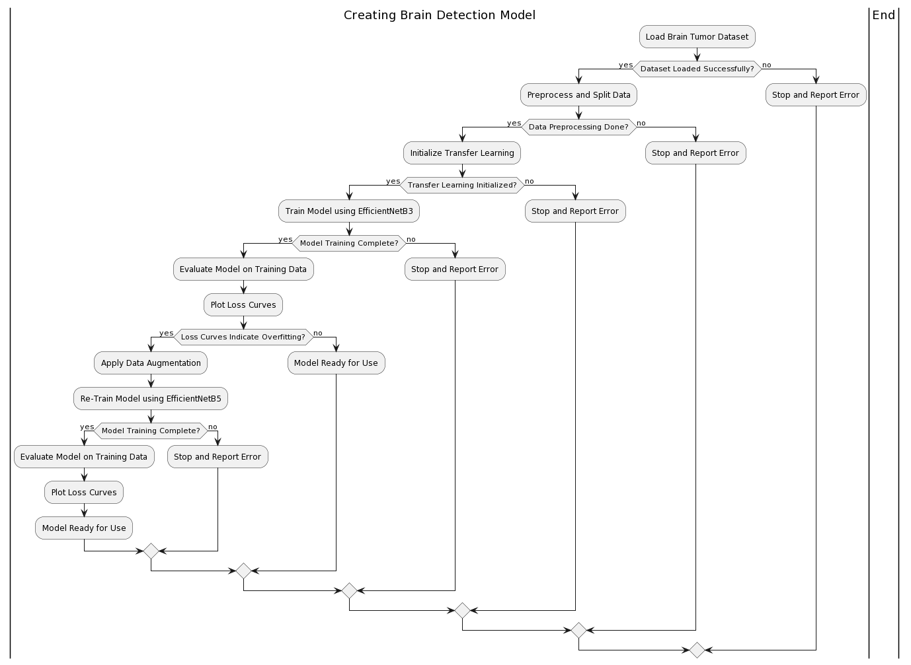
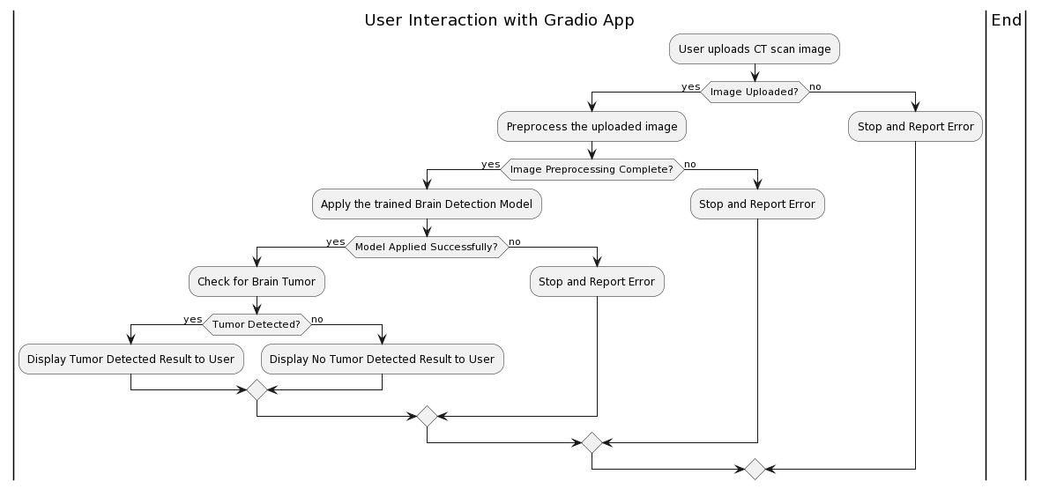
Activity Diagram
Model Creation Activity Diagram
User Interaction Activity Diagram

Slide 10
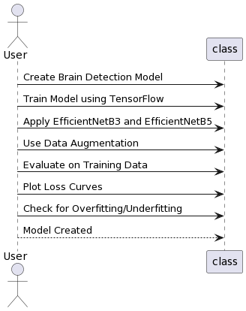
USE CASE DIAGRAM

Slide 11
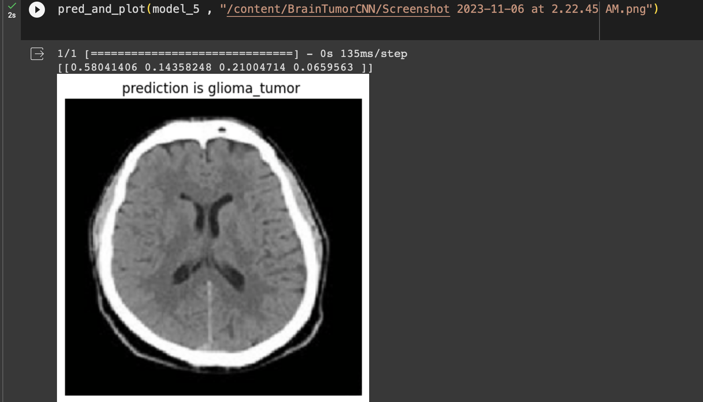
EXECUTABLE SNAPSHOT

Slide 12
Proposed Methodology
Introduction: Our research objective is to contribute to healthcare by enabling early brain tumor detection, a critical need in medical diagnostics.
Data Collection : The planned approach for data collection involves ensuring a diverse and representative dataset
Web Integration :The proposed methodology incorporates Gradio for user-friendly web-based model accessibility.
Conclusion : In summary, our proposed methodology sets the stage for a comprehensive project with the potential to revolutionize brain tumor detection in healthcare.
(*Not to be replaced by actual healthcare support)

Slide 13
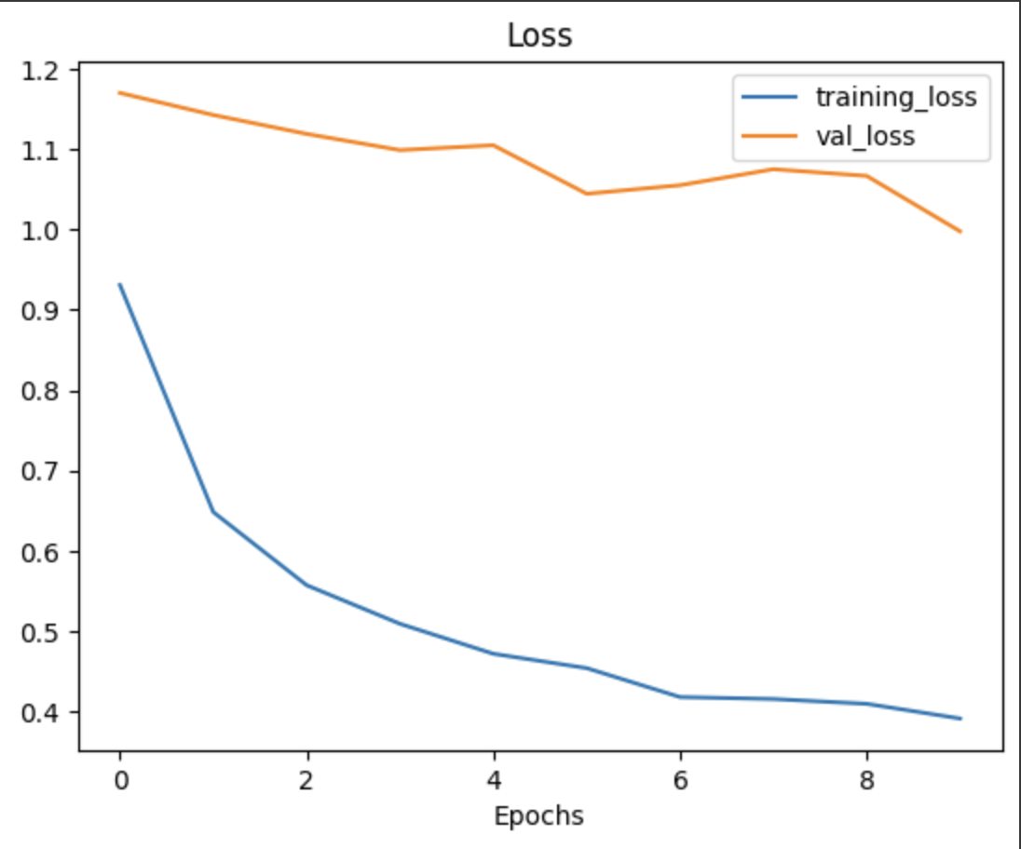
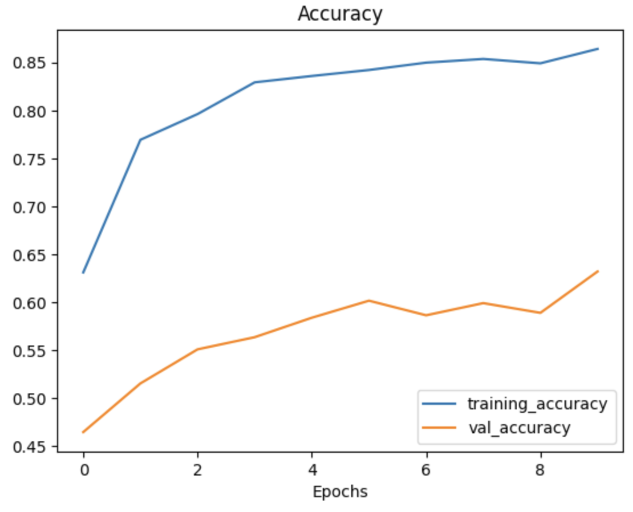
Results & Discussion
Key Results:
Highlight accuracy: The model achieved an average accuracy of 70% in detecting brain tumors.
Loss curve: Include a simplified ROC curve showing the model's performance.

Slide 14
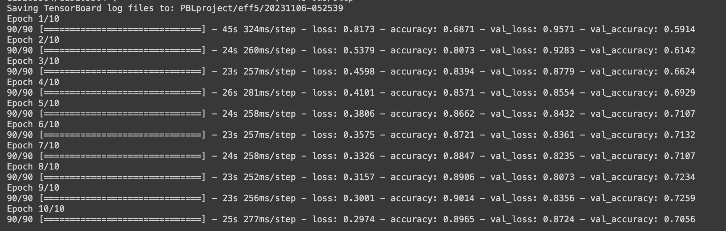
Results & Discussion
Clinical Significance: Early Diagnosis and Treatment, timely treatment can lead to better outcomes, including increased survival rates and improved quality of life for patients.. Plus free detection would help them save a lot money . It can also aid healthcare professionals in diagnosing brain tumors more efficiently.
Challenges and Future Directions: Dataset Limitations , Selecting the appropriate model. Web app would be created in future to integrate the model with website powered by Gradio to give easy access to patients.

Slide 15
Conclusion
Developed a brain tumor detection model using TensorFlow and transfer learning with EfficientNetB3 and EfficientNetB5, for enabling accurate early diagnosis from uploaded CT scan images through a Gradio web app interface.
Although a model can achieve good or even the greatest results, it should not be replaced by professional help/support.
THANK YOU

Slide 16
References
EfficientNet: Rethinking Model Scaling for Convolutional Neural Networks
Transfer Learning with Convolutional Neural Networks for Brain Tumor Classification
Chatgpt

