Slide 1
HEALTHCARE TECHNOLOGY
Online Healthcare
Management System
One secure platform for connected care, coordinated operations, and actionable insight.

Slide 2


THE OPERATING MODEL
One platform
for coordinated care
A shared workflow keeps every handoff visible.
Connect the care network
Cover the full journey
Patients, providers, administrators, and support teams work in one secure workflow.
Registration, appointments, clinical records, billing, communication, and reporting stay connected.

Slide 3

SYSTEM BLUEPRINT
Reference architecture
A layered platform separates user experience, orchestration, domain logic, data, and operational visibility.
01
02
03
Clients
Gateway
Services
Web and mobile portals
API routing and controls
Role-aware domain modules
04
Data
Stores and integrations
Authentication, observability, and reporting span the platform.

Slide 4



FROM EXPERIENCE TO CAPABILITY
Experience and service layers
The interface stays simple because the platform absorbs the operational complexity underneath.
Experience layer
Service layer
Workflow layer
Responsive portals for patients, doctors, staff, and administrators.
Identity, patient records, scheduling, encounters, prescriptions, labs, billing, notifications, and reporting.
Accessible workflows for high-frequency tasks, with clear validation and status.

Slide 5
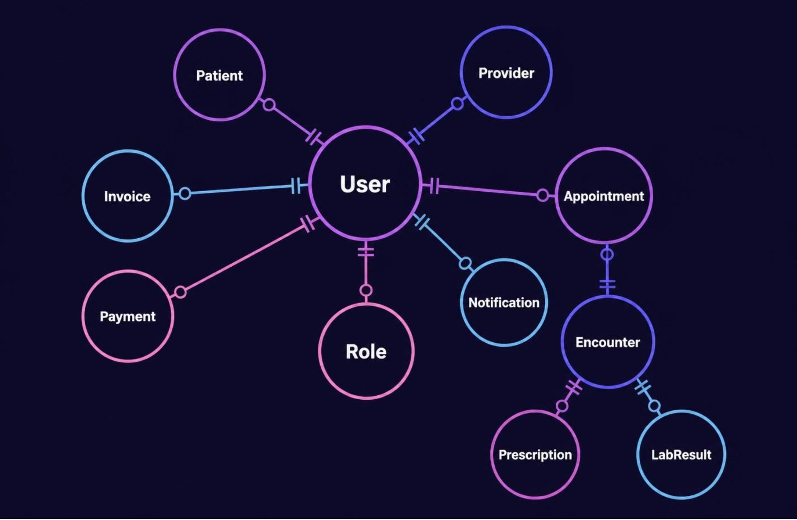
TRUSTED CLINICAL DATA
Data layer and database schema
Relational storage anchors core transactions. Object storage holds documents; cache and search keep common queries fast.
Every clinical action retains its author, timestamp, and status, creating a durable audit trail.
TRANSACTIONAL CORE
TRACEABLE ACTIONS

Slide 6





GUARDRAILS BY DESIGN
Security and governance
Protection is a set of operating controls, not a final-stage feature.
Least privilege
Protected data
Accountable operations
Role-based access control limits each user to the permissions their work requires.
Encryption in transit and at rest protects information across every layer.
Audit logs, consent tracking, session controls, backups, and recovery make actions reviewable.

Slide 7






ROLE-SPECIFIC CARE
Patient and doctor dashboards
PATIENT
DOCTOR
Manage the next step
See the clinical context
Appointments and reminders
Daily schedule and patient context
Medications and lab results
Encounter notes, history, allergies, and medications
Invoices, messages, and self-service
Results, prescriptions, and follow-up

Slide 8

OPERATIONAL CONTROL
Admin and staff dashboards
Operational roles need a wider field of view, with exceptions and queues visible before they become delays.
Govern the system
Move care forward
Users, roles, providers, departments, availability, operational metrics, audit events, and exceptions.
Registration, demographics, check-in, scheduling, queues, referrals, billing status, and communications.
Configuration · oversight · accountability
Intake · coordination · follow-through

Slide 9
ONE EVENT, MANY SIGNALS
From sign-in to insight
01
02
03
04
Authenticate
Load
Act
Learn
Authenticate and resolve role permissions
Load the role-specific dashboard
Complete a task through validated services
Persist the event, notify stakeholders, and surface reporting signals

Slide 10

DELIVER IN TRUSTED LAYERS
Implementation roadmap
Start with the shared foundation, expand into care operations, then harden the platform as adoption grows.
01
02
03
Foundation
Care operations
Scale and trust
Identity, patient records, scheduling, and core schema.
Encounters, prescriptions, labs, and dashboards.
Integrations, analytics, hardening, and continuous improvement.

