Slide 1
INVESTMENT ASSIGNMENT SUBMISSION
Name: Jatin Sharma
Email : jatinsharma7@gmail.com

Slide 2

Abstract
Purpose:
There are a lot of startup or business growth ideas today in industries. Many funding organizations are looking to invest money in some of these brilliant ideas to make money out of it by making right decisions about where to invest.
Spark Funds, an asset management company, is also looking to make investments in some of these high investment regions and business sectors.
This research will help Spark Funds, identify the companies for investment based on best sectors, countries, and a suitable investment type for making investments.
Assumption:
Spark Funds wants to invest where most other investors are investing.

Slide 3
Problem solving methodology
Start
A
Remove Outliers
Input
Rounds2
Companies
Input
Load Data
Load Data
Sector mapping
Identify top 3 countries (highest investment)
Data Preparation
Data Preparation
Data Preparation
Left merge rounds2
from companies
to master_frame
Left merge sectors to
Top9 dataset
Wikipedia
(English – Official language)
Filter for FT
(venture, seed, angel, private equity)
Find top 3 sectors for country C1
Find top 3 sectors for country C2
Find top 3 sectors for country C3
FT average = 5-15m$?
Data scraping & clean up
No
drop
Yes,
Venture
English Speaking countries
Inner merge English speaking countries to top9
Start
Filter for top 9 countries
(highest investments)
A

Slide 4
Investment Type Analysis
Datasets | Total records | Unique records
Companies | 66368 | 66368
Rounds2 | 114949 | 90247
Countries (English official) | 76 | 76
Sector mapping | 688 | 688
Statistics for Datasets considered for analysis (table on right) →
Total records
Unique records
Based on the datasets available, Investment type analysis was performed:
Clearly maximum number/count of investments are happening in funding round “Venture”.
Highest investments are seen in “Private Equity” however it doesn’t fall in Spark Funds investment range, followed by “Venture” (within range of 5-15m$) funding round types.
Investment Type | Seed | Angel | Venture | Private Equity
Investment count | 23603 | 4860 | 50228 | 1936
Average Investment (Million $) | 0.719817 | 0.958694 | 11.748949 | 73.308593

Slide 5
Country Analysis
There are total 76 countries where English is an Official language.
There are 38,433 number of investments that happened in these 76 countries with funding type “Venture” which are considered for analysis.
Top 9 countries with highest investments for “Venture” funding type are :
Based on the above analysis, top 3 countries with highest investment in “Venture” funding round type investments are:
United States (USA)
United Kingdom (GBR)
Canada (CAN)
Country | USA | GBR | CAN | IND | ISR | IRL | SGP | AUS | NZL
Investment amount (million $) | 2.158499e+11 | 1.142338e+10 | 6.756630 e+09 | 5.654659 e+09 | 5.393015 e+09 | 1.205988 e+09 | 1.119768 e+09 | 9.532580 e+08 | 2.323164 e+08

Slide 6
Sector Analysis
There are 688 unique sectors which were considered for analysis.
Primary sector was identified for each historical investment based on business rule:
First string before the vertical bar will be considered the primary sector.
E.g. If category list is EdTech | Education | Systems than primary sector is EdTech.
Lets see what are the top 3 sectors in top 3 countries (USA, GBR and CAN)
 | Sector 1 | Sector 1 Investment ($) | Investment count (Sector 1) | Sector 2 | Sector 2 Investment ($) | Investment count (Sector 2) | Sector 3 | Sector 3 Investment ($) | Investment count (Sector 3)
USA | Others | 2.632101 e+10 | 2950 | Social, Finance, Analytics, Advertising | 2.380738 e+10 | 2714 | Cleantech / Semiconductors | 2.163343 e+10 | 2350
GBR | Others | 1.283624 e+09 | 147 | Social, Finance, Analytics, Advertising | 1.163990 e+09 | 133 | Cleantech / Semiconductors | 1.089404 e+09 | 130
CAN | Cleantech / Semiconductors | 1.015888 e+09 | 112 | Others | 9.261380 e+08 | 109 | Social, Finance, Analytics, Advertising | 6.561431 e+08 | 78

Slide 7
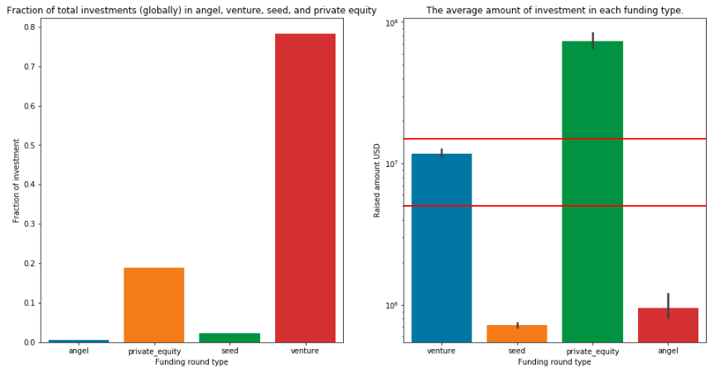
Results – Suitable Funding type (FT)
Spark Funds wants to invest 5-15 million USD.
Four FT are plotted against and fraction of total investments(left) and average investment amount (right).
Venture FT has the maximum fraction of total investments among all four funding types.
RED lines in the right plot shows the Spark Funds investment limits.
Average investments for each FT are clearly mentioned in right box plot.
Clearly “Venture” FT has average(50%) to 75% within Spark funds investment limits.
“Venture” FT is best suited for Spark funds.

Slide 8
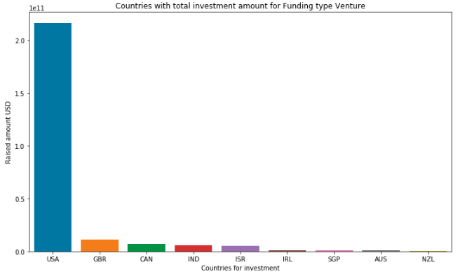
Results - Top 3 countries for Venture Funding Type
Top 9 countries are plotted against the total amount of investments of funding type Venture.
Clearly Top 3 countries which received maximum investments for Venture FT are:
United States of America (USA)
Great Britain (GBR)
Canada (CAN)
United States of America, Great Britain and Canada countries are best suited for investment by Spark Funds.

Slide 9
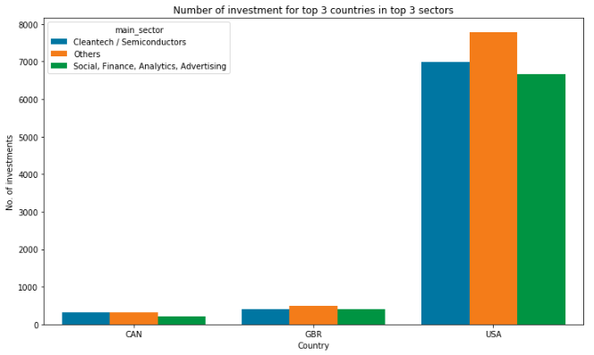
Results – Top 3 sectors of top 3 countries
Total number of investments is plotted in the top 3 sectors of the top 3 countries.
“Others” sector seems to have the highest total investments, however it may comprise of investments in many small sectors which are clearly not visible here.
We should NOT consider “Others” sector for Spark Funds.
Cleantech/Semiconductor sector has the 2nd highest total number of investments.
Social, Finance, Analytics , Advertising has 3rd highest total number of investments.
Difference between 2nd and 3rd highest investments is just 416.

Slide 10
Conclusions
Based on the Investment Type, Country and Sector analysis,
“Venture” funding round type is recommended to Spark Funds for investments between 5-15 million dollar.
Spark Funds should invest in United States of America (USA), Great Britain (GBR) and Canada (CAN) as these are the top 3 countries where most investments are happening.
Cleantech/Semiconductor sector is slightly ahead in total number of investments where as Social, Finance, Analytics , Advertising sector is slightly ahead in amount of investments.
Spark Funds can invest in any of Cleantech/Semiconductor Or Social, Finance, Analytics , Advertising sectors as both have nearly same number of investments and investment amounts.

