Slide 1
Design Review
MVRT

Slide 2
Robot Rumble
http://mvrt.com/?reboundrumble

Slide 3
Strategy
Get ourselves onto bridge
Shoot from fender
Greater accuracy
Go over the bump

Slide 4
Chassis
Goal: Get onto bump
How: Slant
Goal: Not beach
How: 10 4” wheels
Goal: Move fast and have torque (bridge)
How: Shifters
Problem: Balls beaching

Slide 5
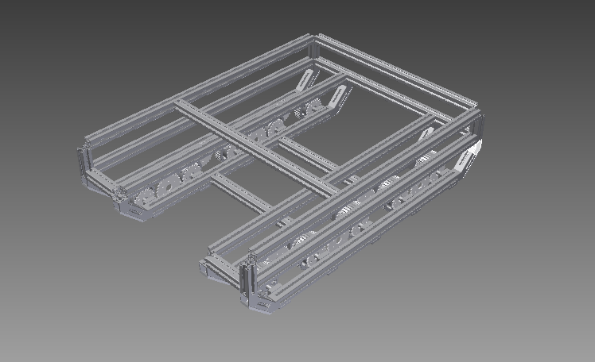
Chassis

Slide 6
Ball Collector
Goal: Adjustable range
How: One sided shooter
Goal: Picking up balls from the floor
How: Conveyor
Polycord
Roller – Pneumatic tubing
Problem: Timer

Slide 7
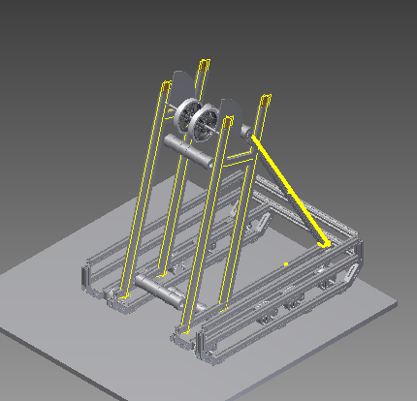
Ball Collector

Slide 8
Bridge Manipulator
Goal: Get ourselves on bridge
How: Simple manipulator
Goal: Possibly get others on
How: Drive onto the bridge to tilt
Ideas:
Wedge
Conveyor

Slide 9
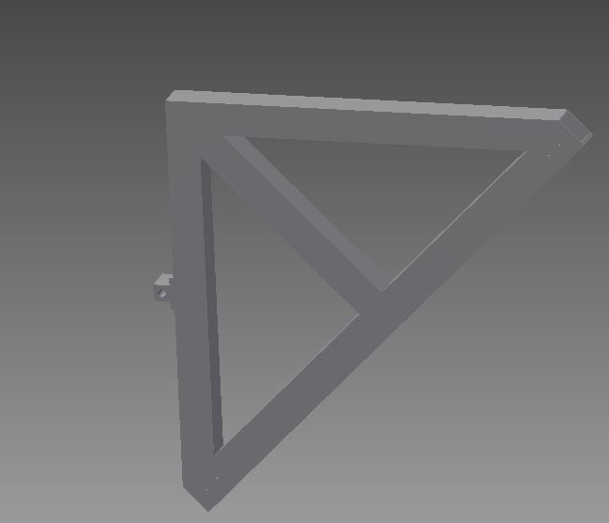
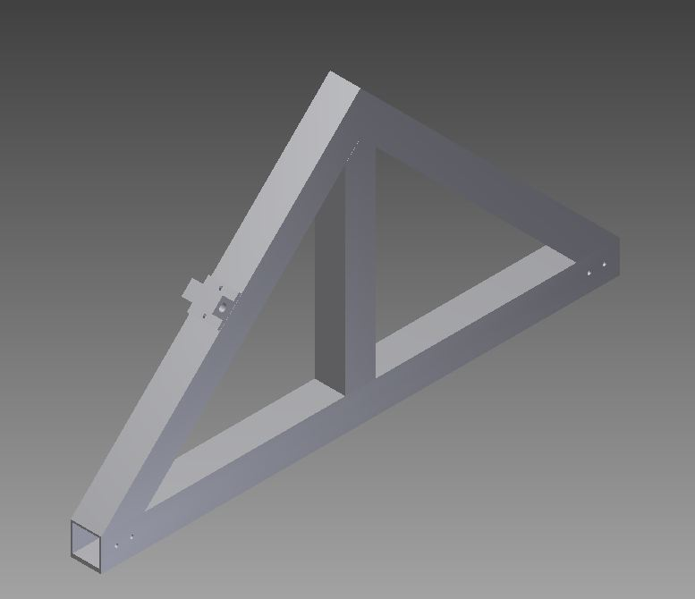
Wedge

Slide 10
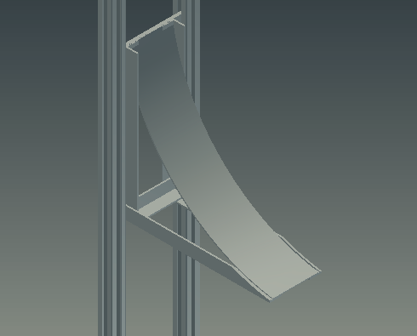
Conveyor

