Slide 1
Electrical Measurements
MVRT 115
2010 – 2011 season

Slide 2
Electricity
Overview: Discussion of electrical measurement
We pretend that electricity is the flow of electrons from the positive to negative terminals of a power source (like a battery)
We know that electrons are negative, but it doesn’t matter for our purposes
We call this flow electric current
more electrons that flow, the larger the current

Slide 3
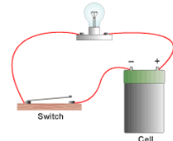
Circuits
The word circuit means to go around. Electric current goes around from battery & back
An open circuit is one that is not connected
When the switch is open, current cannot flow

Slide 4
Conductors/Insulators
Metals, like copper steel, and aluminum, are good conductors of electric current
Plastic, rubber, and paper are poor conductors but good insulators. That’s why wires are wrapped in insulators
Wet skin is a good a conductor
Dry skin is a good insulator
A large diameter wire can carry more current than a small diameter wire
Just like a garden hose can carry more water than a straw
Too much current in too small a wire heats it up

Slide 5
Units of Measurement
Current is measured in amperes, symbol I (A on the digital multimeters)
The energy that pushes electrons into a wire is volts, symbol V (sometimes E)
Resistance is the measure of how hard it is to get current through a wire; no conductor is perfect (except superconductors)
Units of resistance are ohms, symbol Ω

Slide 6
Ohm’s Law
So, the basic relationship between current, resistance, and voltage known as Ohm’s Law
Here, I stands for current, v for voltage and r for resistance
Equation dictates that resistance limits current and voltage increases it

Slide 7
Safety
What happens if you stick your finger in a light bulb socket when the switch is on?
You will get a nasty shock; if you’re unlucky, it might kill you
9V Battery and 12 V battery do nothing
Voltage too low
60V power source? It will shock you
Nothing on the robot is higher than 24V
You won’t get shocked unless you’re soaking wet

Slide 8
Battery Danger
12V batteries can be very dangerous!
If you accidentally short the terminals together with a screwdriver, you’ll weld the screwdriver to the battery.
Welding terminals will cause the battery to get so hot it could explode & spew acid gel all over
Be aware of what you’re doing!

Slide 9
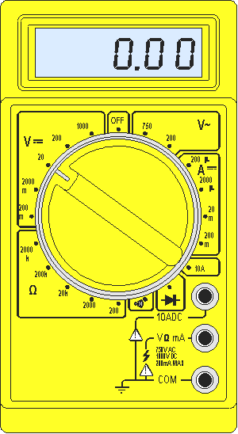
Digital Multimeter (DMM)
V DC Volts
V~ AC Volts
A Amps
Ω Ohms
When meter doesn’t measure it reads
To measure volts or ohms place the black lead on com & black lead on v Ω
To measure amps move red ot mA
1

Slide 10
Reading Ohms
To test continuity set to 200Ω
If resistance higher than range, it will read 1
For example 220 Ω is too high for the 200 Ω range; go to 2k Ω
Check the range to the resistance; work up to highest range
200 Ω: | Read directly | 150 Ω reads as 150
2000 Ω: | value * 1000 | 1500 Ω reads as 1.5
20K Ω: | value * 1000 | 15000 Ω reads as 15
200K Ω: | value * 1000 | 150,000 Ω reads as 150
2M Ω: | value * 1,000,000 | 1.5M Ω reads as 1.5
20M Ω: | value * 1,000,000 | 15M Ω reads as 15

Slide 11
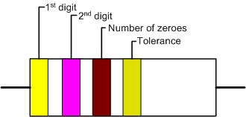
Resistor color code
470Ω 5% tolerance

Slide 12
Resistor tolerances

Slide 13
Answers to worksheet
Resistance & Voltage
A to B = 470Ω
B to C = 330Ω
A to C 800Ω
D to E = 47,000Ω
E to F = 33,000Ω
D to F = 80,000Ω
330Ω /800Ω = 0.4125
0.4125 * 12V = 4.95V (close enough to 5V)
33,000Ω / 80,000Ω = 0.4125
0.4125 * 12V = 4.95V
Current
12V/800 Ω = 0.015A (15mA)
12/80,000 = 0.00015A (.015mA)
So, even though both B to C and E to F measure 5V, only one has enough current to light the LED.

