Slide 1

Part II
Introduction to Robot Code

Slide 2
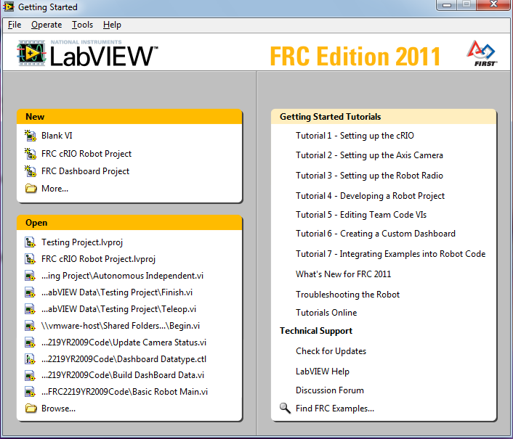
How to open a new FRC robot project
Open LabVIEW.
Click "FRC cRIO Robot Project" in the upper left section "New".

Slide 3
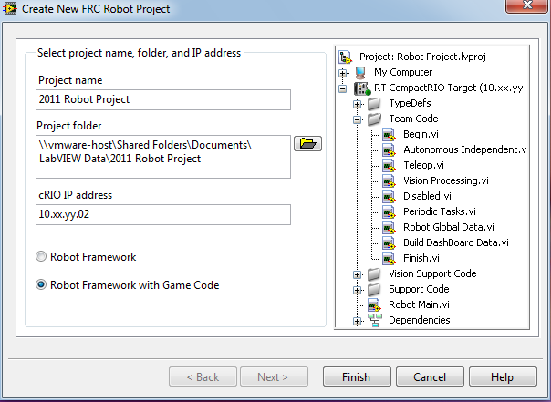
Naming convention
Name the project according to its function, not your name

Slide 4
cRIO IP address
Set the x's and y's in the IP address to match our team number: 0115.
replace this with:
10.01.15.02

Slide 5
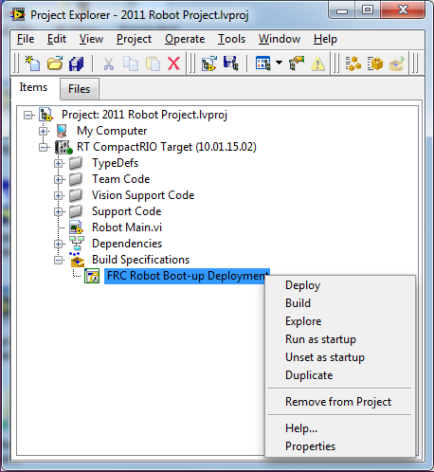
How to deploy code
Open Project Explorer
Hit the plus symbol next to Build Specifications
Right click FRC Robot Boot-up Deployment
"Deploy"

Slide 6
Driver Station
Software and hardware

Slide 7
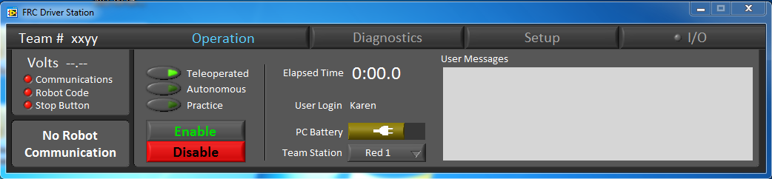
Operations tab
Shows the robot's battery voltage
Shows the state of communication with the robot
Shows whether code has been uploaded
Shows whether stop button is connected
Able to choose between teleoperated, autonomous and practice mode
Enable and disable buttons
The space bar will enable or disable the robot from any window
Elapsed time since you enabled the robot
Shows PC battery
Can choose which team you are (red or blue)

Slide 8
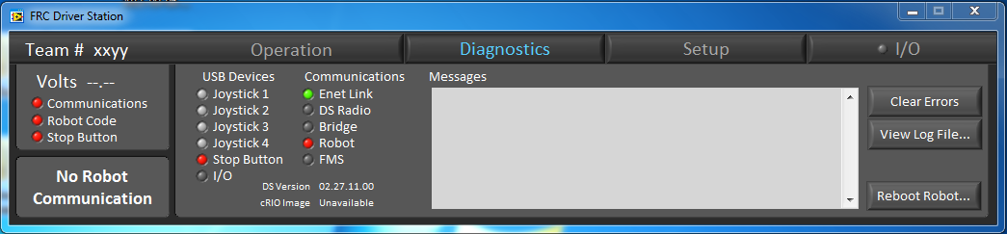
Diagnostics tab
Shows the robot's battery voltage
Shows the state of communication with the robot
Shows whether code has been uploaded
Shows whether stop button is connected
Shows which joysticks are connected
Shows whether an Ethernet link has been formed

Slide 9
Stop button
Acts as an emergency stop
In general the program cannot be run without connecting the stop button
Ctrl-Alt-Enter
Connected by the USB hub to the computer
Have to reboot the cRio after pressing the stop button
Reboot Robot button no longer works after Stop button is pressed, so manual reboot is needed.
Sometimes it does not work when plugged into the USB hub

