Slide 1

Part III
Robot Drive

Slide 2
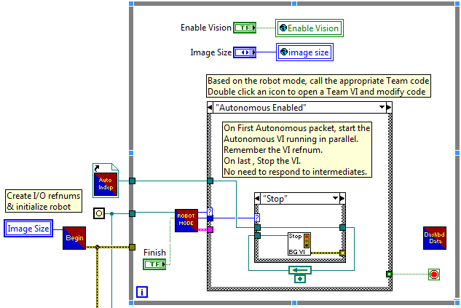
Robot Main.vi
The main body of your code: accesses all of the other programs in your project
A big loop! Do not add any more loops here.

Slide 3
Begin.vi
Begin: initializes variables

Slide 4
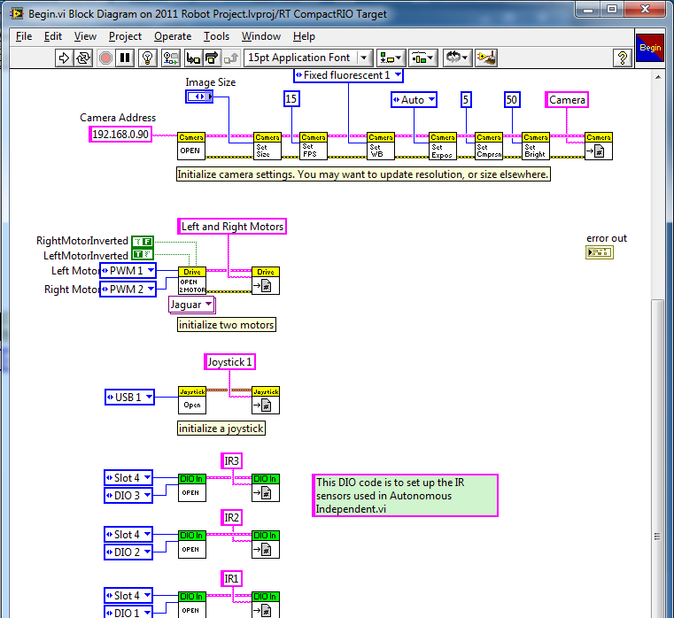
Begin.vi
Initialize the camera, drive train, joystick, and sensors.
Tip:
Name the variable according to its function! It will be called throughout the program with the same name.

Slide 5
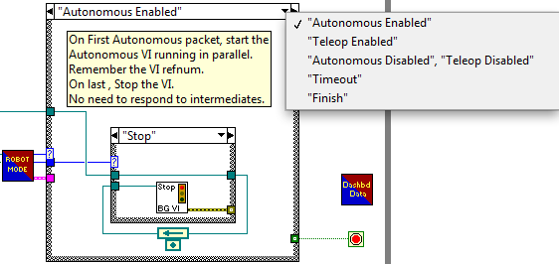
Robot Modes
All of the different modes are programmed in the mode case structure.

Slide 6
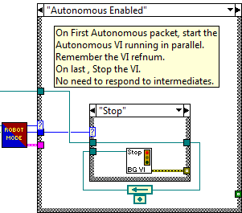
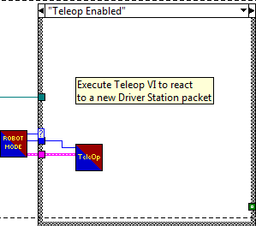
Robot Modes
In autonomous mode, the programmed code is looped over and over again.
The code for teleoperated mode is in a subVI, named TeleOp.

Slide 7
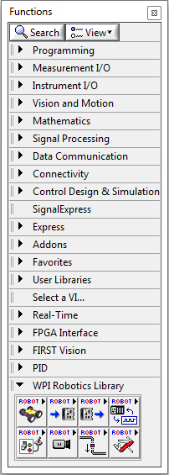

WPI Robotics Library
Contains subVIs produced by FRC for use during competition.
Remember, all devices must be opened and closed!

Slide 8

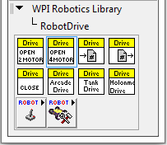
Robot Drive Palette
Remember to close the drive!
How many motors are used on the drive train.
The different types of drive trains.
Joystick palette

Slide 9

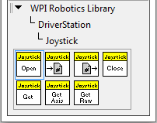


Joystick Palette
Remember to open and close the joystick!
Get data from the joystick.

Slide 10
Tips for Coding
﻿Stay organized!

