Slide 1

Part IV
Reading Power

Slide 2
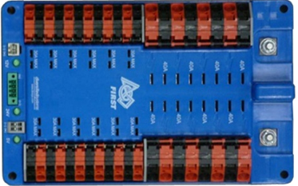
Power Distribution Board
One green light for each power supply (+5V, +24V, +12V)
Red light: a breaker is missing or blown

Slide 3
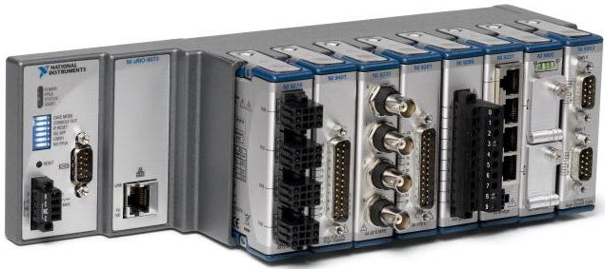

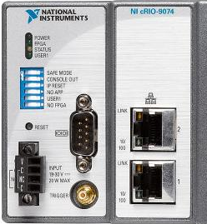
cRIO
Green power light
Yellow status light
Solid: no image
Off: normal operation
Ethernet port status lights (both ports)
No lights: no connection
Solid green: hardware connected and responding
Yellow: software communicating
Ethernet ports

Slide 4
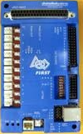
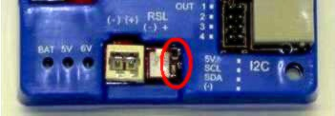
Digital Sidecar
One green light each for battery, +5V, and +6V
Status light
Fast blink: system error
Off: cRIO has shut down or rebooted

Slide 5
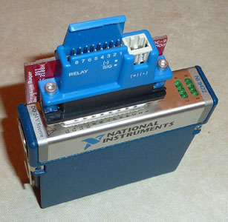
Solenoid Module
Green status light

Slide 6
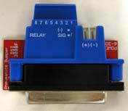
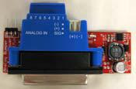

Analog and Solenoid Breakouts
Green power light

Slide 7
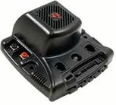
Jaguar
Solid yellow: neutral
Blinking yellow: no communication, disabled
Slow flashing red: fault
Fast flashing green: forward
Fast flashing red: reverse
Solid green: full-speed forward
Solid red: full-speed reverse
No light: no power

