Slide 1
DESIGN II
Manipulators
Mechanical
MVRT
10-09-2006

Slide 2
QUESTION I
QUESTION I
What is a
manipulator
?
What is a
manipulator
?

Slide 3
ANSWER I
Element that interacts with other objects

Slide 4
CONCEPT I
Manipulators work through physical contact

Slide 5
CONCEPT I
No...
Electromagnetism
Non-friction heating
Antigravity
Other unexplained natural phenomena

Slide 6
QUESTION II
Why do we avoid non-physical manipulation?

Slide 7
ANSWER II
Simple and dependable is better

Slide 8
CONCEPT II
Manipulators should be designed for a specific purpose

Slide 9
CONCEPT II
Purposes:
Changing position of field objects
Changing position of robot w/ FOs

Slide 10
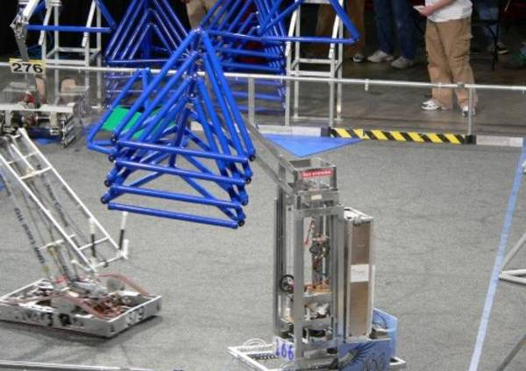
PICTURE I
Team 166 holding 4 tetras.

Slide 11
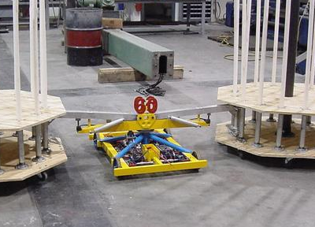
PICTURE II
Team 60 holding 2 goals.

Slide 12
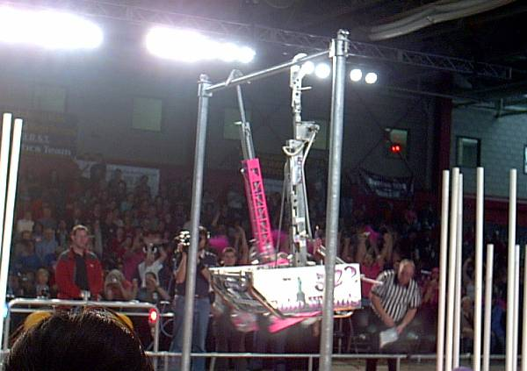
PICTURE III
Teams 233 and 522 hanging from the bar.

Slide 13
QUESTION III
How well does each manipulator accomplish its purpose?

Slide 14
CONCEPT III
Manipulators need to be positioned or position themselves

Slide 15
CONCEPT III
Methods of positioning.
Drivetrain
Powered (mechanized)

Slide 16
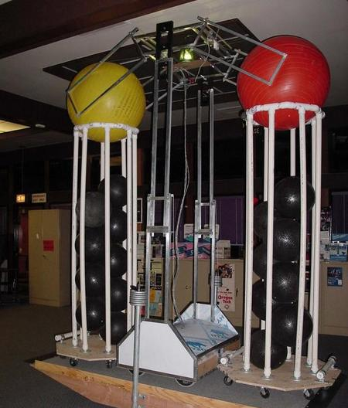
PICTURE IV
Teams 115 balancing with two goals and multiple balls.

Slide 17
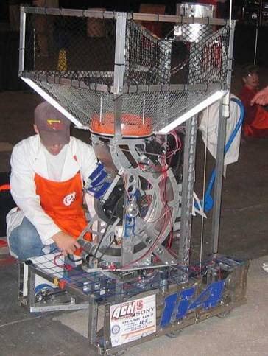
PICTURE V
Teams 114’s self-tracking rotating shooter.

Slide 18
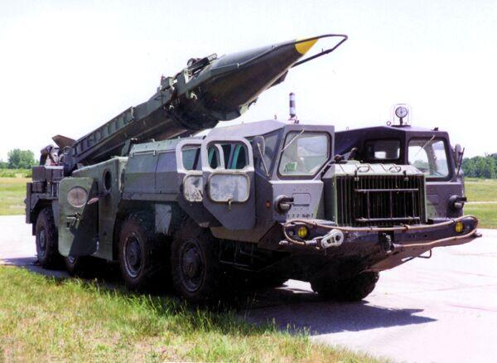
PICTURE VI
Teams 75’s first shooter concept.

Slide 19
QUESTION IV
What are the pros and cons of each positioning method?

Slide 20
CONCEPT IV
Manipulators need to consistently affect FOs

Slide 21
CONCEPT IV
Methods of affection
Friction
Vacuum
Physical constraint

Slide 22
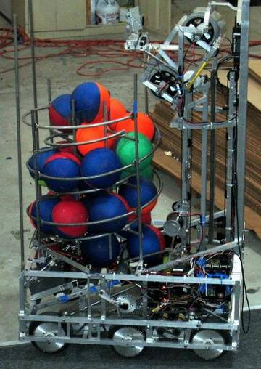
PICTURE VII
Teams 469’s robot for 2006.

Slide 23
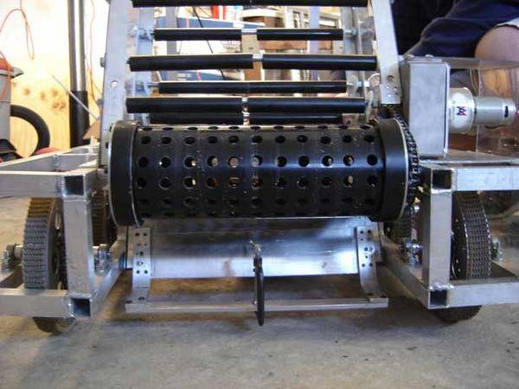
PICTURE VIII
Teams 1902’s intake rollers.

Slide 24
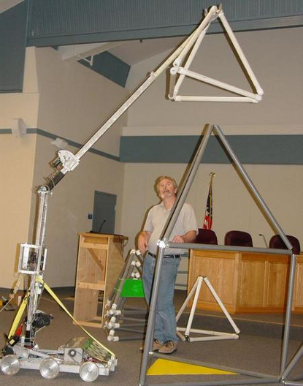
PICTURE IX
Teams 1388 capping a tetra.

Slide 25
QUESTION V
What are some uses for each method of affection?

Slide 26
DESIGN II
Manipulators
By Humphrey Hu
Photographs from ChiefDelphi
You may not modify this Powerpoint without permission

