Slide 1
Wiring the new control system
MVRT
2010 – 2011 Season

Slide 2
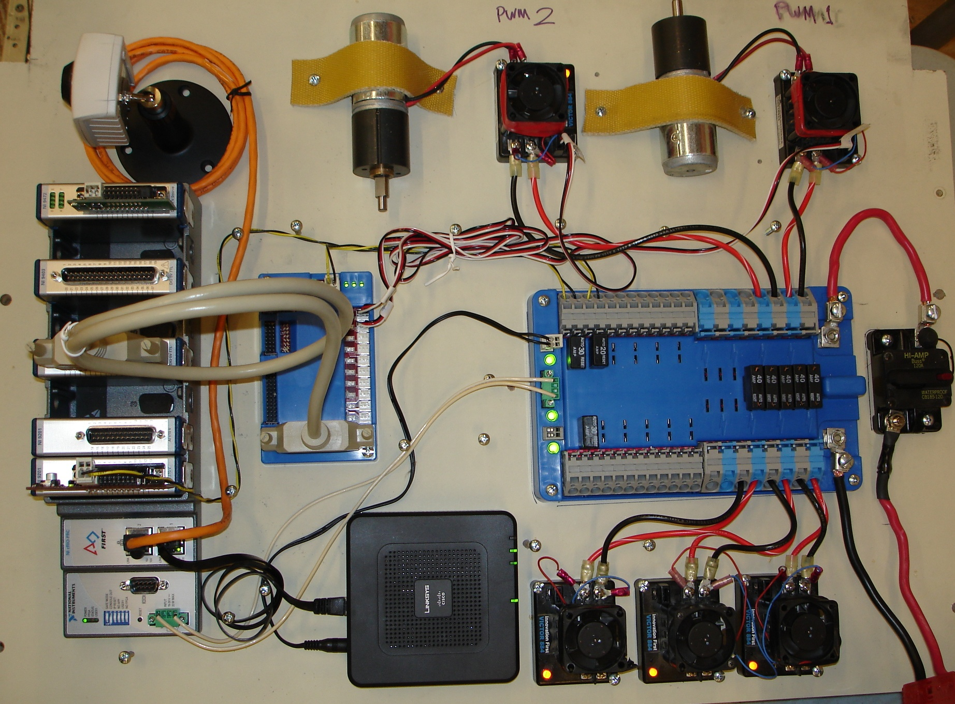

Slide 3
Basic Wiring Principles
Color convention for insulation (according to rules)
Power = red, white, brown
Ground = black, brown
Use right size (gauge/diameter) cables
Big wire = smaller gauge = more current
Basic types
Solid – single wire
Stranded – multiple smaller wires twisted together
Jacketed – multiple insulated wires with an outer cover

Slide 4
FIRST Wiring Rules

Slide 5
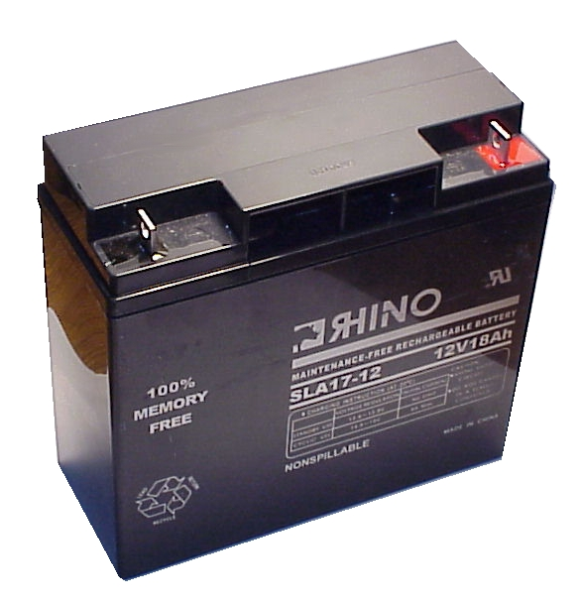
Robot Battery
12V Lead-Acid Battery
Connects to power block and main circuit breaker
Powers all functions of robot

Slide 6
Wiring diagram
Battery

Slide 7
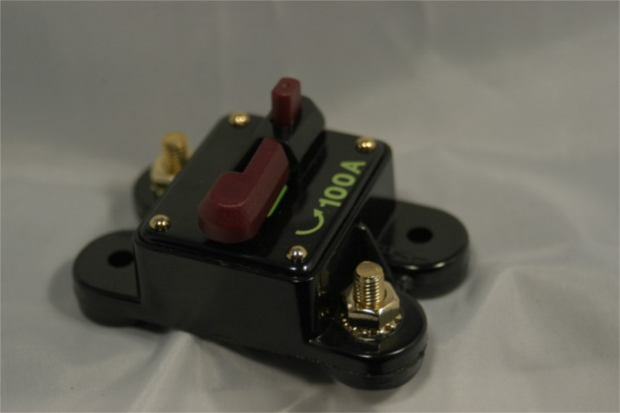
Main Circuit Breaker
Turns robot on and off
To turn it off press the red button on the top
To turn it on close the switch
Connects the battery to the power distribution board
Normally use the red power cable from the battery to the breaker

Slide 8
Wiring diagram
Battery
Circuit breaker

Slide 9
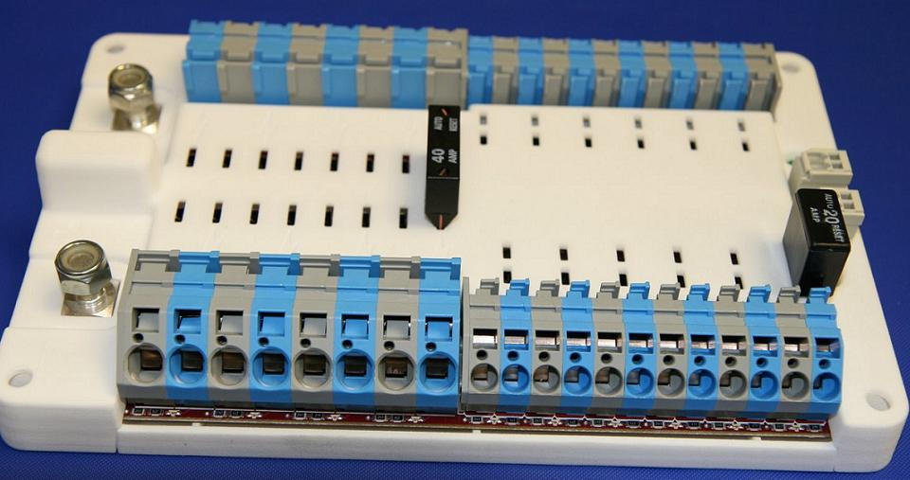
Power Distributor Board
Distributes power to all the electrical components
Makes sure not too much current is drawn and everything is well connected
Connects to everything that requires power

Slide 10
Wiring diagram
Battery
Circuit breaker
Power distribution board

Slide 11
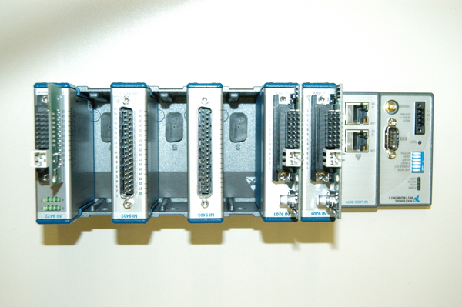
Compact RIO Controller (cRio)
Brains of Robot
Gets power from the power distributor board
Sends power and signal to the Digital Sidecard and the Wi-Fi interface
Connects via Wi-Fi to the driver station and the robot

Slide 12
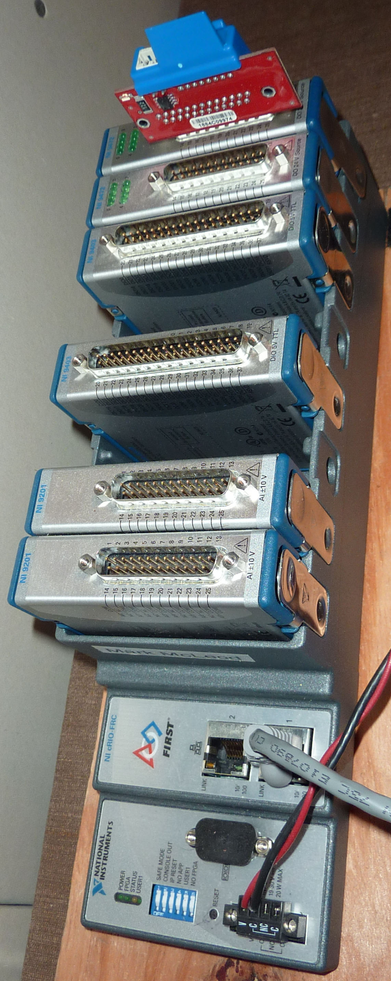
Modules and Bumpers
Analog Input Module
Analog inputs with 3 pin connectors
Digital Adapter Module
Connects to Digital Sidecar with a ribbon cable
PWMs, Digital I/O, 3-pin relay connectors
Relay Module (On/Off)
Control solenoids (electrical controller used with pneumatic system)

Slide 13
Wiring diagram
Battery
cRio controller
Digital module
Solen-
-oid module
Analog module
Circuit breaker
Power distribution board

Slide 14
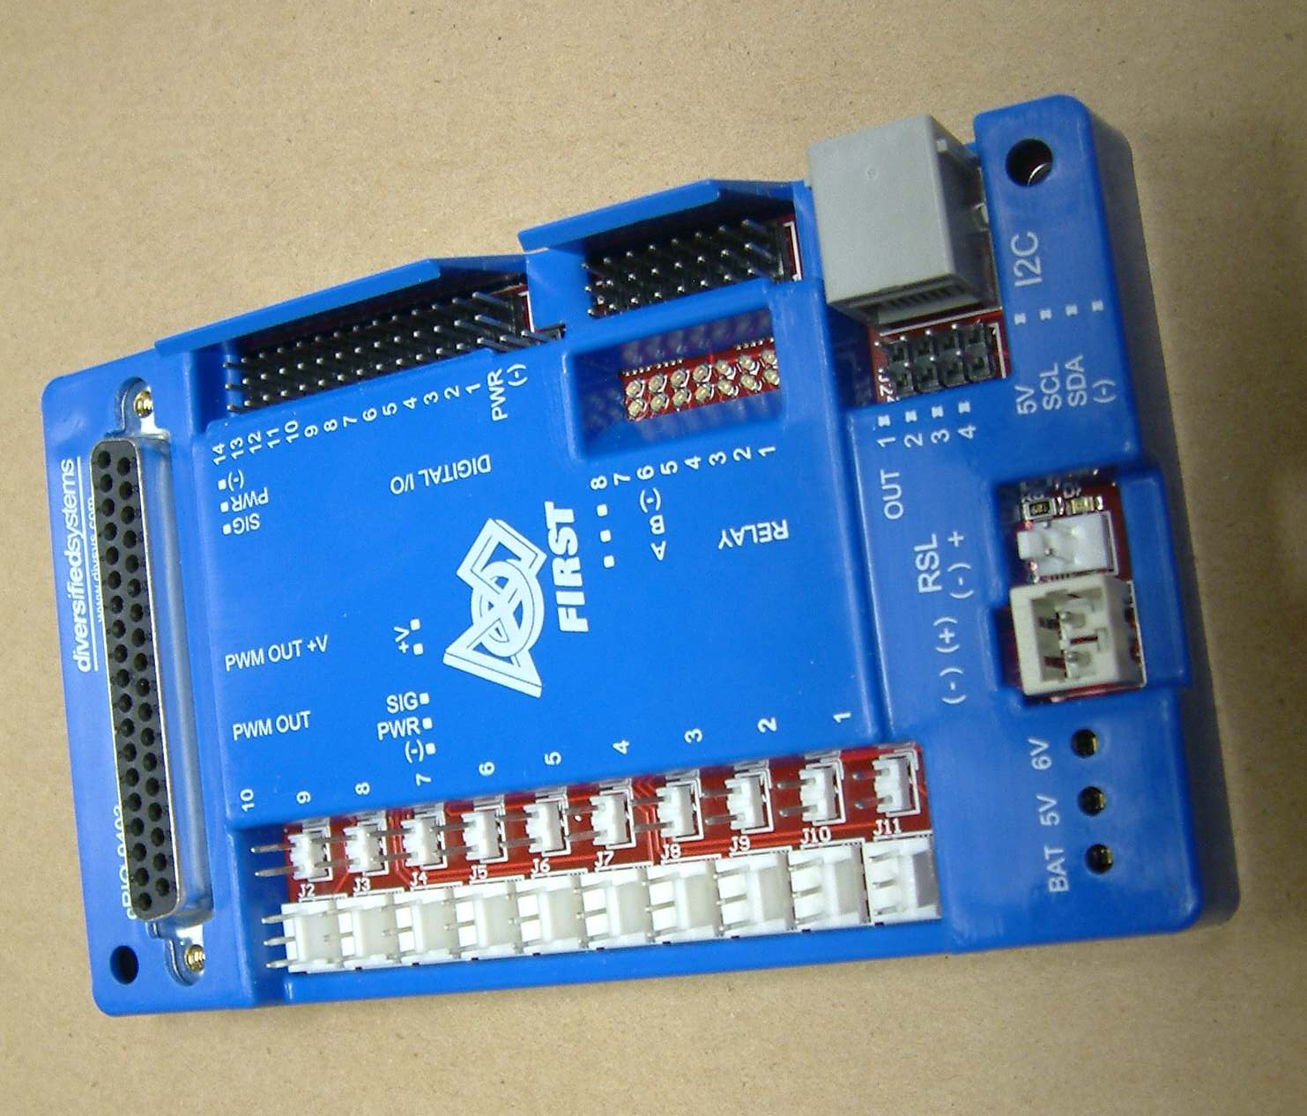
Digital Sidecar
Used to connect variety of different signals, mainly to the Victors
Connects to the cRio module and power distributor block

Slide 15
Wiring diagram
Battery
cRio controller
Digital module
Solen-
-oid module
Analog module
Circuit breaker
Digital sidecar
Power distribution board

Slide 16
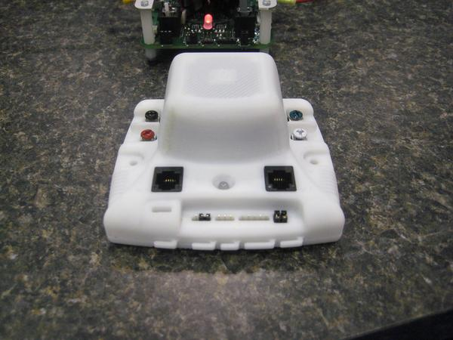
Jaguar Speed Controller
Determines how much power goes to the motor
Gets power from the distribution board, input from the digital sidecard, and outputs to the motors

Slide 17
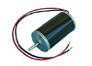
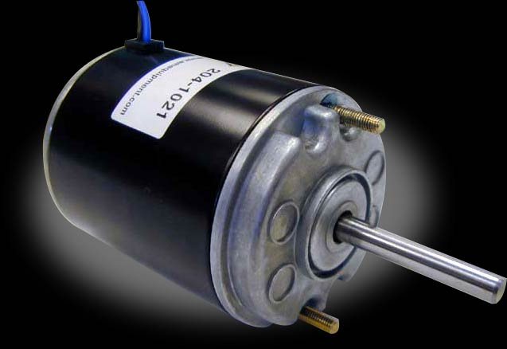
Motors
Motors wired to Jaguar speed controller
Wired up by both the ground and the power
Wire with Powerpole connectors
Jaguars make motors move at a certain speed
Motors allow an object to rotate

Slide 18
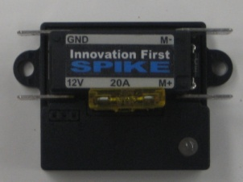
Spike
Input: a voltage input
Output: voltage to a motor
Full forward (+12V)
Full backward (-12V)
Turns compressor on and off to charge pneumatics system
Wired to compressor and digital sidecar

Slide 19
Wiring diagram
Battery
cRio controller
Digital module
Solen-
-oid module
Analog module
Circuit breaker
Digital sidecar
Power distribution board
Digital sensors
Motor speed controllers
Spike relays
motors
compressor

Slide 20
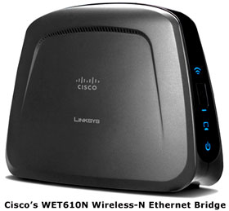
Linksys Wi-Fi Interface
Connects the cRio to the driver station/router
Connected to the OI and the power distribution board

Slide 21
Wiring diagram
Battery
cRio controller
Wireless bridge
Digital module
Solen-
-oid module
Analog module
Circuit breaker
Digital sidecar
Power distribution board
Pneumatic solenoid
Analog sensors
Digital sensors
Motor speed controllers
Spike relays
motors
compressor

Slide 22
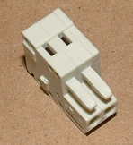
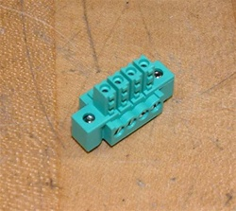
WAGO & Sauro Connector
2 pole
Uses – Power distributor to…
bumpers
gaming adapter
Digital side card
Sauro Connector
4 pole
Uses – Power distributor to…
cRio

Slide 23
Other parts/tools used to wire the robot
Servos
Electrical tape
PWM Wires
Zipties
Label Makers

Slide 24
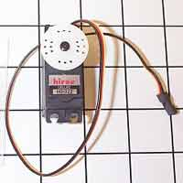
Servos
Rotates from 0 to 254
Once given position, stays there and cannot be moved unless “told” by the code
A very small motor

Slide 25
Servo 2011
2011 changes - Can use more servos starting this year
Max power = (0.5 * stall torque) * (0.5 * no load speed)
Load speed has to be less than 4W
Example (Hitec Hs – 322 servo)
Servo max power rating = torque x speed x unit conversion factor
Torque = 3/7 kg/cm = 0.36 NM
RPM = 0.15s @ 60° = 66.7 RPM
0.36 NM x 66.7 RPM x 0.1047 = 2.5W
Speed (4.8V/6.0v) | 0.19/0.15 sec @ 60°
Torque oz/in (4.8V/6.0V) | 42/51
Torque kg/cm (4.8V/6.0V) | 3.0/3.7

Slide 26
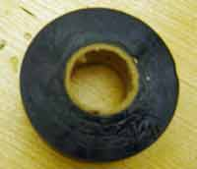
Electrical Tape
Prevents the electrical current from hurting people on battery terminals or open wire
Primarily used to insulate bare wires or ends
use red electrical tape for power wires
Use black tape for ground wires
Use to cover jaguar terminals

Slide 27
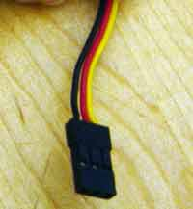
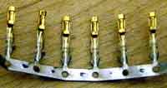
PWM
Stands for pulse width modulator
Used to transmit data to speed controllers
Red - power
Black - ground
White/Yellow - signal

Slide 28
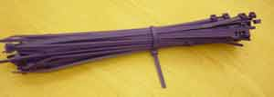
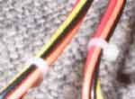
Zip ties
Used to keep wiring neat and out of the way from moving parts to avoid the wires from getting cut

Slide 29
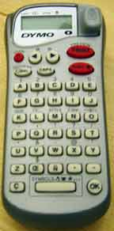
Label Maker
Labeling wire makes it easy to identify where it’s from / going to
Ex. label pwm cables from digital sidecar to jaguars

