Slide 1
Old control system (2005-2008)
MVRT

Slide 2
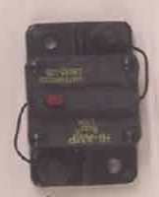
Main Circuit Breaker
Connected to the red wire (power) of the battery
When turned off, all power is cut off and robot turns off
Easy way to turn the robot off
Needs to be place in an accessible but not too accessible place so that it can be pushed but not during competition accidentally
Connects (red) to the breaker panel
Very hard to trip this breaker

Slide 3
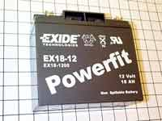
Main Battery
12 volt battery
Main battery that connects to breaker panel and circuit breaker

Slide 4
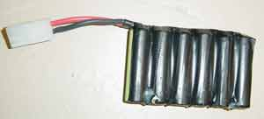
Backup Battery
Takes over for the main battery for a few seconds if the average voltage coming out of the main battery dips below a certain point (generally around 11 volts)

Slide 5
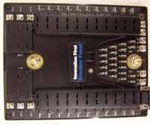

Breaker Panel
Uses automatic reset fuses to control amount of voltage a motor is drawing out from the main battery
20/30/40 amp fuses for different types of motors and sensors
When the fuse pops up, it means that the motor is drawing too much current
Fuse

Slide 6
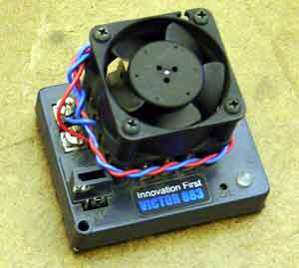
Speed Controller
Regulates speed for the motors
Transmits speed to motor from RC

Slide 7
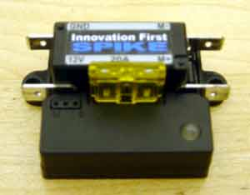
Spikes
Connects directly to the RC rather than to the Breaker Panel
Used to control the pneumatic cylinders
Uses a 12V Battery

Slide 8
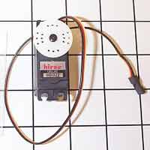
Servos
Rotates from 0 to 254
Once given position, stays there and cannot be moved unless “told” by the code
A very small motor

Slide 9
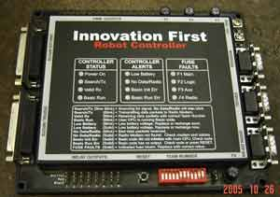
Robot Controller (RC)
PWM output (connects to speed controllers)
Holds the code for the drivetrain, arm / manipulator, and autonomous
Outputs speed that is received via radio/tether to speed controllers to motors
“Brain” of the robot
Tether port connects RC to OI directly
Program port connects the RC to laptop/computer to download new code
Program port
Tether port

Slide 10
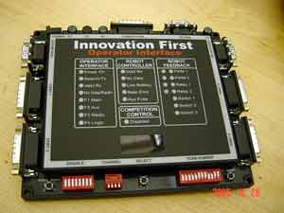
Operator Interface (OI)
Transmit data (i.e. speed from joysticks) to RC via radio/tether
Attaches to external switches (i.e. kill switch, push button)
Ports connect to joysticks and switches
Competition port connects to switches that decide the mode (disabled & autonomous)
Robot controller reset
Operator Interface reset

Slide 11
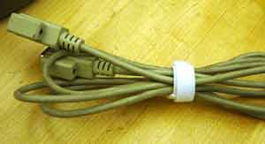
Tether/Programming Cable
Programming cable connects RC to laptop for code download
Tether connects RC (Robot Controller) to IO (Operator Interface)rather than use of radio

Slide 12
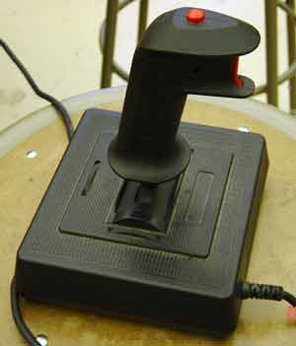
Joystick
Used to drive the robot and move the arm/manipulator
Transmits speed from 0 to 254 with 127 being neutral
Therefore 0 is backwards and 254 forwards full speed
Transmits speed to OI (Operator Interface)

Slide 13
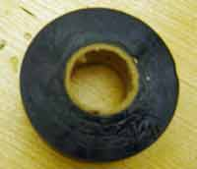
Electrical Tape
Prevents the electrical current from hurting people on battery terminals or open wire
Primarily used to insulate bare wires or ends

Slide 14
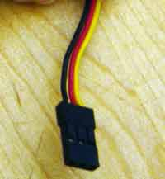
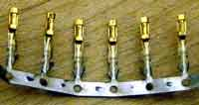
PWM
Stands for pulse width modulator
Used to transmit data to speed controllers
Red for power
Black for ground
White/Yellow for service

Slide 15
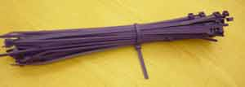
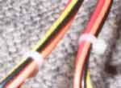
Zip ties
Used to keep wiring neat and out of the way from moving parts to avoid the wires from getting cut

Slide 16
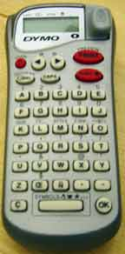
Label Maker
Labeling wire makes it easy to identify where it’s from / going to
ex. from RC to switch

