Slide 1
Robot Code
MVRT
2010 – 2011 Season

Slide 2
Robot Code
Robot code controls the robot
Robot Main.vi
Calls all the smaller SubVis
Rules of programming the robot
Be careful – an error in robot code can make a destructive robot
In general, never edit the Sub Vis provided by FIRST
Learn to code around what provided
The whole robot code is a loop so generally speaking you don’t need to add loops to code

Slide 3
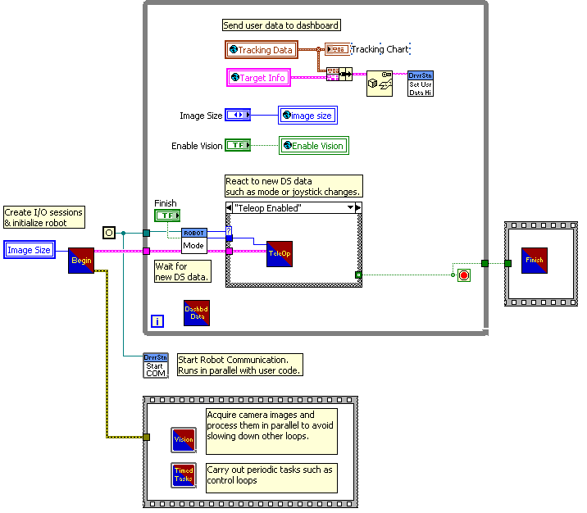
Robot Main
Begin: tells robot how the electrical components are wired up and where to receive inputs
Robot Mode: acts as a timer for the code and it is wired to a case structure that decides what sub VI to call based on elapsed time
Teleop: runs the code for the user controlled period part of game
Autonomous: runs the code for the first fifteen seconds of the game without human driver
Finish: just as we have to open the electrical components in begin we need terminate our use of them in finish, ends the program

Slide 4
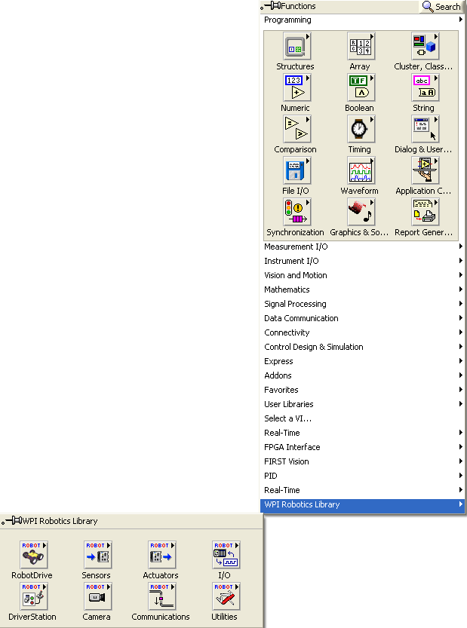
WPI Robotics Library
Right click in Block Diagram to find Functions Pallet
Select WPI Robot Library at bottom

Slide 5
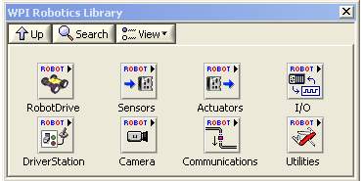
WPI Robotics Library

Slide 6
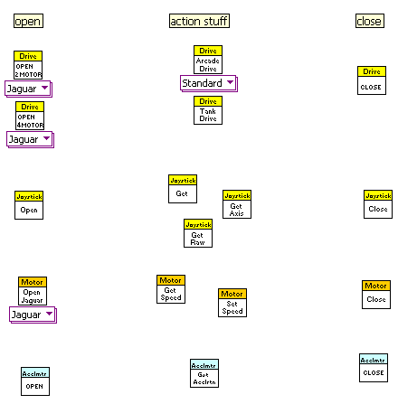
Order of WPI VIs
The WPI library VIs all have a open VIs (in begin), action VIs which vary based on module (in teleop/autonomous), and a close VIs to terminate use with them

Slide 7
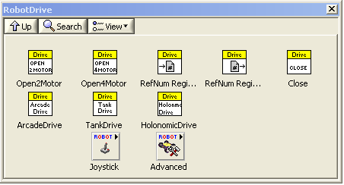
RobotDrive VIs

Slide 8
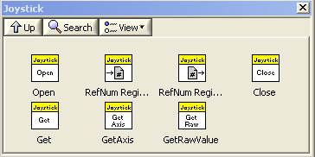
Joystick VIs

Slide 9
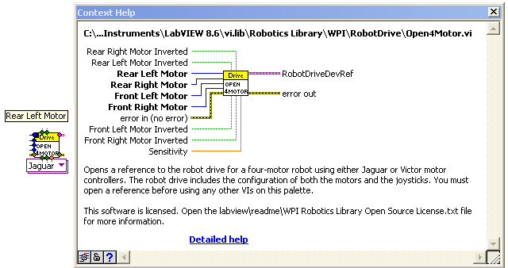

How to use Open VIs
It will look like it is complicated because it’s clustered
Use the help to find out what the inputs are…

Slide 10
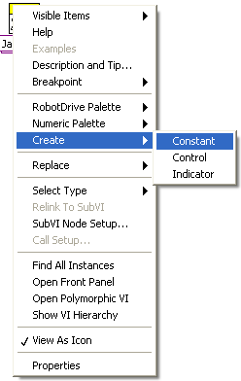
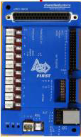
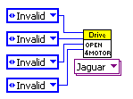
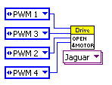
How to use open VI
Then use create constant feature for the necessary inputs

Slide 11
Action VIs
Action VIs – greatly vary but for the most part plug in the reference data of the electrical component and use them
Two general types:
Get type: for receiving data from sensors and other input devices, the values are the indicators on the sub VI
In general the data received will be bundled
Set type: for setting speed value for motors etc, the values are the control side of the sub VI

Slide 12
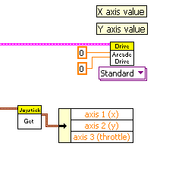
Examples of Action VIs

Slide 13
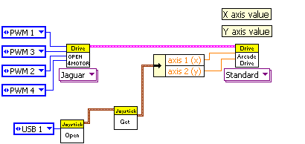
Simple Example of Drive Code

Slide 14
What is RefNum Registry?

Slide 15
Begin.VI
Contains all the Open VIs for the electrical components
Unlike the previous example of drive code, we cannot just connect the references directly to the action VIs because often times they need to be accessed from both Teleop.VI and Autonomous.VI
We use RefNum Registry – a storage of references for electrical components after they have been initialized
Begin.VI initializes and passes references for electrical components in the code

Slide 16
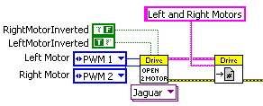

Passing references
Store reference with name in Begin.VI
Note: Use simple name defining basic use
Then use reference with same name in rest of the code
Note: Make sure name matches the name used in Begin.VI
Notes:
Not java type

Slide 17
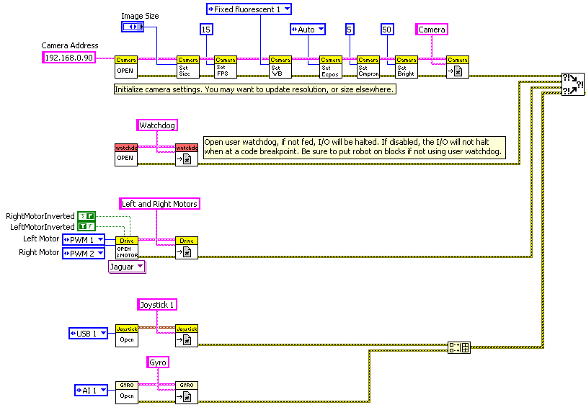
Begin.VI

Slide 18
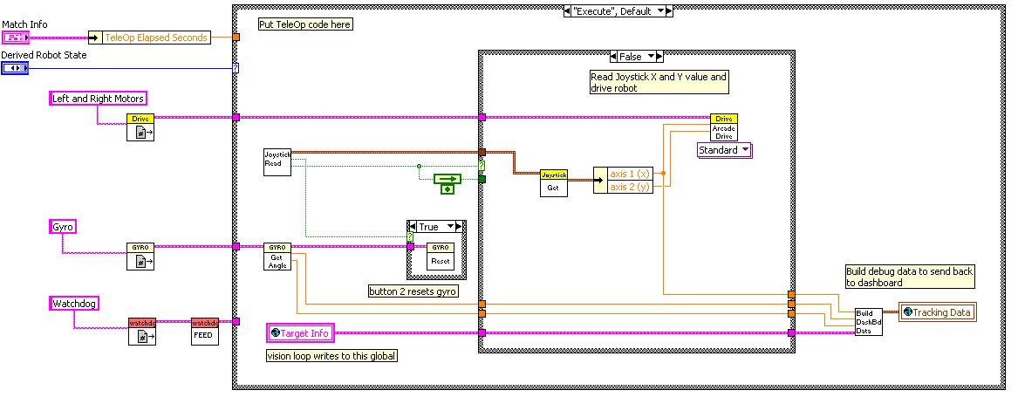
Teleop.VI

Slide 19


Watchdog
WatchDog – it is a tool that executes a certain action for a period of time
Useful for autonomous when you want to complete timed actions
Under WPI library utilities

Slide 20
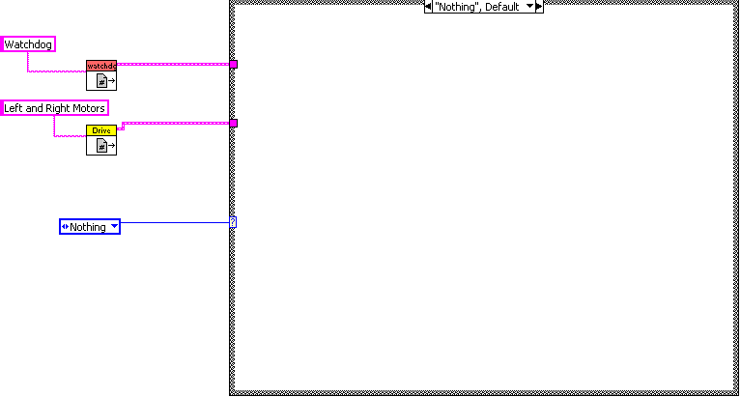
Autonomous.VI
For autonomous always:
1) Have a case structure for multiple autonomous mode
2) Get the references you are going to need – ex. Drive
3) Keep the watchdog reference

Slide 21
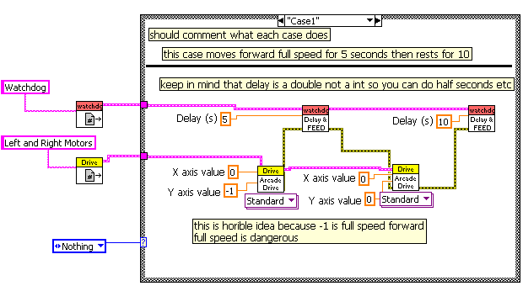
Autonomous.VI Example

