Slide 1
Robot sensors
MVRT
2010 – 2011 season

Slide 2
Analog versus Digital
Analog
Goes from 0 to 254
Numerous values
Similar to making waves because there are not sudden jumps but a flowing motion
ex. Making waves with a rope tied to a door – waves represent analog motion
Digital
Values are 0 and 1
0 for closed and 1 for open or vice versa
Depends on how you wire the switch and decide to program
Similar to switching a light switch on and off

Slide 3
Sensors
Accelerometer
Limit Switch
Gyroscope
Digital Encoder
Analog Encoder
Potentiometer
Line Following Sensor
Other sensors

Slide 4
Accelerometer
What it is: A device which measures acceleration/vibration relative to freefall
Measures force
Force = Mass * Acceleration
mg
mg

Slide 5
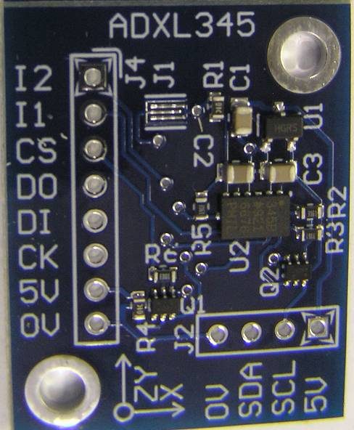
Accelerometer
Purpose: Helps understand surroundings better
Ex. Arm manipulator
Ex. Position on the bump
Digital signal between 0 and 5 volts

Slide 6
Accelerometer 2011 season
Sends out a signal that has acceleration values x, y and z
X axis – axis indicates positive
Y axis – axis indicates positive
Z axis – up is positive
Default is 1G due to gravity
If accelerometer is not level it will give a non-zero acceleration

Slide 7
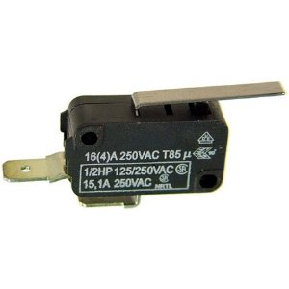
Limit Switch
What: Object presses the actuator the device makes or breaks an electrical connection
Purpose: Stopping the movement of a manipulator
Ex. Stopping the movement of the kicker once it latches into the gate latch
When stopping a heavy manipulator like an elevator, a mechanical stop is needed as well to avoid cracking the plastic covering on the switch
Digital signal
0 and 1 for on & off or vice versa
F

Slide 8
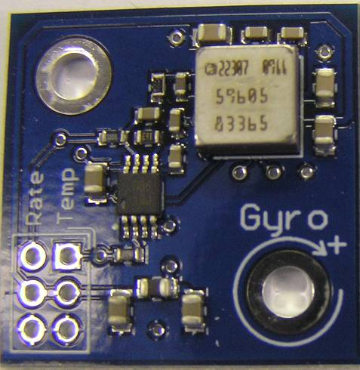
Gyroscope
What: Measures the orientation along the top surface axis
Provides output voltage proportional to robot platform
Purpose: to measure the change from the original position
Ex. Know the direction robot is facing in autonomous
Analog signal

Slide 9
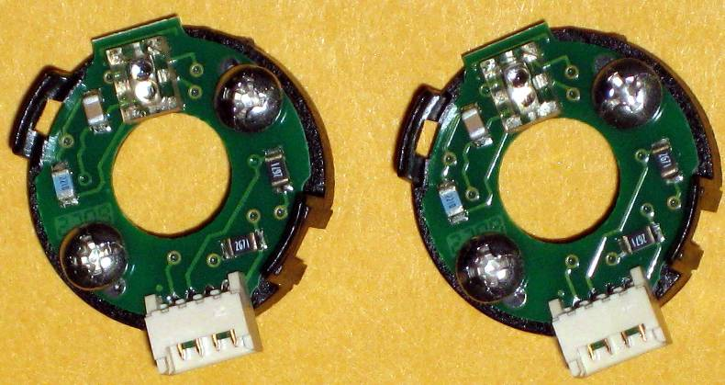
Digital Encoder
What: A device which measures speed and direction of a shaft
First default encoders fit onto 0.25’’ shaft
Purpose: to measure the rotation of a motor
Measures more than one rotation
Ex. Used in autonomous to measure how far the robot goes
By having two readers side by side, you can tell what direction you’re going by seeing which of the two sensors reacts first. Counterclockwise, the left sensor reads first; clockwise, the right sensor reads first.
Digital signal

Slide 10
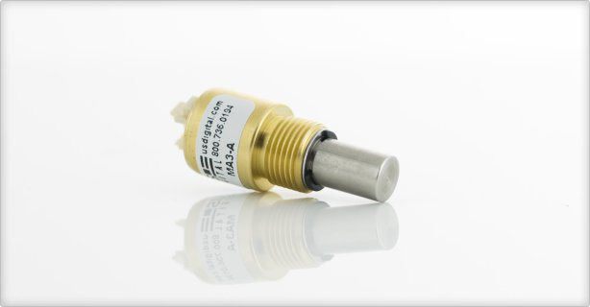
Analog Encoder
What: A device which precisely measures the rotation of a shaft
Used to measure maximum 360 degree rotation
Purpose:
Ex. Measure direction of swerve wheels
Ex2. Measure position of arm
Benefits: measurements are precise
Example of sensor
US Digital MA3
http://www.usdigital.com/products/encoders/absolute/rotary/shaft/ma3/
Analog sensor

Slide 11
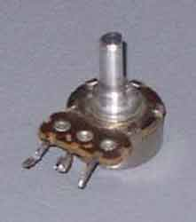
Potentiometers
The top of the potentiometer moves and moves also from the values 0 to 254
Sends feedback telling the program how far the potentiometer has been turn

Slide 12
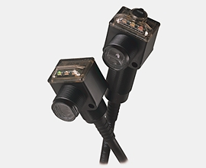
Line Sensor
Used in the 2011 season to detect the gaffers tape
From our tests can be oriented in either direction
Wiring
Brown – Power terminal on PD
Blue – Ground terminal on PD
Black – signal pin in DS
White – signal pin in DS
Digital input

Slide 13
A few other sensors
Camera – a sensor that sends out images the controller can recognize
Current sensor – measures current passing through the wire
Infrared Sensor – measures the distance between the closest object
Ex. Ball in the kicker or not
Analog
Multimeter –volts and current meter
Pressure Gauge – measures pressure in pneumatic system
On/Off

Slide 14
keybounce
Keybounce: the on/off switch may go on & off many times when you first touch it because the metal contacts actually bounce together & apart.
In a light switch it doesn’t matter. But when you’re reading it many times a second, you can be fooled.
Solution: Read your switch many times and when you get two or more of the same readings in a row, then you know the switch value is correct.
Ex. the gyro has to be calibrated so that it returns the proper angle
Some sensors give weird values when they don’t work.
May look like they are constantly changing, or they may just give a steady value.

Slide 15
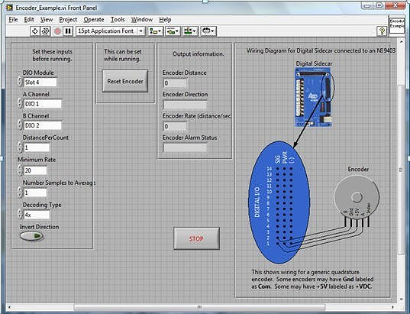
Wiring sensors
Look at sensor manual on usfirst.org
Look in LabVIEW example code

