Slide 1
Lecture Summarizer
Using Extractive Summarization Approach
Drashti Bhuta
Jatin Taneja

Slide 2
Our Proposal
Problem
Solution
Lectures convey great amount of information making it difficult to retain.
Taking notes also hampers student participation.
Disabled student need additional help to follow the lectures.
An application that provides a short gist of everyday’s lecture.
This will come handy to students for understanding a particular lecture anytime.
This application can also empower the disabled by providing an audio clip of the summary.

Slide 3



Description
The application provides student with an overview of a lecture.
Enabling student to participate more and retaining the crux of the lecture
The application aides disabled students in following the lectures.
Summarizer
Model
Input
Transcript
Summary outputs

Slide 4
Related Work
What is Existing
What is New
TextRank Algorithm
LexRank Algorithm
Using BM25 as similarity measure for TextRank graph weights
Using the wikipedia corpus to find idf of a given word
Removing two sentences that are semantically similar

Slide 5
Implementation

Slide 6
Pre-processing
The input(recorded lecture) is converted to text (AWS transcribe)
The generated transcription is processed to remove stopwords
The transcription is then stemmed using porter stemmer
Each sentence in the text is considered to be a feature
The idf value for all words in wikipedia corpus is calculated

Slide 7
Summarizing
The summarizer model takes the preprocessed lecture transcription as input.
Uses two different algorithm to generate two versions of summary.
Text Rank
Lex Rank
Both version are then checked for redundancy removal.
ROUGE-2 and ROUGE-L are used to evaluate the quality of the versions.

Slide 8
Text Rank
A graph is created to represent the input text. Each sentence is a node
The edge of the graph is assigned a weight that represent how similar the two sentences are
The weight is calculated using BM25
The Pagerank algorithm is executed on this graph
Each sentence now have a score assigned and the one with higher scores are important ones
Notes:
Speak about the intuition : That at any given sentence , you tend to go to the page thats more similar to it and that’s indicated by the edge weight. Kind of recomends the next sentence to read

Slide 9
Lex Rank
Based on centrality concept.
Calculating similarity of two sentences by using modified tf-idf cosine formula.
Unlike Page Rank algorithm, graph here is undirected.
Notes:
According to concept of centrality, important sentence in a document is connected to most of the other important sentences.
Here tf is the frequency of term in sentence and idf value has been collected from wiki.

Slide 10
Redundancy Removal
Two sentences are considered to be redundant, if the are semantically similar
Log entropy can be used to determine the information content of a sentence
Sentences having same entropy value are considered to convey same information and one of them is removed
Sent No. | Model Score | Entropy Value
Sent1 | 0.6 | 3.1
Sent2 | 0.5 | 3.1
Sent3 | 0.4 | 3
Sent1, Sent3
Notes:
During the lecture a professor repeats main concept multiple times to emphasis on it. But for summarisation that will redundant data.
Log entropy of a sentence gives us how informative it is, so we are retaining one of all sentences which have same entropy score in order to remove redundancy.
change doc to sentences
change score to algporithm score

Slide 11
Post-Processing
The Generated summary is provided to user in 3 forms
Text Format
Audio clip ( Used Google speech Api to convert text to speech)
Braille Text
This feature makes the application to be useful for disabled students as well.
Notes:
Once we have the final summary , we are exporting that data in 3 forms - Text(for lazy students) , Audio and Braille ( for disabled students)

Slide 12
Experiments

Slide 13
Data Set
Used two different set
CNN news article Dataset consisting of 1000 articles and their corresponding summaries to evaluate the performance of the summarisation module.
15 Recorded lectures with their reference summaries written by an unbiased editor to evaluate the performance of the whole application.
Notes:
We have trained out model on CNN articles as we have their gold summary available on net.
Then we have run our model on lectures.

Slide 14
Evaluation Metrics
ROUGE 2 : evaluates based on number of overlapping bigrams of system generated summaries and gold summary.
ROUGE L : evaluates based on longest common sequence between system generated summary and gold summary.
These ROUGE techniques works well for single document summarization.
Notes:
For evaluation of model, we are using the average of ROUGE 2 and ROUGE L metrics.
Advantage of using ROUGE L is that we can compare on the basis of longest common sequence of system generated summary and gold summary whereas with other method like ROUGE and ROUGE 2 we have restrictions to compare unigrams and bigrams.

Slide 15
Tuning
Lex Rank have two parameter to tune the threshold and error tolerance
The Graph below shows performance of Lex Rank for threshold and error tolerance value in range of 0.1 to 0.3 and 0.7 to 0.8
Show Graph

Slide 16
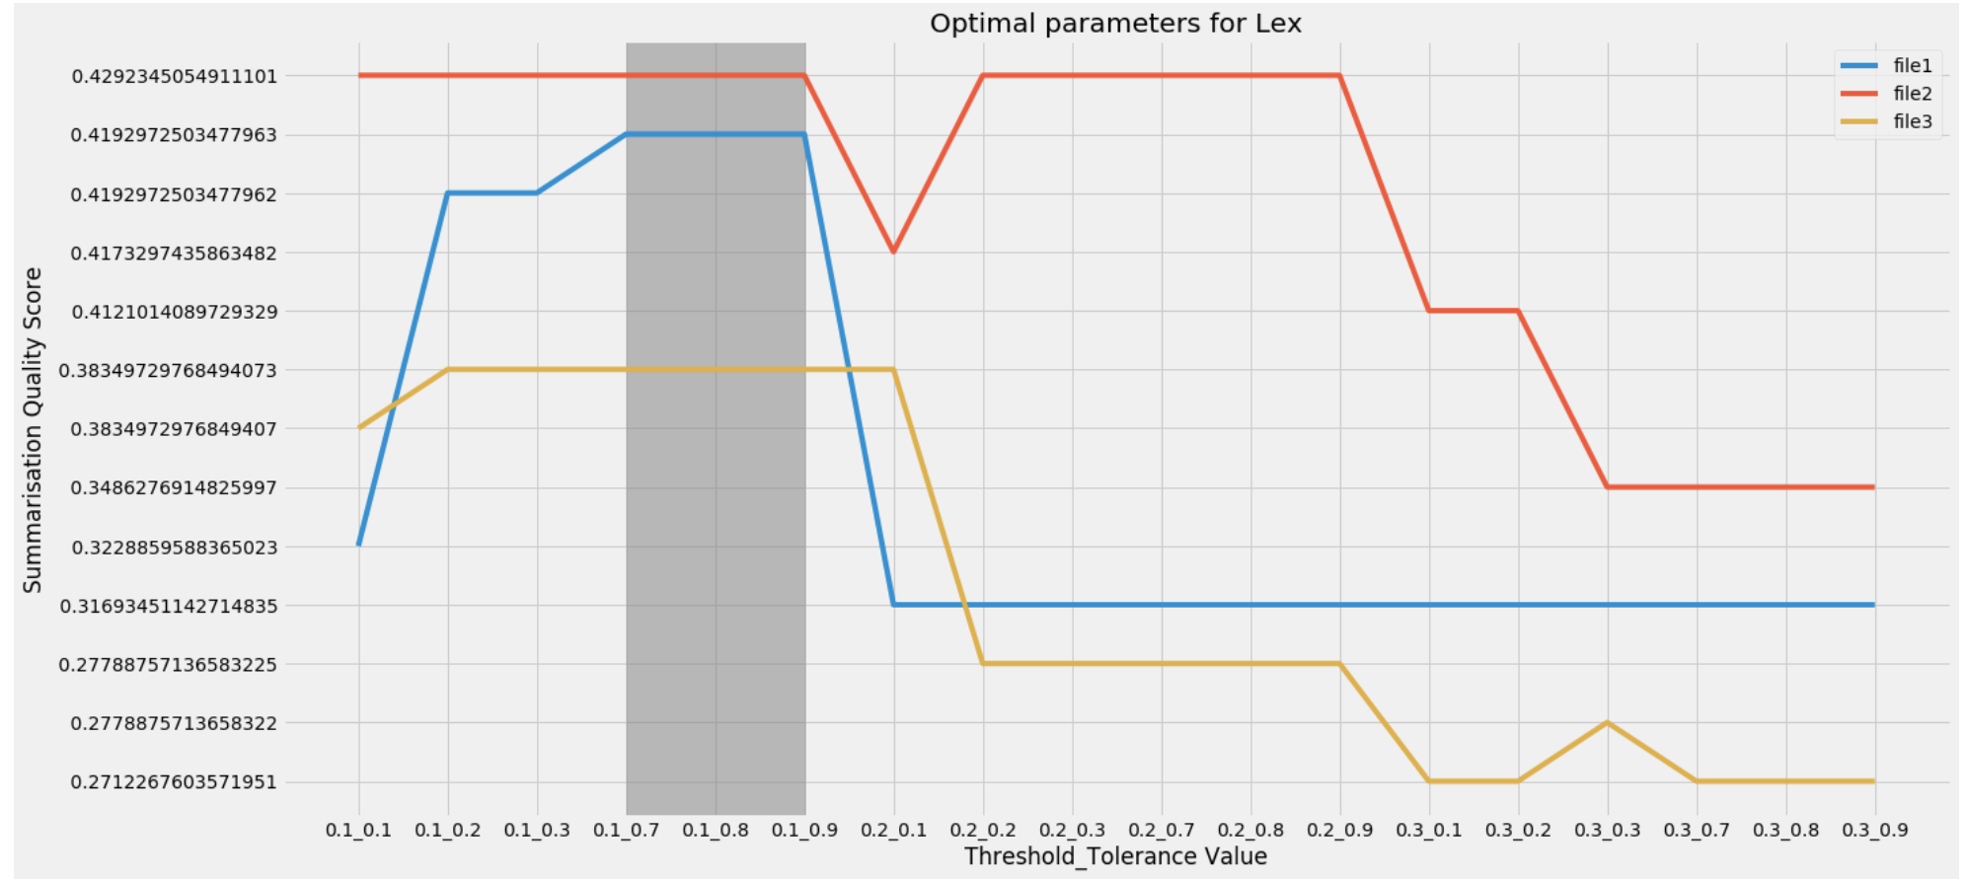
Lex Rank Parameter Optimisation

Slide 17
Informative Redundancy Removal
2. Calculated log entropy for each sentence to identify semantically similar sentences.
Graph showing performance with removal of redundancy.

Slide 18
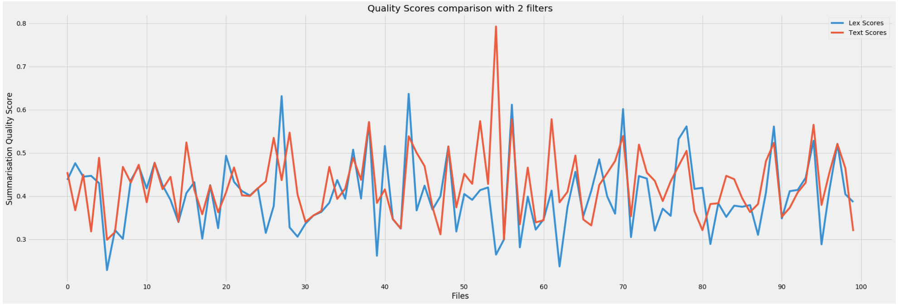
Graph showing performance with removal of redundancy.

Slide 19
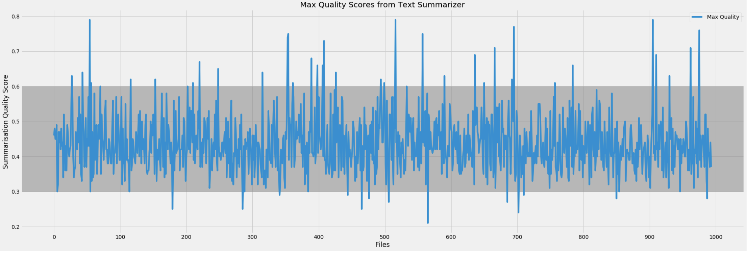
Summarizer Performance on CNN Dataset

Slide 20
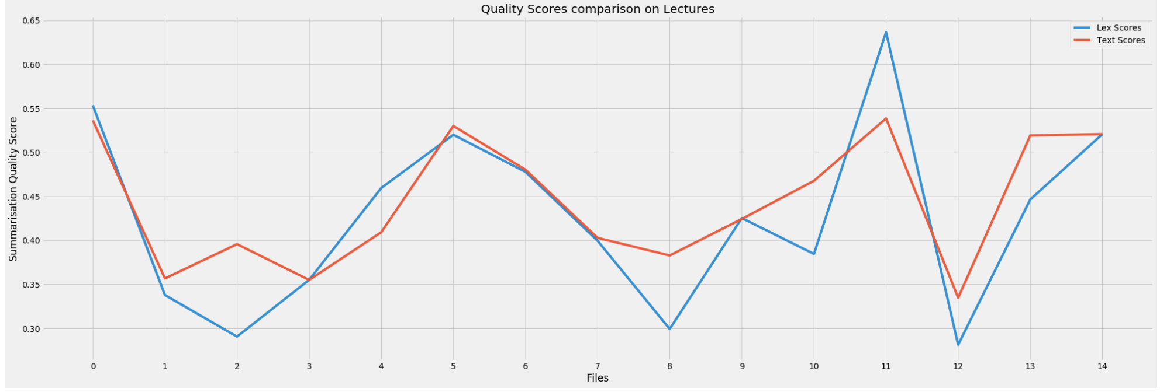
Summarizer Performance on Lecture Dataset

Slide 21
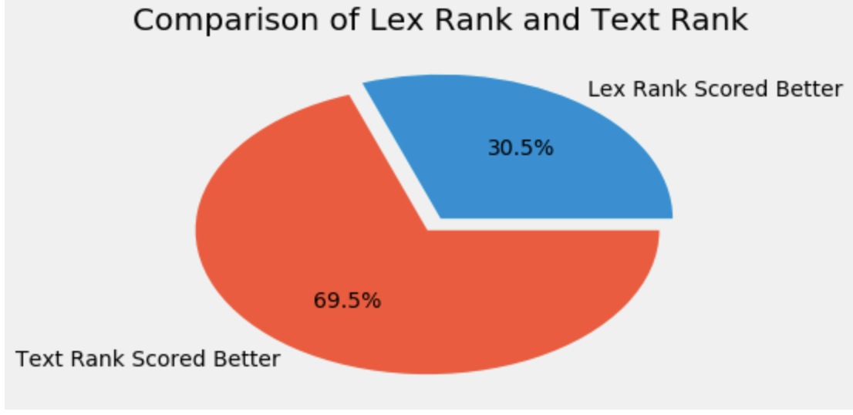
The winner

Slide 22
DEMO

Slide 23
INPUT
Lecture : Solar System
https://www.youtube.com/watch?v=libKVRa01L8
Lecture Transcript: show

Slide 24
Our solar system is one of over five hundred known solar systems in the entire milky way galaxy solar system came into being about four point five billion years ago when a cloud of interstellar gas and dust collapsed, resulting in a solar nebula a swirling disk of material that collided to form the solar system The solar system is located in the milky way's ryan star cluster on lee fifteen percent of stars in the galaxy host planetary systems and one of those stars is our own son revolving around the sun are eight planets the planets are divided into two categories based on their composition terrestrial and jovian terrestrial planets including mercury, venus, earth and mars are primarily made of rocky material Their services are solid, they don't have ring systems, they have very few or no moons and they are relatively small The smallest and closest to the sun is mercury, which has the shortest orbit in the solar system at about three earth monthsVenus is the hottest planet with temperatures of up to eight hundred sixty seven degrees fahrenheit due to an atmosphere of carbon dioxide and extensive lava flows Next to this world of fire is a world of water earth water systems on this planet helped create the only known environment in the universe capable of sustaining life the last of the terrestrial planets mars might have also supported life about three point seven a billion years ago when the planet had a watery surface and moist atmosphere beyond the four terrestrial planets of the inner solar system lie that jovian planets of the outer solar system the jovian planets include gas giants jupiter and saturn and ice giant it's uranus and neptune the gas giants are predominantly made of helium and hydrogen and the ice giants also contained rock eyes and a liquid mixture of water, methane and ammonia All four jovian planets have multiple moons sport ring systems have no solid surface and are immense the largest jovian is also the largest planet in the solar system jupiter nearby is saturn the solar system's second largest planet its signature rings are wide enough to fit between earth and the moon but are barely a kilometer thick past saturn are the ice giants uranus and neptune the slightly bigger of these ice giants uranus is famous for rotating on its side next uranus is neptune the outermost planet in the solar system and also one of the coldest orbiting the terrestrial planets is the asteroid belt a flat disk of rocky objects full of remnants from the solar system's formacion from microscopic dust particles to the largest known object the dwarf planet siri's another disc of space debris lies much further out and orbits the jovian planets the icy copperbelt apart from asteroids, the kiper belt is also home to dwarf planets such as plato and is the birthplace of many comments beyond the keiper belt is the or cloud, a vast spirit, kal collection of icy debris It is considered the edge of the solar system, since that is where the gravitational and physical influences of the sun end our solar system's particular configuration of planets and other celestial objects, all revolving around a life giving star Make it a special place to call home

Slide 25
Summary from Text Rank
solar system came into being about four point five billion years ago when a cloud of interstellar gas and dust collapsed, resulting in a solar nebula a swirling disk of material that collided to form the solar system
beyond the four terrestrial planets of the inner solar system lie that jovian planets of the outer solar system
the solar system's second largest planet its signature rings are wide enough to fit between earth and the moon but are barely a kilometer thick past saturn are the ice giants uranus and neptune the slightly bigger of these ice giants
uranus is famous for rotating on its side next uranus is neptune the outermost planet in the solar system and also one of the coldest orbiting the terrestrial planets is the asteroid belt a flat disk of rocky objects full of remnants from the solar system's formacion from microscopic dust particles to the largest known object

Slide 26
Summary from Lex Rank
Beyond the four terrestrial planets of the inner solar system lie that jovian planets of the outer solar system
the solar system's second largest planet its signature rings are wide enough to fit between earth and the moon but are barely a kilometer thick past saturn are the ice giants uranus and neptune the slightly bigger of these ice giants
uranus is famous for rotating on its side next uranus is neptune the outermost planet in the solar system and also one of the coldest orbiting the terrestrial planets is the asteroid belt a flat disk of rocky objects full of remnants from the solar system's formacion from microscopic dust particles to the largest known object
the dwarf planet siri's another disc of space debris lies much further out and orbits the jovian planets the icy copperbelt

Slide 27

Output
Audio clip of summary
Textrank Summary audio clip
Lexrank Summary audio clip

Slide 28
Output
Braille Text of Summary
⠃⠑⠽⠕⠝⠙ ⠞⠓⠑ ⠋⠕⠥⠗ ⠞⠑⠗⠗⠑⠎⠞⠗⠊⠁⠇ ⠏⠇⠁⠝⠑⠞⠎ ⠕⠋ ⠞⠓⠑ ⠊⠝⠝⠑⠗ ⠎⠕⠇⠁⠗ ⠎⠽⠎⠞⠑⠍ ⠇⠊⠑ ⠞⠓⠁⠞ ⠚⠕⠧⠊⠁⠝ ⠏⠇⠁⠝⠑⠞⠎ ⠕⠋ ⠞⠓⠑ ⠕⠥⠞⠑⠗ ⠎⠕⠇⠁⠗ ⠎⠽⠎⠞⠑⠍
⠞⠓⠑ ⠎⠕⠇⠁⠗ ⠎⠽⠎⠞⠑⠍'⠎ ⠎⠑⠉⠕⠝⠙ ⠇⠁⠗⠛⠑⠎⠞ ⠏⠇⠁⠝⠑⠞ ⠊⠞⠎ ⠎⠊⠛⠝⠁⠞⠥⠗⠑ ⠗⠊⠝⠛⠎ ⠁⠗⠑ ⠺⠊⠙⠑ ⠑⠝⠕⠥⠛⠓ ⠞⠕ ⠋⠊⠞ ⠃⠑⠞⠺⠑⠑⠝ ⠑⠁⠗⠞⠓ ⠁⠝⠙ ⠞⠓⠑ ⠍⠕⠕⠝ ⠃⠥⠞ ⠁⠗⠑ ⠃⠁⠗⠑⠇⠽ ⠁ ⠅⠊⠇⠕⠍⠑⠞⠑⠗ ⠞⠓⠊⠉⠅ ⠏⠁⠎⠞ ⠎⠁⠞⠥⠗⠝ ⠁⠗⠑ ⠞⠓⠑ ⠊⠉⠑ ⠛⠊⠁⠝⠞⠎ ⠥⠗⠁⠝⠥⠎ ⠁⠝⠙ ⠝⠑⠏⠞⠥⠝⠑ ⠞⠓⠑ ⠎⠇⠊⠛⠓⠞⠇⠽ ⠃⠊⠛⠛⠑⠗ ⠕⠋ ⠞⠓⠑⠎⠑ ⠊⠉⠑ ⠛⠊⠁⠝⠞⠎
⠥⠗⠁⠝⠥⠎ ⠊⠎ ⠋⠁⠍⠕⠥⠎ ⠋⠕⠗ ⠗⠕⠞⠁⠞⠊⠝⠛ ⠕⠝ ⠊⠞⠎ ⠎⠊⠙⠑ ⠝⠑⠭⠞ ⠥⠗⠁⠝⠥⠎ ⠊⠎ ⠝⠑⠏⠞⠥⠝⠑ ⠞⠓⠑ ⠕⠥⠞⠑⠗⠍⠕⠎⠞ ⠏⠇⠁⠝⠑⠞ ⠊⠝ ⠞⠓⠑ ⠎⠕⠇⠁⠗ ⠎⠽⠎⠞⠑⠍ ⠁⠝⠙ ⠁⠇⠎⠕ ⠕⠝⠑ ⠕⠋ ⠞⠓⠑ ⠉⠕⠇⠙⠑⠎⠞ ⠕⠗⠃⠊⠞⠊⠝⠛ ⠞⠓⠑ ⠞⠑⠗⠗⠑⠎⠞⠗⠊⠁⠇ ⠏⠇⠁⠝⠑⠞⠎ ⠊⠎ ⠞⠓⠑ ⠁⠎⠞⠑⠗⠕⠊⠙ ⠃⠑⠇⠞ ⠁ ⠋⠇⠁⠞ ⠙⠊⠎⠅ ⠕⠋ ⠗⠕⠉⠅⠽ ⠕⠃⠚⠑⠉⠞⠎ ⠋⠥⠇⠇ ⠕⠋ ⠗⠑⠍⠝⠁⠝⠞⠎ ⠋⠗⠕⠍ ⠞⠓⠑ ⠎⠕⠇⠁⠗ ⠎⠽⠎⠞⠑⠍'⠎ ⠋⠕⠗⠍⠁⠉⠊⠕⠝ ⠋⠗⠕⠍ ⠍⠊⠉⠗⠕⠎⠉⠕⠏⠊⠉ ⠙⠥⠎⠞ ⠏⠁⠗⠞⠊⠉⠇⠑⠎ ⠞⠕ ⠞⠓⠑ ⠇⠁⠗⠛⠑⠎⠞ ⠅⠝⠕⠺⠝ ⠕⠃⠚⠑⠉⠞
⠞⠓⠑ ⠙⠺⠁⠗⠋ ⠏⠇⠁⠝⠑⠞ ⠎⠊⠗⠊'⠎ ⠁⠝⠕⠞⠓⠑⠗ ⠙⠊⠎⠉ ⠕⠋ ⠎⠏⠁⠉⠑ ⠙⠑⠃⠗⠊⠎ ⠇⠊⠑⠎ ⠍⠥⠉⠓ ⠋⠥⠗⠞⠓⠑⠗ ⠕⠥⠞ ⠁⠝⠙ ⠕⠗⠃⠊⠞⠎ ⠞⠓⠑ ⠚⠕⠧⠊⠁⠝ ⠏⠇⠁⠝⠑⠞⠎ ⠞⠓⠑ ⠊⠉⠽ ⠉⠕⠏⠏⠑⠗⠃⠑⠇⠞

Slide 29

THANK YOU

