Slide 1
Project Based Learning -IV
Team Details:
Jatin Verma(2110993803)
Kangna Galhotra(2110993804)
Faculty Coordinator: Dr. Kamal Deep Garg
:
Chitkara University Institute of Engineering and Technology,
Chitkara University, Punjab

Slide 2
Table of Contents
Introduction
Research objectives
Dataset
Preprocessing of dataset
Models details
Flowchart
Experiments
Results
Analysis
Conclusion

Slide 3
Introduction
HOUSE PRICE PREDICTION
Jatin Verma and Kangna Galhotra
House price prediction refers to the estimation of the future value or selling price of residential properties in the real estate market. It involves utilizing various factors and data points to forecast the potential price at which a house is likely to be sold. This prediction is valuable for buyers, sellers, investors, and real estate professionals who are involved in property transactions.
The significance of house price prediction in real estate markets can be understood from several perspectives:
Informed Buying and Selling: For prospective buyers, accurate price predictions enable them to make informed decisions about the affordability and value of a property. Sellers can set competitive prices based on market trends and predictions, attracting potential buyers and facilitating faster transactions.
Investment Decision Making: House price prediction is crucial for investors who aim to generate returns through real estate. By accurately predicting price trends, investors can identify lucrative investment opportunities, time their buying and selling decisions, and maximize their profits.
Market Analysis and Planning: House price predictions play a vital role in market analysis and planning for real estate professionals, developers, and policymakers. They provide insights into market trends, demand-supply dynamics, and potential risks. This information assists in formulating strategies, identifying target markets, and making informed decisions about development projects.
Risk Management: House price prediction helps individuals and organizations manage risks associated with real estate investments. By assessing the potential appreciation or depreciation of property values, investors can make informed decisions about diversifying their portfolios, managing cash flows, and mitigating potential losses.

Slide 4
Research objectives
Size and Area: The total area of the property, including both the land and the house, is an essential feature. It is typically measured in square feet or square meters.
Number of Bedrooms and Bathrooms: The number of bedrooms and bathrooms in a house is a fundamental feature. It gives an indication of the property's capacity and affects its value.
Location: The location of the house is a crucial factor in determining its price. This includes factors such as the neighborhood, proximity to amenities (schools, parks, shopping centers), transportation access, and desirability of the area.
Property Age: The age of the house is an important feature. Older houses may have lower prices due to factors like wear and tear, outdated features, or the need for renovations.
Property Condition: The overall condition of the house influences its value. Well-maintained properties or those with recent renovations tend to command higher prices.
Amenities and Features: Special amenities and features like swimming pools, garages, fireplaces, outdoor spaces, smart home technology, and energy-efficient systems can affect the price.

Slide 5
Amenities and Features: Special amenities and features like swimming pools, garages, fireplaces, outdoor spaces, smart home technology, and energy-efficient systems can affect the price.
Architectural Style: The architectural style of a house can impact its value. Certain styles may be more desirable in specific markets or have unique characteristics that attract buyers.
View and Natural Light: Houses with attractive views, such as waterfront or scenic landscapes, or those that receive ample natural light, may have higher prices.
Upgrades and Renovations: Recent upgrades and renovations, such as a modernized kitchen, updated appliances, renovated bathrooms, or new flooring, can add value to a property.
Comparable Sales: Historical data of similar properties in the area, known as comparables or comps, can provide insights into the pricing trends and help in estimating house prices accurately.
Market Conditions: Factors such as supply and demand dynamics, interest rates, and overall market conditions play a role in determining house prices. Monitoring these macroeconomic factors helps in understanding the current market environment.
Seasonal Factors: Housing market trends can fluctuate seasonally. Accounting for seasonal variations can improve the accuracy of price predictions, as certain times of the year may exhibit higher or lower demand

Slide 6
Dataset
The dataset we have used for training and testing in our model have more than 50 parameters some of them are :
MSZoning: The general zoning classification
LotFrontage: Linear feet of street connected to property
LotArea: Lot size in square feet
Street: Type of road access
Alley: Type of alley access
LotShape: General shape of property
LandContour: Flatness of the property
LandSlope: Slope of property
Neighborhood: Physical locations within Ames city limits
Condition1: Proximity to main road or railroad
Condition2: Proximity to main road or railroad (if a second is present)
BldgType: Type of dwelling
HouseStyle: Style of dwelling
OverallQual: Overall material and finish quality
OverallCond: Overall condition rating
YearBuilt: Original construction date
YearRemodAdd: Remodel date
RoofStyle: Type of roof

Slide 7
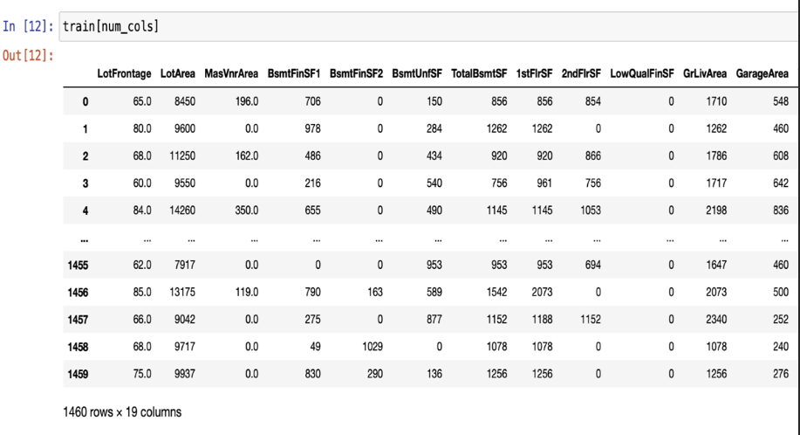
Preprocessing of dataset
Clean the dataset: Handle missing values, outliers, and inconsistent data.
Normalize or scale the features: Standardize the numerical features to ensure they have a similar scale and distribution.

Slide 8
Models details
Random Forest Regressor: Random forest regression is a supervised learning algorithm and bagging technique that uses an ensemble learning method for regression in machine learning. The trees in random forests run in parallel, meaning there is no interaction between these trees while building the trees.
Elastic Net: Elastic net linear regression uses the penalties from both the lasso and ridge techniques to regularize regression models. The technique combines both the lasso and ridge regression methods by learning from their shortcomings to improve the regularization of statistical models
Support Vector Regressor: Support Vector Regression (SVR) is a type of machine learning algorithm used for regression analysis. The goal of SVR is to find a function that approximates the relationship between the input variables and a continuous target variable, while minimizing the prediction error
Gradient Boosting Regressor: Gradient boosting Regression calculates the difference between the current prediction and the known correct target value.

Slide 9
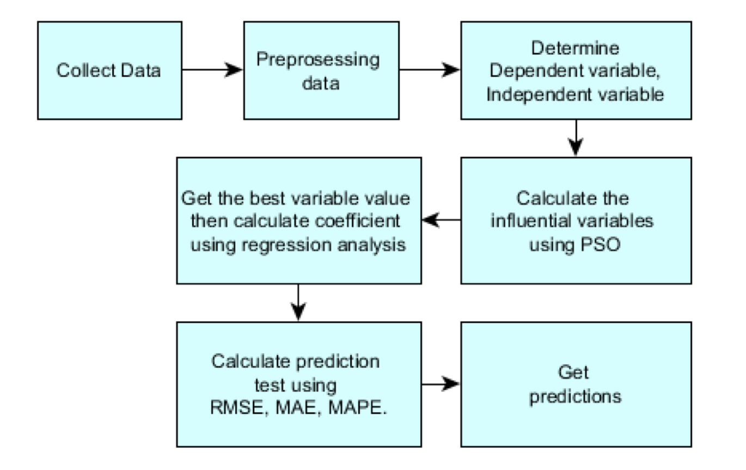
Flowchart

Slide 10
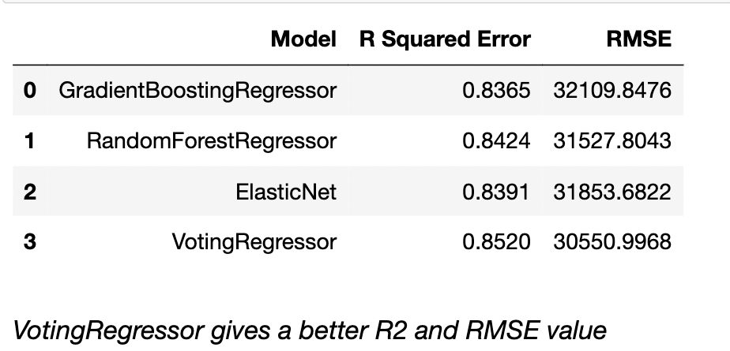
Results

Slide 11
Analysis
Among the models, Voting Regressor showed the best performance, achieving low mean RMSE and high mean R-squared values. Random Forest Regressor also performed well, with a comparable RMSE to Elastic Net and Gradient Boosting Regressor but a slightly lower R-squared. SVR exhibited poor performance, with a high RMSE and a negative R-squared, indicating its limitations for house price prediction in this case.

Slide 12
Conclusion
In conclusion, the task of house price prediction is of significant importance in real estate markets. Accurate prediction of house prices allows buyers, sellers, and investors to make informed decisions and navigate the complex real estate landscape. Machine learning techniques play a crucial role in addressing this problem by leveraging historical data and learning patterns to make predictions.
During the analysis, we explored various regression algorithms for house price prediction, including Elastic Net, SVR, Random Forest Regressor, and Gradient Boosting Regressor. Among these, Elastic Net and Gradient Boosting Regressor showed promising results, achieving low mean squared error (RMSE) and high R-squared values. These algorithms effectively capture the relationships between input features and house prices, allowing for accurate predictions.
On the other hand, SVR exhibited poorer performance in this context, with high RMSE and a negative R-squared value. This suggests that SVR may not be suitable for house price prediction in this particular scenario.
Overall, the choice of the regression algorithm depends on the specific dataset, problem requirements, and desired trade-offs between interpretability and predictive accuracy. It is crucial to perform thorough evaluation and fine-tuning of the chosen algorithm, including hyperparameter optimization, to ensure optimal performance.
Future work in house price prediction could involve exploring ensemble methods, feature engineering techniques, and additional regression algorithms to further improve prediction accuracy. Additionally, incorporating domain-specific knowledge and external factors such as economic indicators or neighborhood characteristics may enhance the predictive power of the models.
By employing machine learning techniques, we can harness the power of data to make more informed decisions in the real estate market and facilitate better outcomes for buyers, sellers, and investors.

Slide 13


