Slide 1
Inference of features
By Vishal

Slide 2
Features Summary
Time
Use(kw)
Gen(kw)
House overall (kw)
Applinaces
Solar Energy influencers

Slide 3
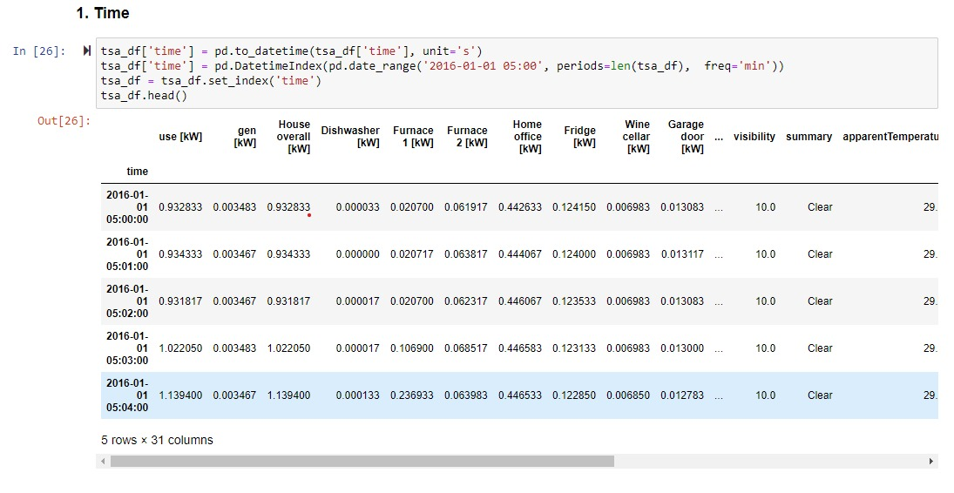
Time related feature
Time object converted to Time stamp
So We perform time series analysis
Data consist minute data of 350 days
We can derive hourly or daily time stamp
We can predict future consumption in terms of minute, hour, days, week etc.

Slide 4
Feature: Use(kw)
Total Energy consumption
From Usage history we can predict future usages
So we optimize usage

Slide 5
Features Gen(kw)
Total energy generated by solar power
This will help us to distribution energy
Gives capacity of energy can provide to us
It will lead us to different insights like
When we need more energy than generated Energy
When we need less enegy than generated Energy

Slide 6
Features: House overall (kw)
overall house energy consumption
Calculated from each appliances

Slide 7
Features Applinaces
energy consumed by specific appliance
It will shows behavior of user in energy consumption
Also shows seasonal usage

Slide 8
Features: Solar Energy influencers
This feature will impact solar energy
There are different influencers like wind, temperature
So important for calculate and predict good values of solar enegy

Slide 9
Thank You

