Slide 1
INFO251 – Applied Machine Learning
Lab 10
Suraj R. Nair

Slide 2
Topics
Convolutional neural networks (CNNs)

Slide 3
Convolutional Layers
Goal: Capture the spatial dependencies in parts of an image
Multiply a kernel matrix (“filter”) k by subsets of the input image
Hyperparameter: Size of k (often 3x3, 5x5, or 7x7)
Learn: The weights of k
Stride: How to shift the kernel matrix
Hyperparameter: Stride value (integer)

Slide 4
Convolutional Layers
Channels: Number of ”layers” in the input image
Grayscale: 1 channel
RGB: 3 channels
RGBA: 4 channels
Same filter size and stride length, but each channel has different weights
Outputs of channels are summed up

Slide 5
Pooling Layers
Goal: Reduce size of convolved layer to decrease compute cost
Again, operates kernel matrix k over the convolved matrix
Hyperparameter: Size of k (usually 2x2)
Hyperparameter: Stride width (usually 2)
Max pooling: Return maximum value in area covered by kernel
Average pooling: Return average value in area covered by kernel

Slide 6
Convolutional Neural Network Structure
Convolutional layer
Pooling layer
Convolutional layer
Pooling layer
Flatten
Fully connected layer(s) (activation: sigmoid/tanh/relu)
Output layer (activation: determined by problem type)
Repeat convolution followed by pooling any number of times. Option to add dropout after pooling.
Add any number of fully connected layers. Option to add dropout.

Slide 7
Dimensions
In general, output size from a convolutional layer: [(N − F + 2P)/S] + 1
N: Input image dimensions (e.g. 28 X 28)
F: Filter / Kernel dimension(e.g. 3 X 3)
P: Padding (default 0)
S: Stride (default 1)
Number of parameters associated with a convolutional layer: ((f * f * d)+1)* k)
d is the number of filters/ channels in the previous layer
k is the number of filters in the current layer

Slide 8
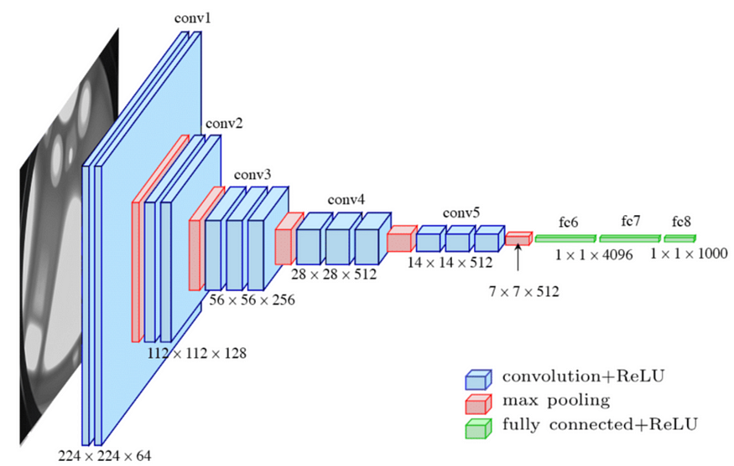
Example: VGG-16 (Simonyan & Zisserman, 2015)

