Slide 1
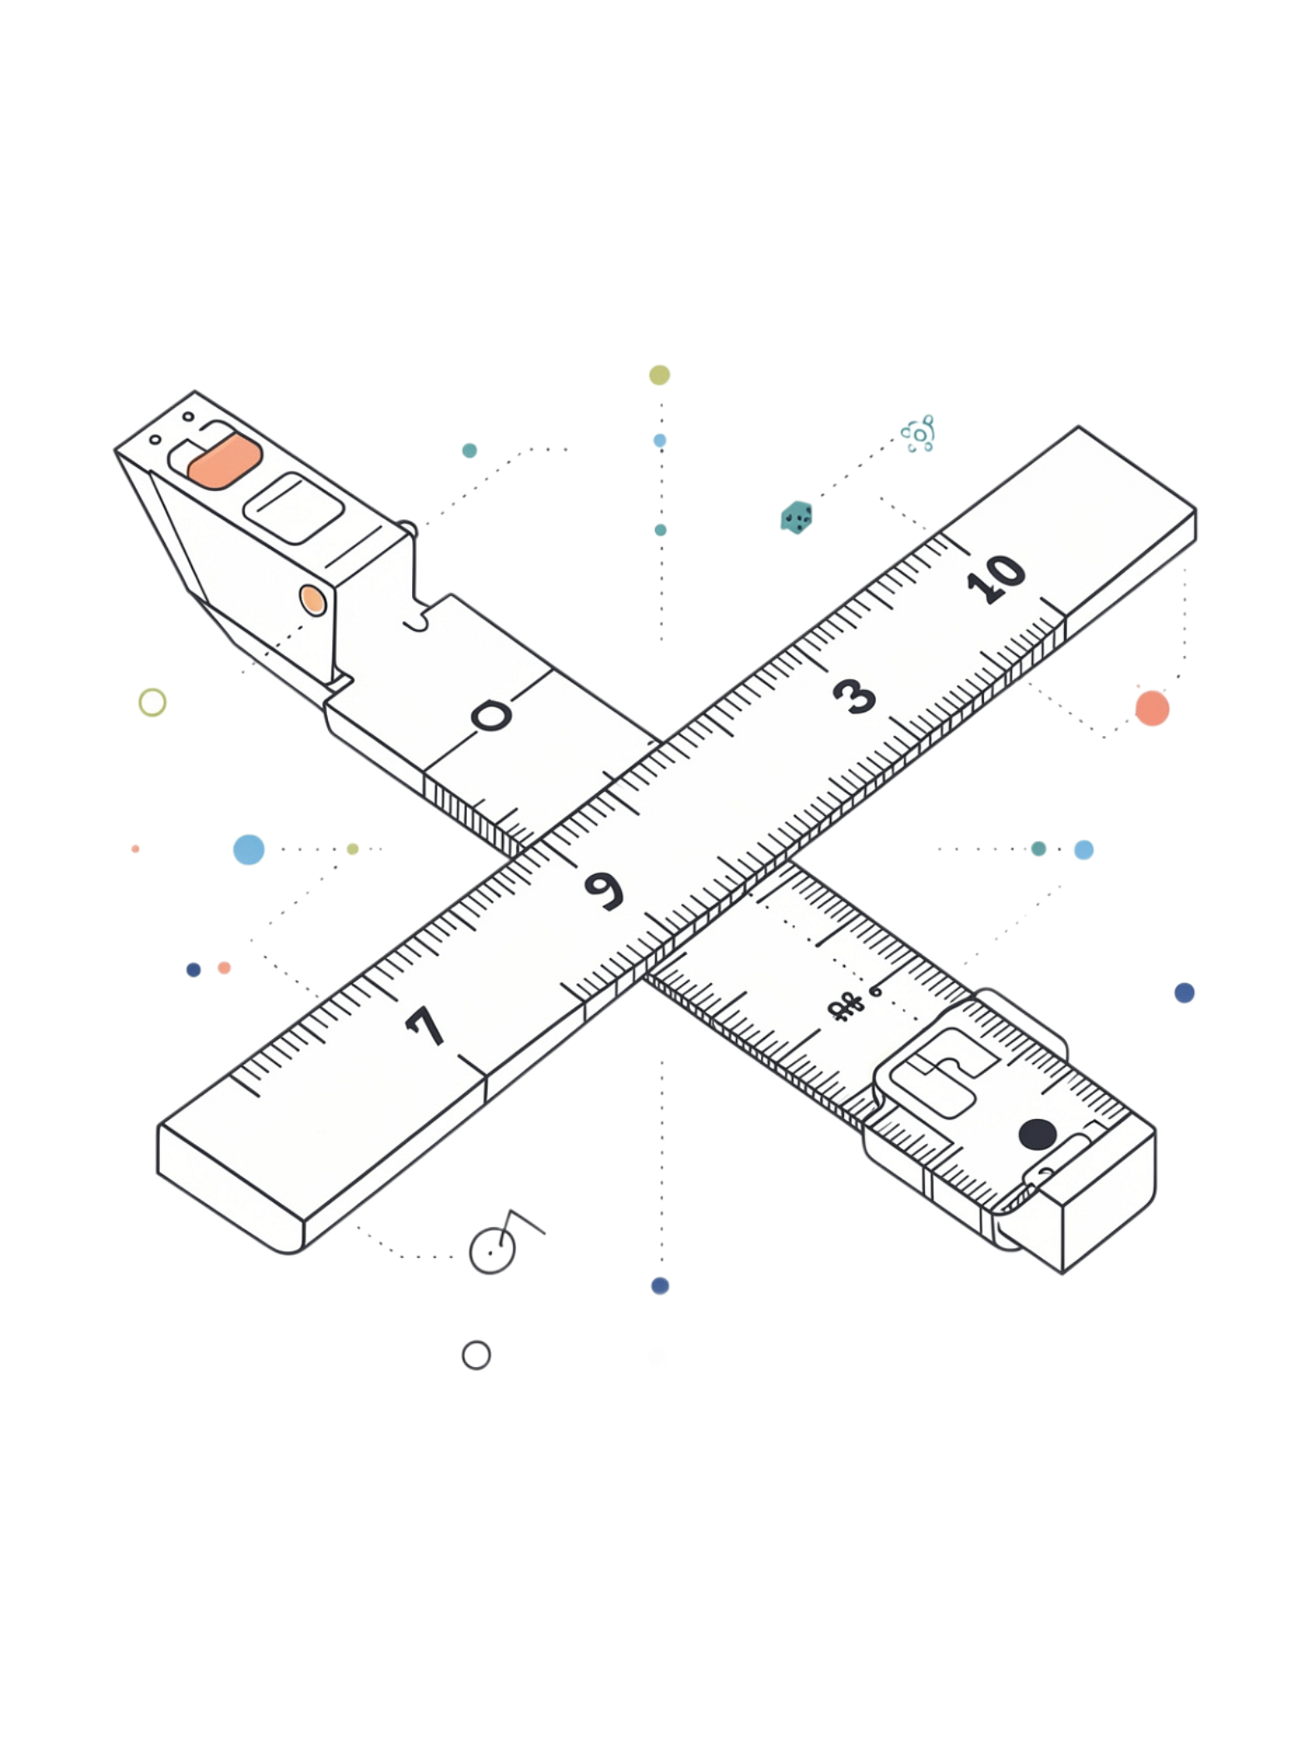
SI Units & Unit Conversion
Class 11 Physics · 30-Minute Lecture

Slide 2
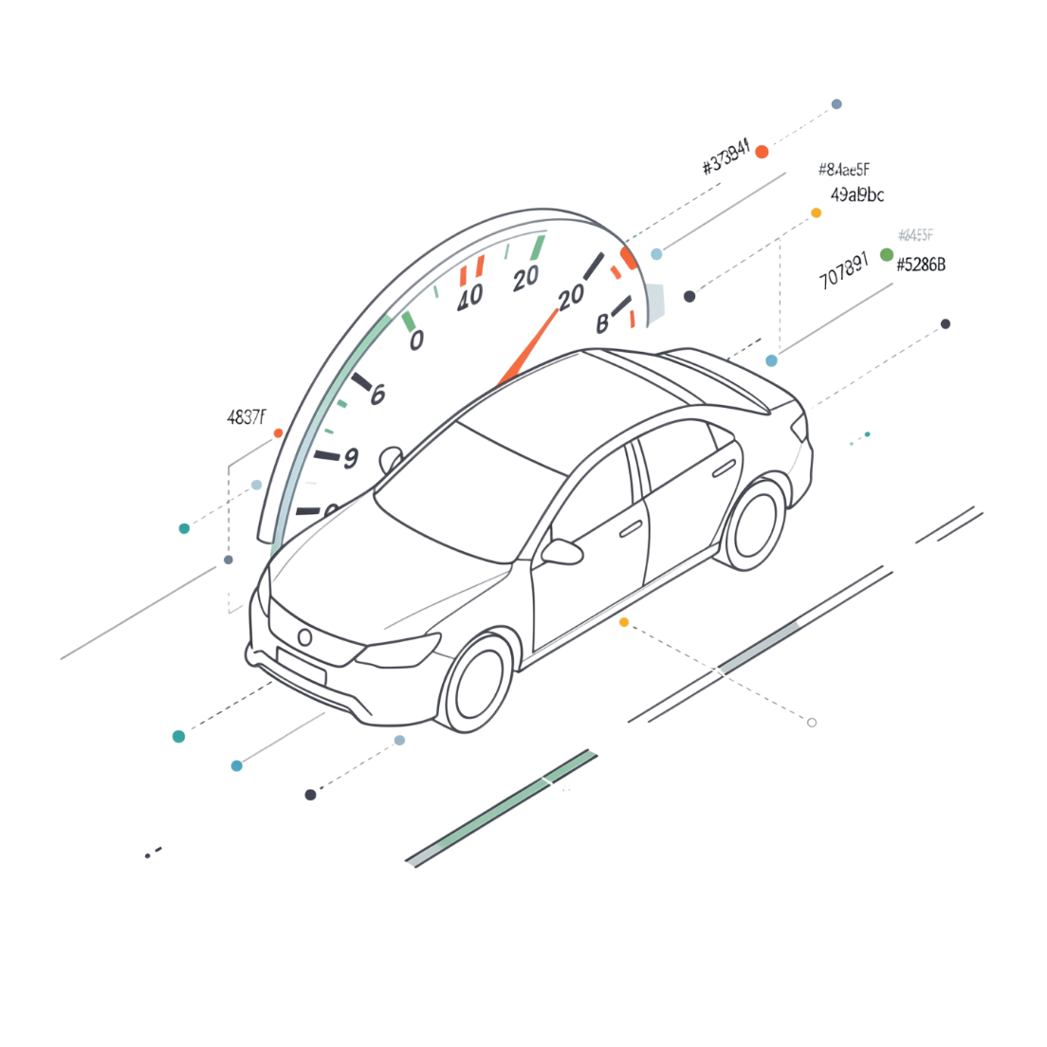

HOOK QUESTION
Why can't we simply say the speed of a car is 20?
What's missing?
Think about it — 20 what? Miles? Kilometers? Meters per second?
A number alone is meaningless without a unit.

Slide 3

What is a Measurement?
Number
Unit
The magnitude — how much
The standard — of what
Together
5 meters · 10 seconds · 2 kilograms

Slide 4
The 7 SI Base Units
Quantity
Unit
Symbol
Length
Meter
m
Mass
Kilogram
kg
Time
Second
s
Temperature
Kelvin
K
Electric Current
Ampere
A
Luminous Intensity
Candela
cd
Amount of Substance
Mole
mol

Slide 5
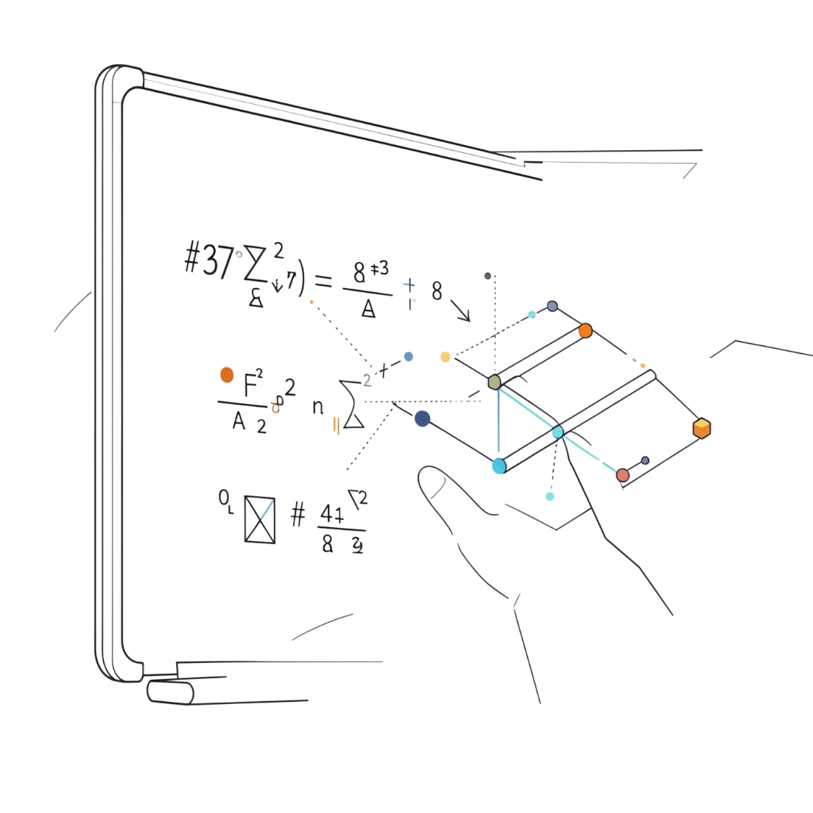

Derived Units
Definition: Units formed by combining SI base units through multiplication or division.
Force — Newton (N)
Energy — Joule (J)
Power — Watt (W)
kg · m/s²
kg · m²/s²
kg · m²/s³

Slide 6

Why Convert Units?
The Problem
Real-world data arrives in mixed, inconsistent units
The Requirement
Physics equations demand complete unit consistency on both sides

Slide 7

Converting km/h → m/s
Time
1 h = 3600 s
DERIVE ON BOARD
Key Relation
1 km/h = 5/18 m/s ≈ 0.278 m/s
Distance
Convert
Notes
1 km = 1000 m
Divide by 3.6 or ×5/18
Follow the derivation on the board step by step.

Slide 8
DERIVE ON BOARD
Quick Reference
Converting m/s → km/h
→ km/h to m/s: × 5/18
→ m/s to km/h: × 18/5
→ m/s to km/h: × 3.6
Reciprocal of the previous conversion
My Notes
Key Relation
1 m/s = 18/5 km/h = 3.6 km/h
Multiply by 3.6 to convert from m/s to km/h.

Slide 9

Practice: Speed Conversions
1
2
72 km/h = ? m/s
10 m/s = ? km/h
72 × (5/18) = 20 m/s
10 × (18/5) = 36 km/h
Space for your working below ↓

Slide 10
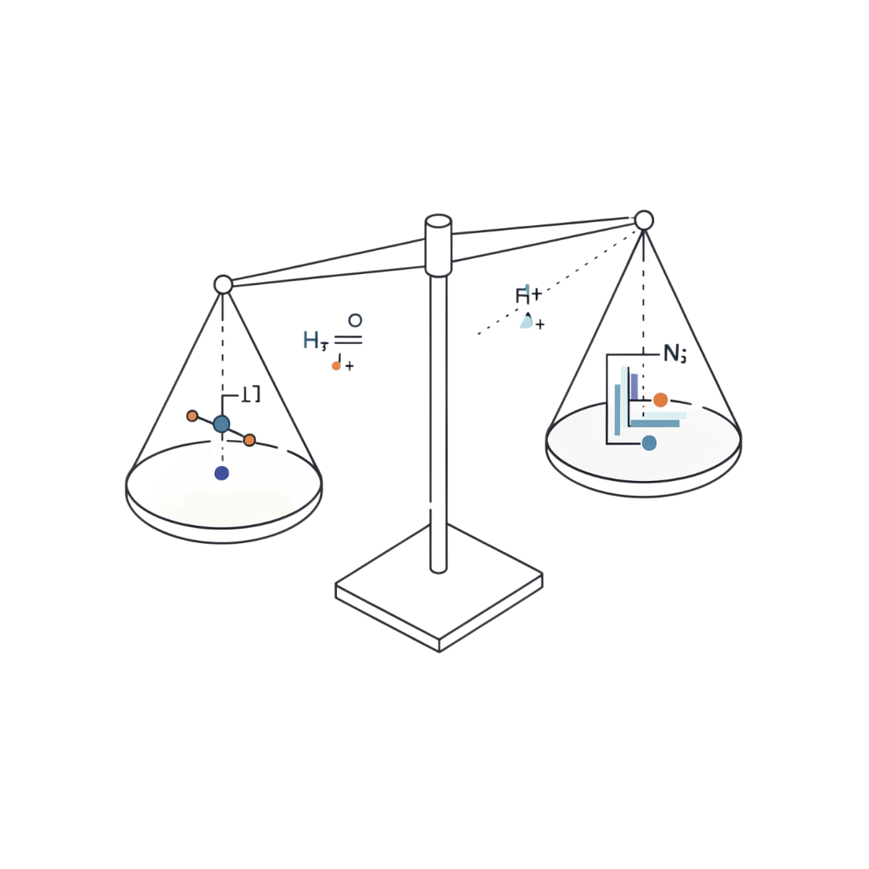
Dimensional Analysis
Rule: Both sides of any equation must carry the same dimensions.
Dimensions don't lie — use them to verify every formula.
Check F = ma
[kg · m/s²] = [kg] × [m/s²] ✓
Notes

Slide 11

Exit Question
Why can't we simply say the speed of a car is 20?
Write your answer in the space below — in one complete sentence, explain what makes a measurement meaningful.

