Slide 1
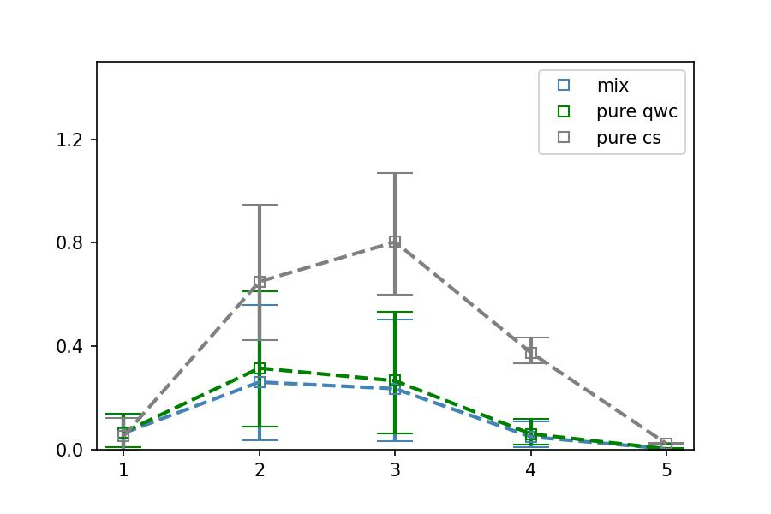
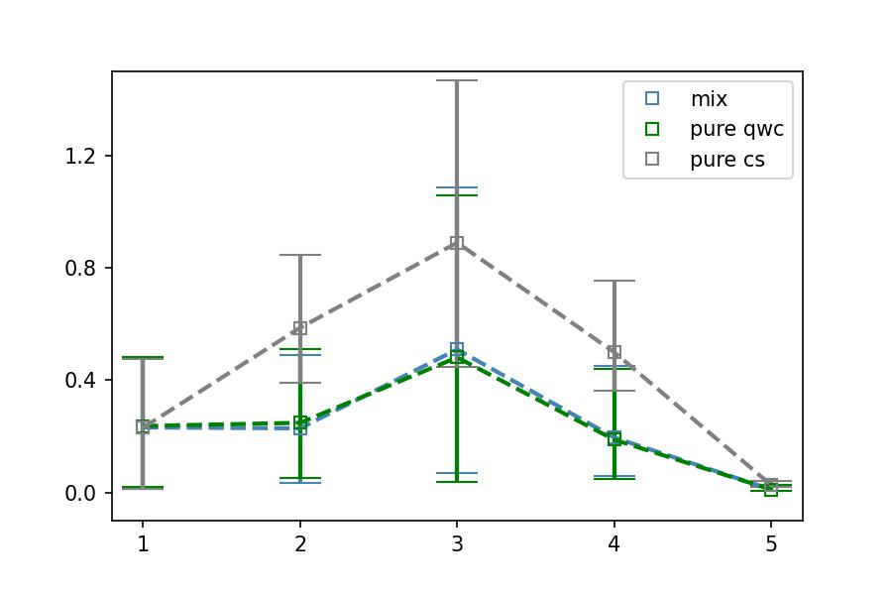
Noiseless Linear 4 | Noisy Linear 4
Noiseless Linear 6 | Noisy Linear 6
Fixed shots mix
MAE W.R.T. Analytical PDS (95% Confidence Intervals)
K in PDS(K)

