Slide 1


BioHEL hands-on demo IWLCS 2019
Jaume Bacardit
Interdisciplinary Computing and Complex BioSystems (ICOS) research group, Newcastle University, UK
jaume.bacardit@newcastle.ac.uk
Twitter: @jaumebp

Slide 2
BioHEL in a nutshell
BioHEL is an evolutionary machine learning system designed explicitly to deal with noisy large-scale datasets
It learns sets of classification rules by applying the separate-and-conquer approach of rule learning
Is it Pittsburgh?
Probably not: An individual is not the whole solution
Is it Michigan?
While individuals are single rules, there is no RL component
Function IterativeRuleLearning(TrainingSet TR)
Solution = Create empty rule set
While(TR is not empty) {
Rule = Run Genetic Algorithm to generate a rule from TR
Add Rule to Solution
Remove from TR the examples covered by Rule
}
Return Solution
J. Bacardit, E.K. Burke and N. Krasnogor. Improving the scalability of rule-based evolutionary learning. Memetic Computing journal 1(1):55-67, 2009

Slide 3
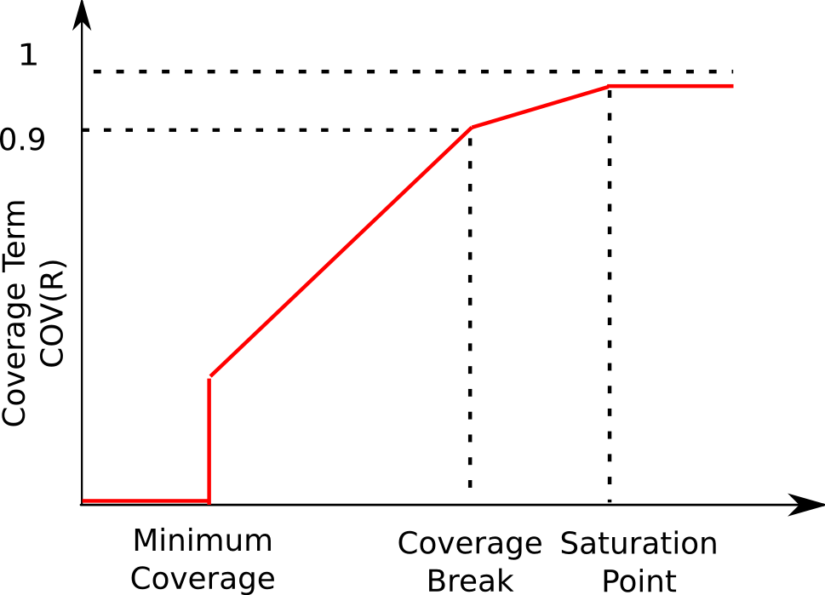
BioHEL’s fitness function
An objective function based on the Minimum-Description-Length (MDL) (Rissanen,1978) principle that tries to promote rules with
High accuracy: not making mistakes
High coverage: covering as much examples as possible without sacrificing accuracy. Recall (TP/(TP+FN)) will be used to define class-wise coverage
Low complexity: rules as simple and general as possible
The objective function is a linear combination of the three objectives above
Coverage is redefined to enforce it is not ignored at the expense of accuracy

Slide 4
BioHEL’s main components
An explicit default rule mechanism
Generating more compact rule sets
Iterative process terminates when it is impossible to evolve a rule where the associated class is the majority class among the matched examples
At this point, all remaining training instances are assigned to the default class
Attribute list rule representation [Bacardit et al., 2009]
Embeded rule-wise feature selection. Automatically identifying the relevant attributes for a given rule and discarding all the other ones
The ILAS windowing scheme [Bacardit et al., 2004]
Efficiency enhancement method, not all training points are used for each fitness computation
GPU implementation of its rule evaluation [Franco et al., 2010]
Speedups of ~60X on its own, speedups of ~700X when combined with ILAS windowing
With local search operators performing rule editing [Calian & Bacardit, 2013]

Slide 5
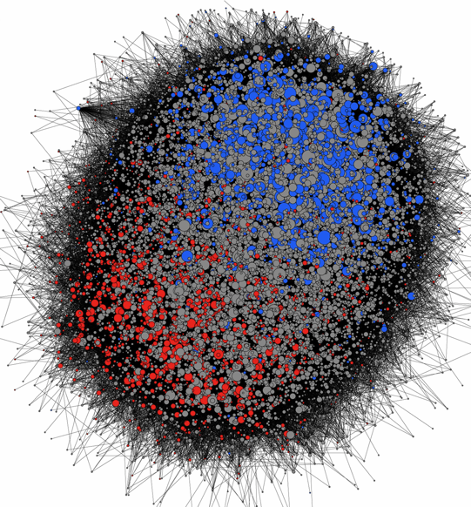
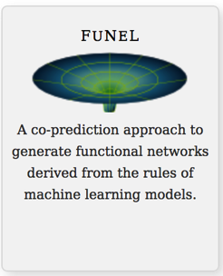
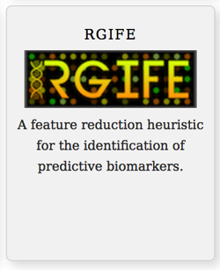
BioHEL for Knowledge Extraction from biodata
Functional Network Construction in Arabidopsis Using Rule-Based Machine Learning on Large-Scale Data Sets. The Plant Cell, 23(9):3101-3116, 2011
Systematic algorithmic pipelines to extract knowledge from data
Heuristics to identify reduced but highly predictive sets of variables (panels of biomarkers)
Swan et al. BMC Genomics 2015, 16(Suppl 1):S2; Lazzarini et al. BMC Bioinformatics 2017 18(1):322
Inference of networks of interactions
Lazzarini et al. BioData Mining 2016, 9:28
Using Rule-Based Machine Learning for Candidate Disease Gene Prioritization and Sample Classification of Cancer Gene Expression Data. PLoS ONE 7(7):e39932. 2012
Mining of models
Final Ranking of variables
Analysis of mass spectrometry data from the secretome of an explant model of articular cartilage exposed to pro-inflammatory and anti-inflammatory stimuli using machine learning. BMC Musculoskeletal Disorders, 14:349, 2013
Dataset
BioHEL
Ensemble of Models
A machine learning heuristic to identify biologically relevant and minimal biomarker panels from omics data, BMC Genomics, 2015, 16(Suppl 1):S2
S. Baron, N. Lazzarini and J. Bacardit. Characterising the Influence of Rule-Based Knowledge Representations in Biological Knowledge Extraction from Transcriptomics Data. Proceedings of EvoApplications 2017, LNCS 10199, p.125-141, Springer, 2017
http://ico2s.org/resources.html

Slide 6
How to compile and run BioHEL
All code and example data is available at https://github.com/jaumebp/BioHEL-demo
BioHEL canonic implementation is in C++, and compiles natively in ~unix environments
It requires
A C++ compiler (e.g. G++)
Flex (to parse the config file)
CUDA (for the GPU implementation)
Tested in up to CUDA 10.0
18scompd223 ~/research/src/BioHEL-demo/BioHEL-cuda $ make cuda
/usr/local/cuda/bin/nvcc -O3 --ptxas-options=-v --compiler-options -DUNIX -o kernels.cu.o -c kernels.cu
.
.
.
g++ -O3 -march=native -D__CUDA_COMPILED__=1 -c functions.cpp
g++ -O3 -march=native -D__CUDA_COMPILED__=1 -c random.cpp
.
.
.
g++ -O3 -march=native -D__CUDA_COMPILED__=1 -c main.cpp
g++ -fPIC functions.o kernels.cu.o random.o classifier_gabil.o classifierFitness.o instanceSet.o lex.yy.o instance.o timeManagement.o JString.o populationWrapper.o timersManagement.o ga.o factory.o attributesInfo.o timerHierar.o timerMDL.o timerSymbolicKR.o timerRealKR.o agentPerformance.o utils.o timerGlobals.o timerMutation.o timerEvolutionStats.o windowingILAS.o timerCrossover.o classifier_hyperrect.o mtwist.o agentPerformanceTraining.o classifier_hyperrect_sse.o classifier_rotated_hyperrect.o classifier_hyperrect_list.o windowingGWS.o classifier_hyperrect_list_real.o classifier_hyperrect_list_discrete.o main.o -o biohelcuda -L/usr/local/cuda/lib64/ -lcuda -lcudart

Slide 7
Running BioHEL
biohelcuda <config file> <training file> <test file>
Config file: next page
Training and test files:
Using the ARFF file format of the WEKA machine learning package
Almost like a CSV file but with a metadata section specifying the type of each variable, and in case of discrete variables the set of legal values
For this demo I used the MNIST training/test files converted to ARFF
No special preprocessing, so an extremely naïve representation just for the sake of the demo
Files TrainFold0 and TestFold0

Slide 8
BioHEL’s config file
crossover operator 1px
default class major
fitness function mdl
initialization min classifiers 20
initialization max classifiers 20
iterations 50
mdl initial tl ratio 0.25
mdl iteration 10
mdl weight relax factor 0.90
pop size 500
prob crossover 0.6
prob individual mutation 0.6
prob one 0.75
selection algorithm tournamentwor
tournament size 4
windowing ilas 5
#dump evolution stats
smart init
class wise init
coverage breakpoint 0.005
repetitions of rule learning 2
coverage ratio 0.90
kr hyperrect
num expressed attributes init 15
hyperrectangle uses list of attributes
prob generalize list 0.25
prob specialize list 0.25
minimal interval at initialization 0.25
maximal interval at initialization 0.75
device selected 0
device memory used 0.30
cuda enabled
As always, lots of parameters to potentially tune.
Most important ones are marked in bold
Crucial one is the coverage breakpoint (controls fitness function)
Uncomment “dump evolution stats” to see a trace for each GA iteration

Slide 9
But what if we need to run lots of experiments?
Script runBioHEL.pl
This script will scan the current directory
Find training/test files (prefix TrainFold and TestFold
Find config files (suffix *.conf)
And with the pre-specified number of repetitions run all combinations of config files and training/test pairs of files
Also: If you have a multi-core machine you can specify the number of concurrent runs to execute
18scompd223 ~/research/src/BioHEL-demo/demo $ ../scripts/runBioHEL.pl &
[2] 17739
18scompd223 ~/research/src/BioHEL-demo/demo $ tail -f experiments.log
Fri 12 Jul 12:26:10 BST 2019: Running test1Fold0rep1.out
Fri 12 Jul 12:26:10 BST 2019: Running test1Fold0rep2.out
Fri 12 Jul 12:26:10 BST 2019: Running test1Fold0rep3.out

Slide 10
The experiments have run, what now?
Extract the rule sets out of the BioHEL output files
Use all of these rule sets as an ensemble and predict again all samples of the test set
Compute the predictive performance/confusion matrix of these test predictions

Slide 11
Extract the rule sets (PATH pointing to the scripts directory)
$ ls
README.md test1Fold0rep12.out test1Fold0rep16.out test1Fold0rep1.out test1Fold0rep23.out test1Fold0rep3.out test1Fold0rep7.out TrainFold0
test1.conf test1Fold0rep13.out test1Fold0rep17.out test1Fold0rep20.out test1Fold0rep24.out test1Fold0rep4.out test1Fold0rep8.out
test1Fold0rep10.out test1Fold0rep14.out test1Fold0rep18.out test1Fold0rep21.out test1Fold0rep25.out test1Fold0rep5.out test1Fold0rep9.out
test1Fold0rep11.out test1Fold0rep15.out test1Fold0rep19.out test1Fold0rep22.out test1Fold0rep2.out test1Fold0rep6.out TestFold0
$ extractAllRuleSets.sh
test1Fold0rep10.out
test1Fold0rep11.out
.
.
.
test1Fold0rep9.out
18scompd223 ~/research/src/BioHEL-demo/demo $ ls
README.md rules_test1Fold0rep17.dat rules_test1Fold0rep24.dat rules_test1Fold0rep8.dat test1Fold0rep15.out test1Fold0rep22.out test1Fold0rep6.out
rules_test1Fold0rep10.dat rules_test1Fold0rep18.dat rules_test1Fold0rep25.dat rules_test1Fold0rep9.dat test1Fold0rep16.out test1Fold0rep23.out test1Fold0rep7.out
rules_test1Fold0rep11.dat rules_test1Fold0rep19.dat rules_test1Fold0rep2.dat test1.conf test1Fold0rep17.out test1Fold0rep24.out test1Fold0rep8.out
rules_test1Fold0rep12.dat rules_test1Fold0rep1.dat rules_test1Fold0rep3.dat test1Fold0rep10.out test1Fold0rep18.out test1Fold0rep25.out test1Fold0rep9.out
rules_test1Fold0rep13.dat rules_test1Fold0rep20.dat rules_test1Fold0rep4.dat test1Fold0rep11.out test1Fold0rep19.out test1Fold0rep2.out TestFold0
rules_test1Fold0rep14.dat rules_test1Fold0rep21.dat rules_test1Fold0rep5.dat test1Fold0rep12.out test1Fold0rep1.out test1Fold0rep3.out TrainFold0
rules_test1Fold0rep15.dat rules_test1Fold0rep22.dat rules_test1Fold0rep6.dat test1Fold0rep13.out test1Fold0rep20.out test1Fold0rep4.out
rules_test1Fold0rep16.dat rules_test1Fold0rep23.dat rules_test1Fold0rep7.dat test1Fold0rep14.out test1Fold0rep21.out test1Fold0rep5.out

Slide 12
A rule set file
$ head rules_test1Fold0rep1.dat
Att X10x22 is [>28.093348]|Att X11x4 is [<238.569153]|Att X13x9 is [>112.024353]|Att X13x17 is [<220.221649]|Att X15x23 is [>68.420822]|Att X17x11 is [<235.057236]|Att X18x21 is [>89.765793]|Att X19x7 is [>64.713676]|Att X24x12 is [>65.696175]|0
Att X5x17 is [>75.034363]|Att X6x20 is [<218.502716]|Att X11x18 is [<0.000000]|Att X16x20 is [>165.218063]|Att X16x27 is [<188.070068]|Att X17x14 is [>81.901314]|Att X19x13 is [>145.838638]|Att X21x8 is [<65.981895]|Att X23x19 is [<177.192368]|6
Att X8x11 is [<252.815414]|Att X8x20 is [>76.711205]|Att X9x18 is [>3.508859]|Att X12x17 is [<158.681580]|Att X12x22 is [>114.972229]|Att X14x9 is [>18.219933]|Att X15x18 is [<95.900986]|Att X17x8 is [>13.328730]|Att X17x21 is [>30.318712]|Att X23x10 is [>31.441572]|0
Att X9x22 is [<161.314056]|Att X11x18 is [<164.772339]|Att X12x9 is [<68.596794]|Att X13x11 is [>62.873333]|Att X15x16 is [>47.050545]|Att X16x11 is [>158.092819]|Att X19x12 is [>98.049377]|Att X19x19 is [>177.886169]|Att X21x16 is [>91.673332]|Att X24x13 is [<0.000000]|6
Att X10x7 is [>6.055946]|Att X10x19 is [>51.134369]|Att X11x11 is [>87.384544]|Att X11x16 is [>0.484161]|Att X13x15 is [<235.868332]|Att X16x13 is [<0.000000]|Att X19x20 is [<80.263817]|Att X20x22 is [<235.509308]|Att X21x22 is [<166.797318]|7
Att X7x15 is [>3.314911]|Att X13x17 is [<3.628872]|Att X16x8 is [>124.701294]|Att X16x17 is [<0.000000]|Att X17x12 is [<165.184128]|Att X19x22 is [>195.117081]|Att X20x14 is [<121.442223]|0
Att X10x23 is [<145.689911]|Att X11x21 is [>82.312256]|Att X15x10 is [>171.899384]|Att X15x13 is [<10.252256]|Att X18x15 is [<0.000000]|Att X18x24 is [<173.719864]|Att X23x11 is [>156.670639]|0
Att X4x16 is [>0.243688]|Att X8x18 is [<161.434006]|Att X12x11 is [>124.984222]|Att X15x17 is [>87.880379]|Att X17x9 is [>49.992168]|Att X21x13 is [>158.043808]|6
Att X9x10 is [>193.611679]|Att X10x13 is [>101.181999]|Att X14x13 is [<166.309311]|Att X16x13 is [<24.845459]|Att X19x16 is [>116.028320]|Att X26x12 is [>36.771595]|7
Att X3x12 is [<249.905151]|Att X5x13 is [>6.543748]|Att X11x15 is [<236.782028]|Att X13x8 is [<0.000000]|Att X20x14 is [>158.256897]|Att X21x8 is [94.353569,254.338348]|Att X22x17 is [<146.934280]|Att X23x11 is [<176.656723]|2
$ tail -1 rules_test1Fold0rep1.dat
Default rule -> 1

Slide 13
Running an ensemble of BioHEL rule sets
classifierEnsemble.pl TestFold0 rules_test1Fold0rep* > pred1Fold0.out
Format of the output file
One line per test instance
<predicted class> <real class>
$ head pred1Fold0.out
7 7
2 2
1 1
0 0
4 4
1 1
4 4
9 9
5 5
9 9

Slide 14
And evaluating the predictive performance
$ cat pred1Fold0.out | evaluatePerformance.pl
Acc on dataset 0.954
Confusion matrix. Rows = real class, Columns = pred. class
0 1 2 3 4 5 6 7 8 9
----------------------------------------------------------------------------------------
0| 962 0 1 0 0 2 8 2 5 0
1| 0 1118 5 2 0 1 6 0 3 0
2| 8 0 974 9 7 2 4 7 19 2
3| 0 0 8 968 1 5 1 9 15 3
4| 1 0 2 1 933 0 9 1 6 29
5| 4 0 4 20 3 828 10 4 15 4
6| 6 2 2 1 9 12 919 0 6 1
7| 2 3 22 4 3 0 0 963 1 30
8| 4 0 5 9 10 8 4 4 921 9
9| 5 5 2 11 16 4 0 7 5 954

Slide 15
BioHEL hands-on demo IWLCS 2019
Questions?

