Slide 1
Small conductance based network
Mathematical Models for Biology FME-UPC
Jaume Colom Hernandez
03/11/2020

Slide 2
The 2-neuron network

Slide 3
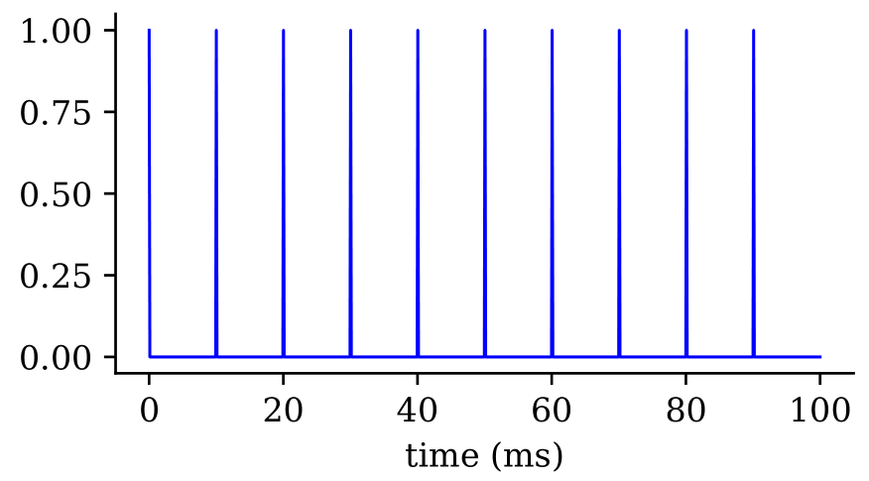
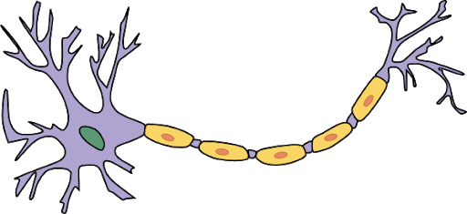
The 2-neuron network
Poisson Spike Train
N1

Slide 4
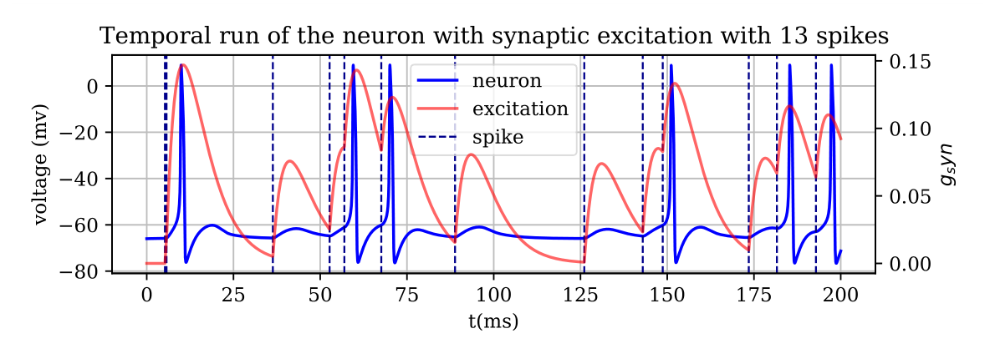
The 2-neuron network
Poisson Spike Train
N1

Slide 5
The 2-neuron network
N2
Poisson Spike Train
N1

Slide 6
The 2-neuron network
N2
Poisson Spike Train
Excitatory synapse
N1

Slide 7
The 2-neuron network
N2
Poisson Spike Train
Inhibitory synapse
Excitatory synapse
N1

Slide 8




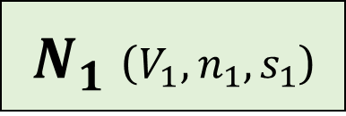
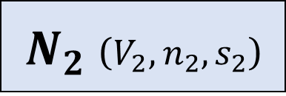

Equations: Conductance based neurons
$$Spike Train$$
$N_{1}$ ($V_{1},n_{1},s_{1}$)
$N_{2}$ ($V_{2},n_{2},s_{2}$)

Slide 9
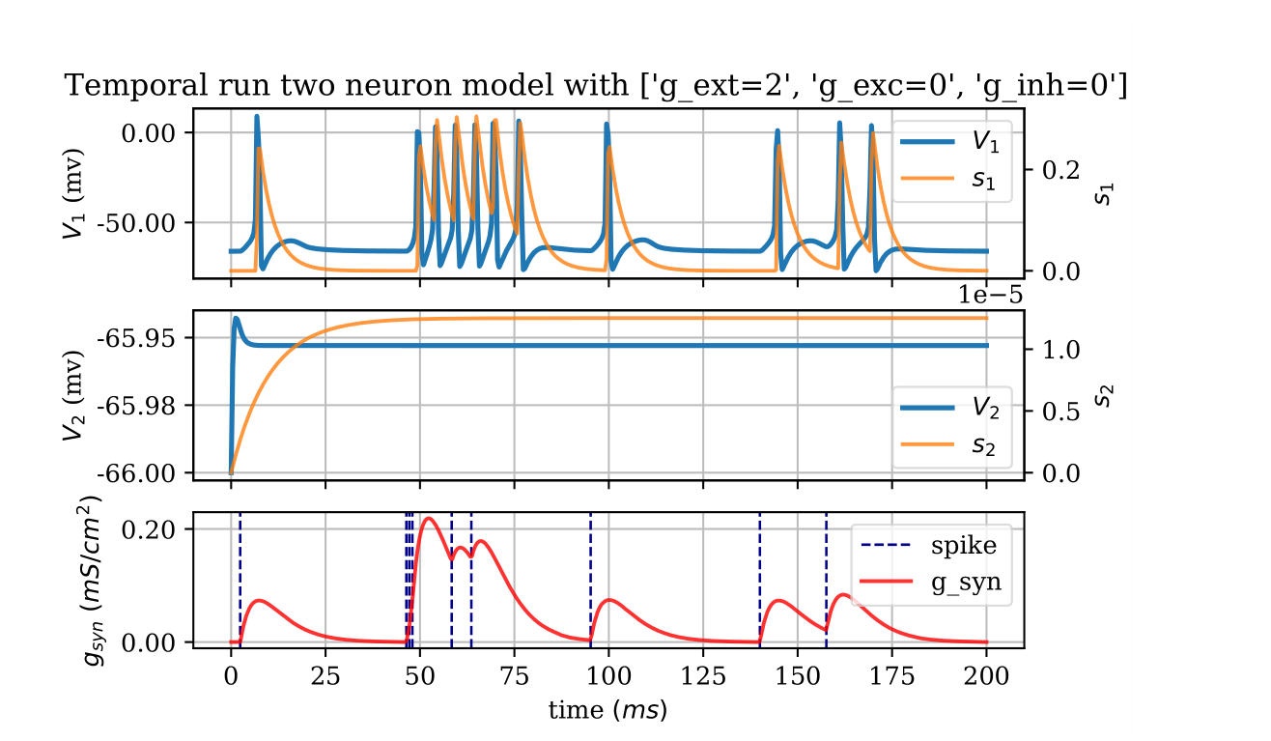

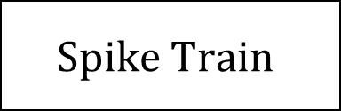
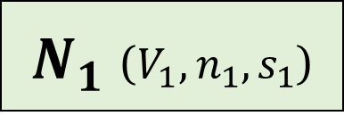
Some results I
$$Spike Train$$
$N_{1}$ ($V_{1},n_{1},s_{1}$)
$N_{2}$ ($V_{2},n_{2},s_{2}$)

Slide 10
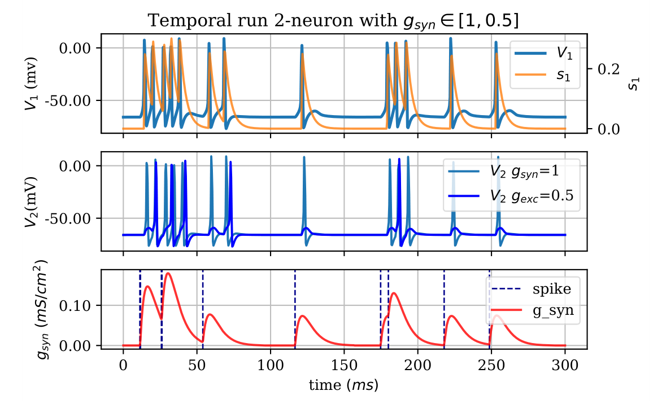
Some results II
$$Spike Train$$
$N_{1}$ ($V_{1},n_{1},s_{1}$)
$N_{2}$ ($V_{2},n_{2},s_{2}$)

Slide 11
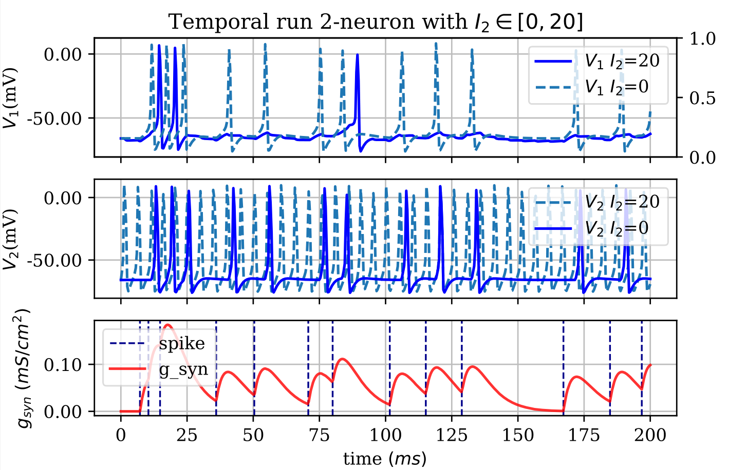
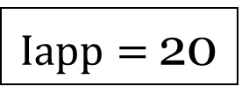
Some results III
$$Spike Train$$
$N_{1}$ ($V_{1},n_{1},s_{1}$)
$N_{2}$ ($V_{2},n_{2},s_{2}$)
$Iapp=$20

Slide 12
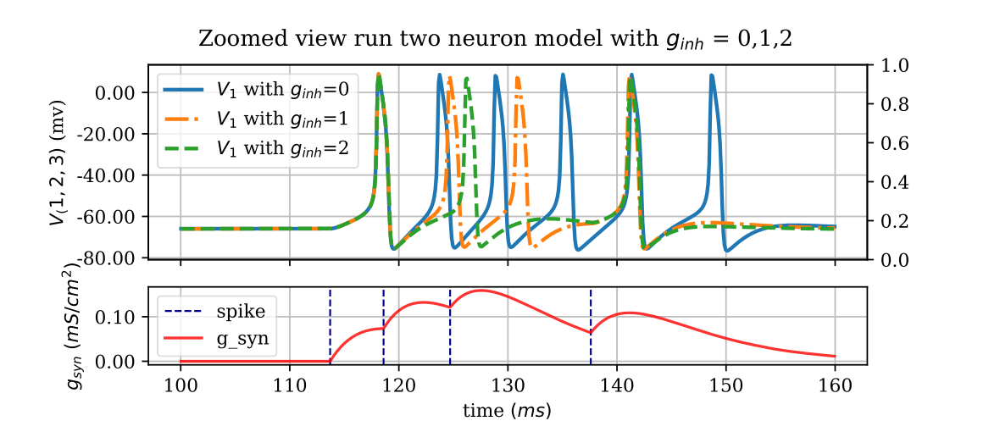
Network behaviour I
$$Spike Train$$
$N_{1}$ ($V_{1},n_{1},s_{1}$)
$N_{2}$ ($V_{2},n_{2},s_{2}$)

Slide 13
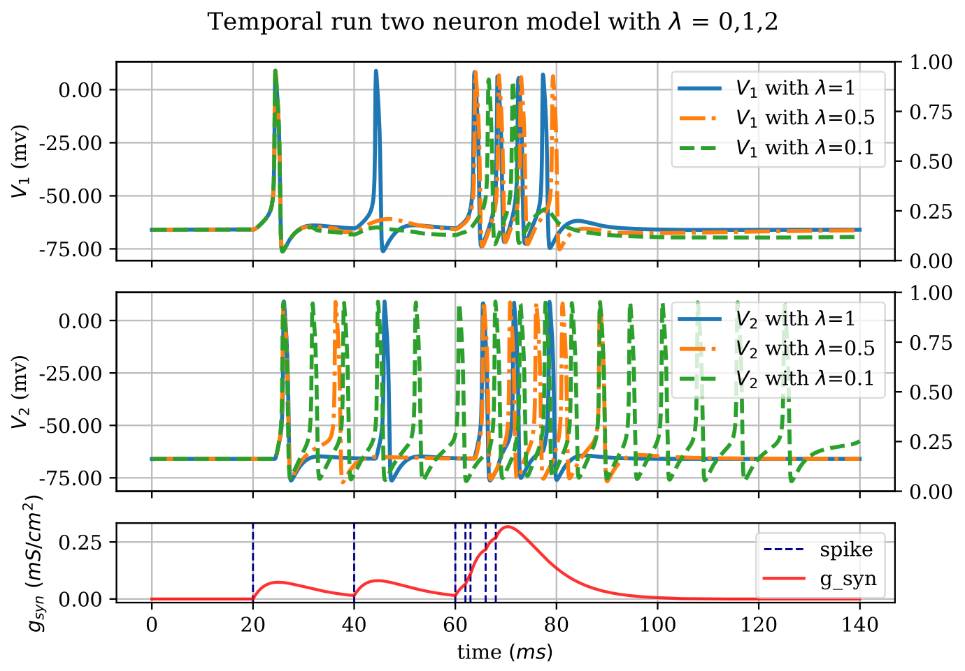
Network behaviour II
$$Spike Train$$
$N_{1}$ ($V_{1},n_{1},s_{1}$)
$N_{2}$ ($V_{2},n_{2},s_{2}$)

Slide 14
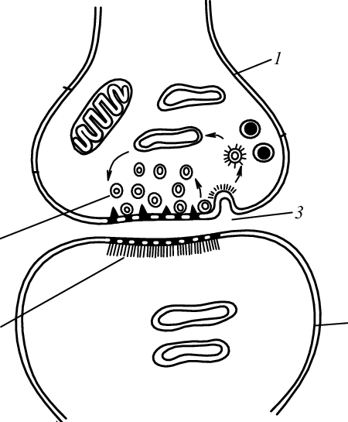
STP - Plasticity
- It describes the observation that synaptic strength changes constantly, depending upon use of a synapse
- Plasticity occurs on a time scale from milliseconds to years
- Synaptic depression and facilitation
- Depression: reduction of the postsynaptic response during repetitive presynaptic activity
- Facilitation: increased synaptic efficacy
Figure 1: Drawing of a synapse Source: [1]
[1] Abarbanel, H.D.I. and Selverston, A. and Huerta, Ramón and Bazhenov, Maxim and Sushchik, M.M. and Rubchinskiǐ, L.L. and Rabinovich,
Mikhail “Synchronisation in neural assemblies ” Uspekhi Fizicheskikh Nauk, vol. 166, pp. 389-390, 1996.

Slide 15
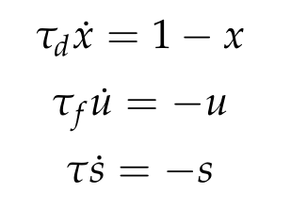
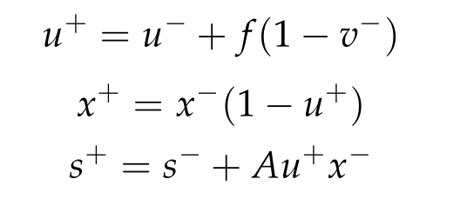
STP - Model
Tsodyks and Markram [2] propose the following model for short term plasticity
It is modelled with x as the fraction of available vesicles and u an utilization variable
At each spikes they are updated
[2] Abarbanel, H.D.I. and Selverston, A. and Huerta, Ramón and Bazhenov, Maxim and Sushchik, M.M. and Rubchinskiǐ, L.L. and Rabinovich,
Mikhail “Synchronisation in neural assemblies ” Uspekhi Fizicheskikh Nauk, vol. 166, pp. 389-390, 1996.

Slide 16
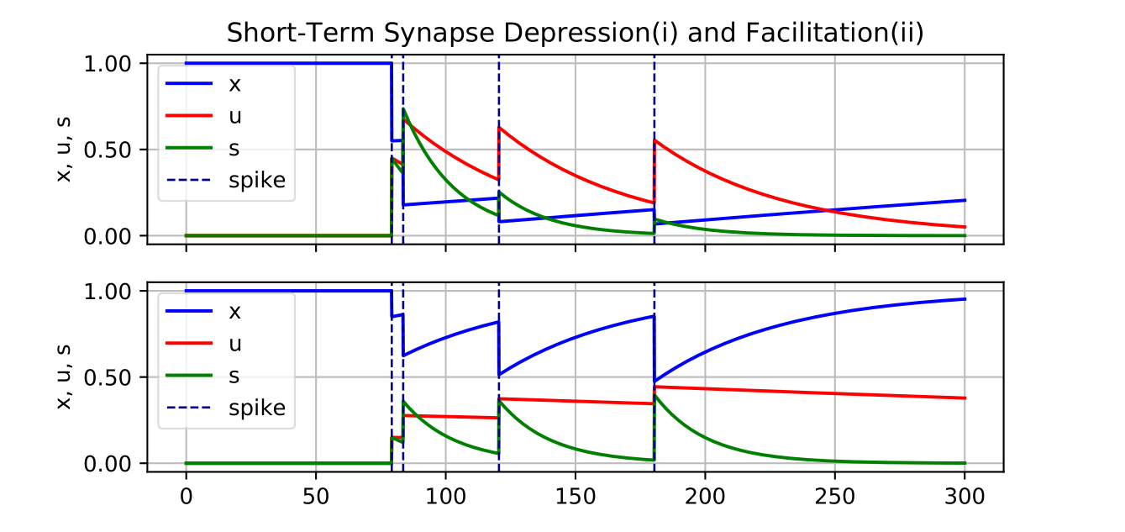
STP dynamics

Slide 17
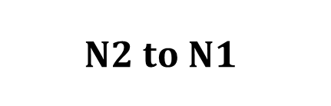
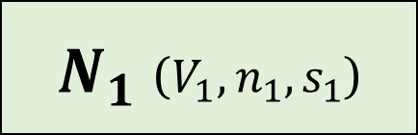
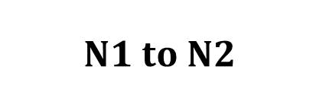
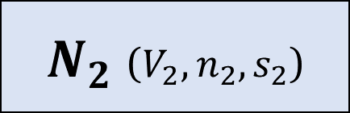

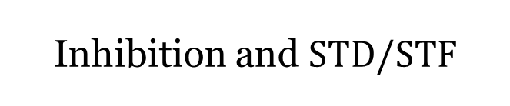
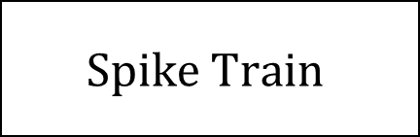
STP on the 2-neuron network I
$$Spike Train$$
$N_{1}$ ($V_{1},n_{1},s_{1}$)
$$N1 to N2$$
$$N2 to N1$$
$$Excitation and STF$$
Inhibition and $STD/STF$
$N_{2}$ ($V_{2},n_{2},s_{2}$)

Slide 18
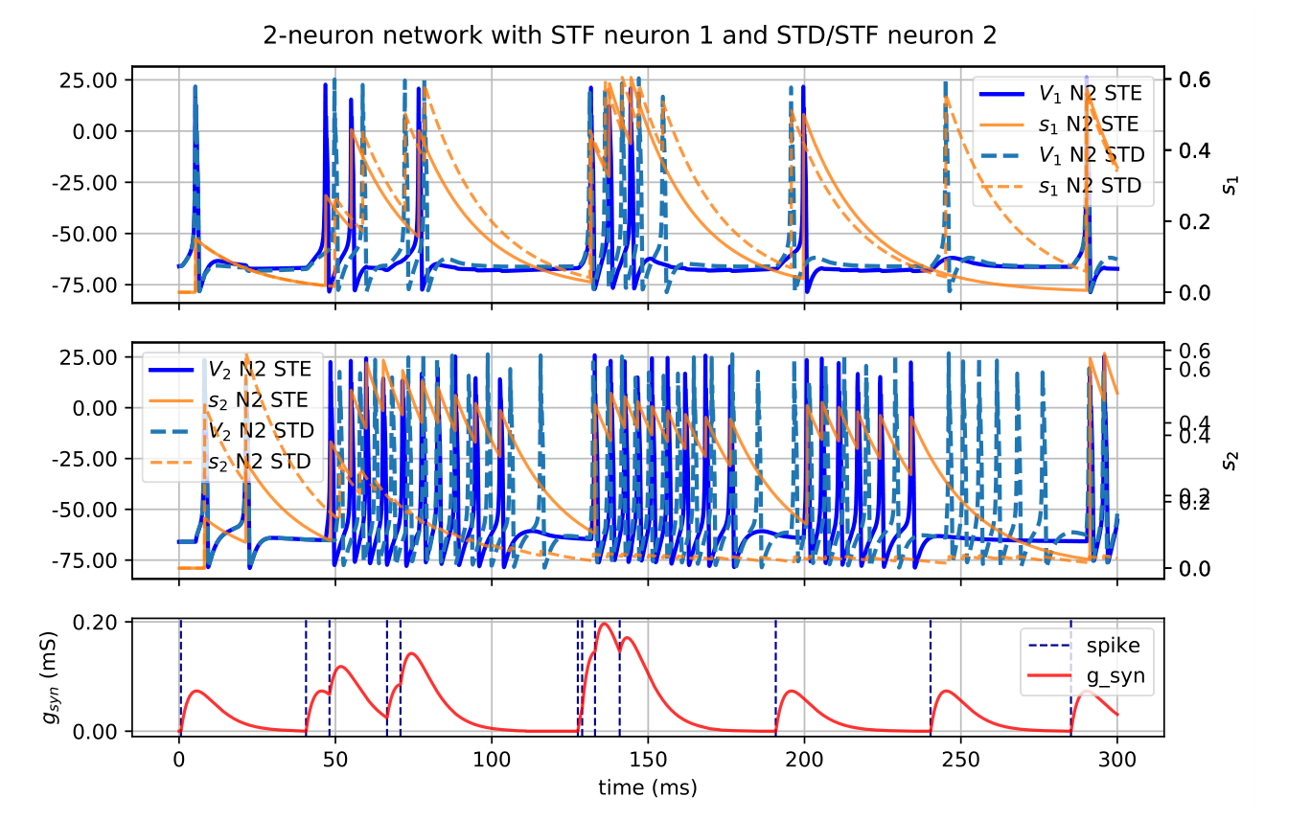
STP on the 2-neuron network II

Slide 19
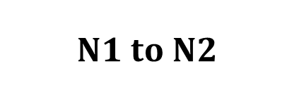

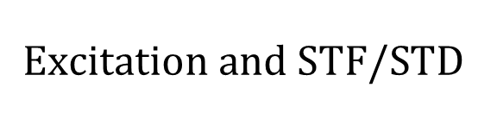
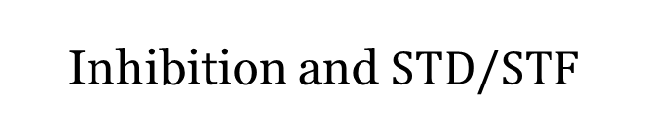
STP on the 2-neuron network II
$$Spike Train$$
$N_{1}$ ($V_{1},n_{1},s_{1}$)
$$N1 to N2$$
$$N2 to N1$$
$$Excitation and STF/STD$$
Inhibition and $STD/STF$
$N_{2}$ ($V_{2},n_{2},s_{2}$)

Slide 20
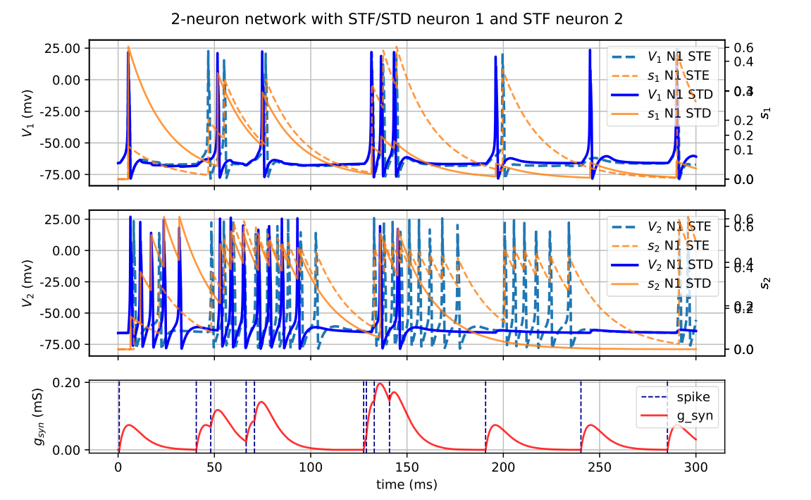
STP on the 2-neuron network I

Slide 21
Thank you for your attention! Any questions?

