Slide 1

NATURE VS. WEALTH & INCOME
Davis Lee
Aaron Halbert
April Doster

Slide 2
Motivation & INITIAL QUESTIONS
Does the NATURE impact your WEALTH and INCOME?
If so, what are the major factors that increase this productivity?
We were NOT able to answer these questions to our satisfaction.
The majority of our findings are inconclusive and warrant further study

Slide 3
Questions & Data UTILIZED
DOES NATURE IMPACT WEALTH & INCOME?
Temperature?
DATA: US Household Income Statistics & Weather API
Air Pressure?
DATA: US Household Income Statistics & Weather API
Can Humidity Affect Income?
DATA: US Household Income Statistics & Weather API
Does Latitude and Longitude Affect Income?
DATA: US Household Income Statistics
How about Proximity to WATER?
DATA: US Household Income Statistics
NATURE
INCOME

Slide 4
Data Cleanup & Exploration
Exploration & Cleanup Process
Selected the “NATURE FACTORS” to compare to income.
Insights
Anticipated finding more of a correlation between weather impact on Income
Problems
1) Data Reading Error: [df_main = pd.read_csv(file,engine = "python")]
Switched from Census Dataset → Income Dataset + Added Weather API
2) Restriction in Weather API (availability)
3) Insufficient Data – Not able to acquire enough data to confirm our hypothesis

Slide 5
Data Analysis
2nd
TRIED CENSUS DATABASE
1st
LISTED NATURE ELEMENTS
3rd
DECIDED INCOME DATA
4th
ADDED WEATHER API

Slide 6
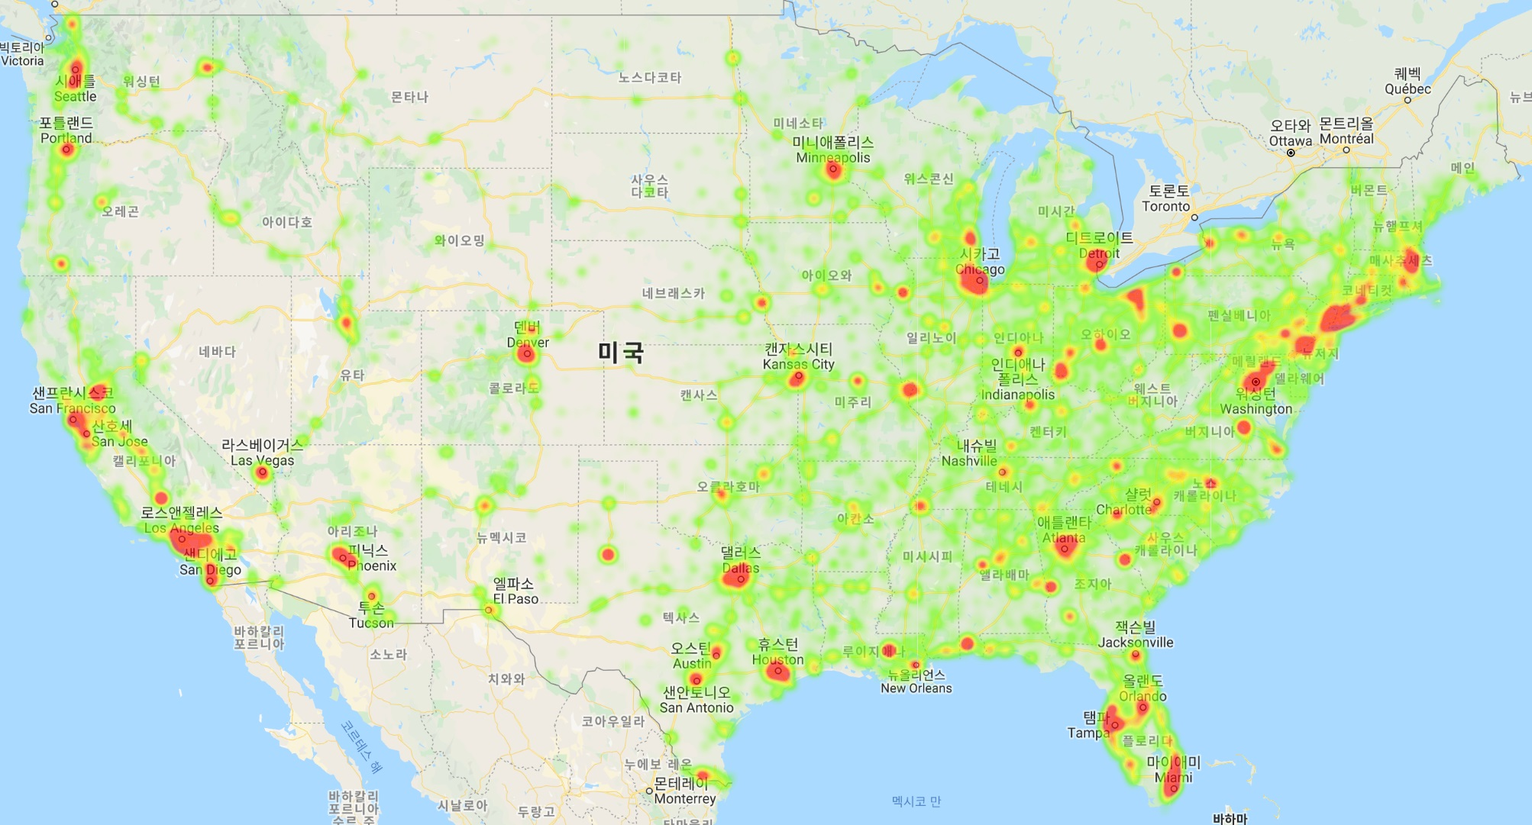
Wealth Heatmap

Slide 7
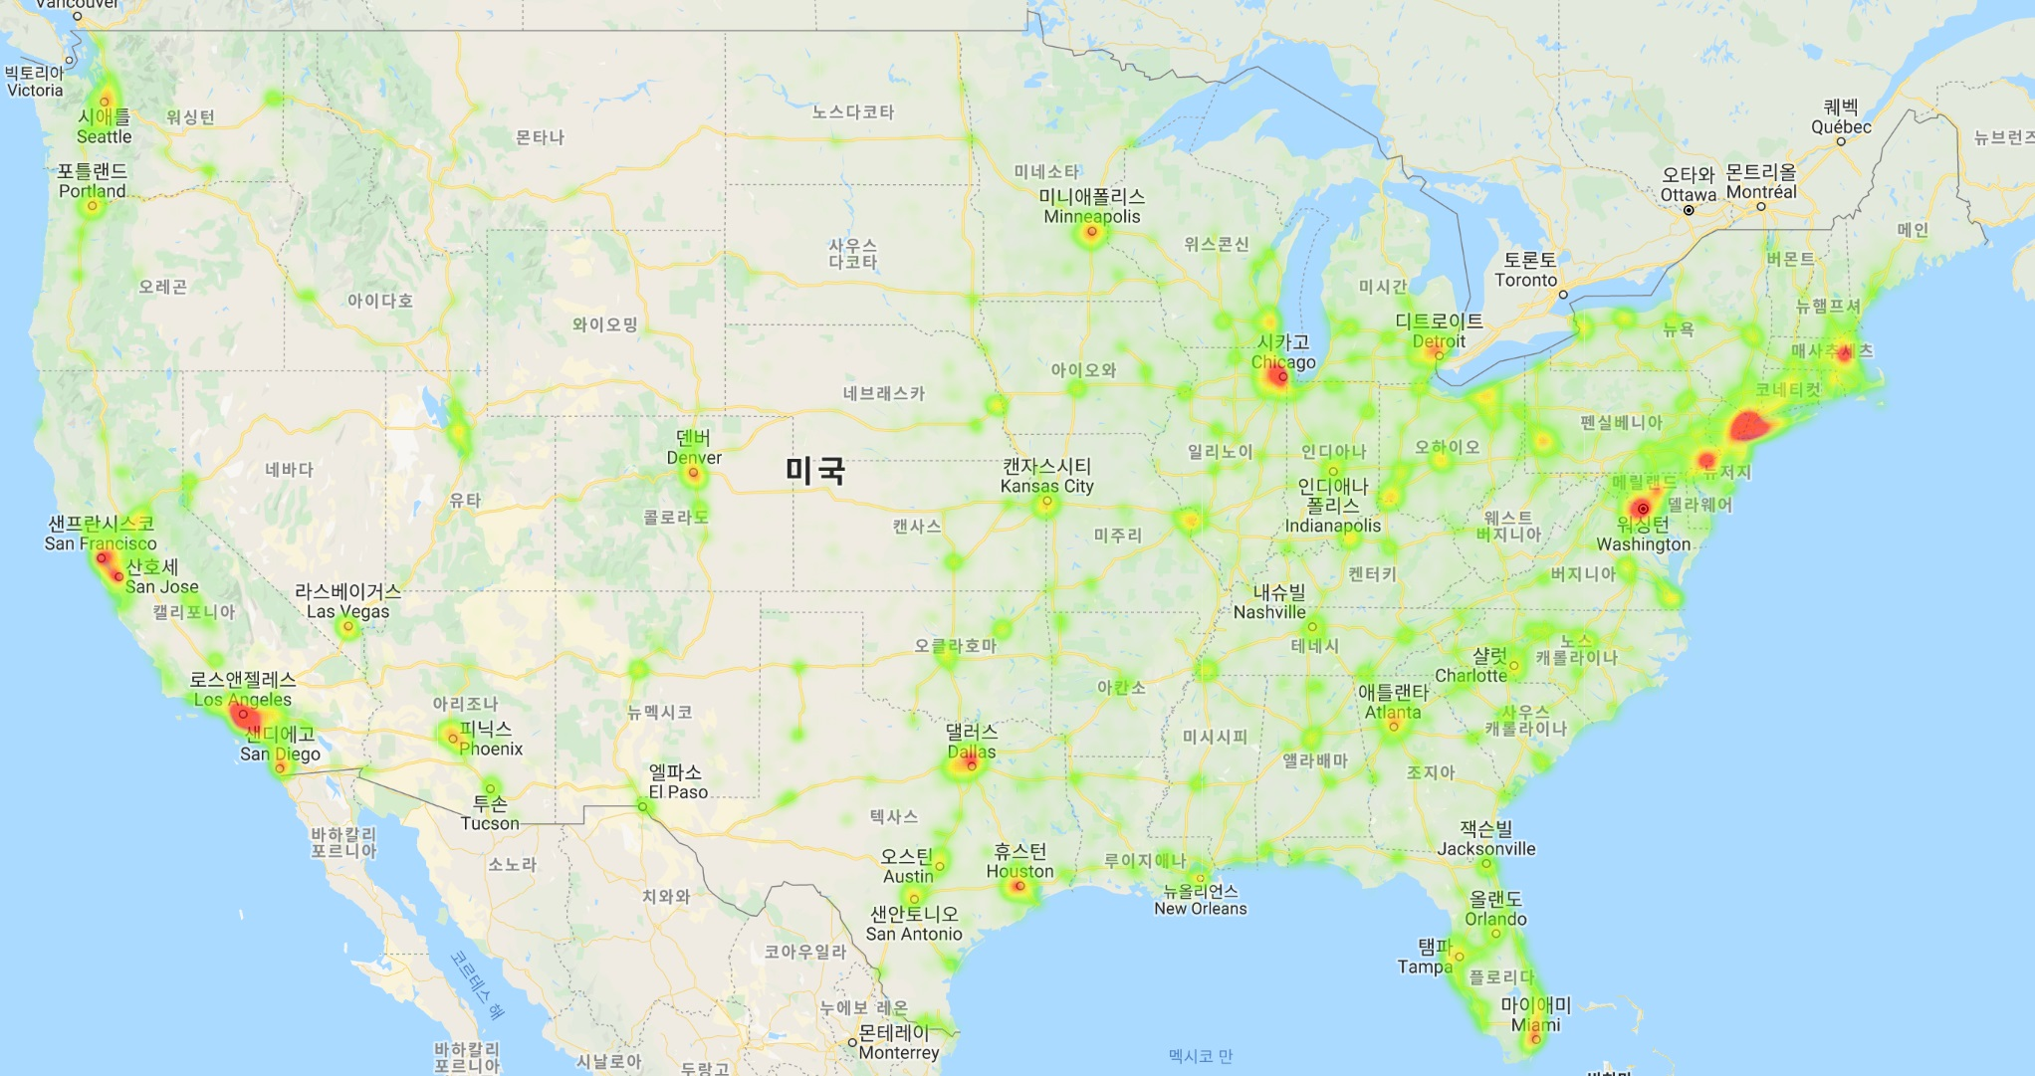
Mean Household Income Heatmap

Slide 8
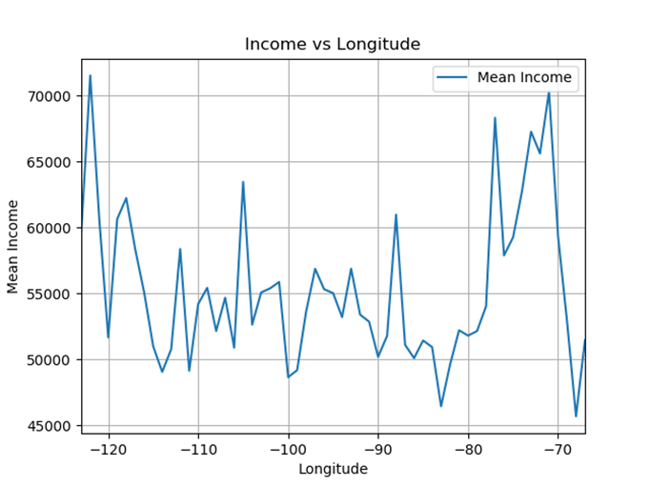
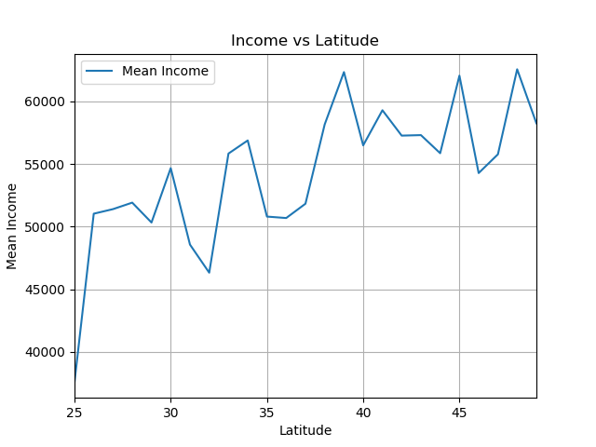
Latitude & Longitude VS Mean Household INCOME
WEST
EAST
LATITUDE
LONGITUDE

Slide 9
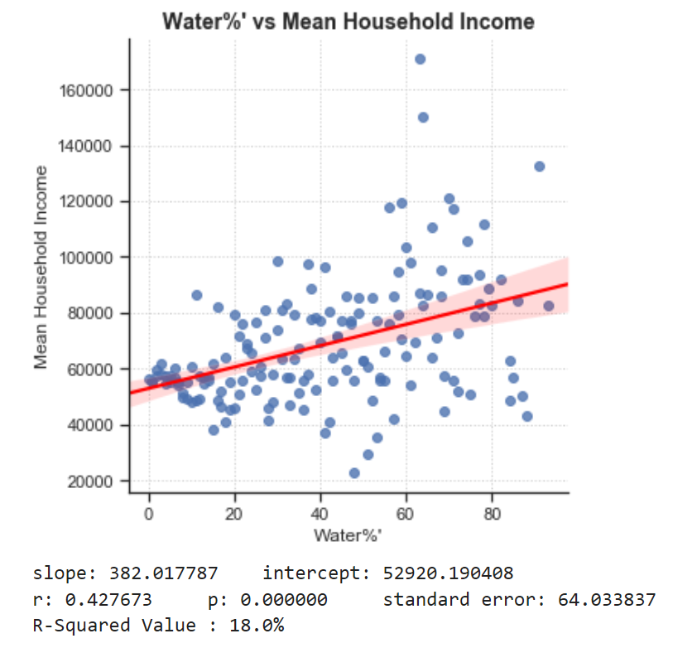
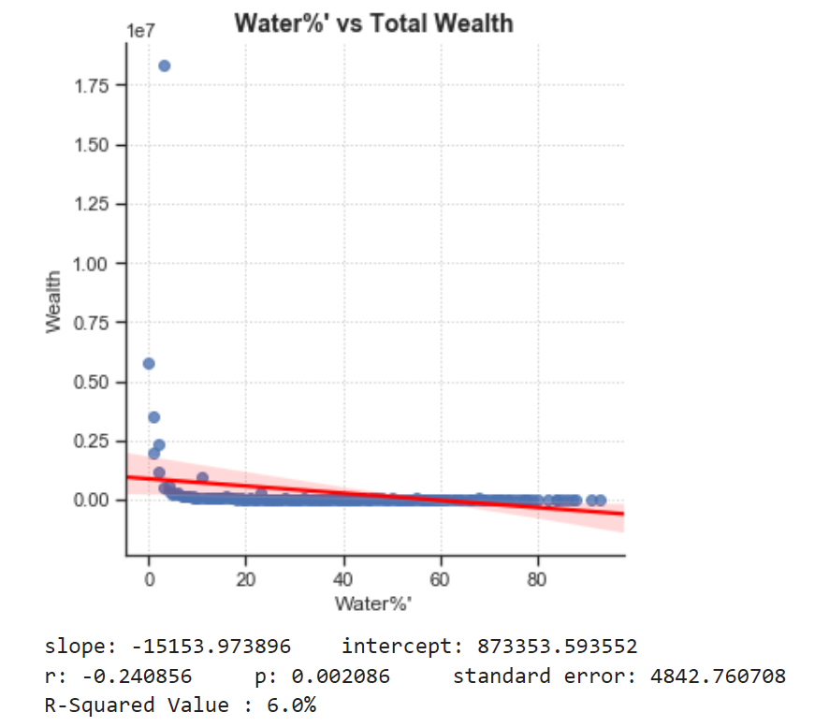
Water vs Wealth & MEAN HOUSEHOLD INCOME

Slide 10
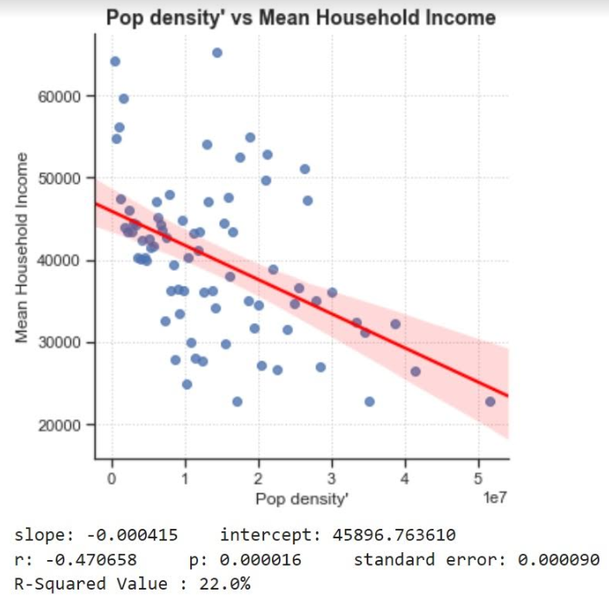
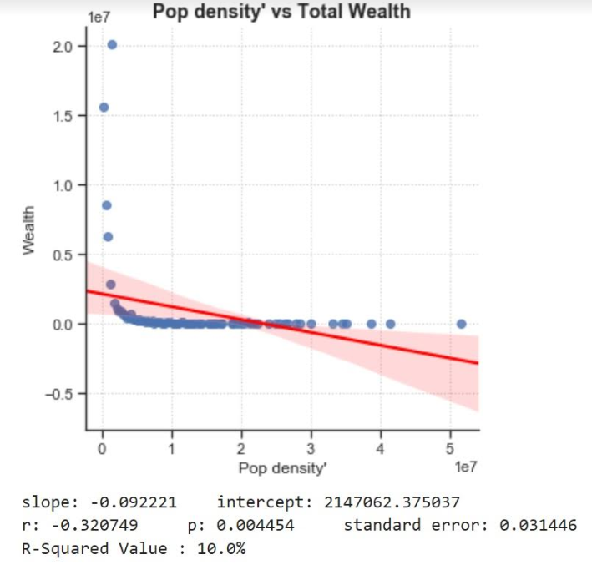
Population Density vs Wealth & MEAN HOUSEHOLD INCOME

Slide 11
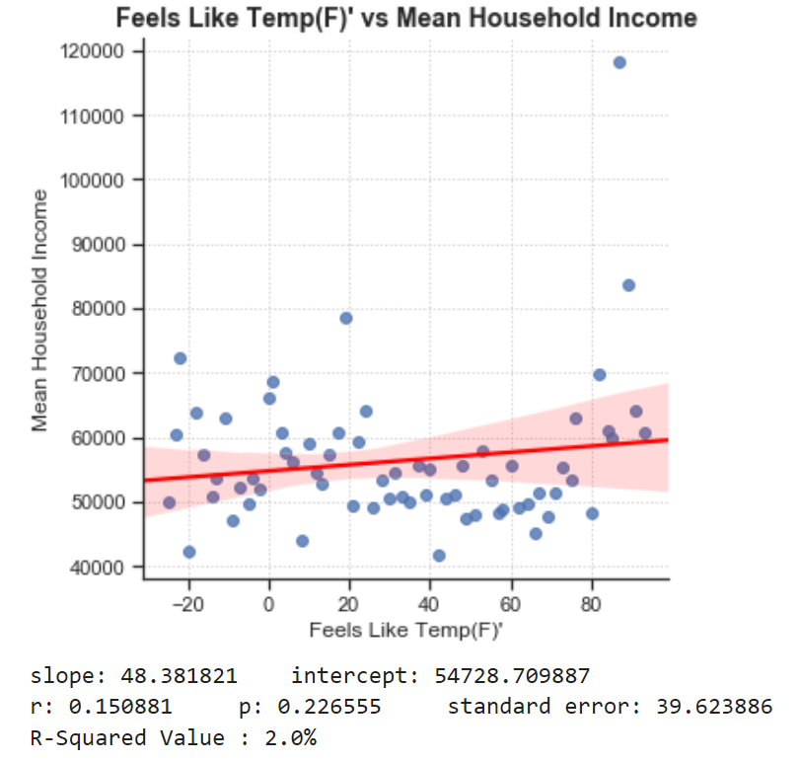
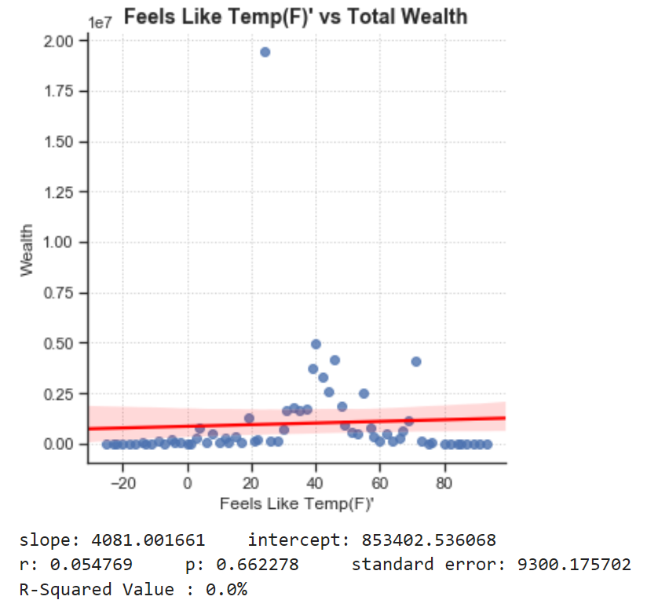
Temperature vs Wealth & MEAN HOUSEHOLD INCOME

Slide 12
Temperature vs Wealth & MEAN HOUSEHOLD INCOME

Slide 13
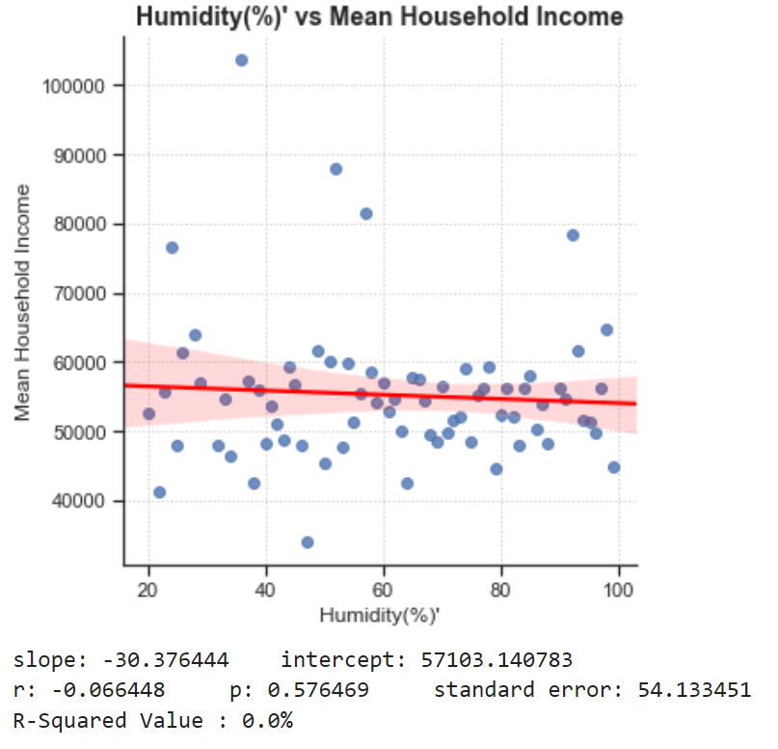
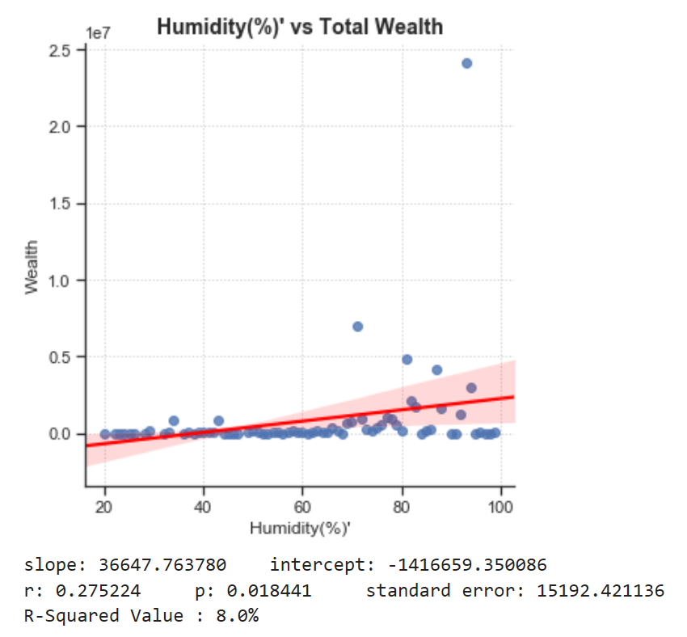
Humidity vs Wealth & MEAN HOUSEHOLD INCOME

Slide 14
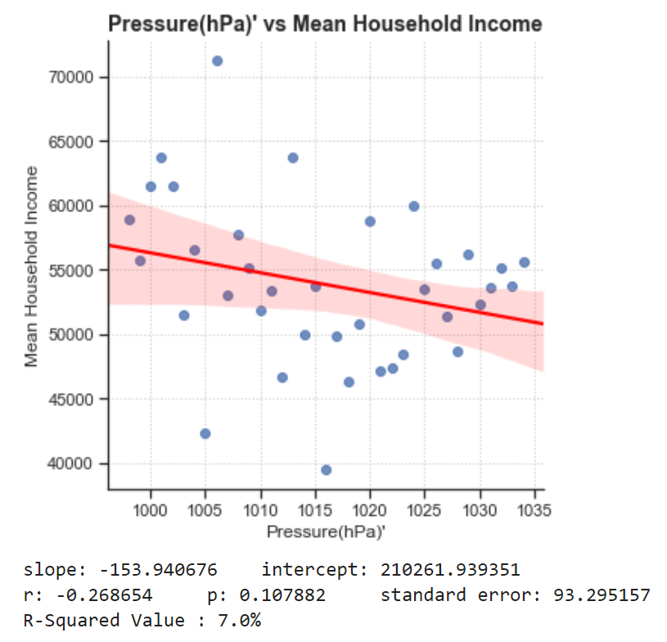
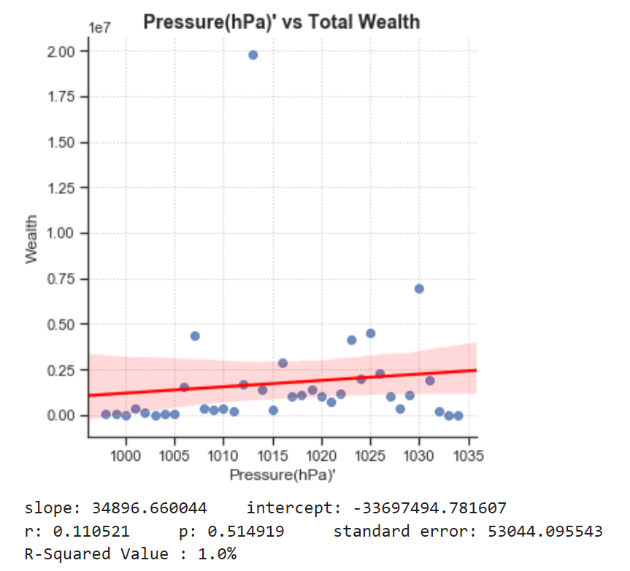
Air Pressure vs Wealth & MEAN HOUSEHOLD INCOME

Slide 15
Our Findings
We did see that
Income Earnings are
HIGHER near COASTAL and NORTHERN states
We now realize that the proximity to water data would be more relevant instead of utlizing water area percentage.
Weather did NOT have any correlation. We realize we need statistical aggregated weather data to validate our hypothesis.
We assumed there would be a clear correlation between “NATURE & INCOME” but that we need more time to confirm this is the case.

Slide 16
Difficulties & FUTURE RESEARCH TOPICS
DIFFICULTIES:
1) API: Time, Cost & Blocked Out
2) Finding Best Graphs to Represent Data Findings
4) Uncovering Correlation between NATURE & INCOME
FUTURE:
1) Explore and Compare Other
Datasets and APIs
2) INVESTIGATE a variety of Weather Elements & Terrains

