Slide 1

Income & Nature
Davis Lee
Aaron Halbert
April Doster

Slide 2
Motivation & INITIAL QUESTIONS
Does the nature around you impact your productivity and income?
If so, what are the major factors that increase productivity?
We were NOT able to answer these questions to our satisfaction.
The majority of our findings are inconclusive and warrant further study

Slide 3
Questions & Data UTILIZED
DOES NATURE IMPACT INCOME?
Temperature?
DATA: US Household Income Statistics & Weather API
Air Pressure?
DATA: US Household Income Statistics & Weather API
Can Humidity Affect Income?
DATA: US Household Income Statistics & Weather API
Does Latitude and Longitude Affect Income?
DATA: US Household Income Statistics
How about Proximity to WATER?
DATA: US Household Income Statistics
NATURE
INCOME

Slide 4
Data Cleanup & Exploration
Exploration & Cleanup Process
Selected the “NATURE FACTORS” to compare to income.
Insights
Didn't anticipate finding minimal weather impact on Income
Problems
1) Data Reading Error: [df_main = pd.read_csv(file,engine = "python")]
Interesting Figures Developed
* Present and discuss interesting figures developed during exploration, ideally with the help of Jupyter Notebook
Switched from Census Dataset → Income Dataset + Added Weather API
2) Restriction in Weather API (length and number of calls and being blocked)

Slide 5
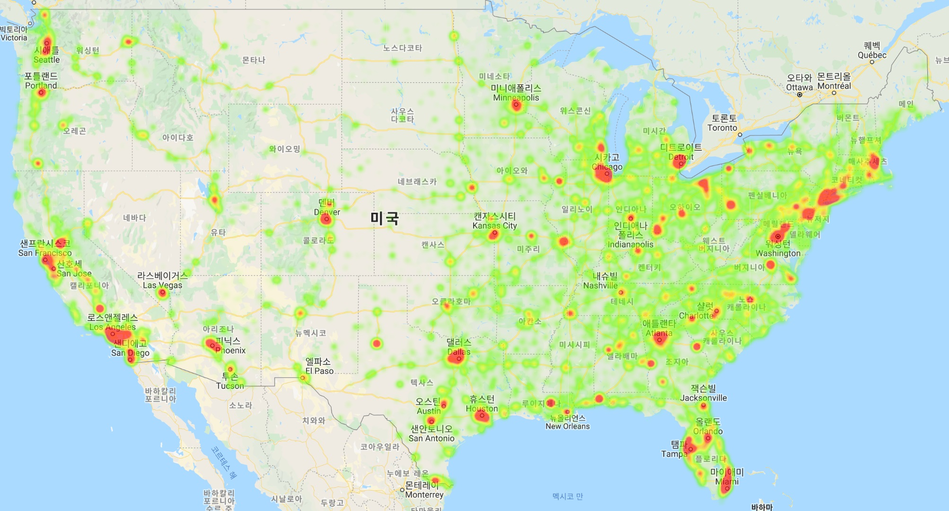
Wealth Heatmap

Slide 6
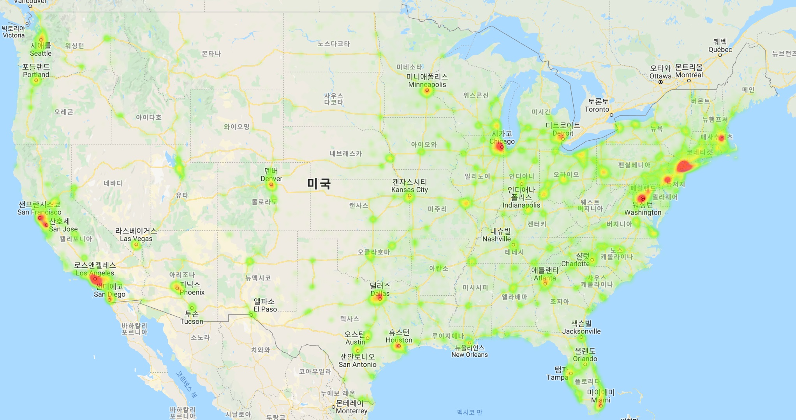
Mean Household Income Heatmap

Slide 7
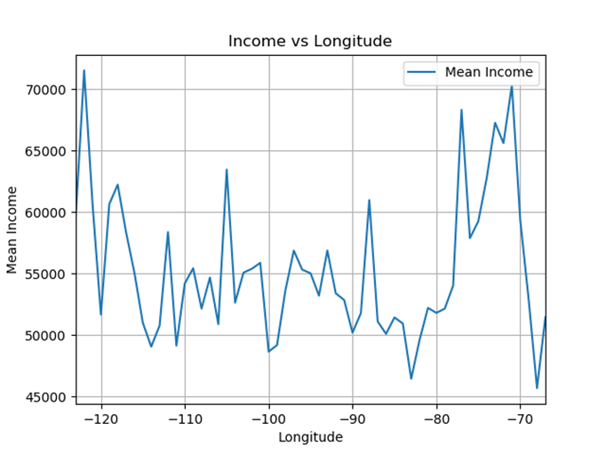
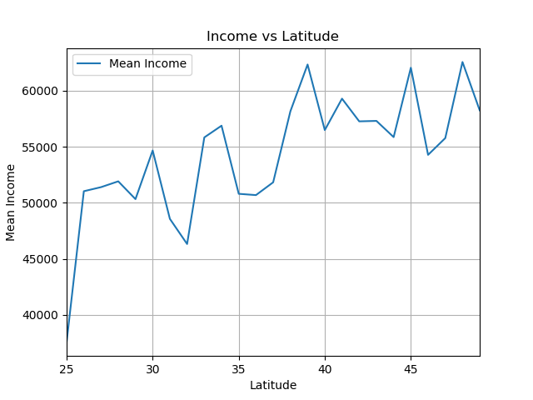
Latitude & Longitude VS Mean Household INCOME
WEST
EAST
LATITUDE
LONGITUDE

Slide 8
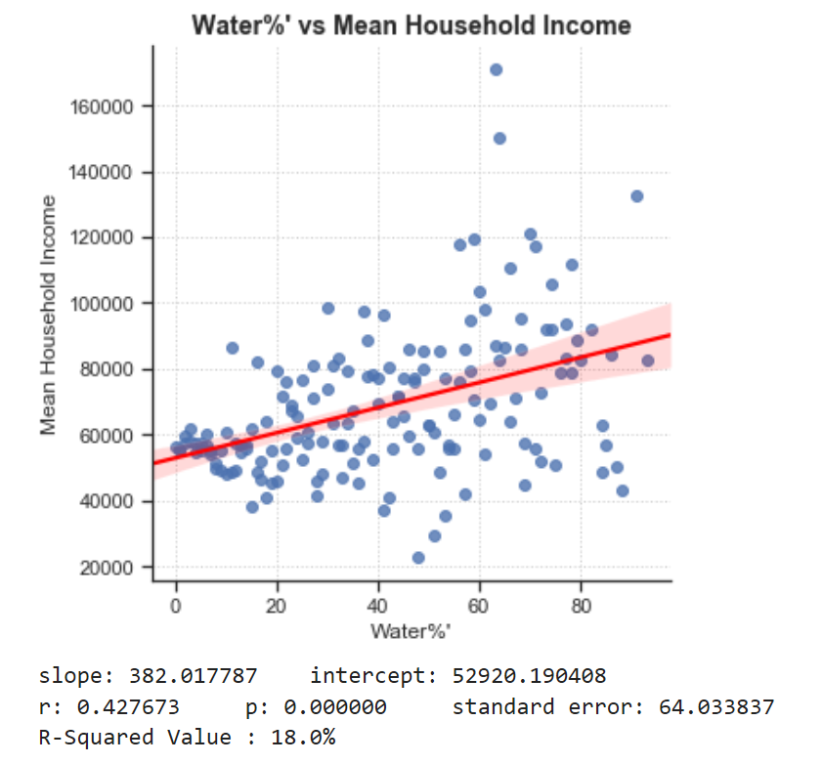
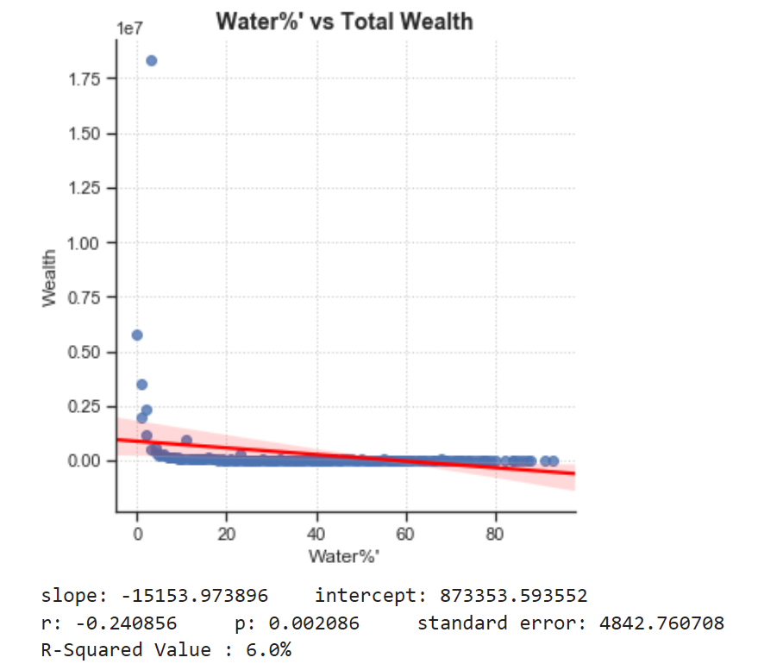
Water vs Wealth & MEAN HOUSEHOLD INCOME

Slide 9
Population Density vs Wealth & MEAN HOUSEHOLD INCOME

Slide 10
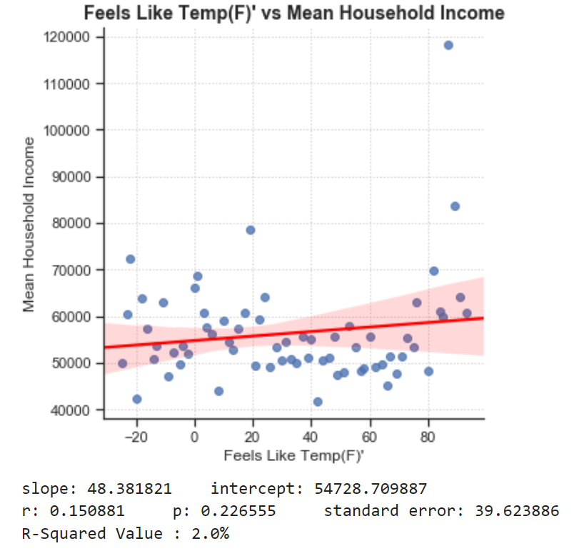
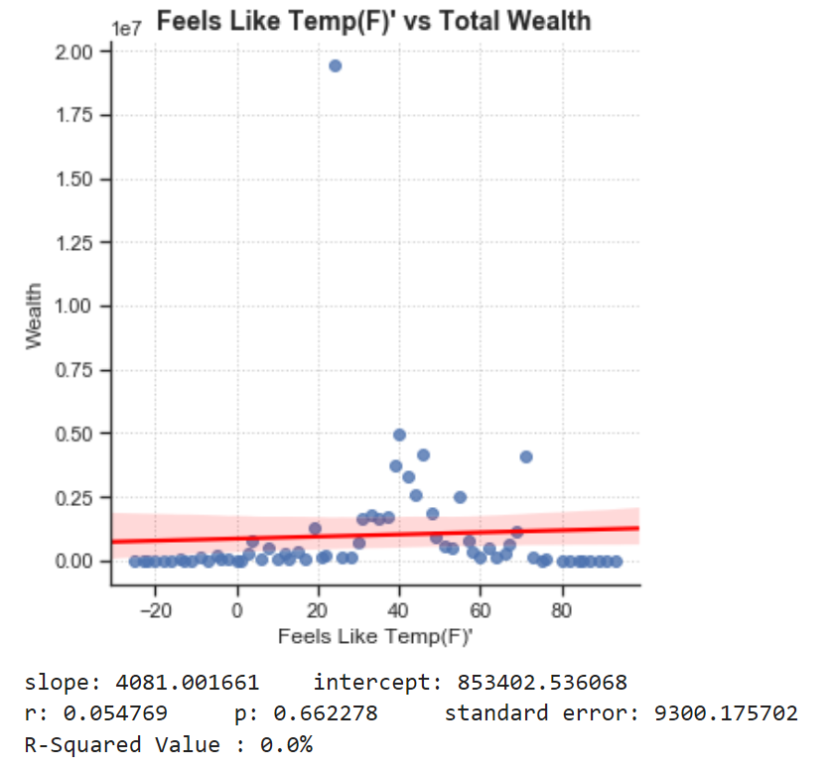
Temperature vs Wealth & MEAN HOUSEHOLD INCOME

Slide 11
Temperature vs Wealth & MEAN HOUSEHOLD INCOME

Slide 12
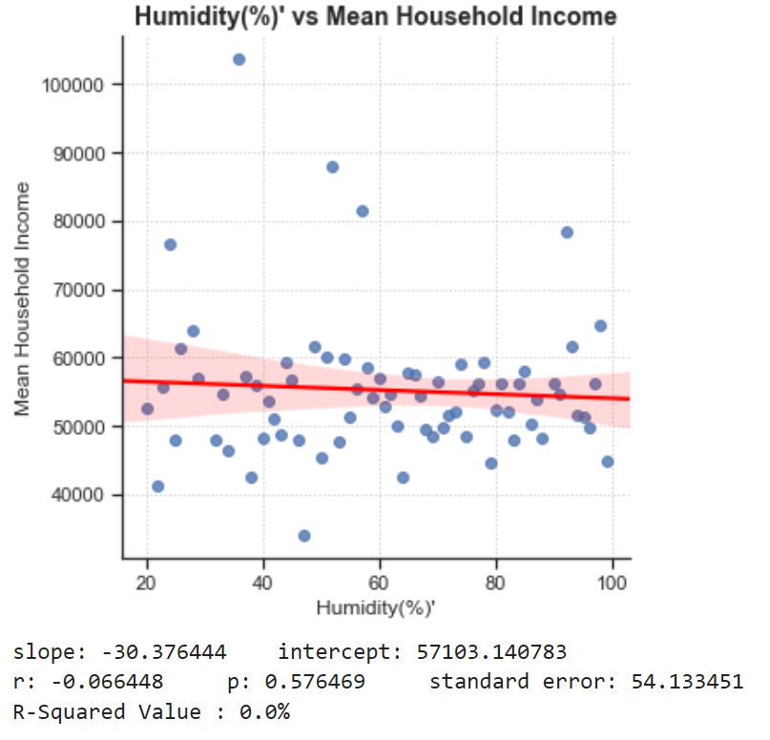
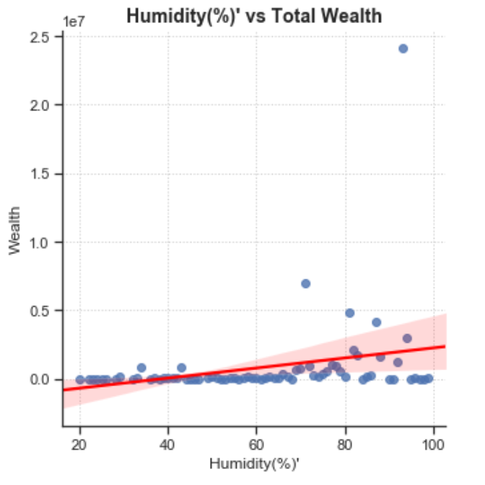
Humidity vs Wealth & MEAN HOUSEHOLD INCOME

Slide 13
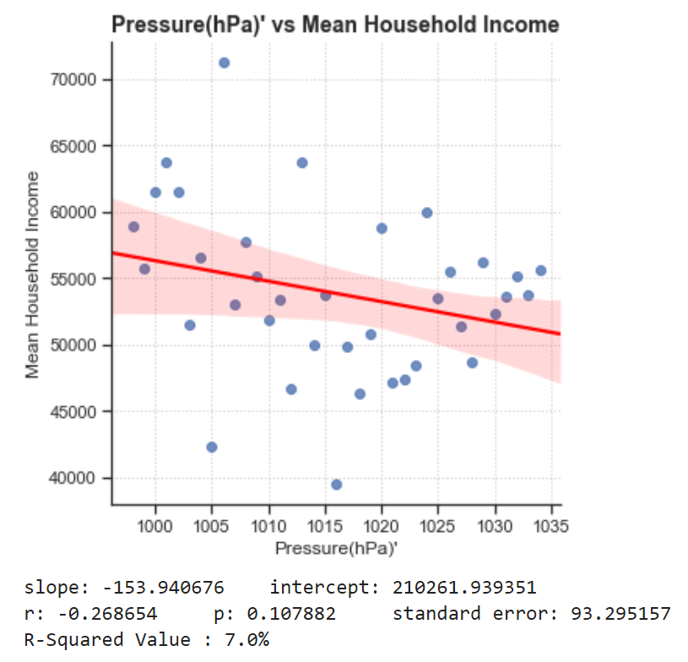
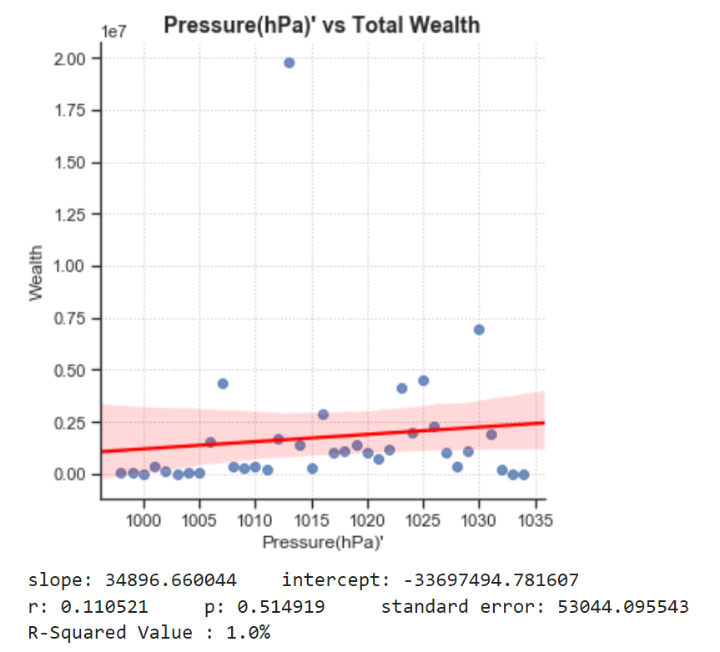
Air Pressure vs Wealth & MEAN HOUSEHOLD INCOME

Slide 14
Data Analysis
2nd
TRIED CENSUS DATABASE
1st
LISTED NATURE ELEMENTS
3rd
DECIDED INCOME DATA
4th
ADDED WEATHER API

Slide 15
Our Findings
We did see that
Income Earnings are
HIGHER near each COAST
Discussion 2
We assumed there would be a clear correlation between “NATURE & INCOME” but that was NOT the case.

Slide 16
Difficulties & FUTURE RESEARCH TOPICS
DIFFICULTIES:
1) API: Time, Cost & Blocked Out
2) Finding Best Graphs to Represent Data Findings
4) Uncovering Correlation between NATURE & INCOME
FUTURE:
1) Explore and Compare Other
Datasets and APIs
2) INVESTIGATE a variety of Weather Elements & Terrains

