Slide 1
Install via .mlapp

Slide 2
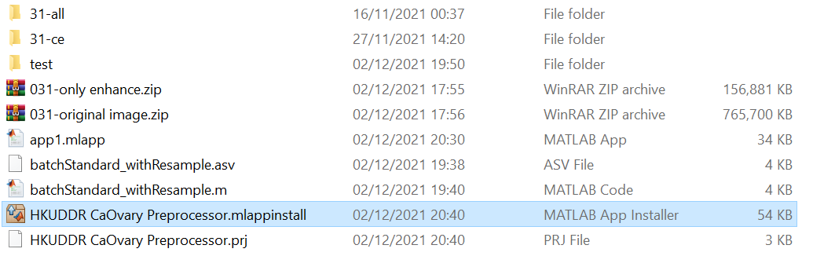
Step 1: Install app
Just double click the .mlappinstall file with MATLAB open

Slide 3
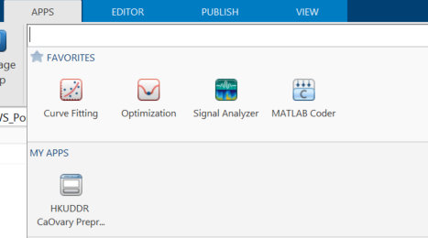
Step 2: Open app on MATLAB
Once installed click on the “Apps” tab of MATLAB
Find the “HKUDDR CaOvary Preprocessing” app under “My Apps”

Slide 4
Install via standalone .exe

Slide 5
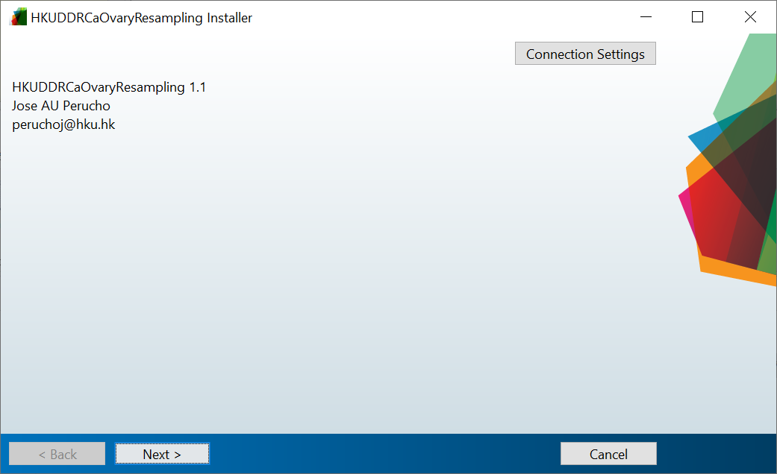
Step 1: Install via MATLAB web installer
Follow wizard instructions

Slide 6
Step 2: Run the Standalone .exe
Simply double click the .exe to run once

Slide 7
Using the app

Slide 8
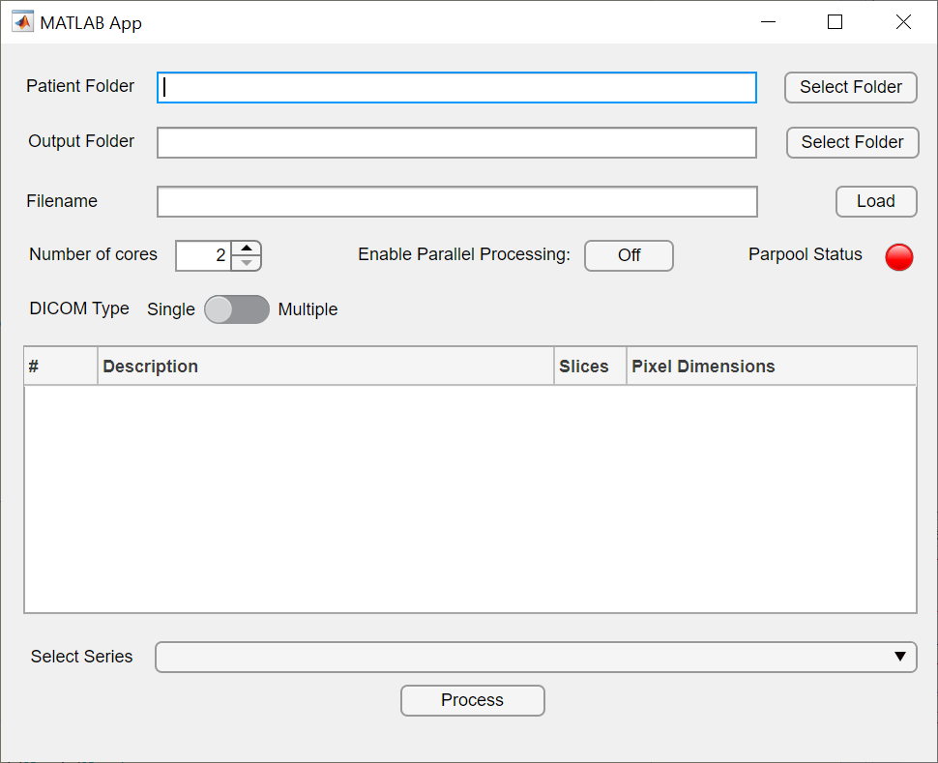
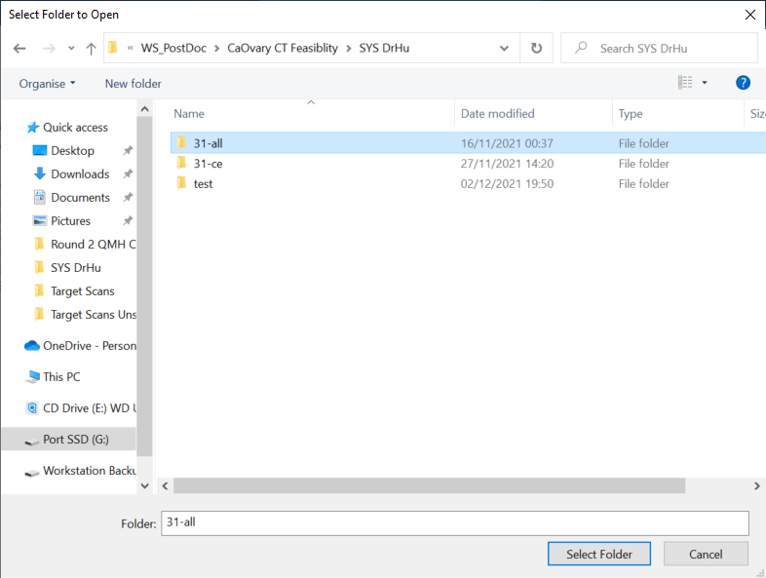
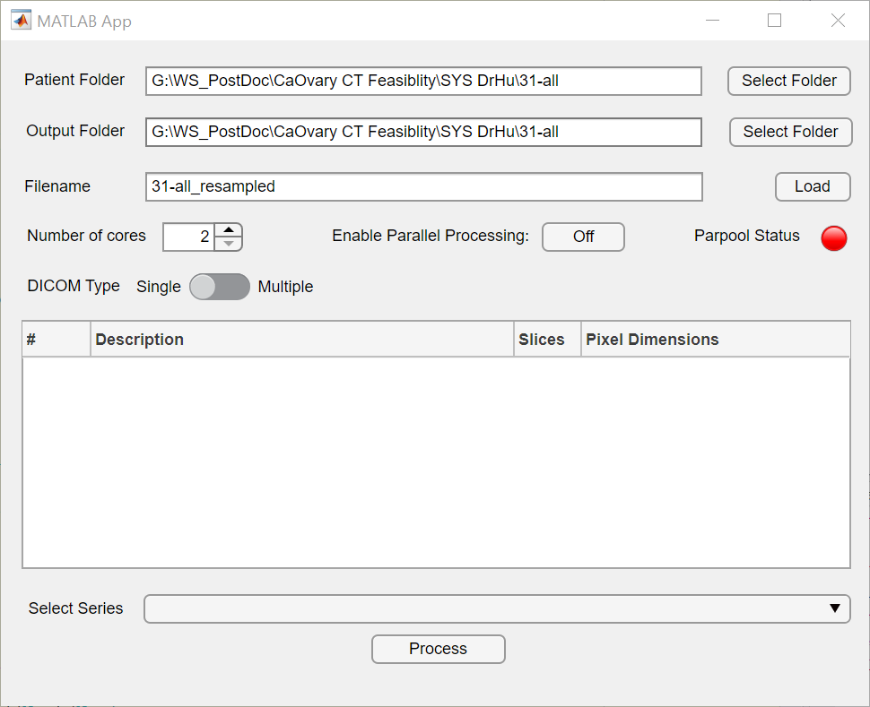
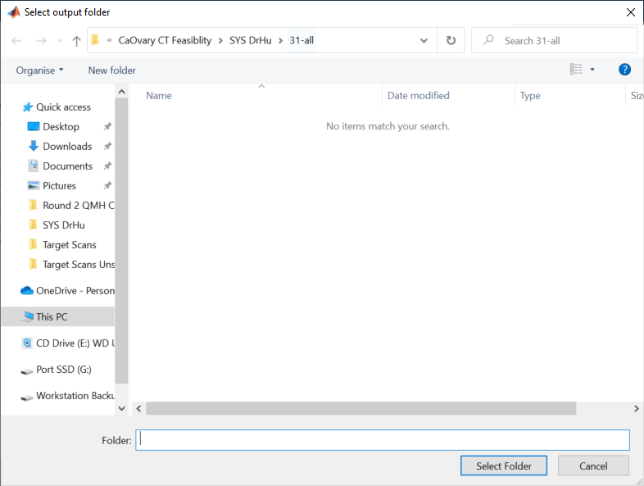
Step 1: Select folders
A
A: Choose the appropriate input folder
Can also copy and paste the exact address to the text field
B: App automatically fills in the target output folder. This can be changed to a different folder if desired
B

Slide 9
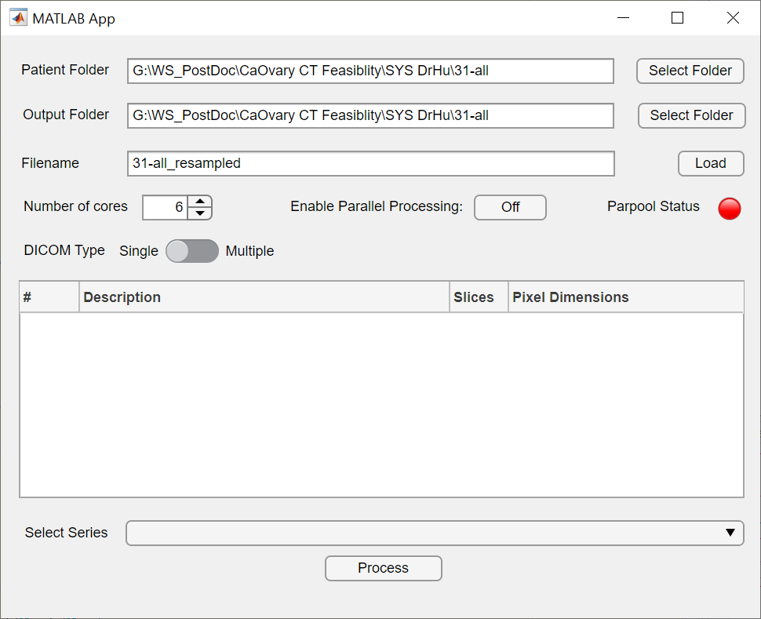
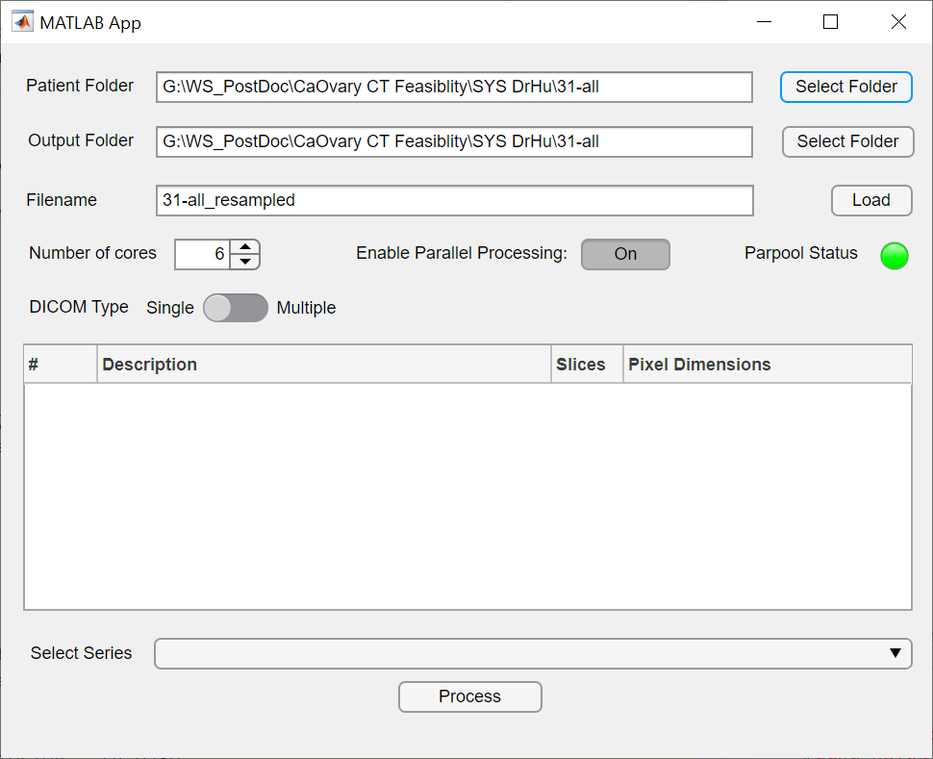
Step 2 (Optional): Enable Parallel Processing
A
B
If the PC in use is has more than 1 logical core, parallel processing can be enabled to reduce processing time
A: Select the number of cores to assign to this app
B: Press the “Enable Parallel Processing”Button.
C: Wait until the lamp turns green
C

Slide 10
Step 3 (Optional): Change output filename
By default, the filename will be the name of the parent directory + “_resampled”
If desired, the filename can be changed

Slide 11
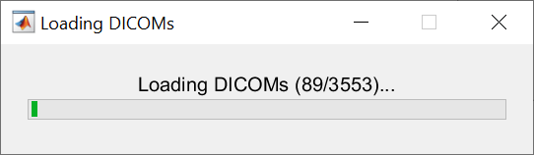
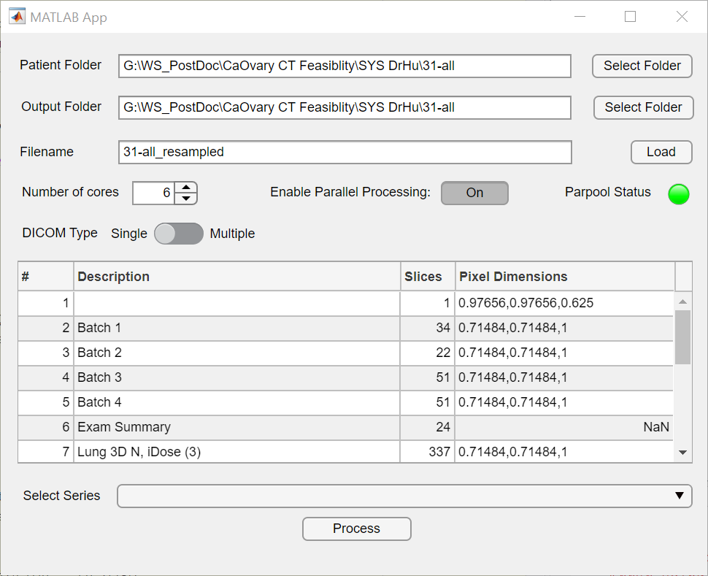
Step 4: Load the folder
A
B
A: Click the “Load” button to load all the DICOMs so it will show all the series
B: Progress bar shows progress of loading process
C: Once finished loading, the table will fill with the series details detected
C

Slide 12
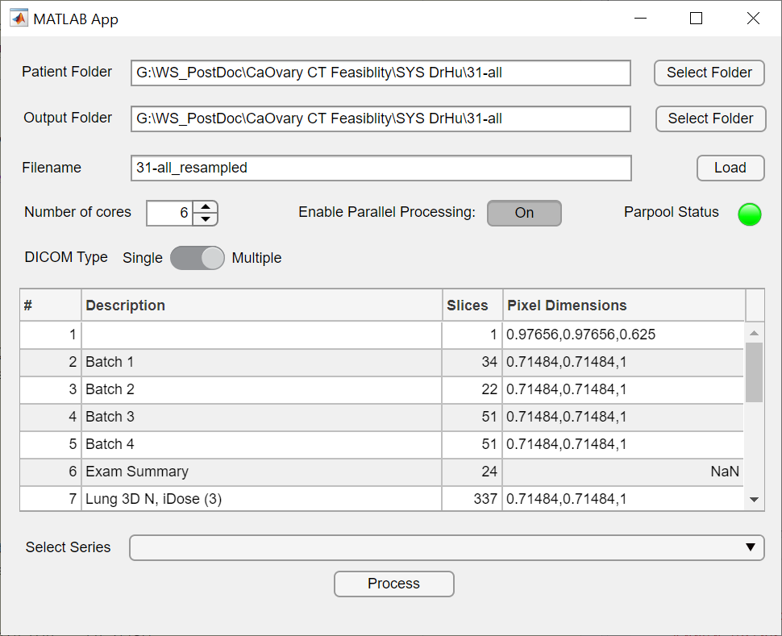
Step 5 (Optional): Select DICOM save type
A
DICOM is usually stored as multiple files (one file corresponds to one slice); however, it is possible to save as a single “compressed” file (all slices in a single file)
Some apps (e.g. ImageJ) does not recognise single compressed DICOMs
(A->B) By default the app will save as the single compressed file
(A->C) If desired, click on the toggle button to save in the “standard” multiple file format
B
C

Slide 13
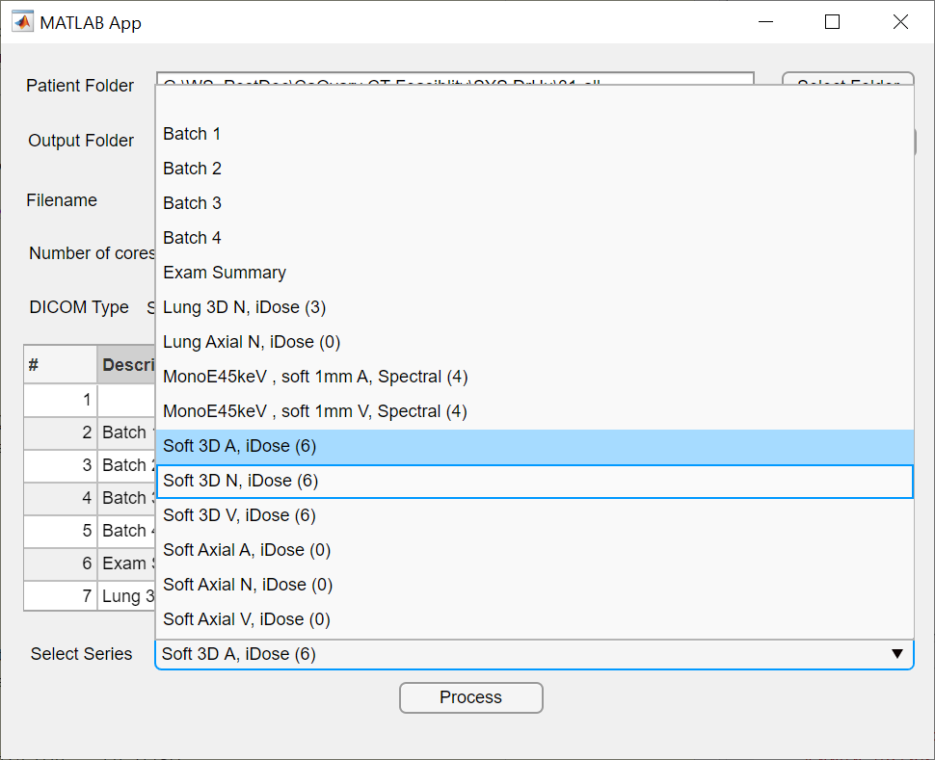
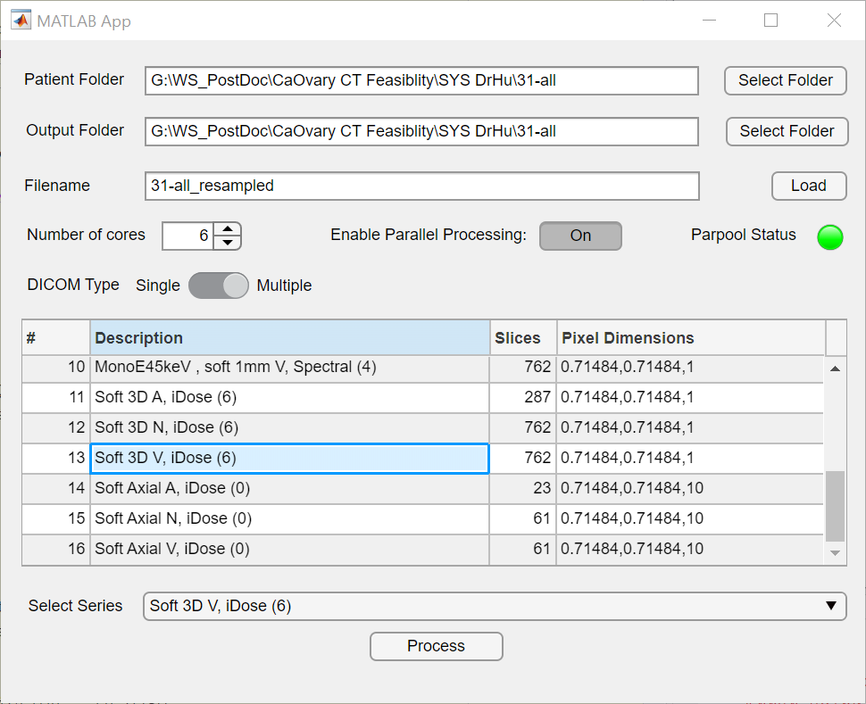
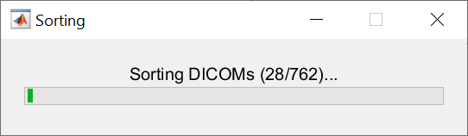
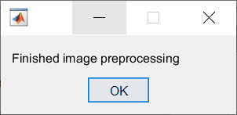
Step 6: Choose the correct series
A
B
A: Use the drop down menu and select the appropriate series
B: Or click directly on the series table
C: Click “Process” button
D: Progress bar
E: Wait for “Finished” message
C
D
E

Slide 14
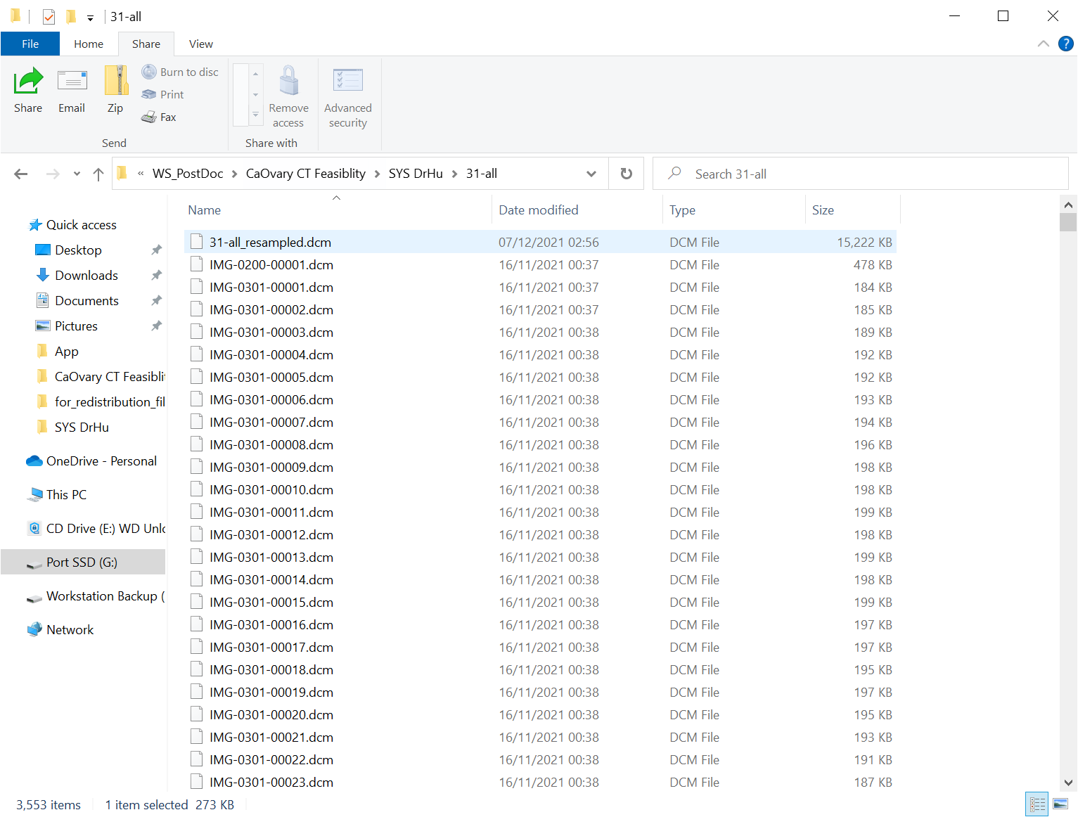
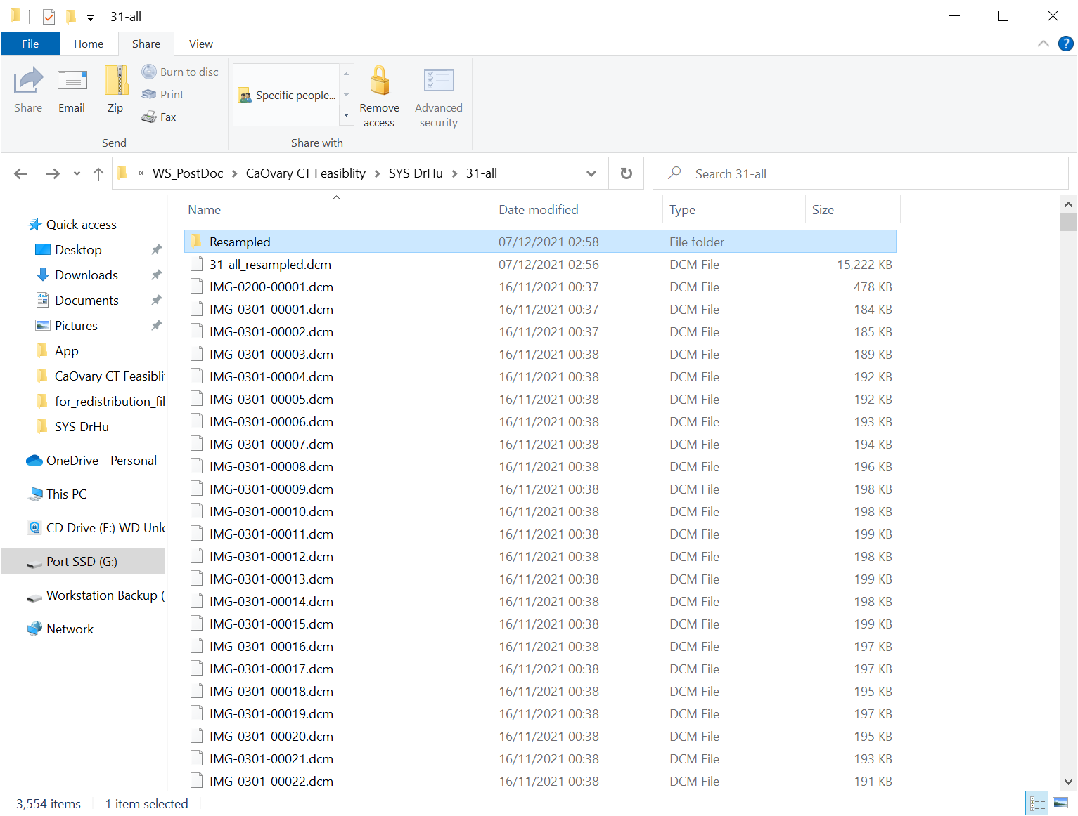
Step 7: Find the series
A
A: If “Single” DICOM save format was chosen, the resulting file should appear as shown
B: If “Multiple” DICOM save format was chosen, a folder named “Resampled” will be created which contains the multiple DICOMs
B

