Slide 1
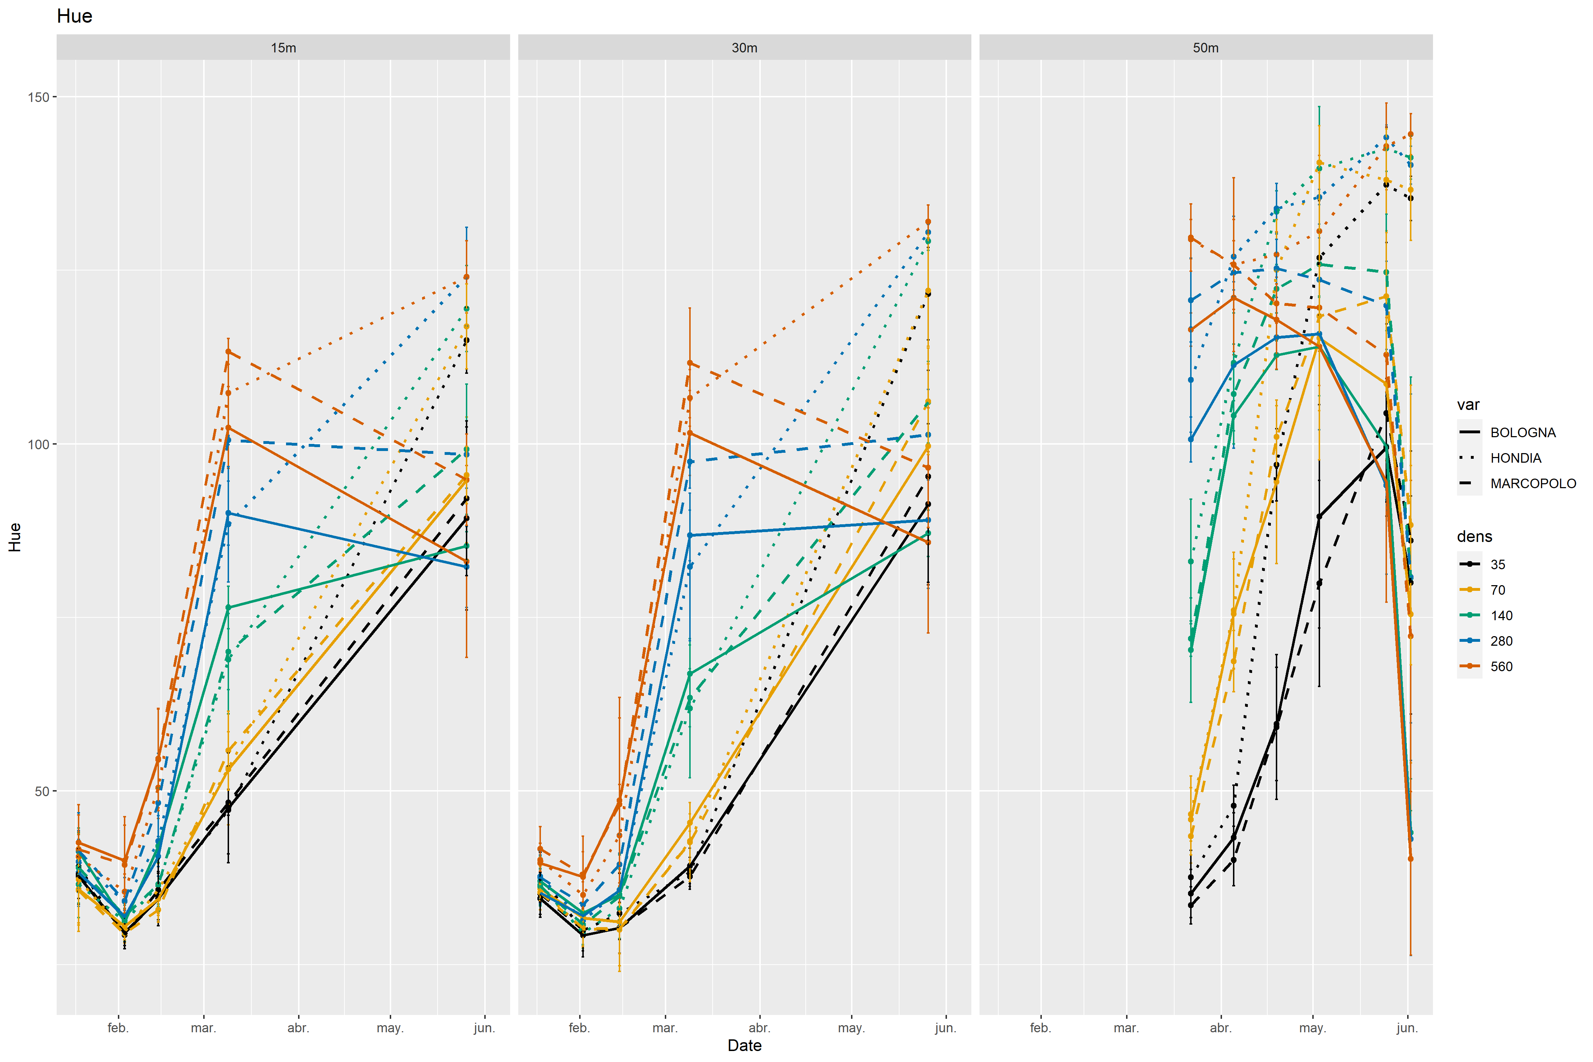

Slide 2
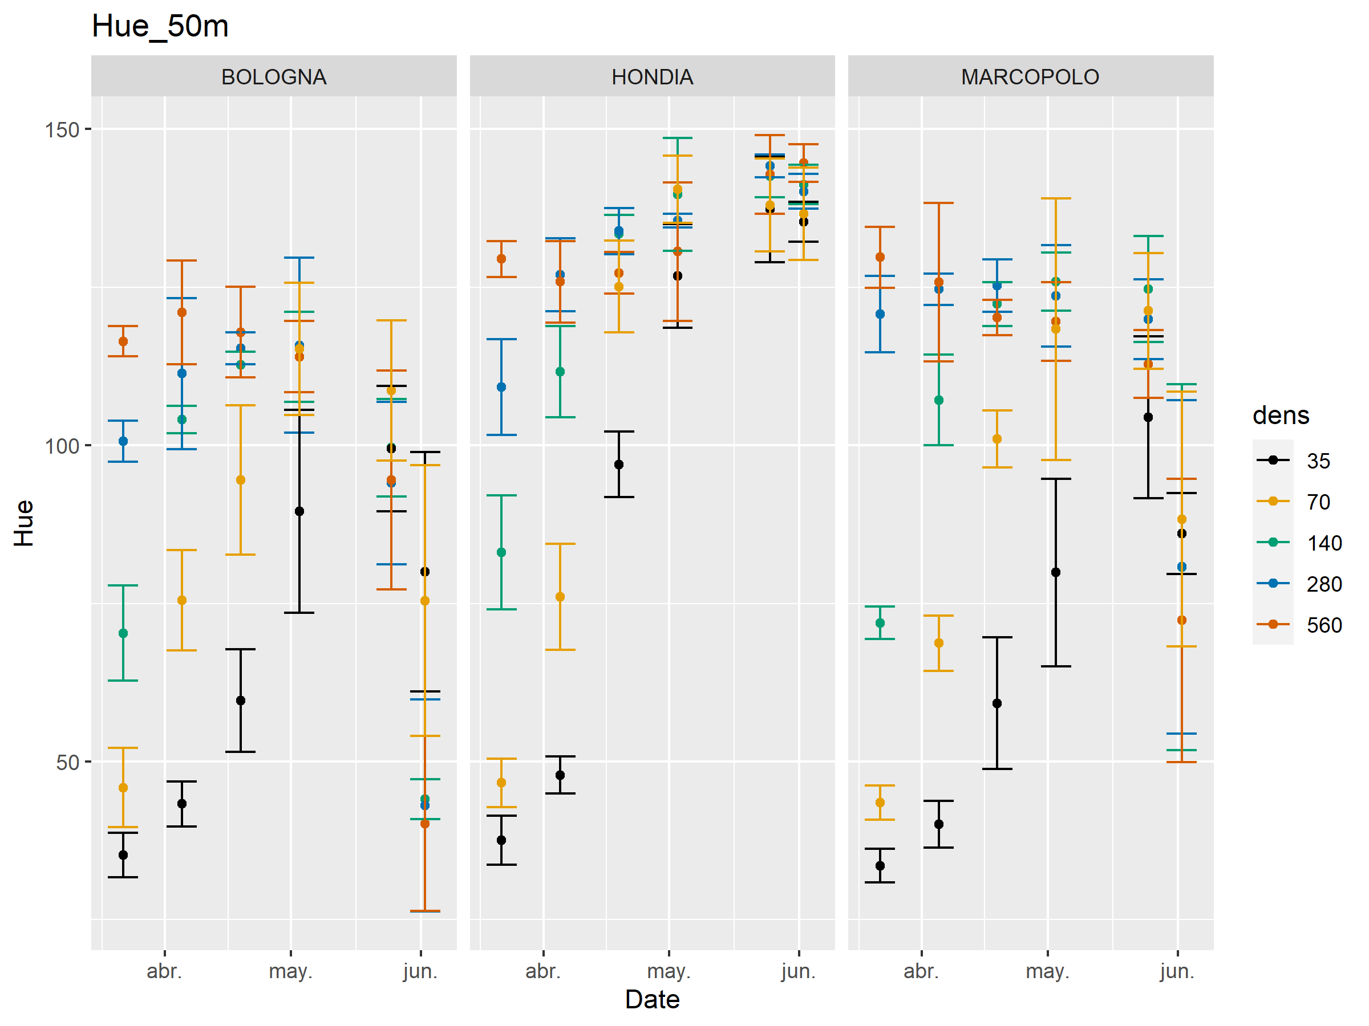

Slide 3
For most of the indexes there’s either heteroscedasticity or non-normality, or both.
Not possible to do ANOVA to assess dens, var and dens*var effects
Assessment of dens-VegIndex relationship:
Spearman’s Rank correlation (nonparametric)

Slide 4
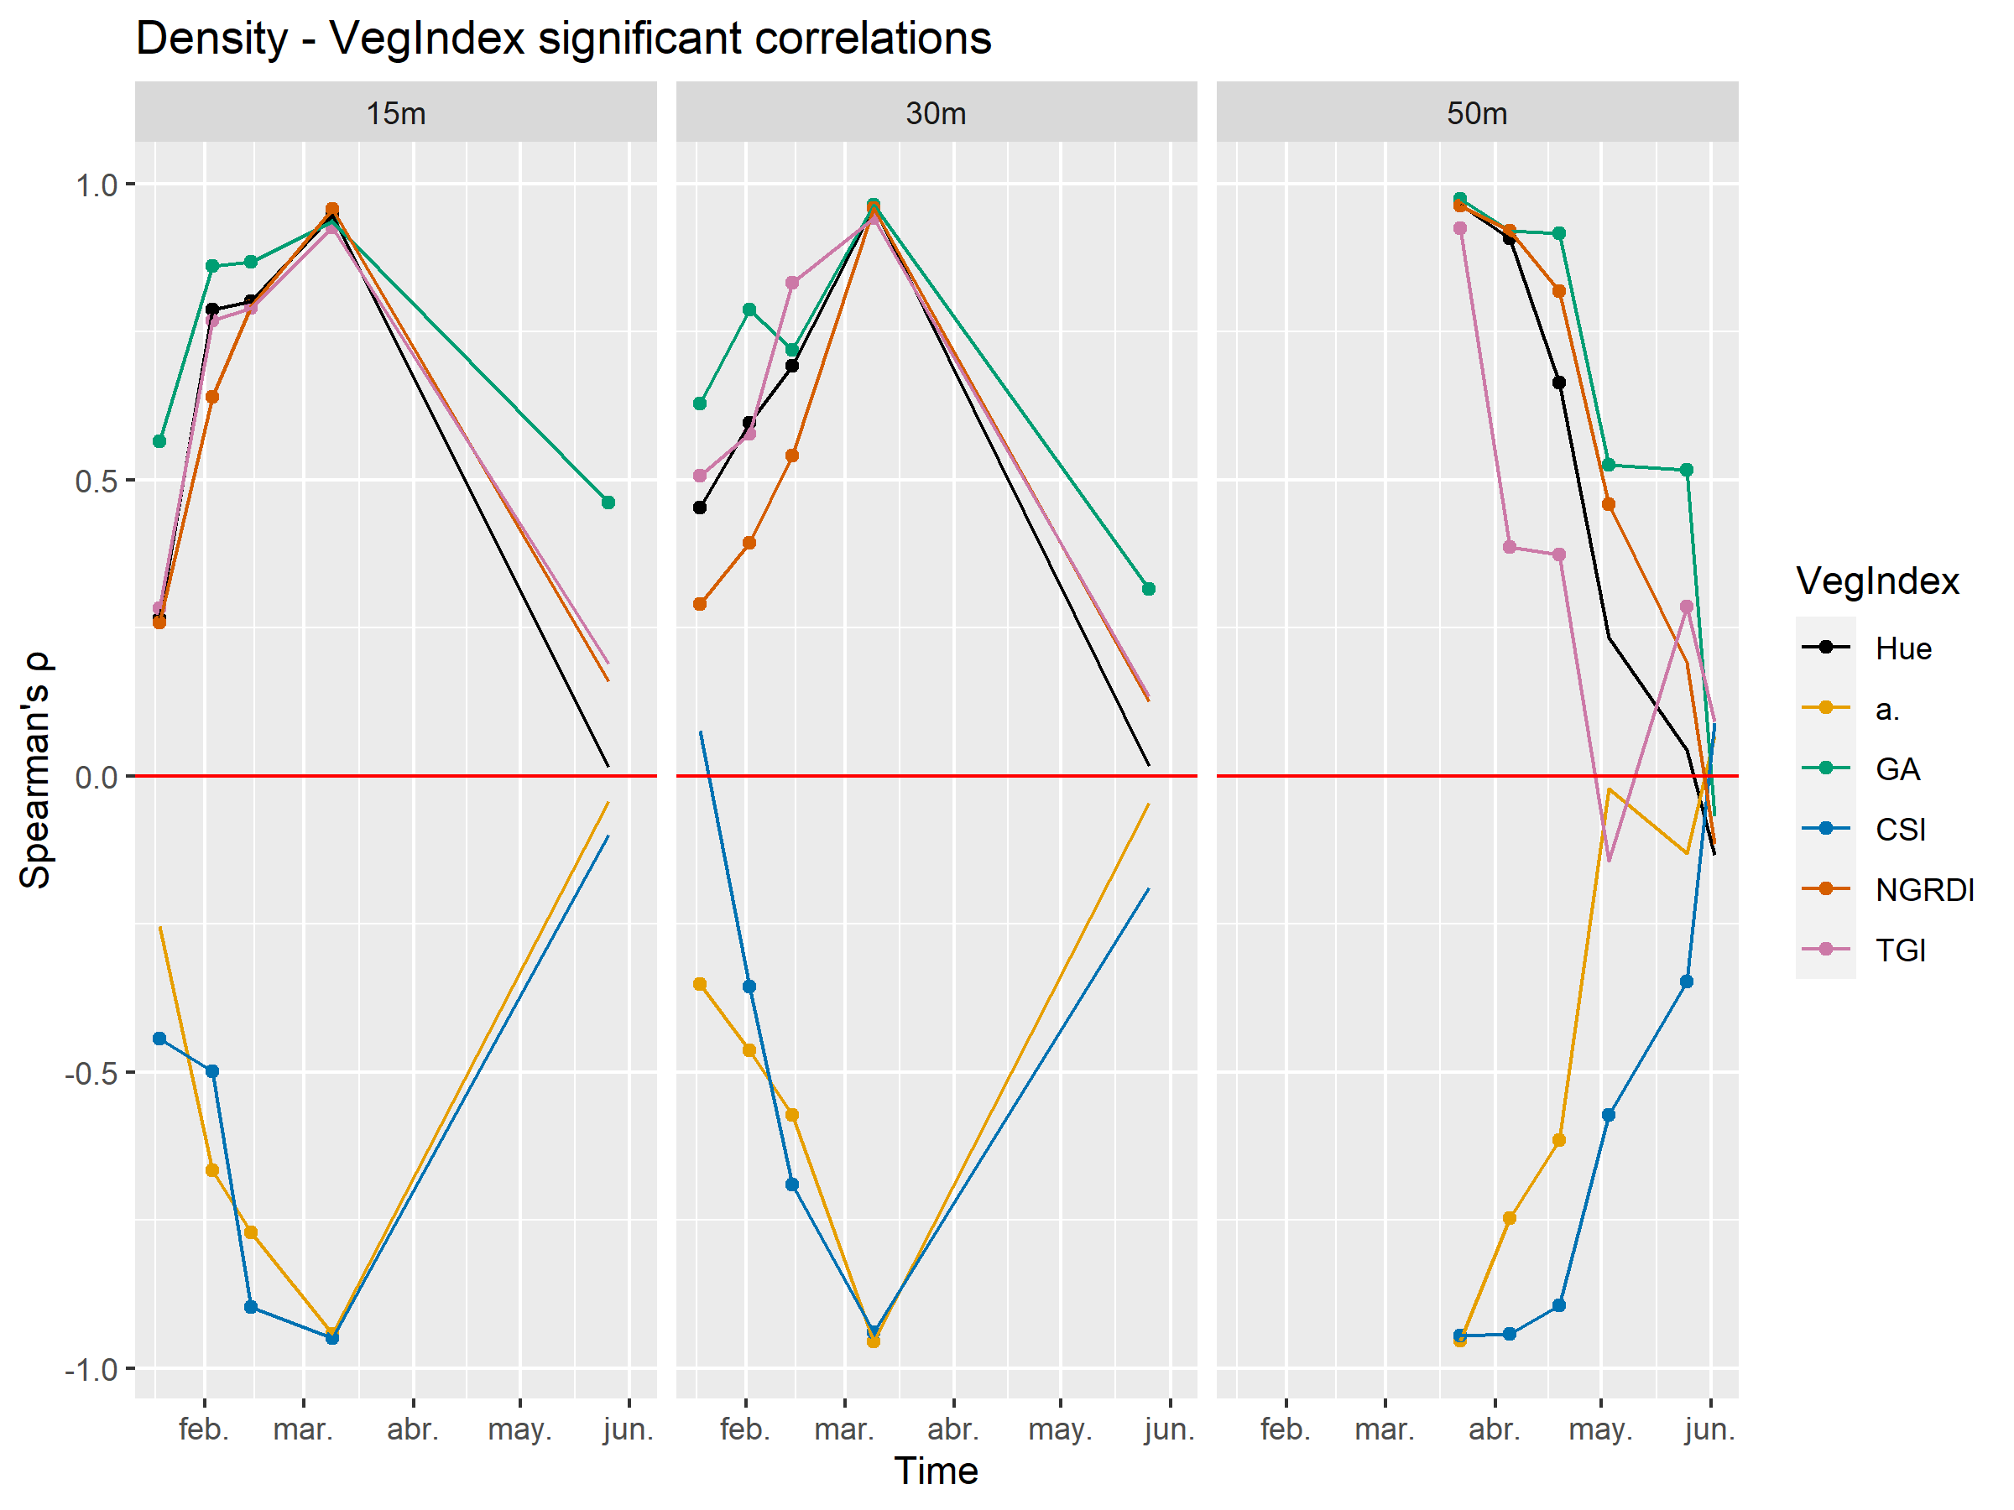

Slide 5
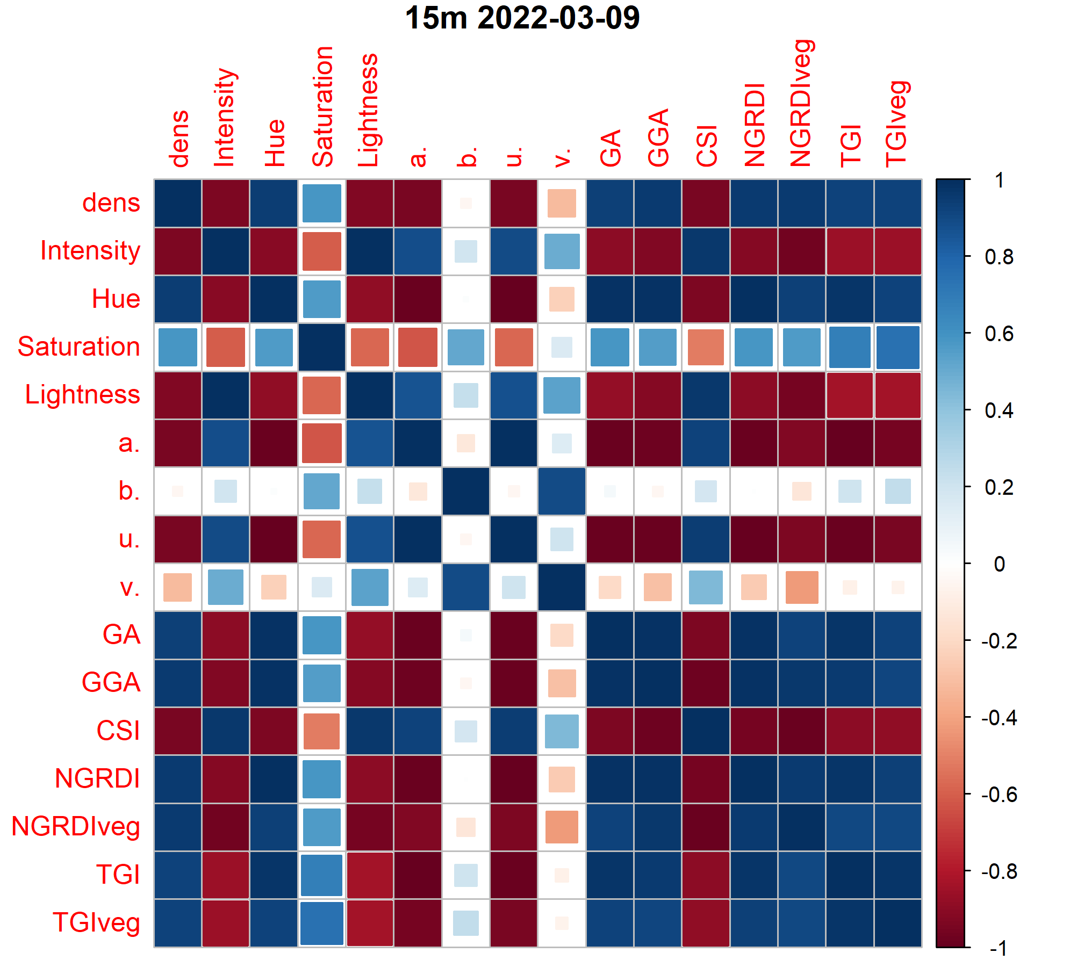
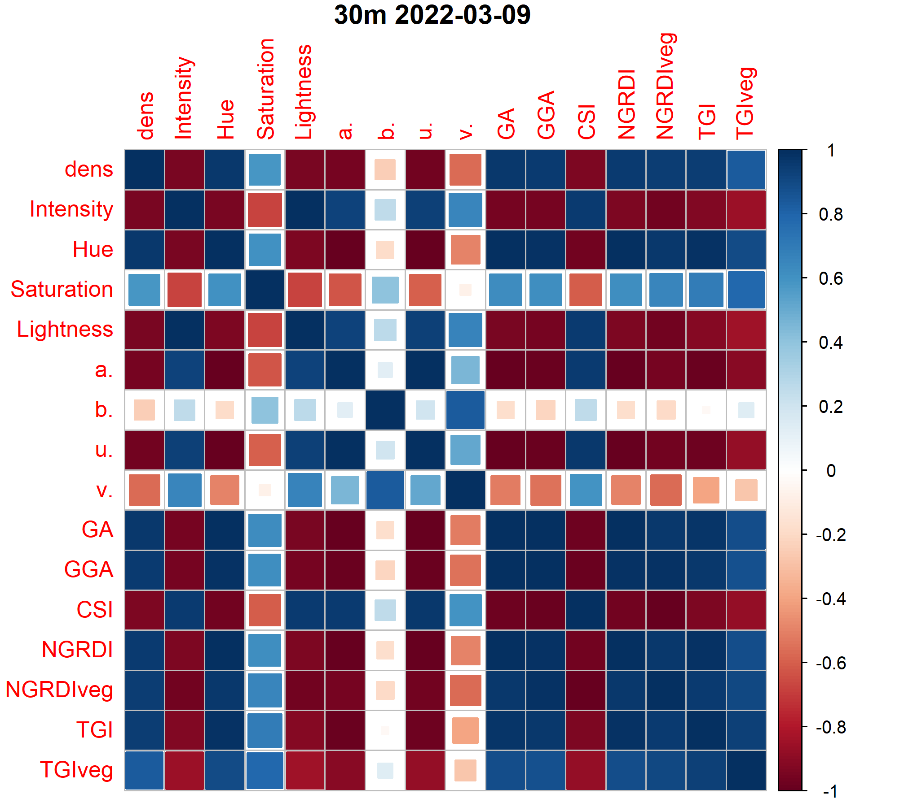
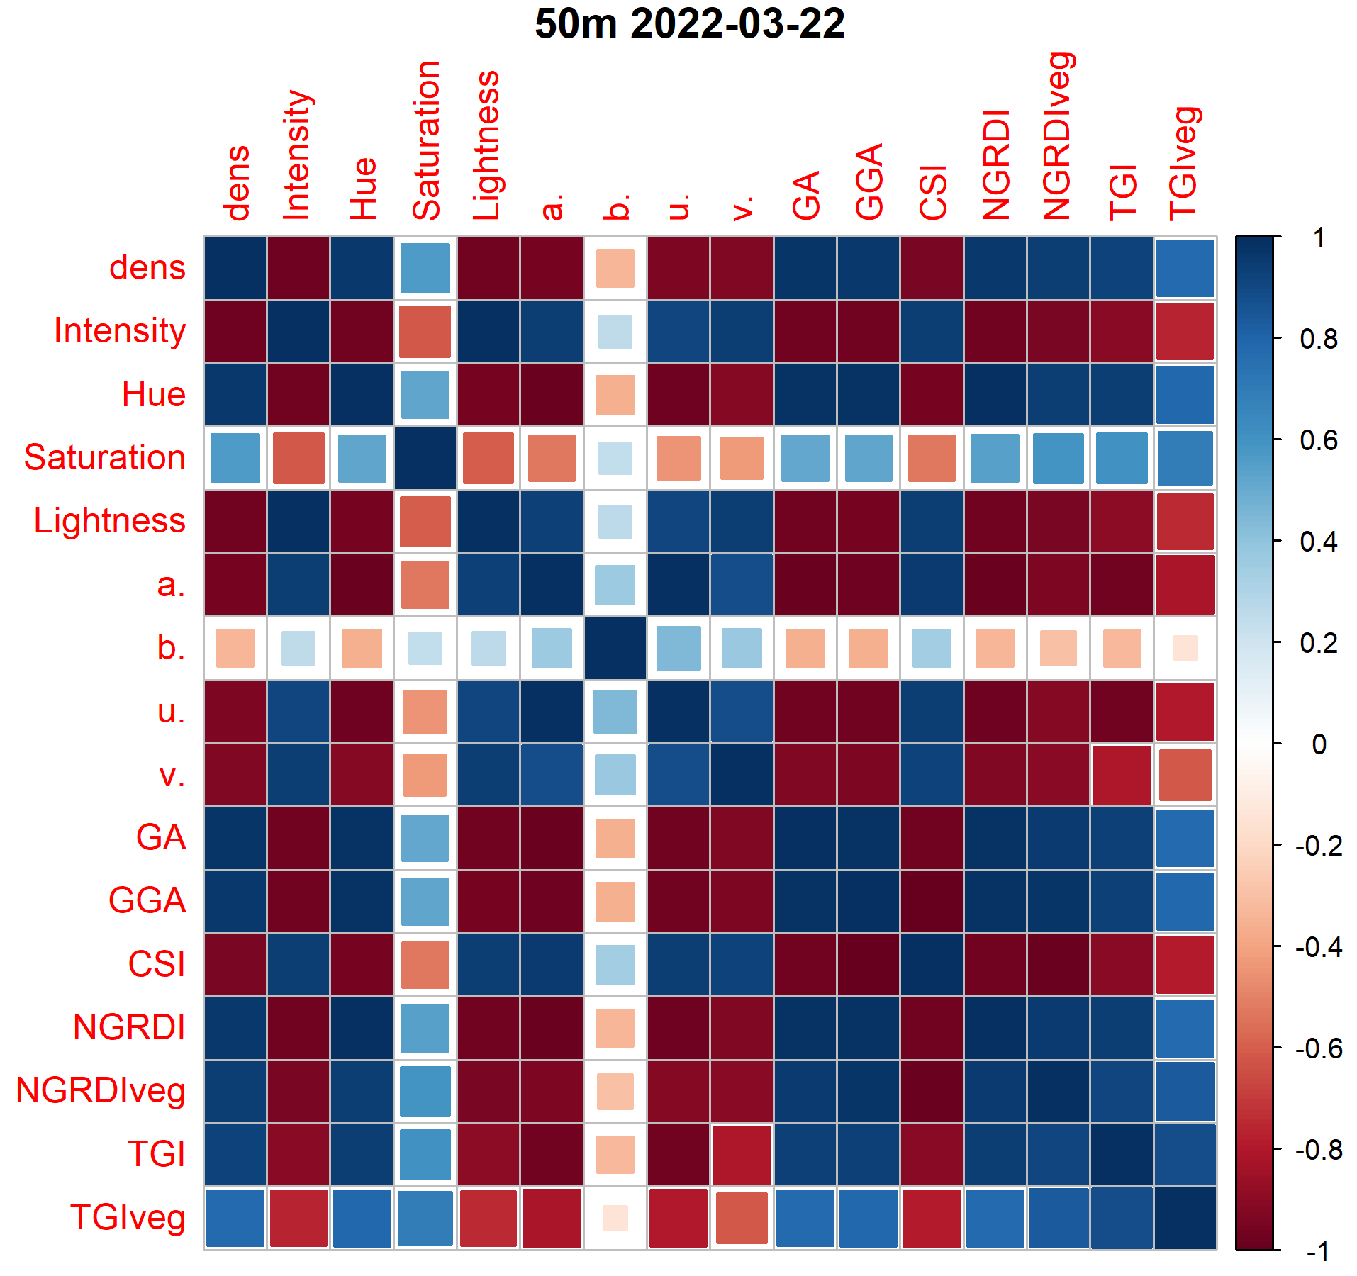
High vegIndex intercorrelation

Slide 6
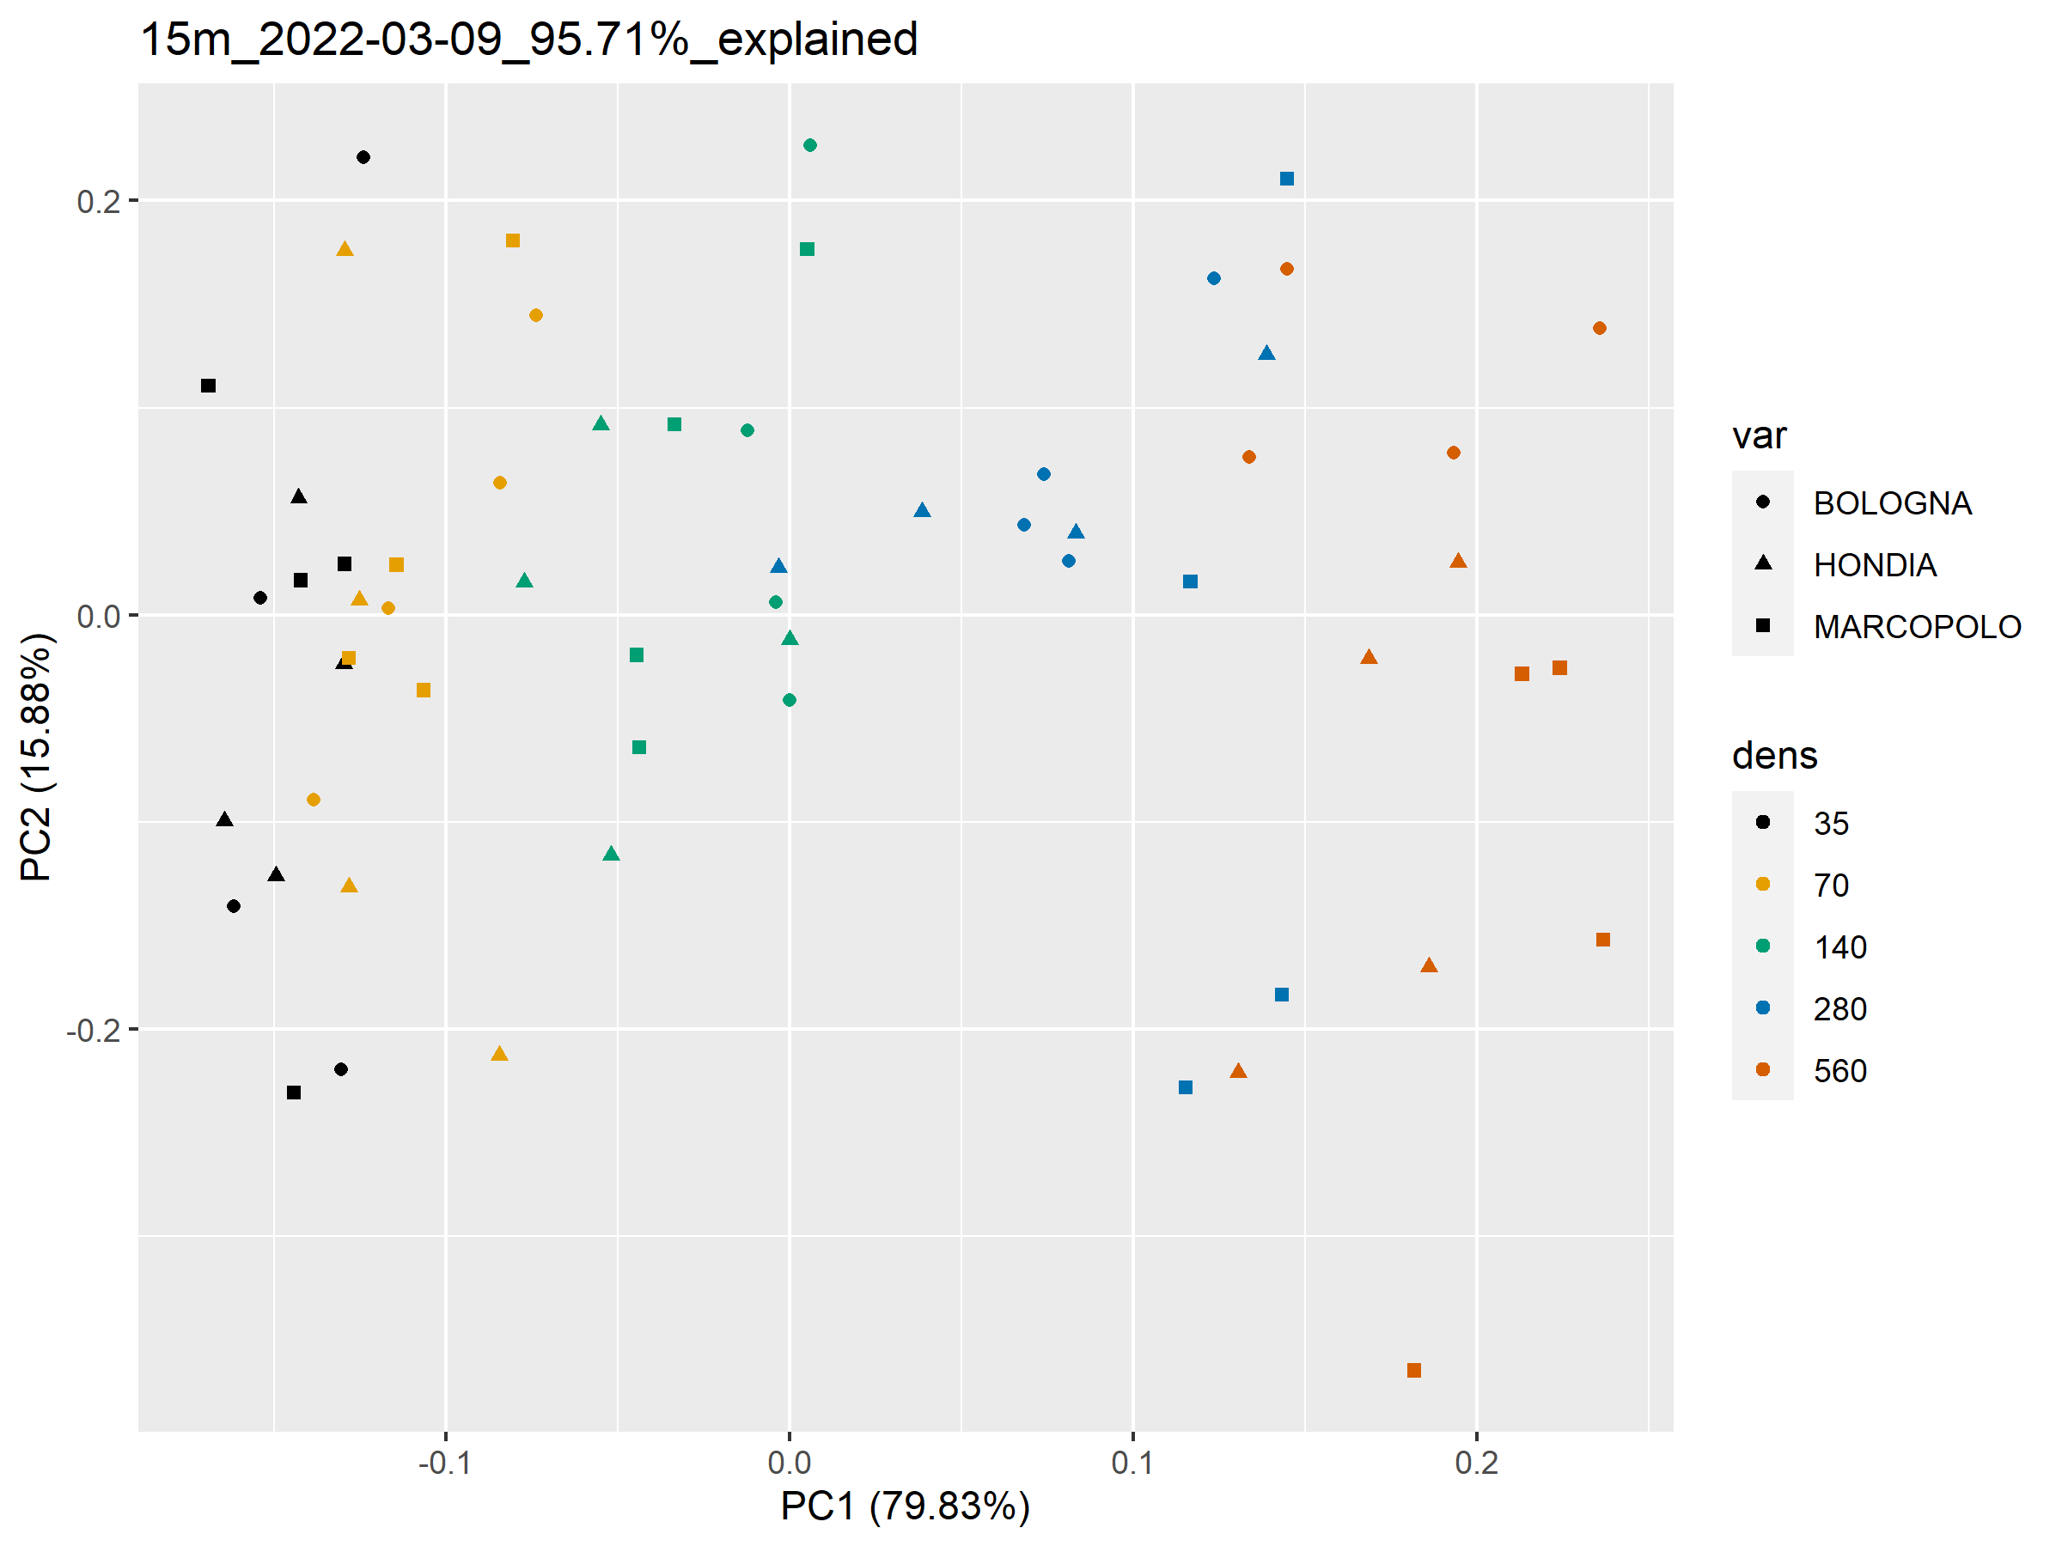
15m
03-09

Slide 7
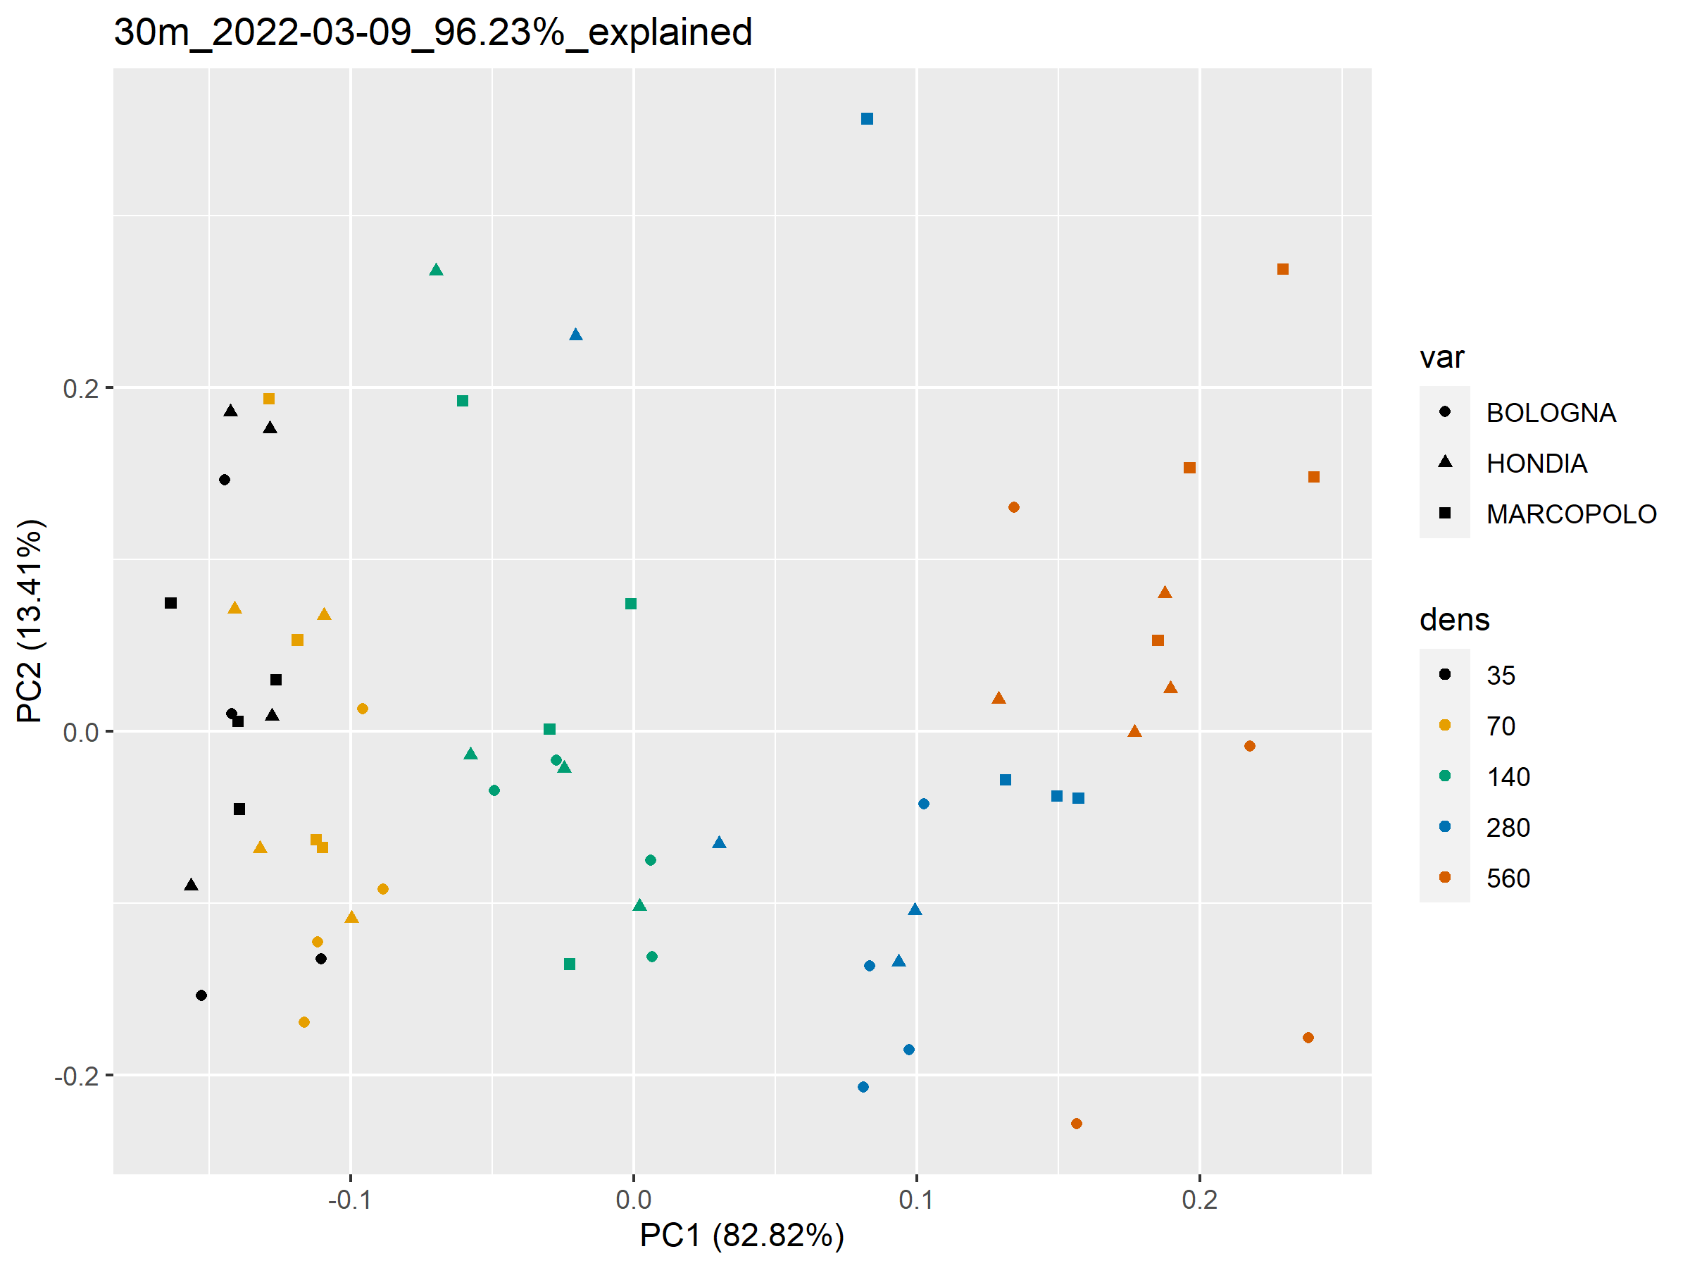
30m
03-09

Slide 8
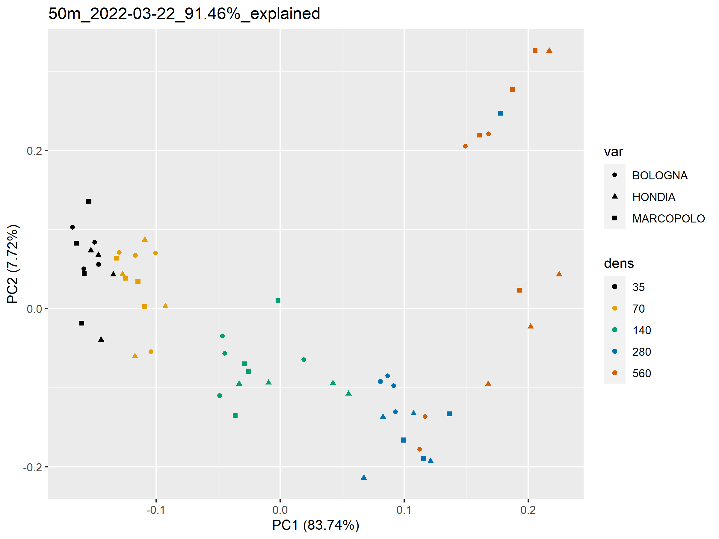
50m
03-22

Slide 9
Random Forests
15m 03-09
PC1 & PC2
70% train 30% test random split
10000 trees

Slide 10
Random Forests
30m 03-09
PC1 & PC2
70% train 30% test random split
10000 trees

Slide 11
Random Forests
50m 03-22
PC1 & PC2
70% train 30% test random split
10000 trees

