Slide 1
Design, dataset (altitudes and dates), indexes
..

Slide 2
Design
38 m
Artur Nick | Artur Nick | Artur Nick | Artur Nick
Hondia 70 | Marcopolo 70 | Marcopolo 560 | Hondia 560
Marcopolo 140 | Hondia 140 | Bologna 70 | Bologna 35
Bologna 560 | Bologna 280 | Hondia 35 | Marcopolo 280
Bologna 70 | Marcopolo 280 | Hondia 140 | Hondia 70
Marcopolo 560 | Hondia 560 | Marcopolo 70 | Marcopolo 35
Hondia 280 | Bologna 35 | Bologna 280 | Bologna 140
Hondia 560 | Bologna 70 | Hondia 280 | Bologna 280
Bologna 140 | Marcopolo 560 | Marcopolo 140 | Hondia 140
Marcopolo 35 | Hondia 35 | Bologna 560 | Marcopolo 70
Bologna 280 | Hondia 70 | Bologna 35 | Marcopolo 140
Marcopolo 70 | Marcopolo 35 | Hondia 560 | Hondia 280
Hondia 35 | Bologna 140 | Marcopolo 280 | Bologna 560
Bologna 35 | Marcopolo 140 | Bologna 140 | Bologna 70
Hondia 140 | Bologna 560 | Marcopolo 35 | Marcopolo 560
Marcopolo 280 | Hondia 280 | Hondia 70 | Hondia 35
Artur Nick | Artur Nick | Artur Nick | Artur Nick
25.5 m

Slide 4
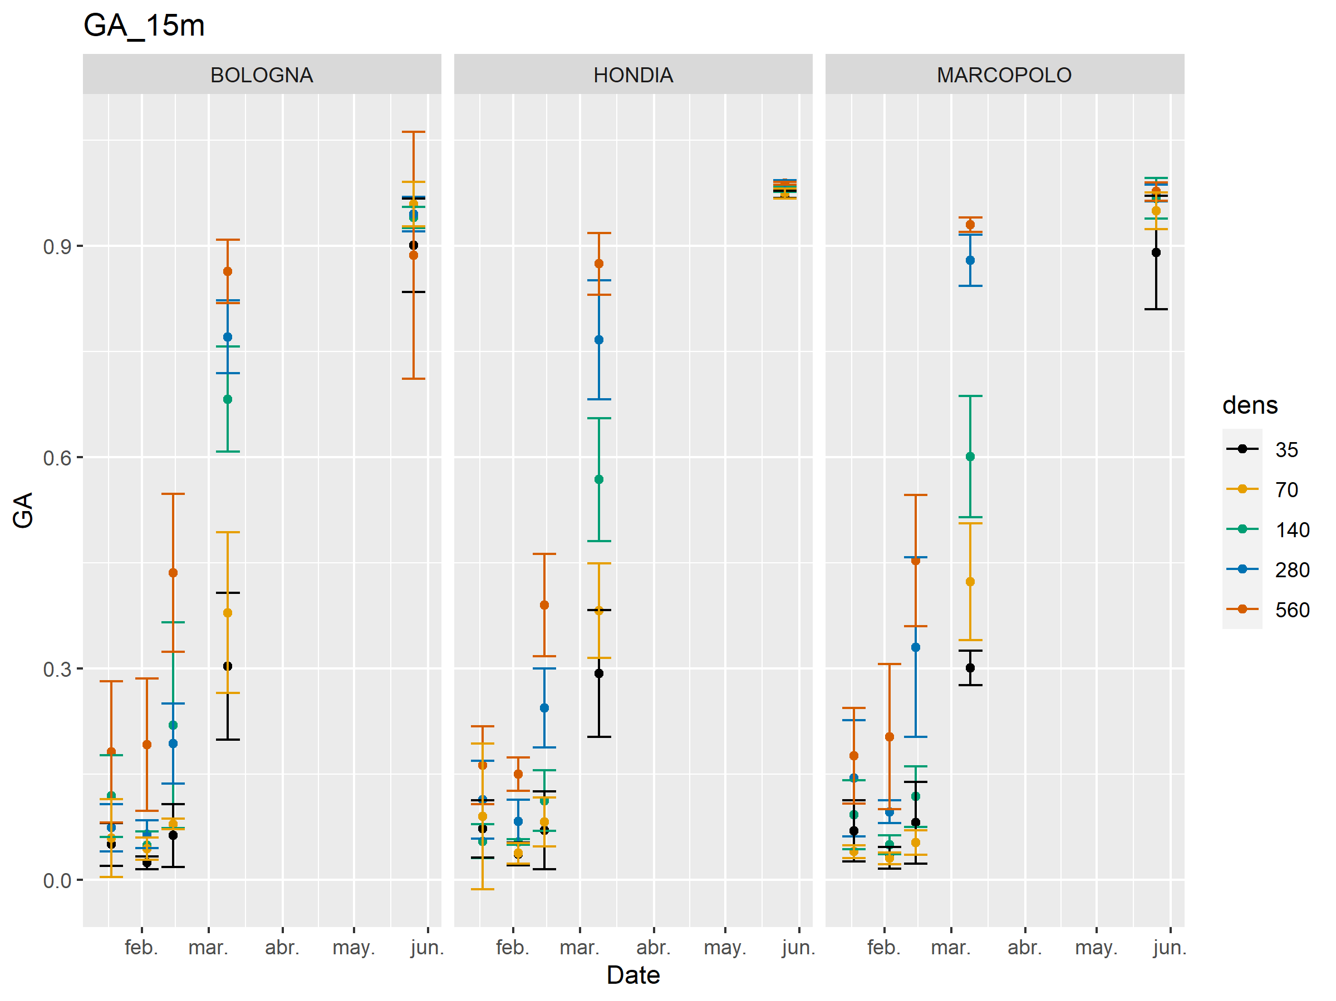

Slide 5
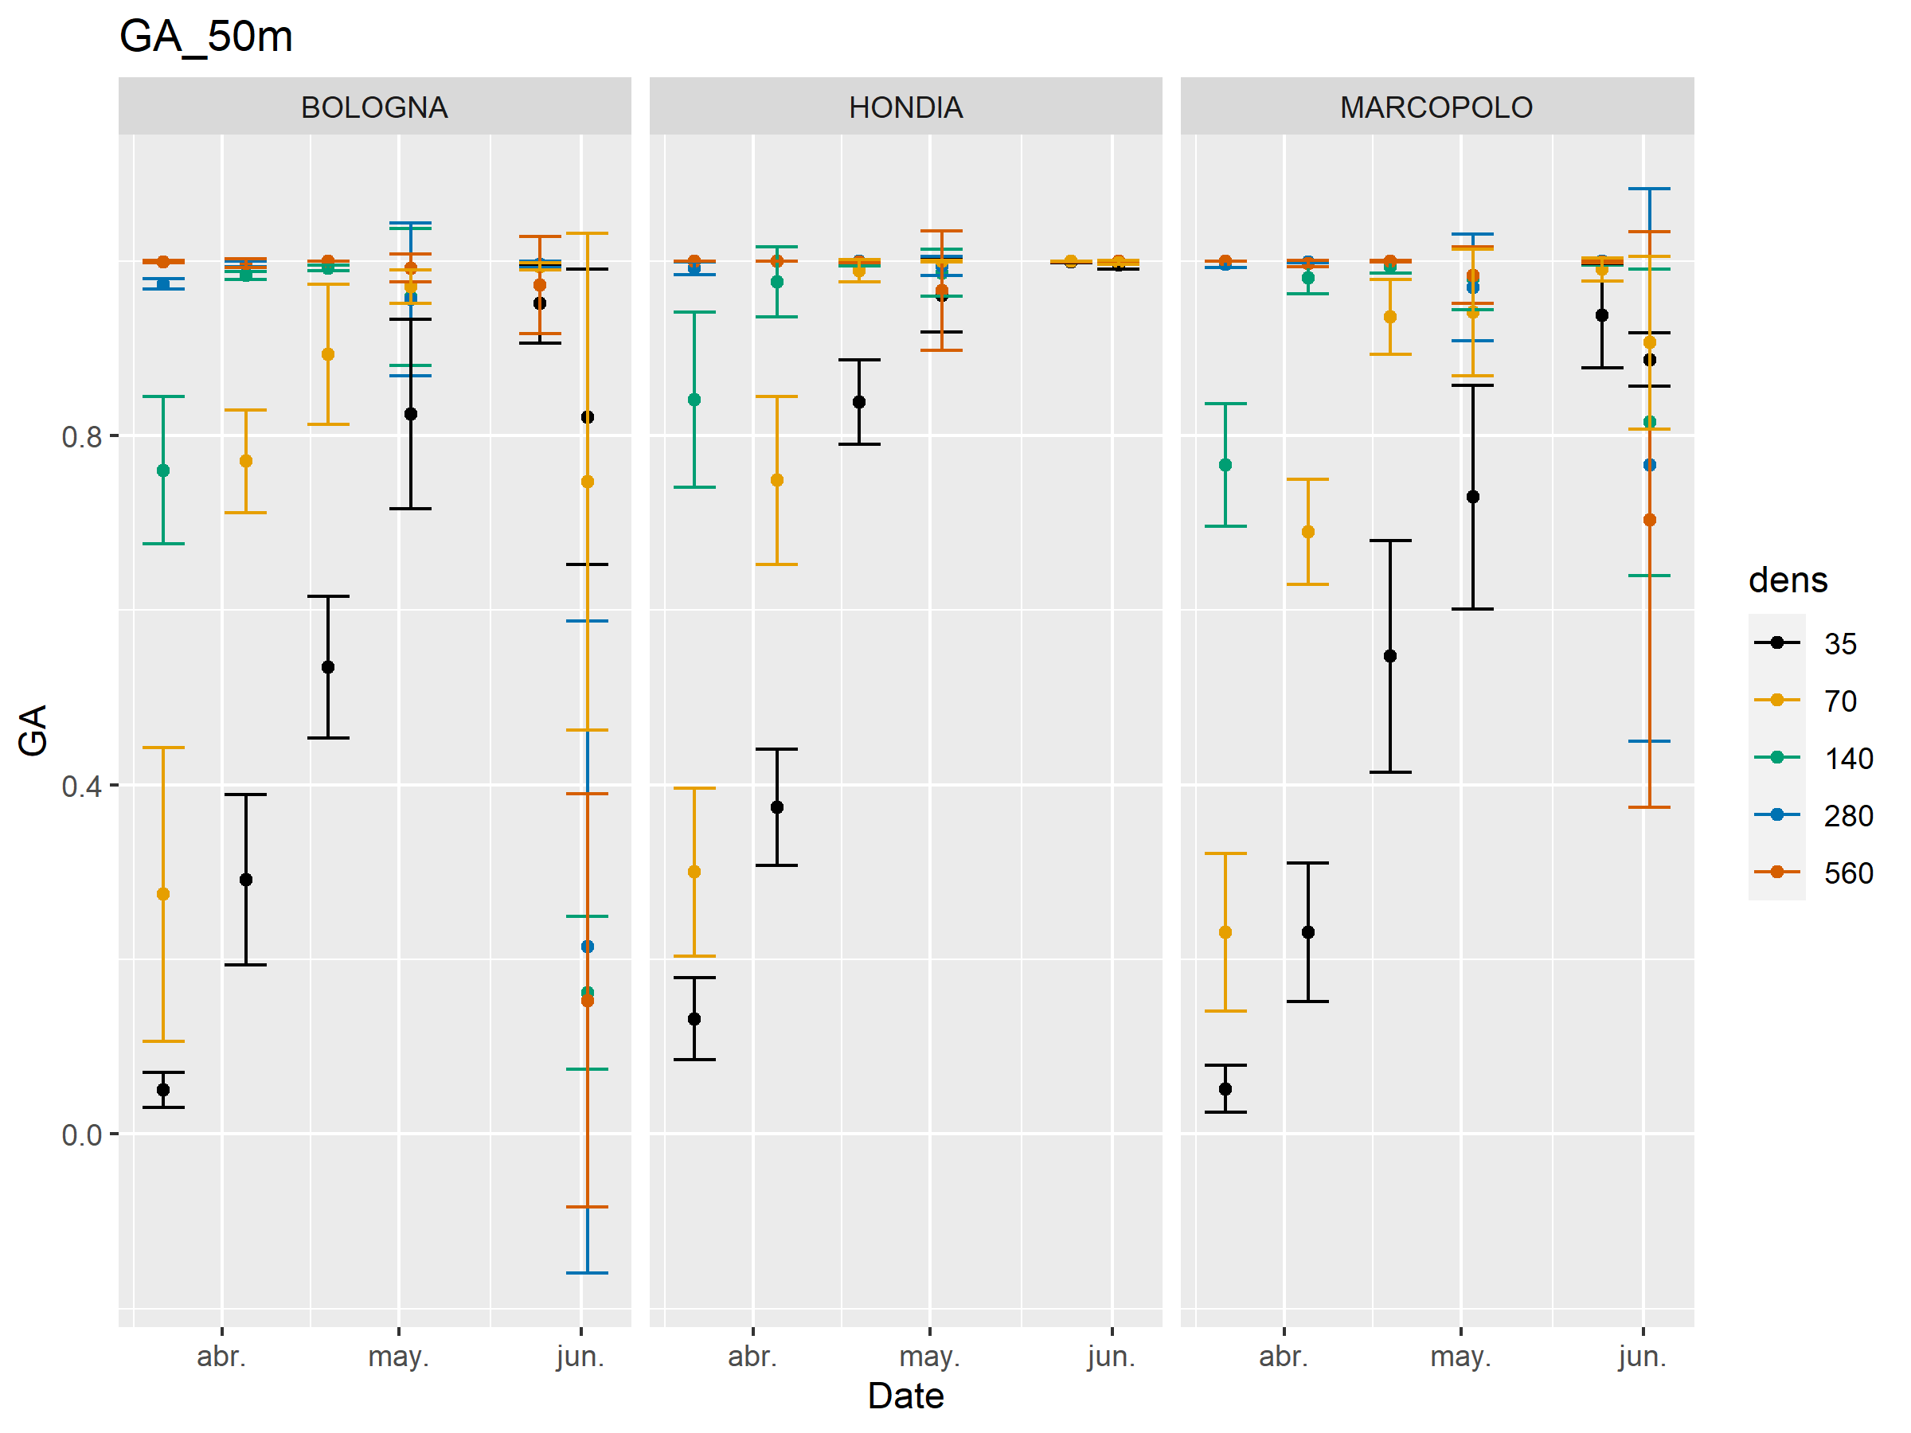

Slide 6
Most of the vegetation indexes have non-parametric distributions or grups are heteroscedastic.
→ Not possible to do ANOVA to assess dens, var and dens*var effects
Assessment of dens-VegIndex relationship:
Spearman’s Rank correlation (non-parametric)
PCA
Decision trees:
Classification CART trees
Conditional inference trees
Random forests

Slide 7
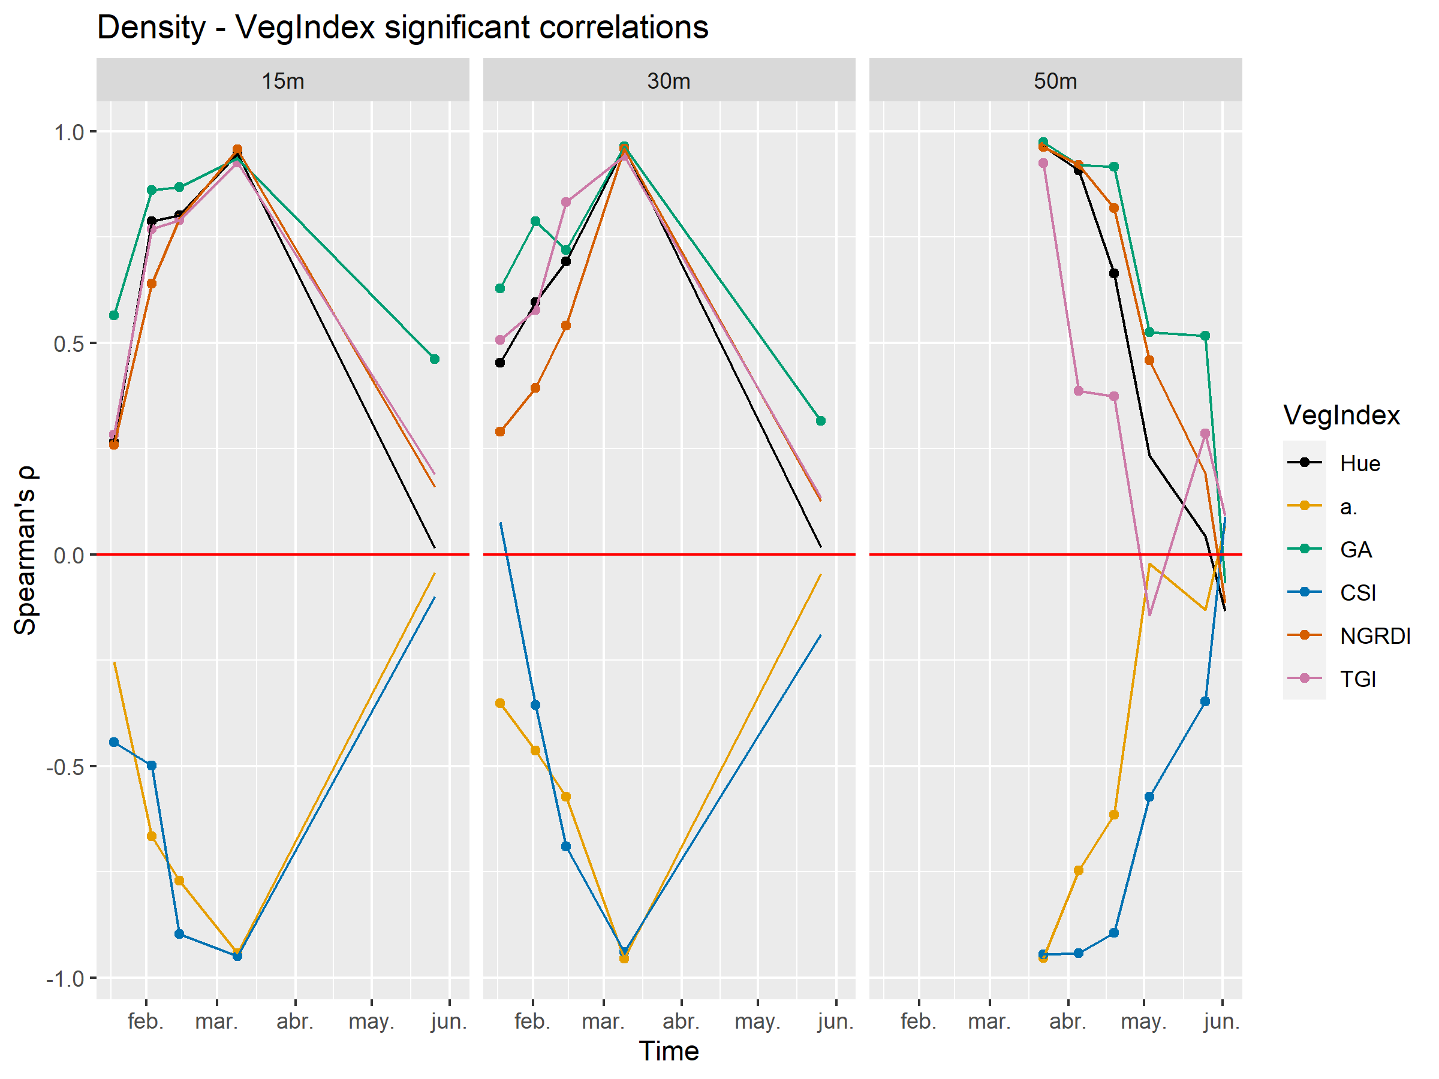

Slide 8
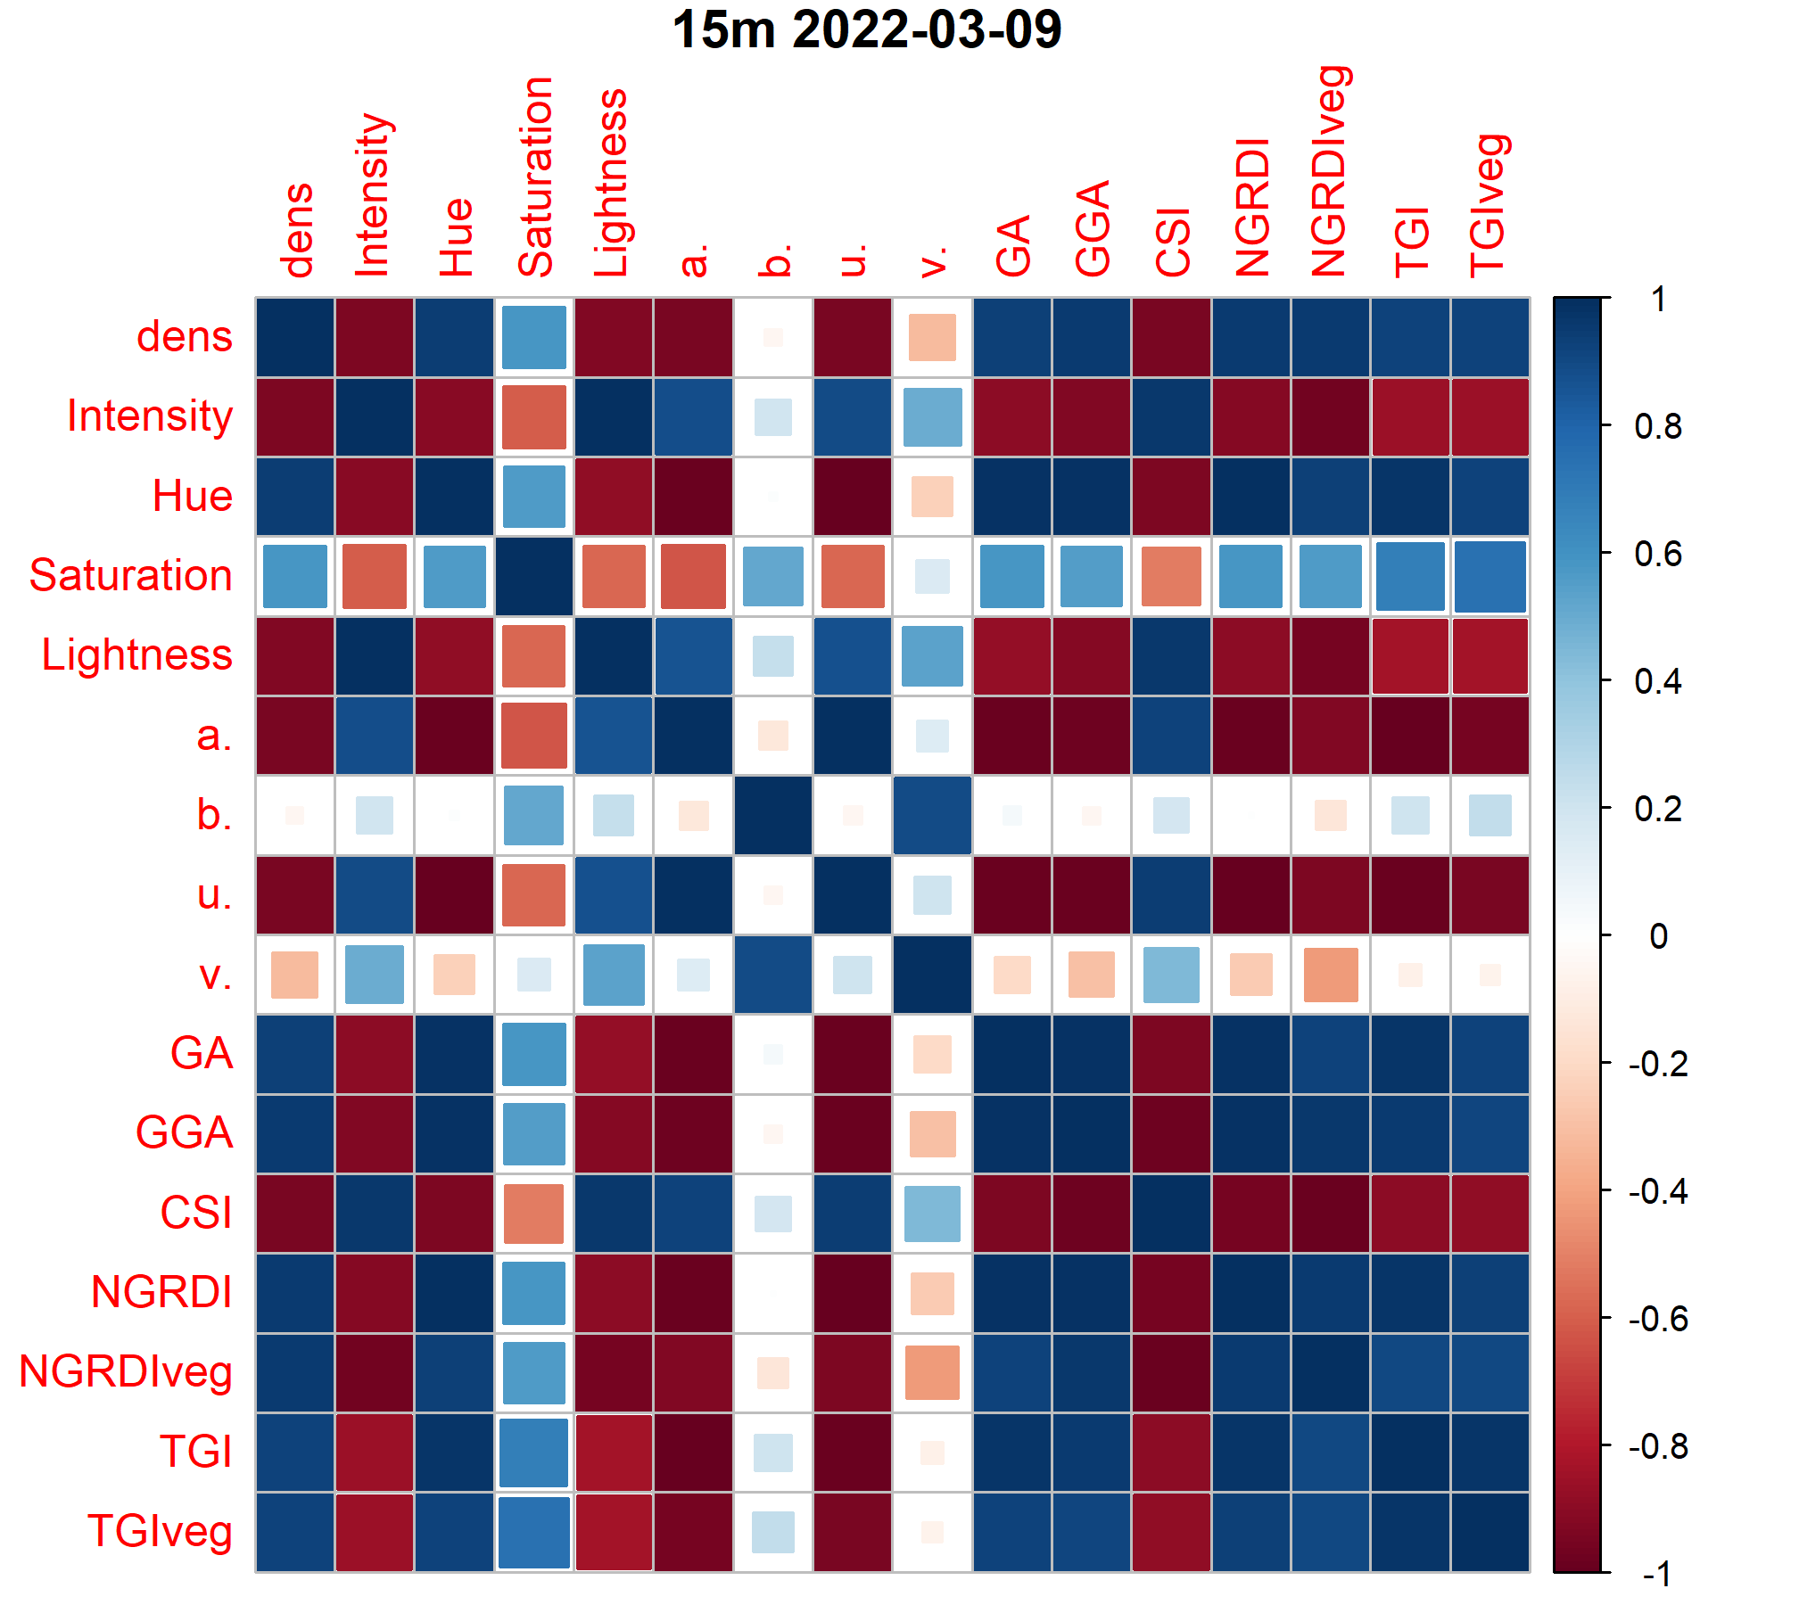
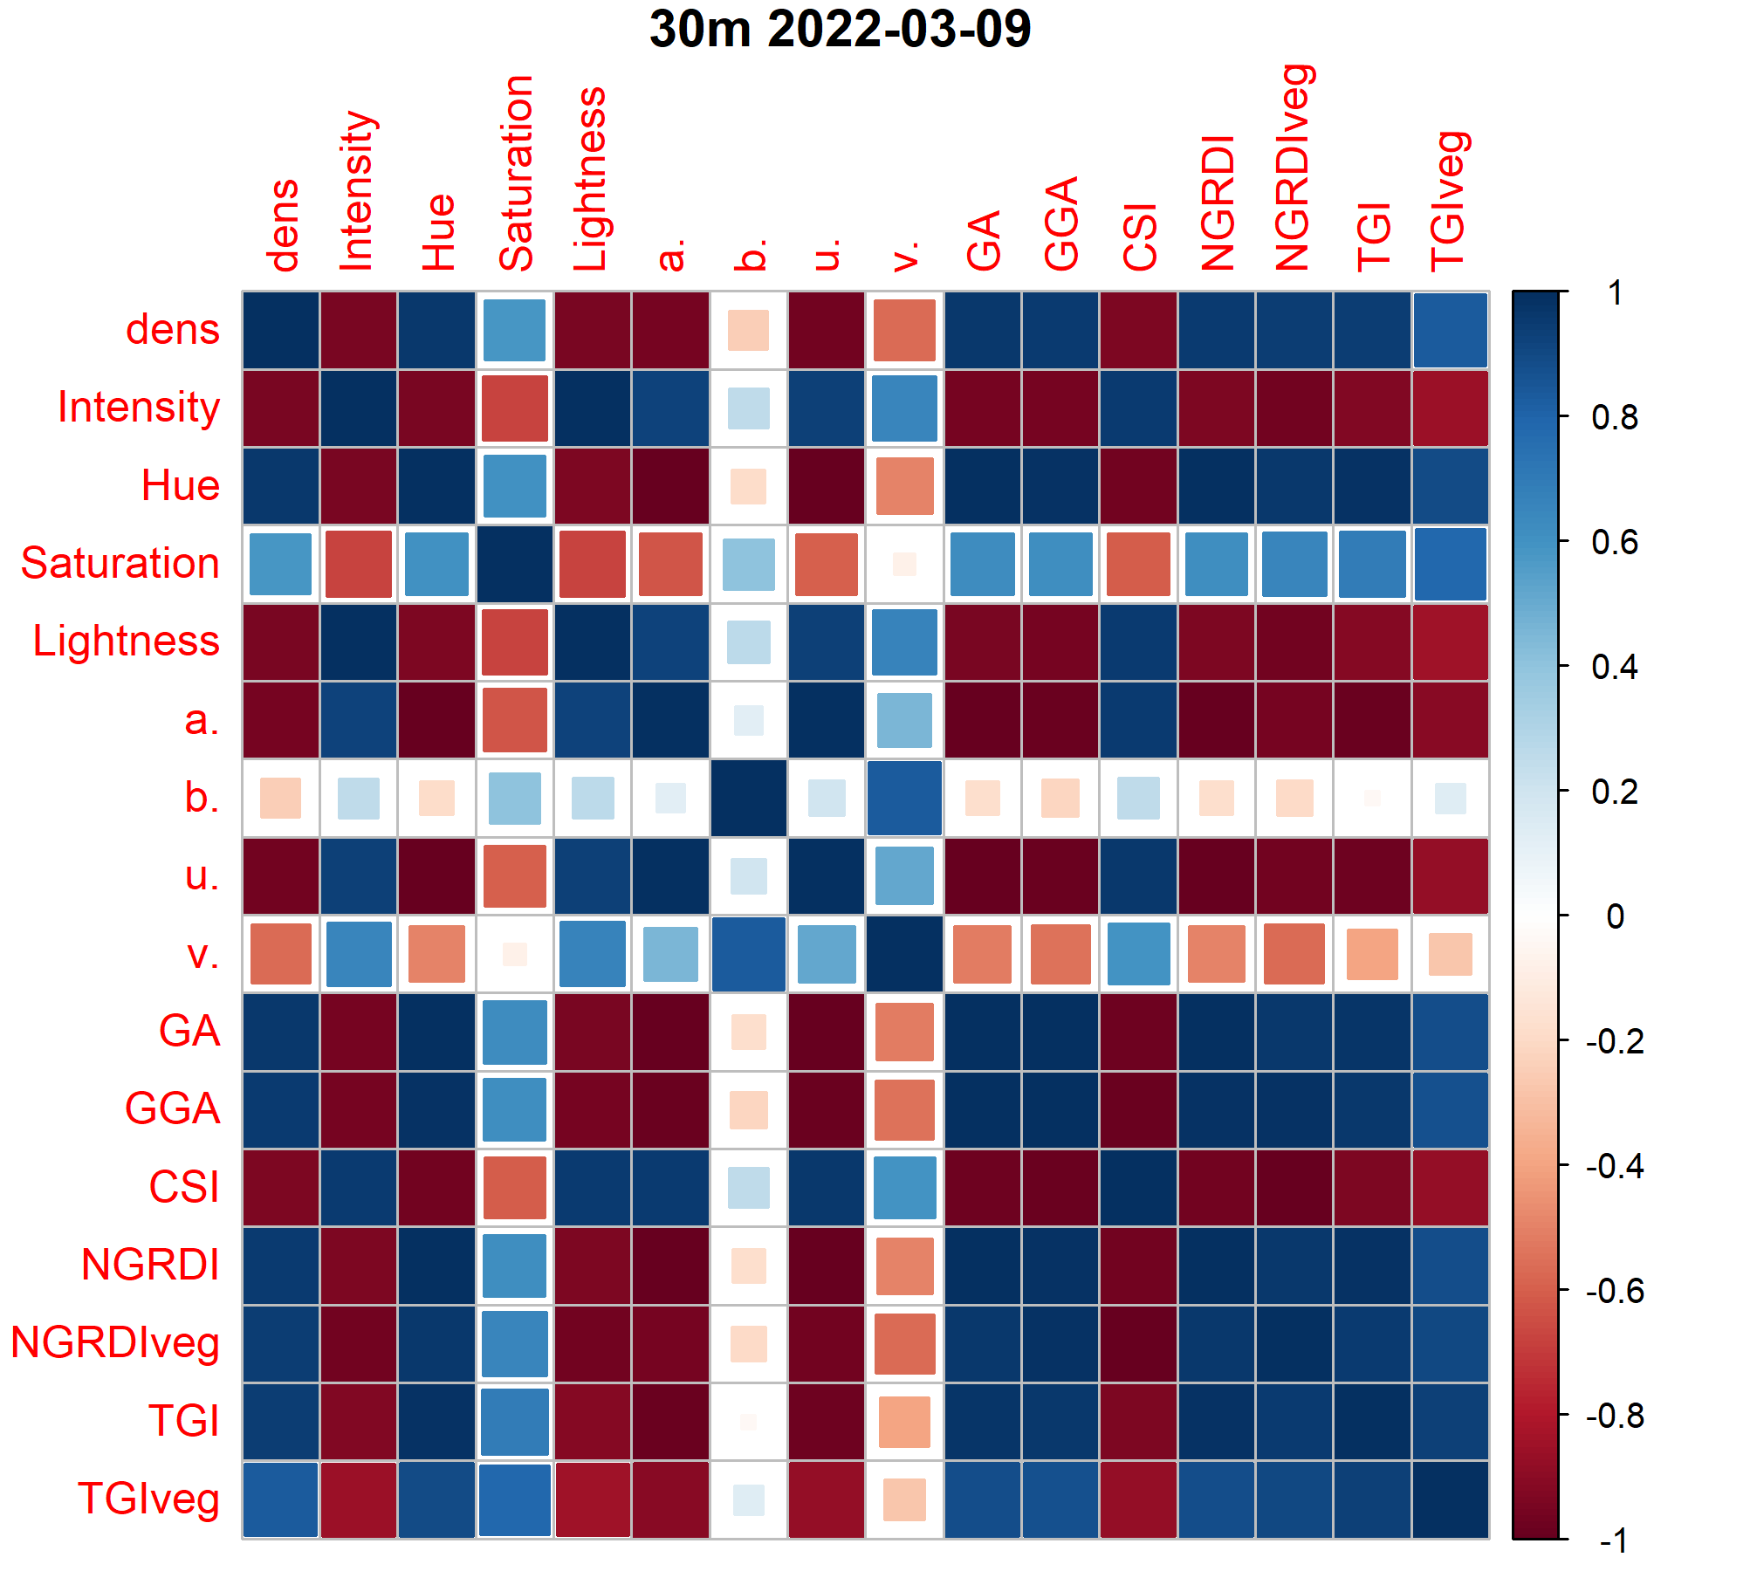
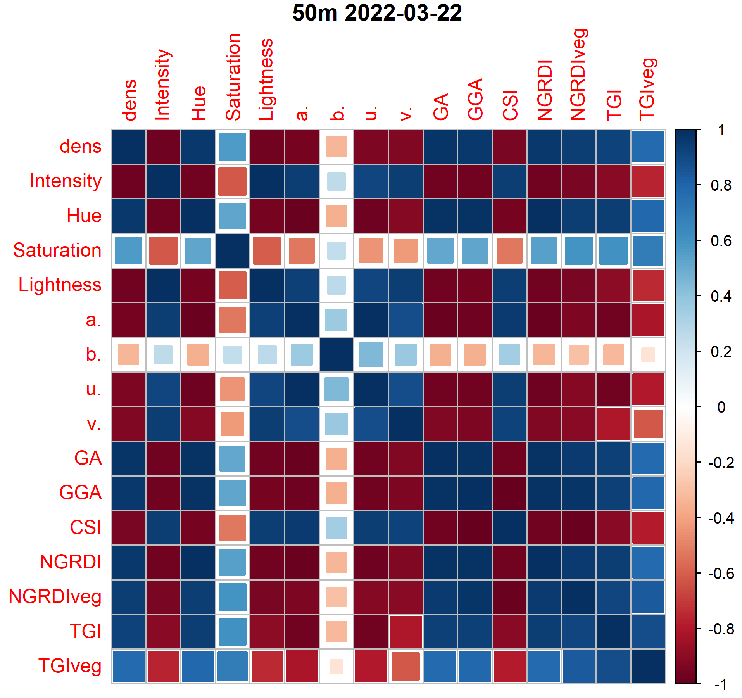
High vegIndex intercorrelation

Slide 9
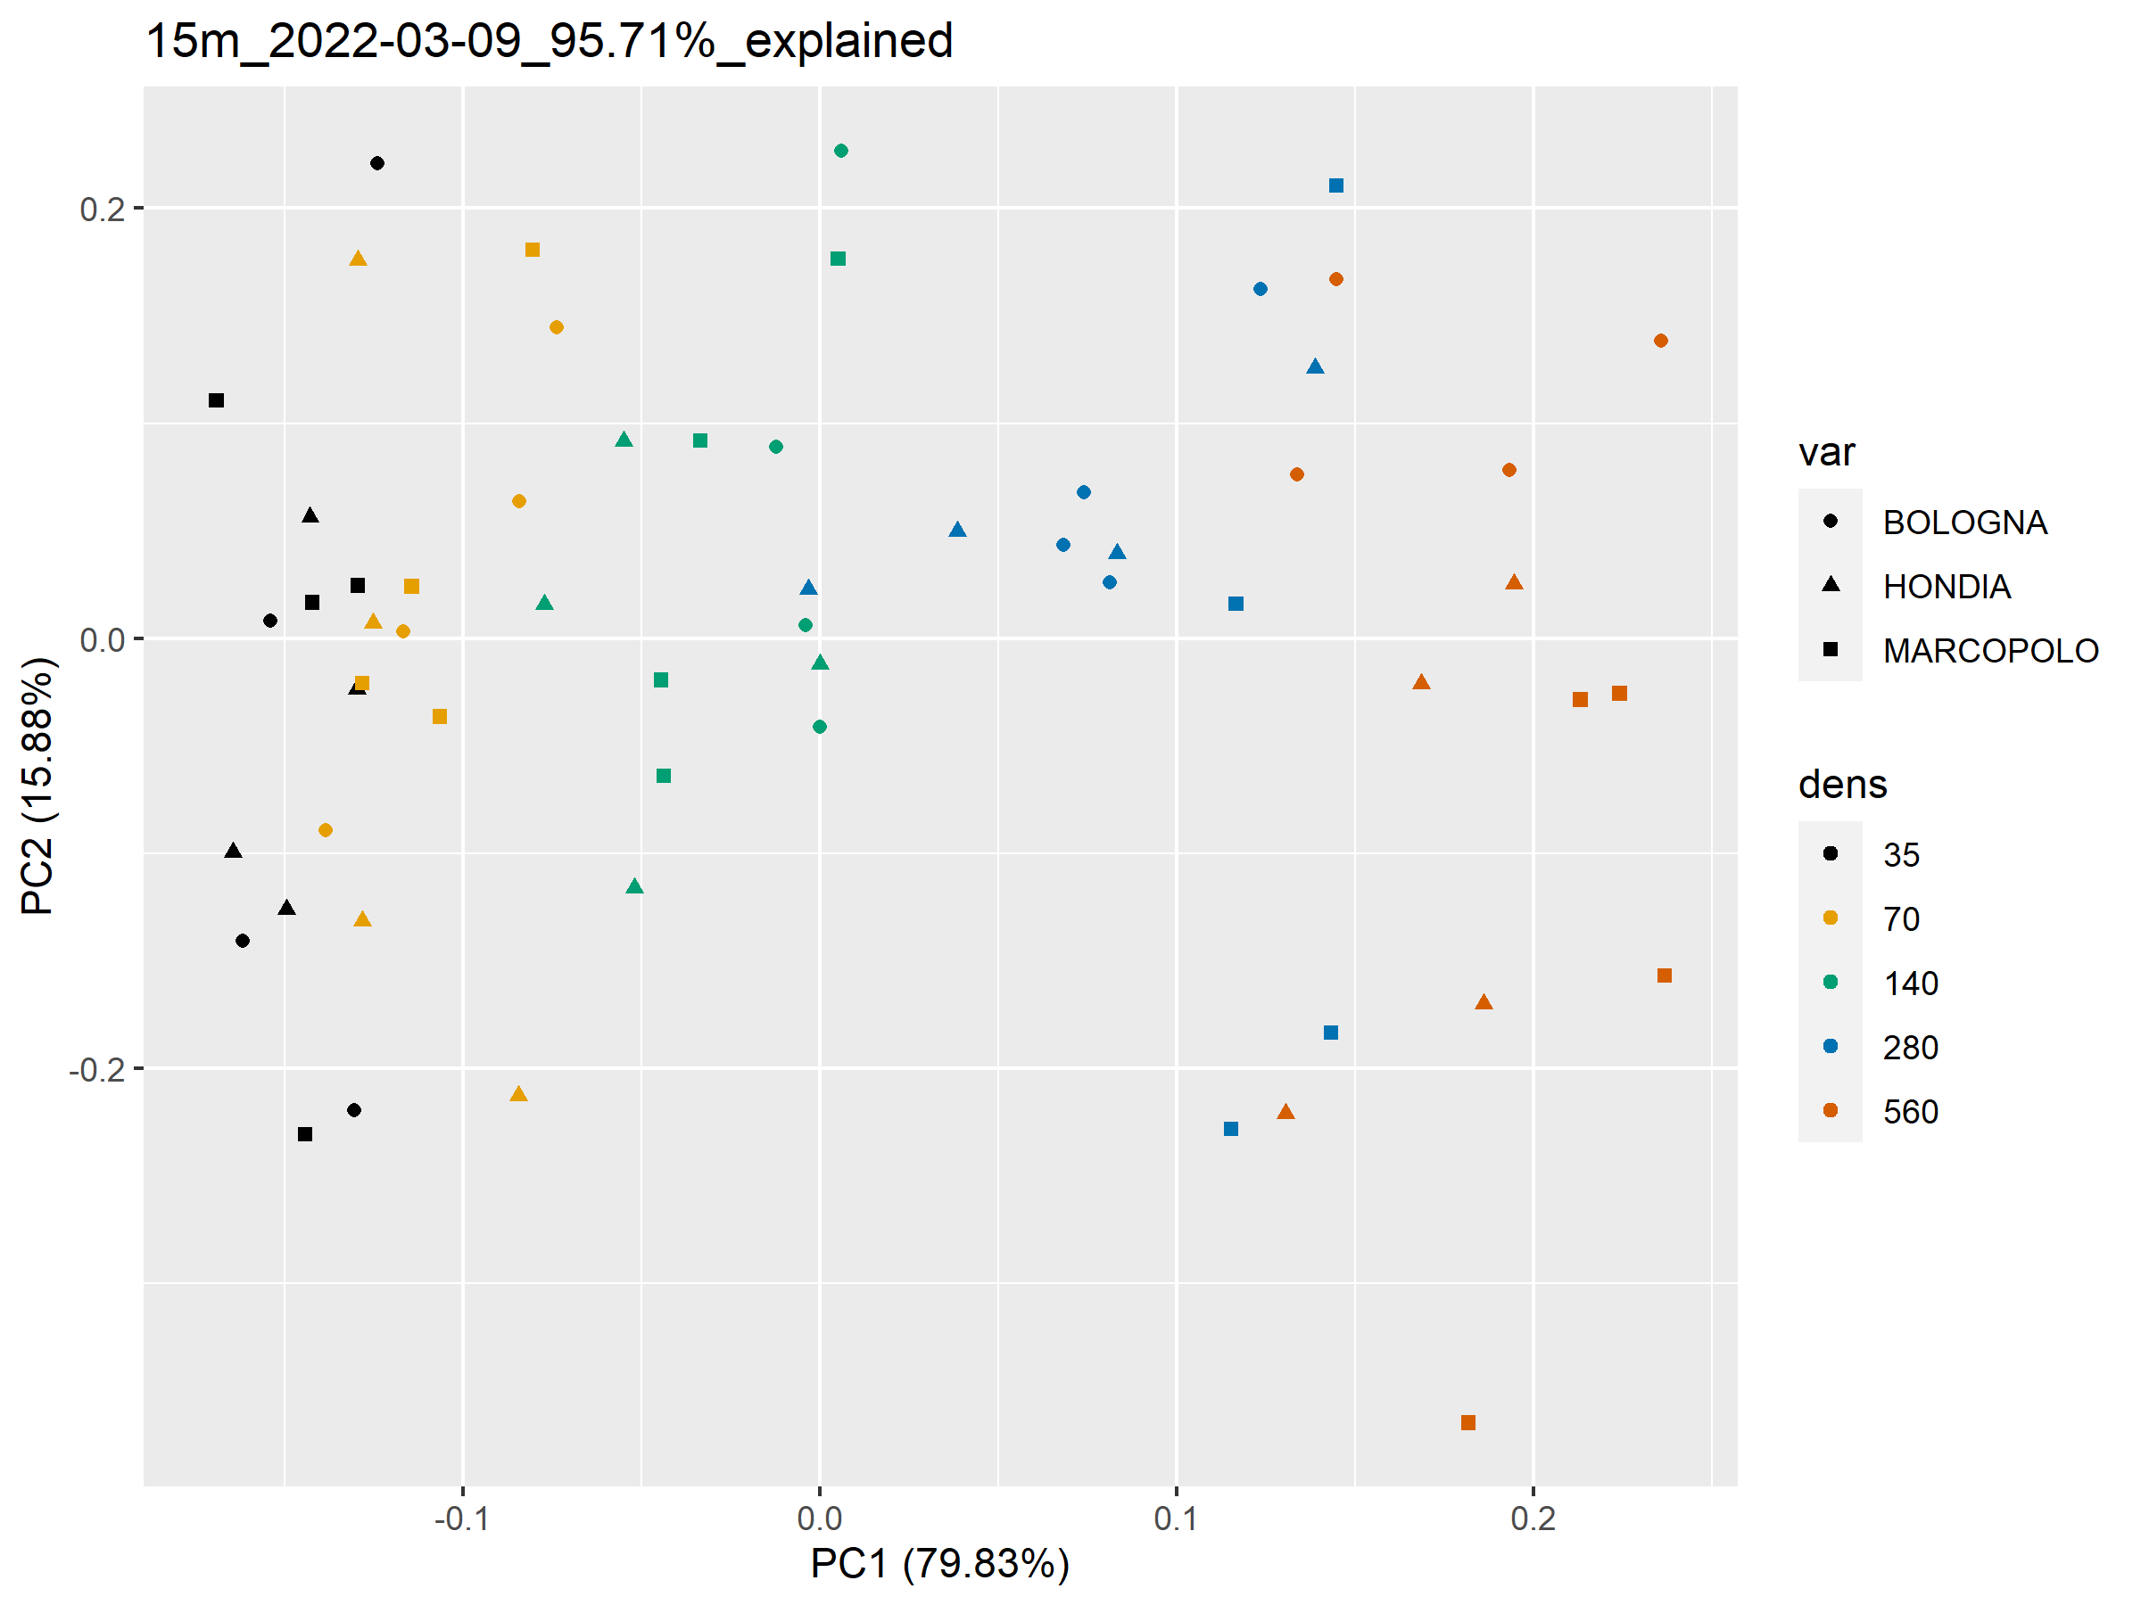
15m
03-09

Slide 10
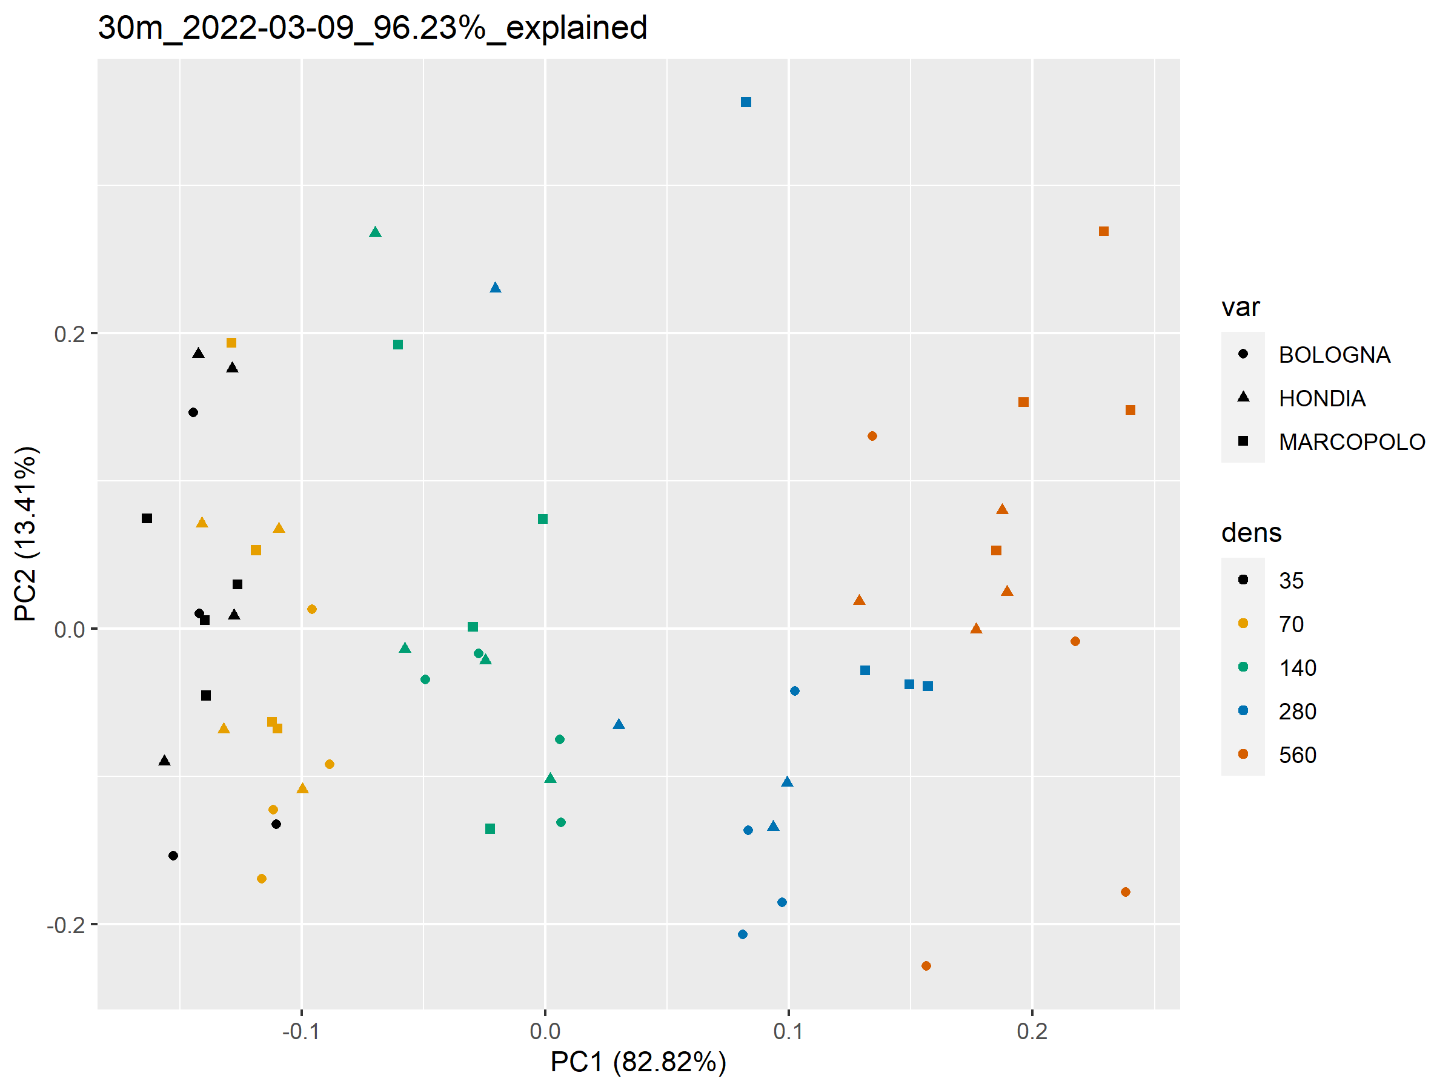
30m
03-09

Slide 11
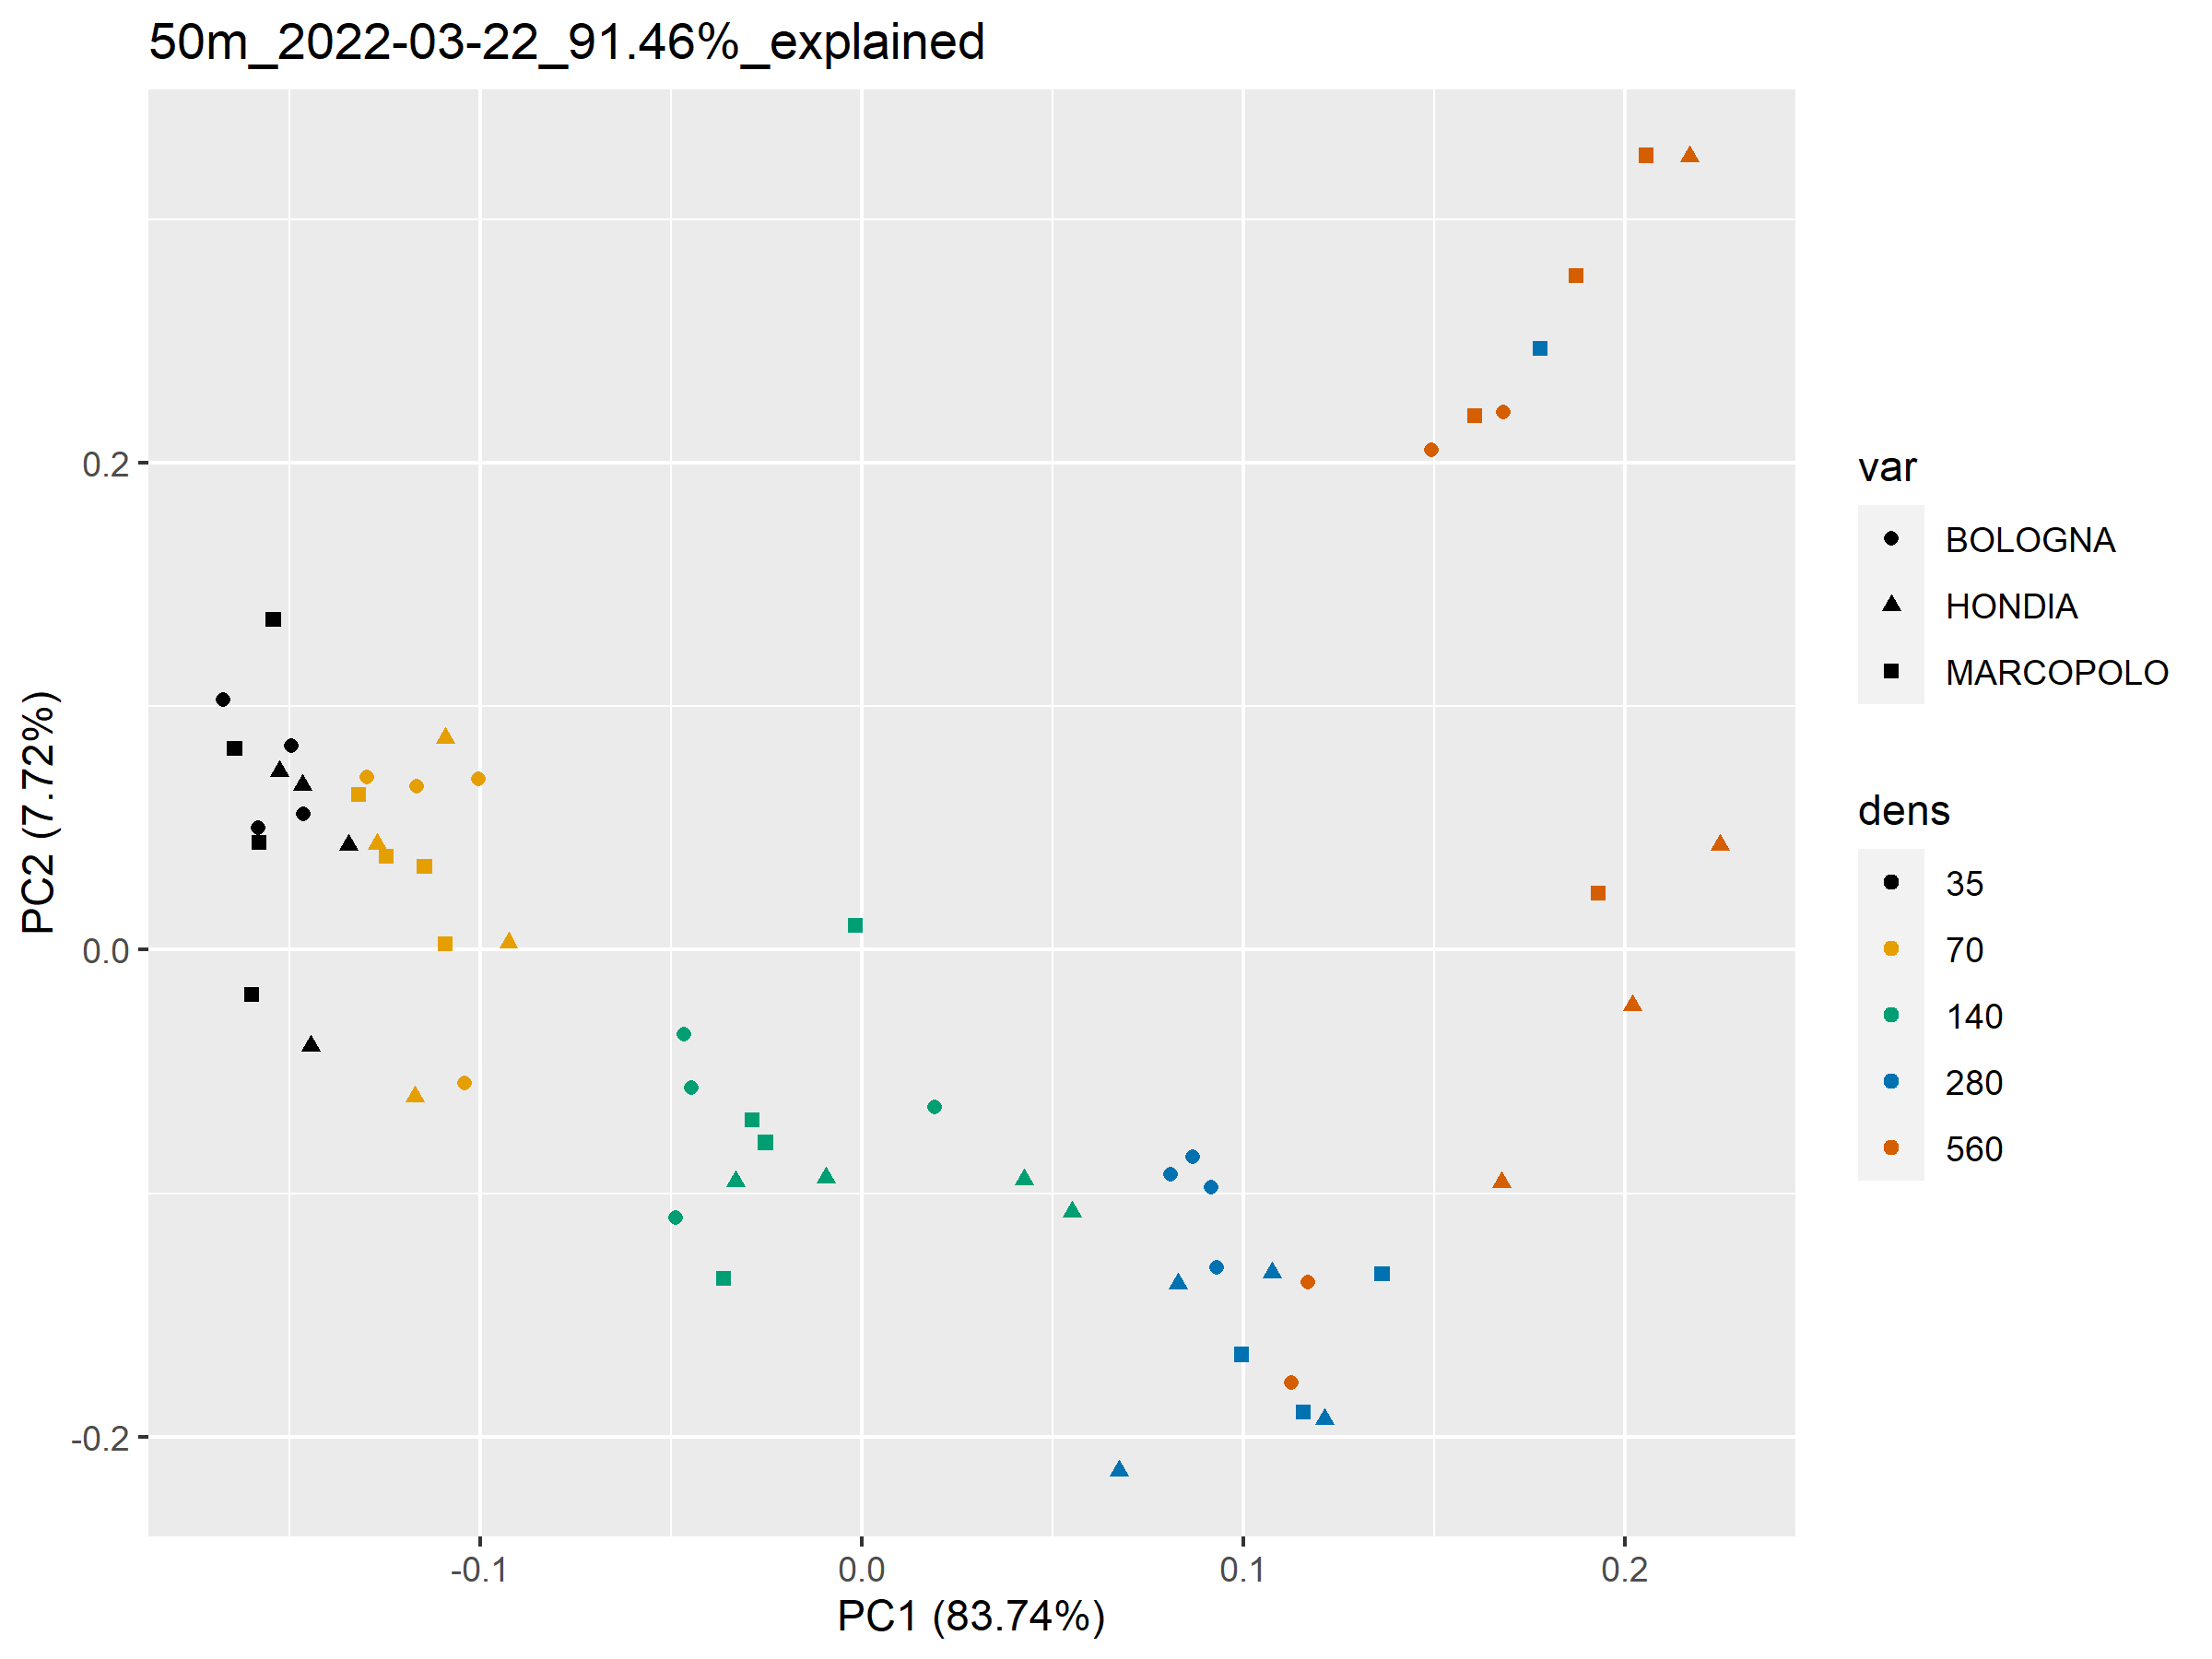
50m
03-22

Slide 12
Classification
Data partition:
Per date and altitude, separating data per flight
Per date, combining data taken in different flights, including flight Altitude as predictor in the model
Model:
Using raw variables
Using Principal Components

Slide 13
CART trees (rpart)
10-fold Cross-Validation with 10 repeats, n = 10 (results averaged over 10 different models)
Model trained with entire dataset
Model trained in 80% of the data, accuracy tested in 20% holdout

Slide 14
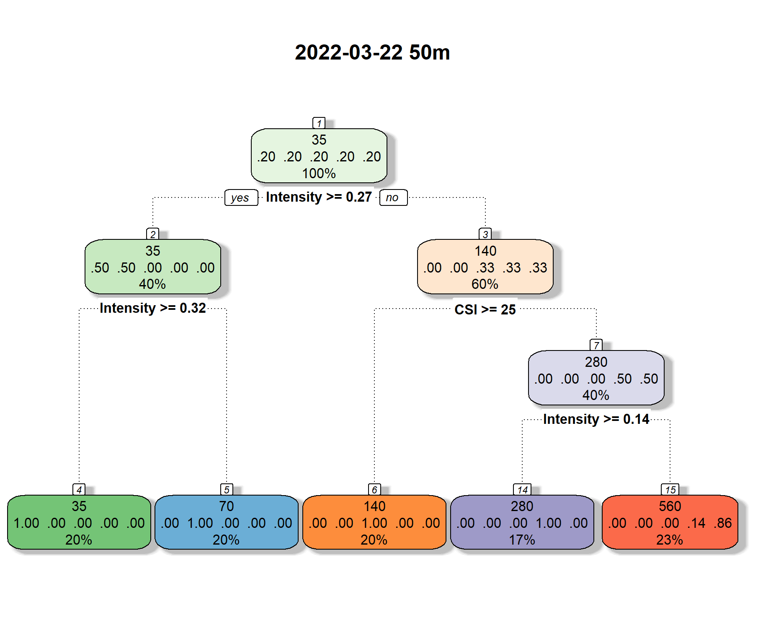
CART trees (rpart)
1) Trained with entire dataset (not validated)
Best performance : 03-22 at 50m with or w/o PC (p-value = 1)
Mean accuracy: 87 % (sd: 0. 5%)
Mean Kappa: 83.1 % (sd: 0. 65%)
Contrast second best model 05/04_50m_var_nosplit (accuracy: 78%, sd: 0.8%), p-value = 0.0006 (Bonferroni)

Slide 15
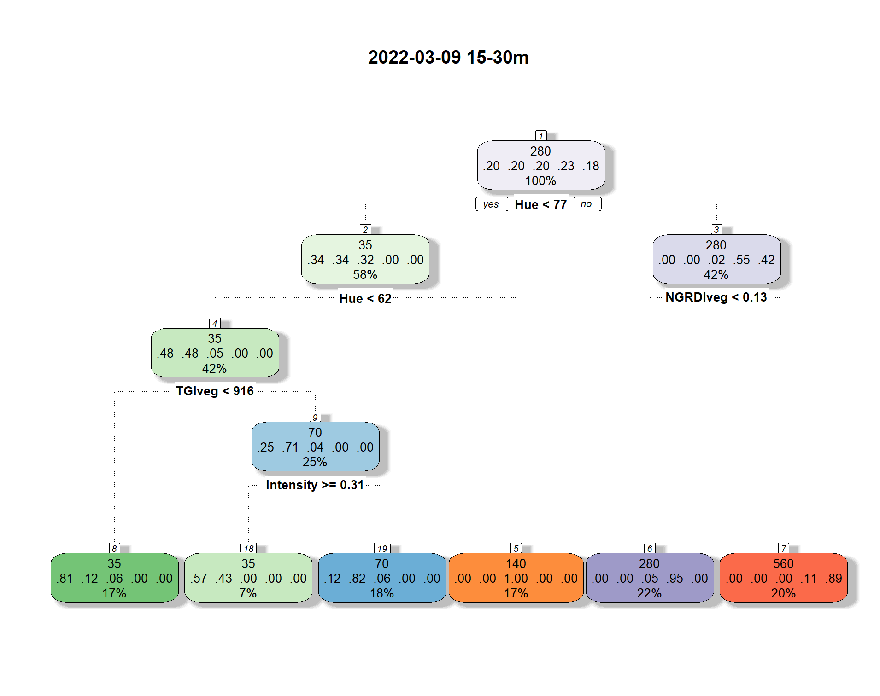
CART trees (rpart)
2) Trained in 80% of the data, accuracy tested in 20% holdout
Best performance in holdout set : 03-09 15 + 30 m w/o PC
Mean accuracy:
Trained: 66.29% (sd: 2.9 %)
Tested: 70.83 % (sd:10.4%)
Mean Kappa:
Trained: 55.71% (sd: 6.82 %)
Tested: 62.84 % (sd: 13.29%)
(one-way ANOVA p-value = 0.00063) All pairwise contrasts among models with accuracies above 50% result in non-significant, p-value = 1 (Bonferroni) no differences among algorithm validation accuracies in holdout set

Slide 16
Conditional Inference (ctree)
10-fold Cross-Validation with 10 repeats, n = 10 (results averaged over 10 different models)
Model trained with entire dataset
Model trained in 80% of the data, accuracy tested in 20% holdout

Slide 17
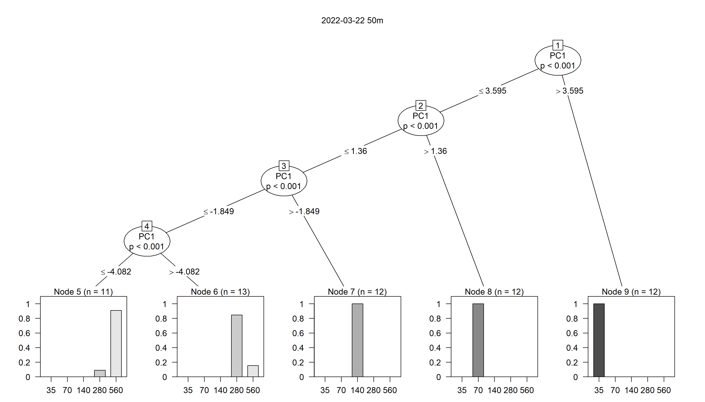
Conditional Inference (ctree)
1) Trained with entire dataset (not validated)
Best performance : 03-22 at 50m with PC
Mean accuracy: 84.58 % (sd: 0. 32%)
Mean Kappa: 80.47 % (sd: 0. 38%)
Contrast second best model 03/22_50m_var_nosplit (accuracy: 77%, sd: 1%), p-value = 0.00027 (Bonferroni)

Slide 18
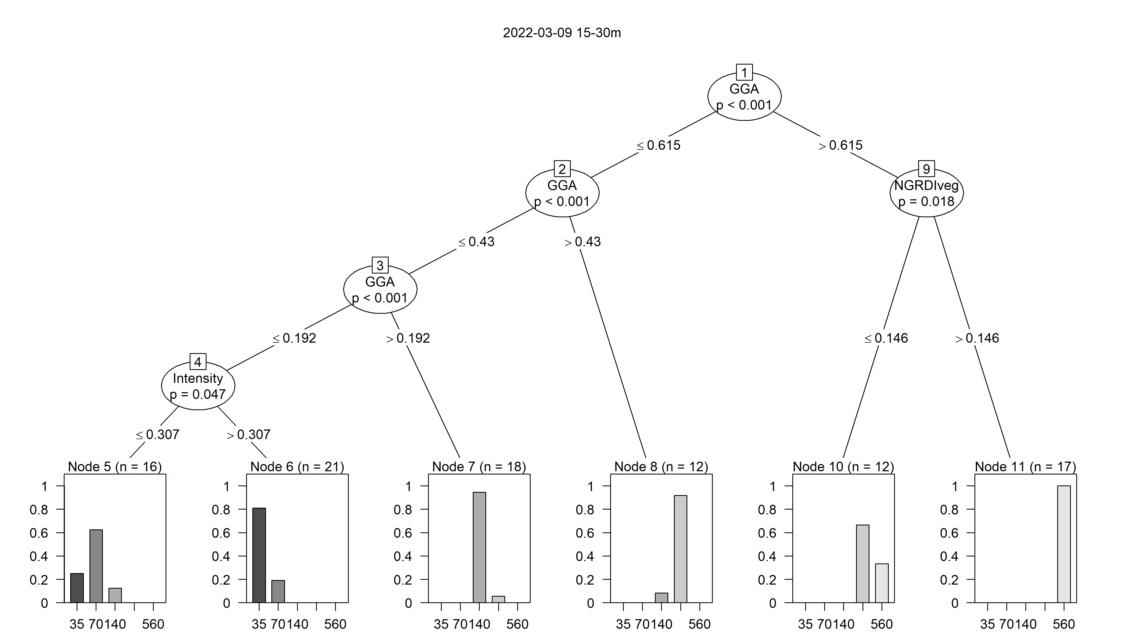
Conditional Inference (ctree)
2) Trained in 80% of the data, accuracy tested in 20% holdout
Best performance in holdout set : 03-09 15 + 30 m w/o PC
Mean accuracy:
Trained: 69.4% (sd: 0.8 %)
Tested: 70.41% (sd:10.4%)
Mean Kappa:
Trained: 61.65% (sd: 1.1 %)
Tested: 62.77 % (sd: 12.90%)
All contrasts among models with accuracies above 50% result in non-significant, p-value = 0.1735 no differences among algorithm validation accuracies in test set

Slide 19
Random forests (rf)
5000 trees, n = 10 (results averaged over 10 different models)
Model trained in 70% of the data, accuracy tested in 30% holdout
Model trained in 80% of the data, accuracy tested in 20% holdout

Slide 20
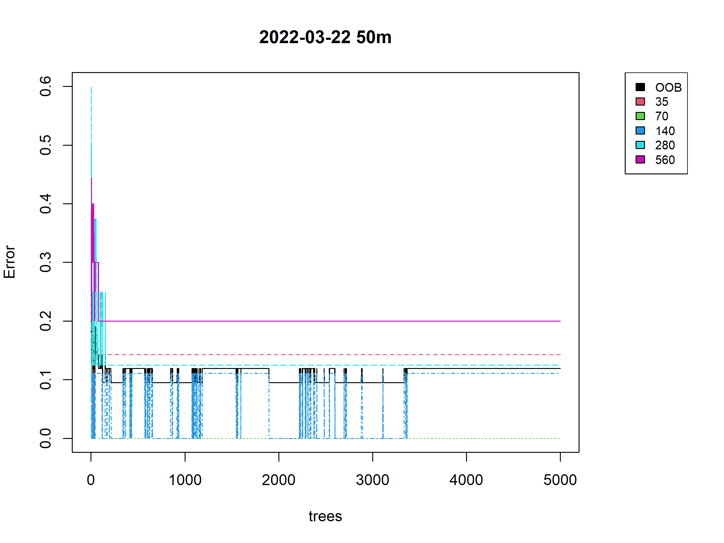
Random Forests
Best performance :
80 - 20 % train - test split
03-22 at 50m without PC
Mean accuracy: 89.17 % (sd: 6.86%)
Mean Kappa: 85.81 % (sd: 8.7%)
Mean OOB: 13.75 % (sd: 2%)
Not significantly different from 70-30% split
Contrasts among first 9 models result in non-significant differences p-value > 0.05 (Tukey), Accuracy = (77.5 %, 89.17%)

Slide 21
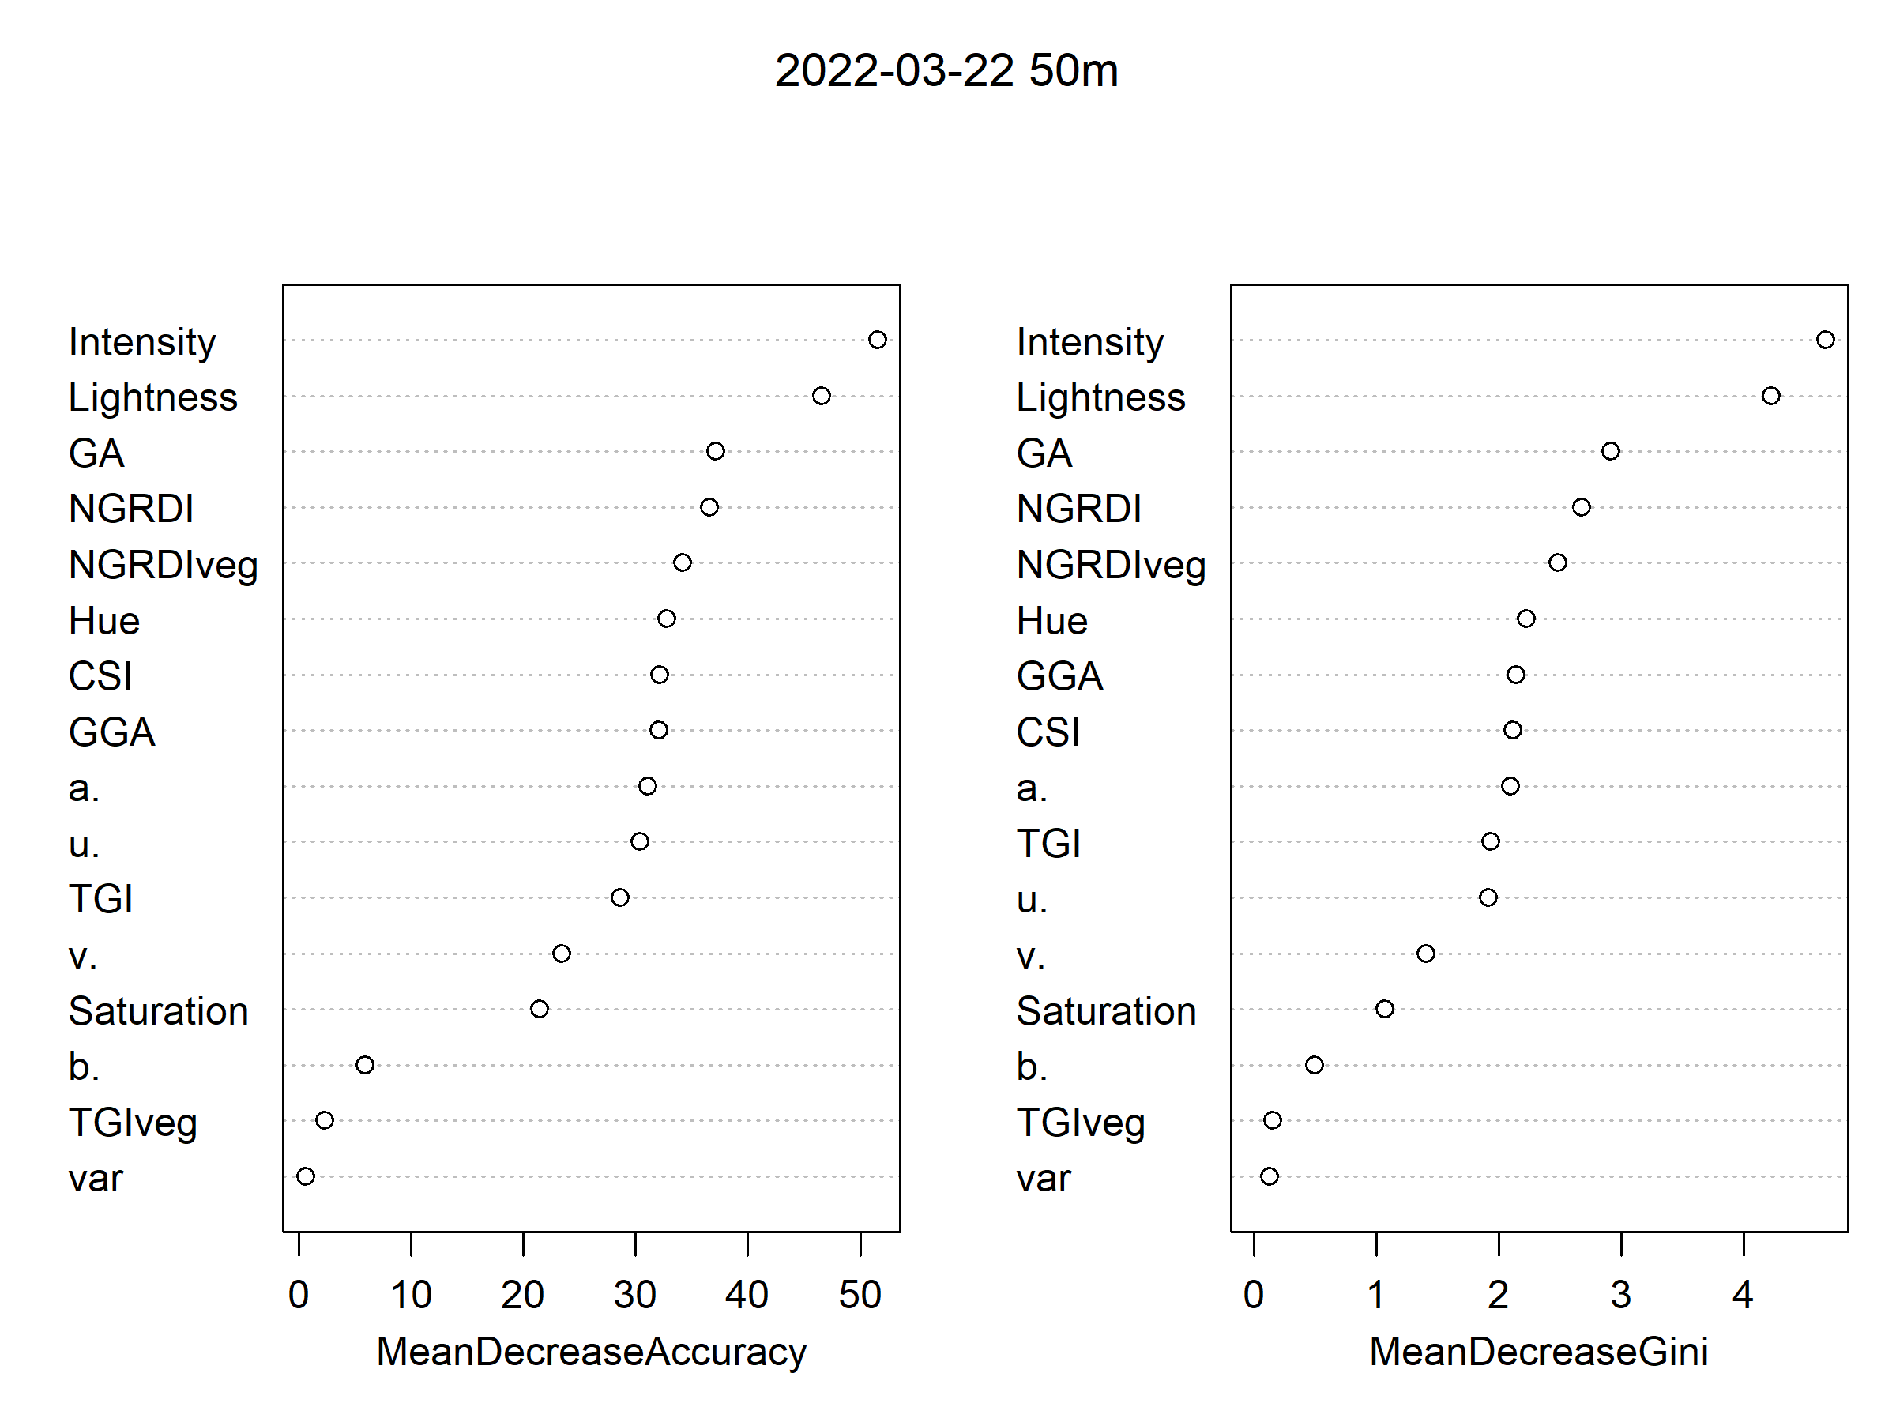
Random Forests
Best performance :
80 - 20 % train - test split
03-22 at 50m without PC
Mean accuracy: 89.17 % (sd: 6.86%)
Mean Kappa: 85.81 % (sd: 8.7%)
Mean OOB: 13.75 % (sd: 2%)
Not significantly different from 70-30% split
Contrasts among first 9 models result in non-significant differences p-value > 0.05 (Tukey), Accuracy = (77.5 %, 89.17%)

