Slide 1
Design, dataset (altitudes and dates), indexes

Slide 2
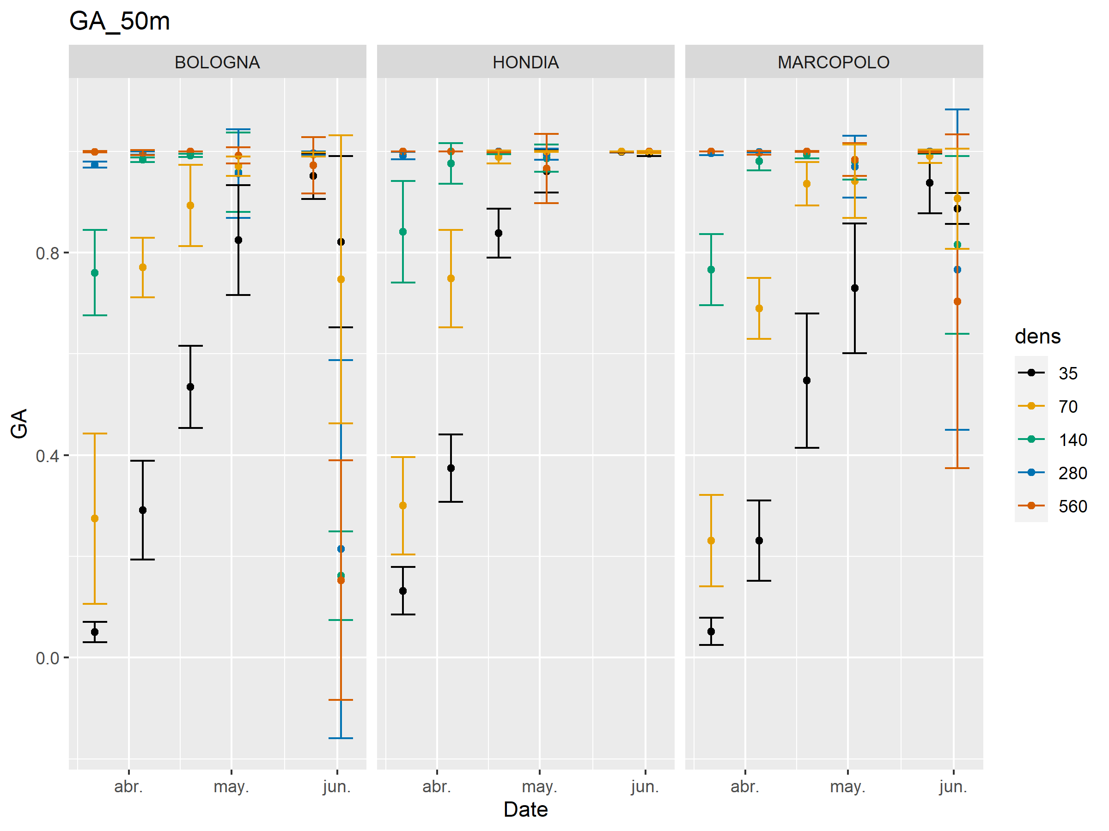

Slide 3
Most of the vegetation indexes have non-parametric distributions or grups are heteroscedastic.
→ Not possible to do ANOVA to assess dens, var and dens*var effects
Assessment of dens-VegIndex relationship:
Spearman’s Rank correlation (non-parametric)
PCA
Decision trees:
Classification CART trees
Conditional inference trees
Random forests

Slide 4
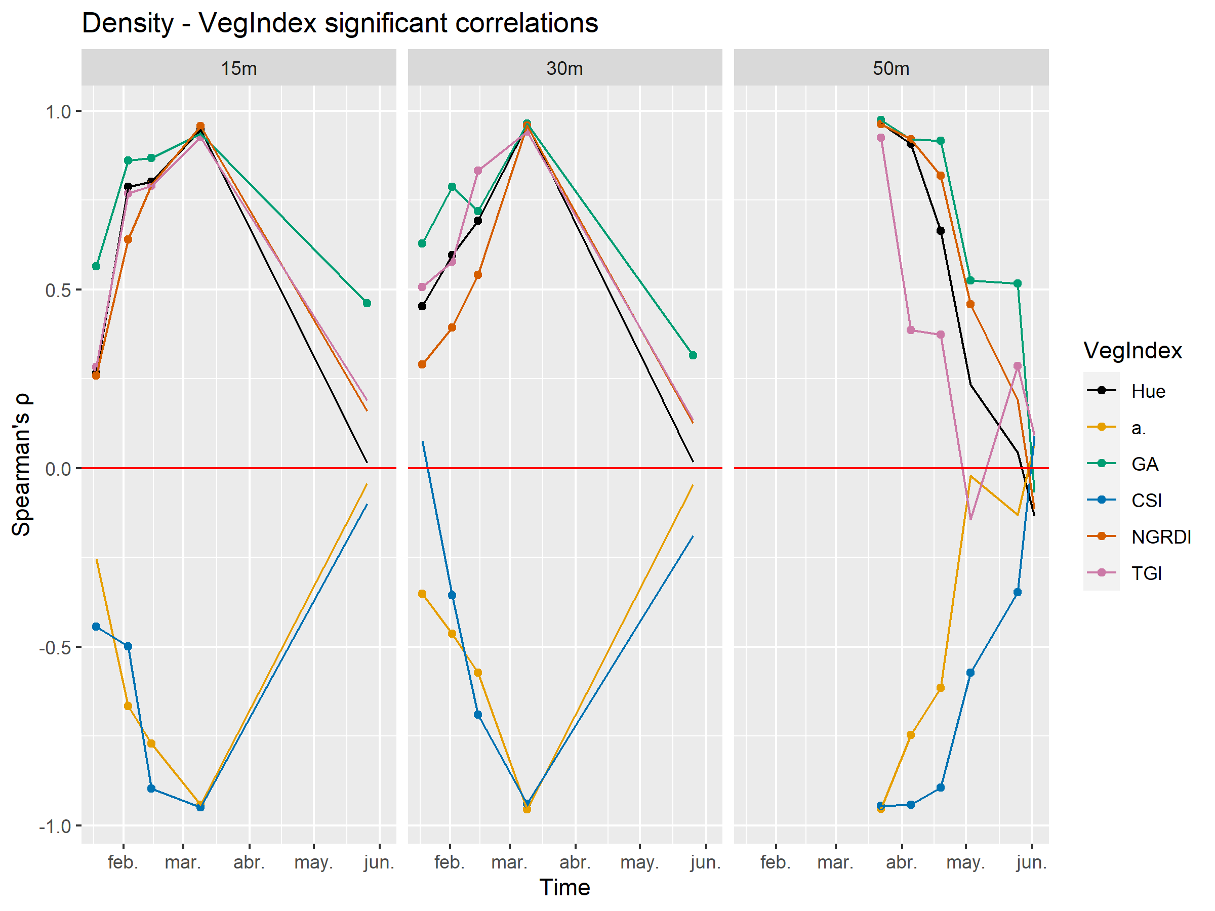

Slide 5
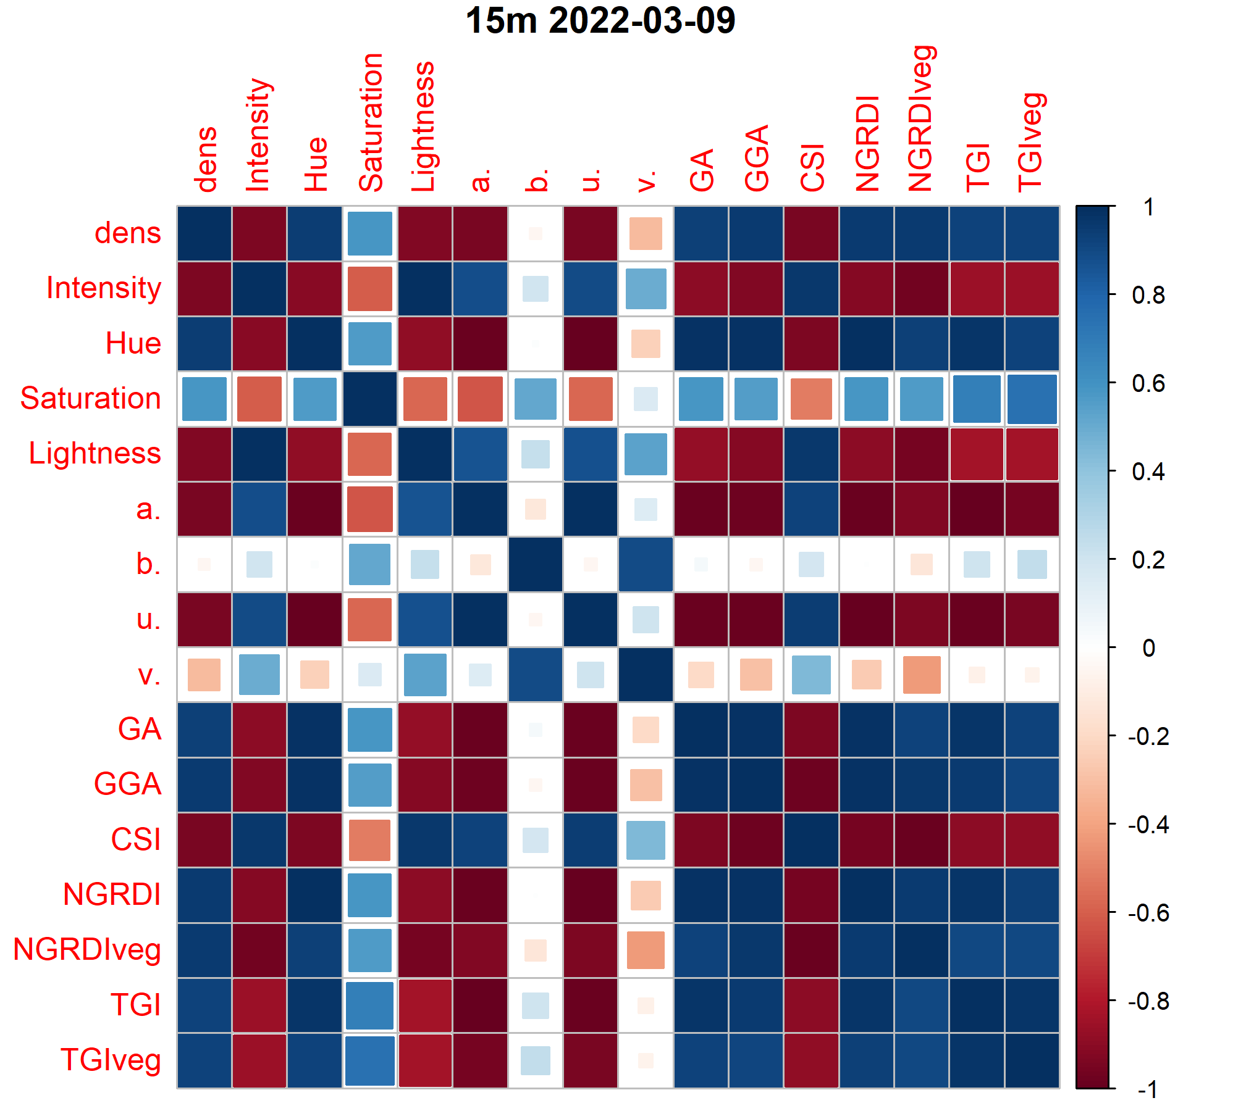
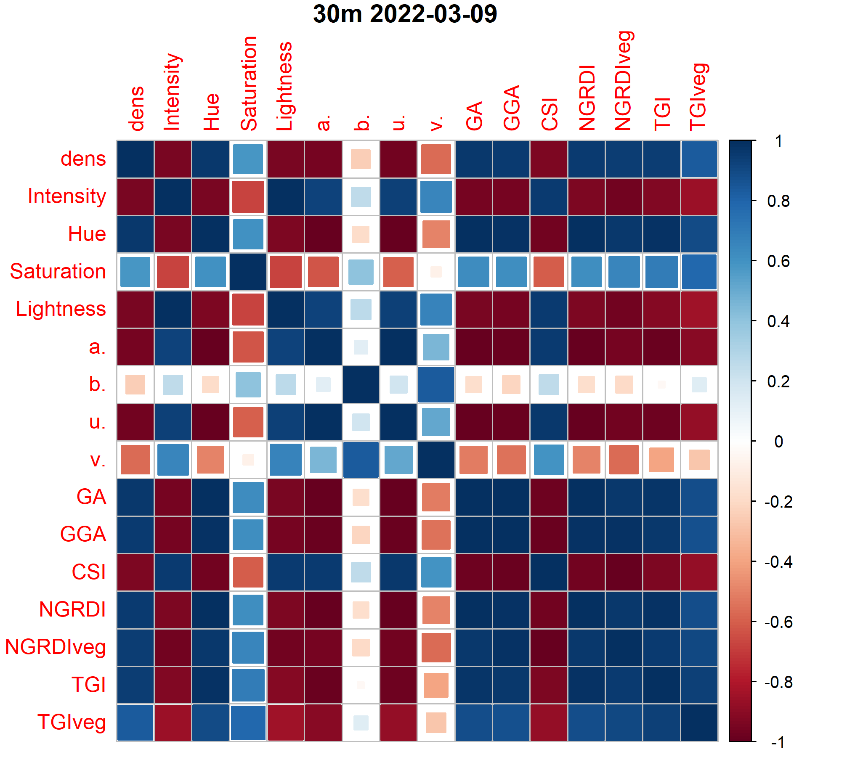
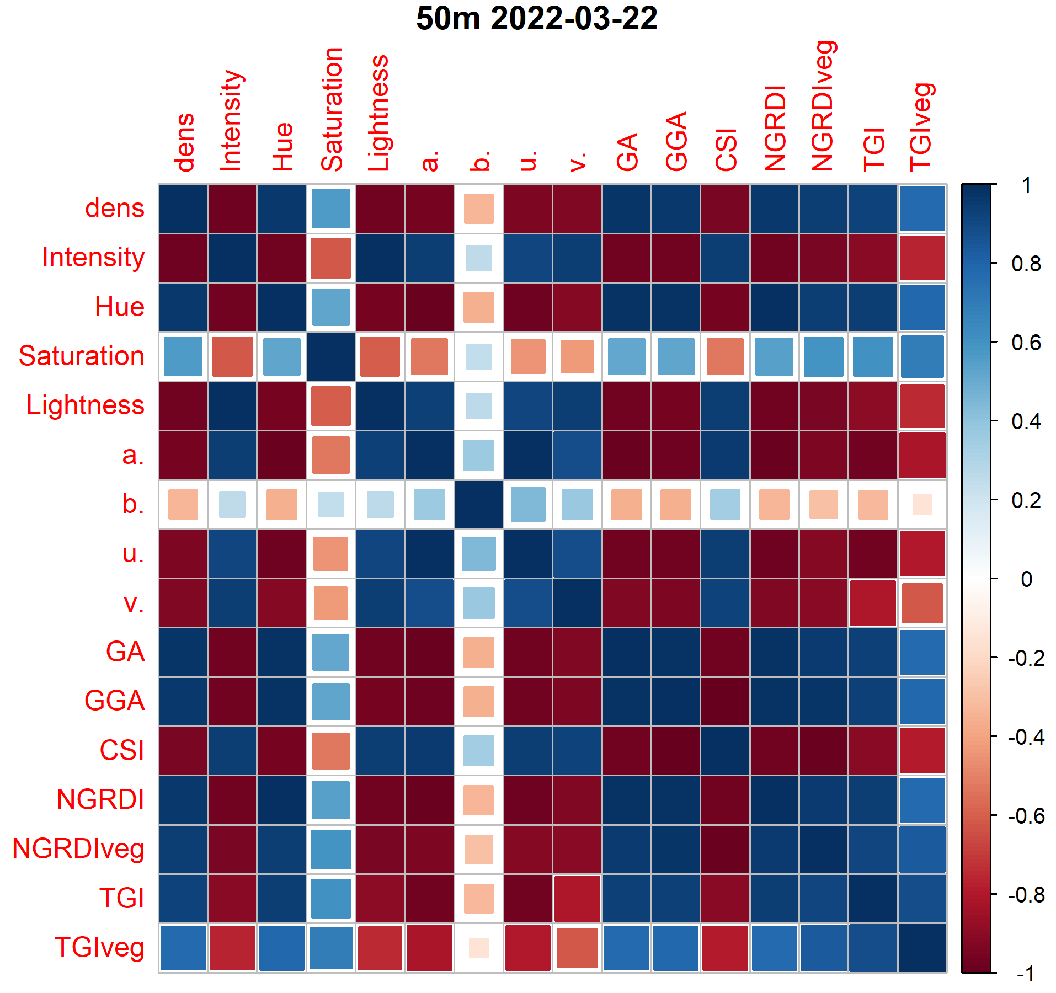
High vegIndex intercorrelation

Slide 6
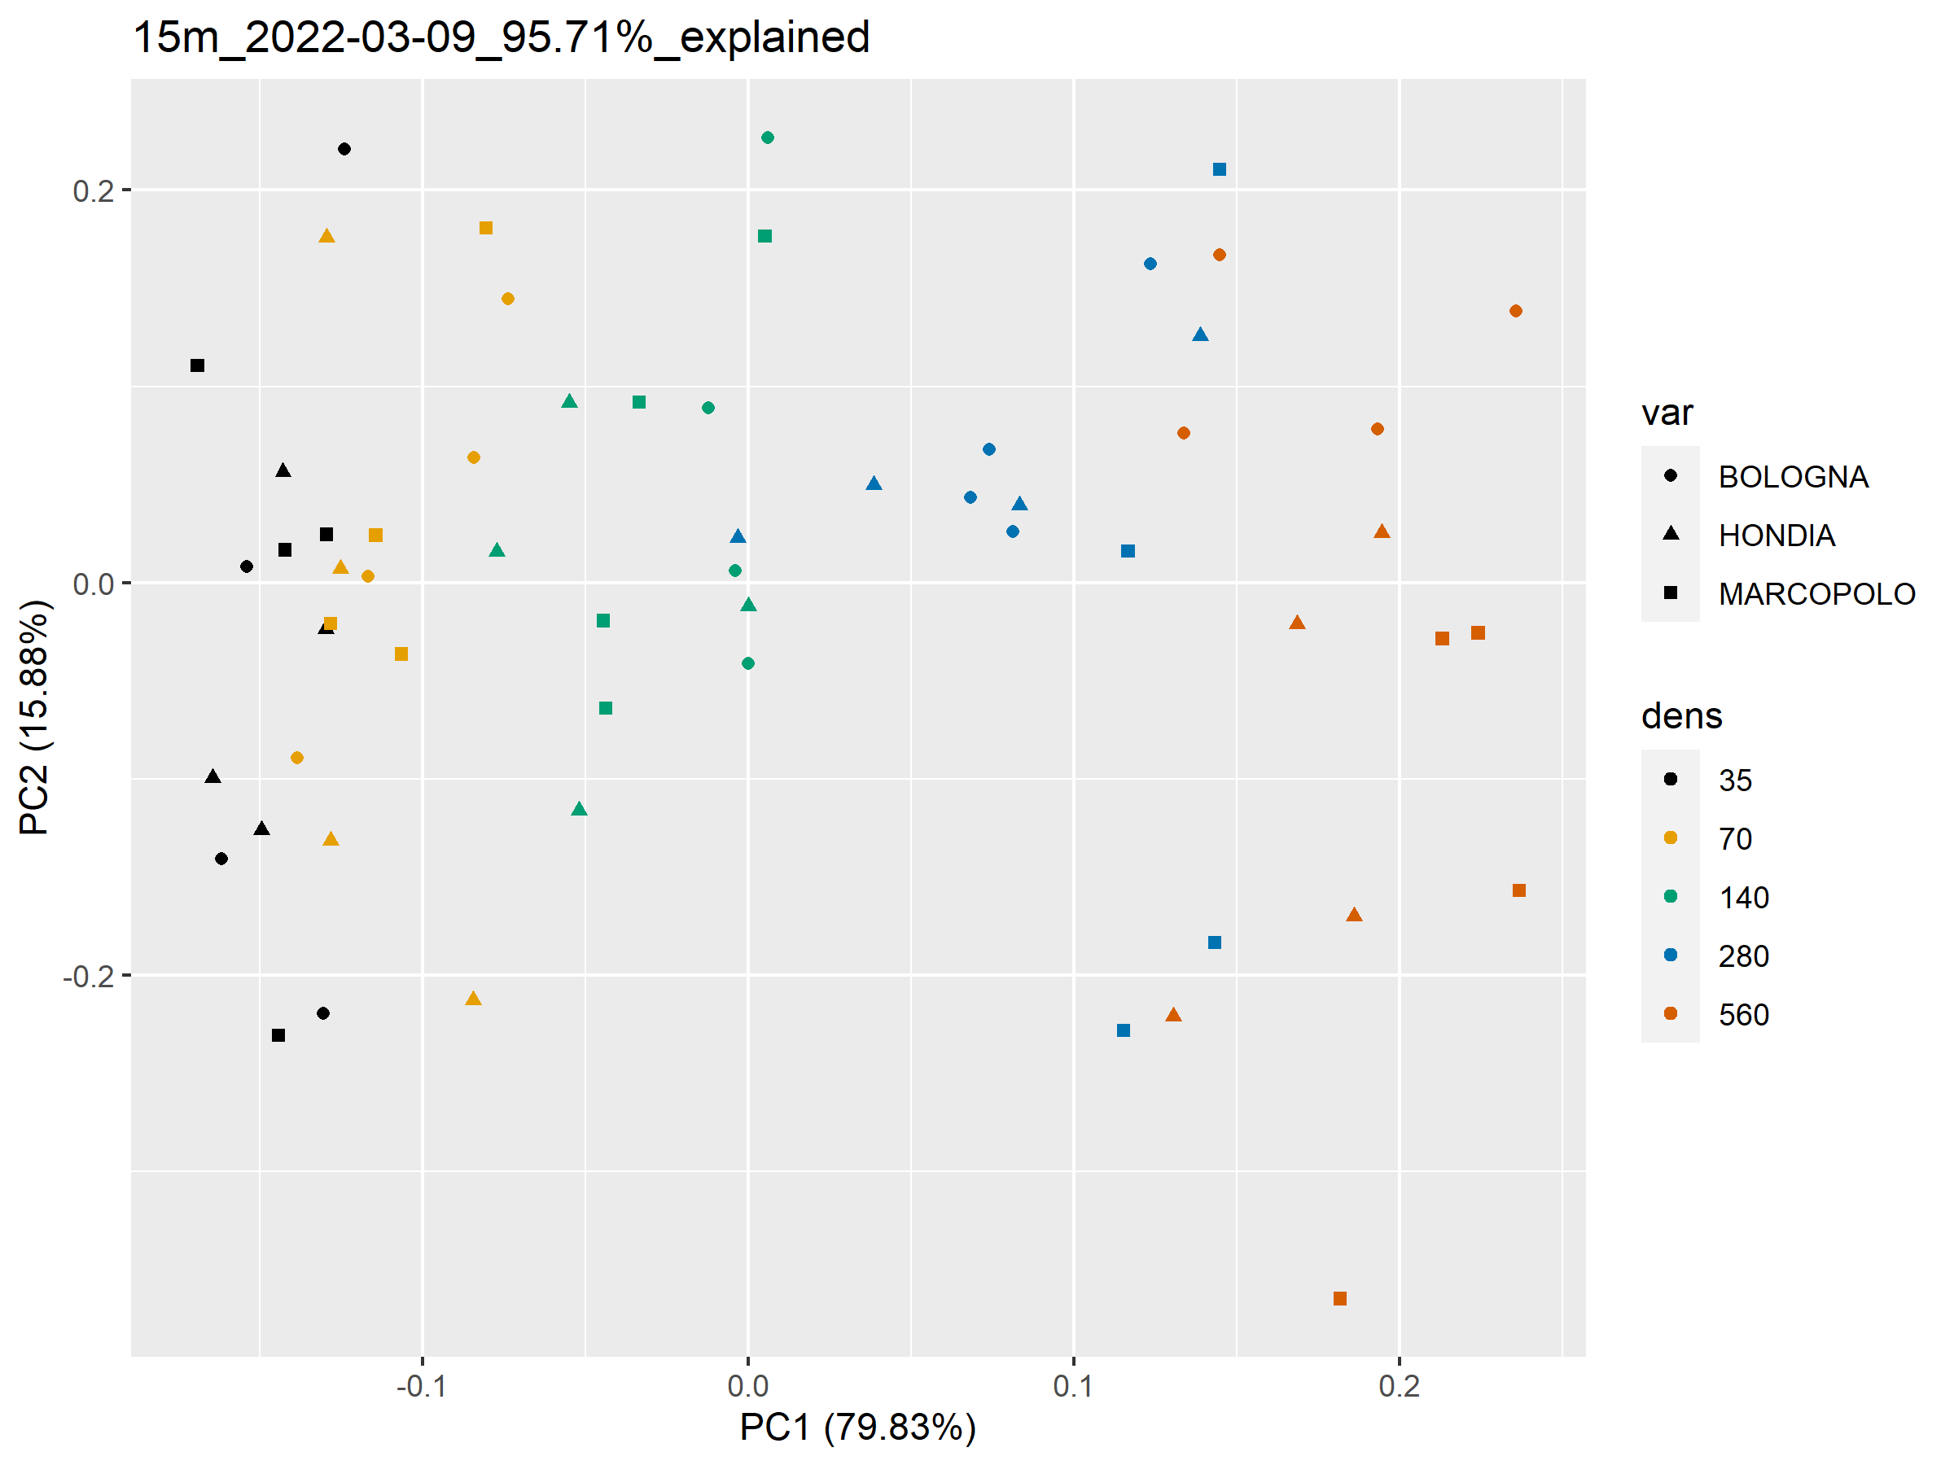
15m
03-09

Slide 7
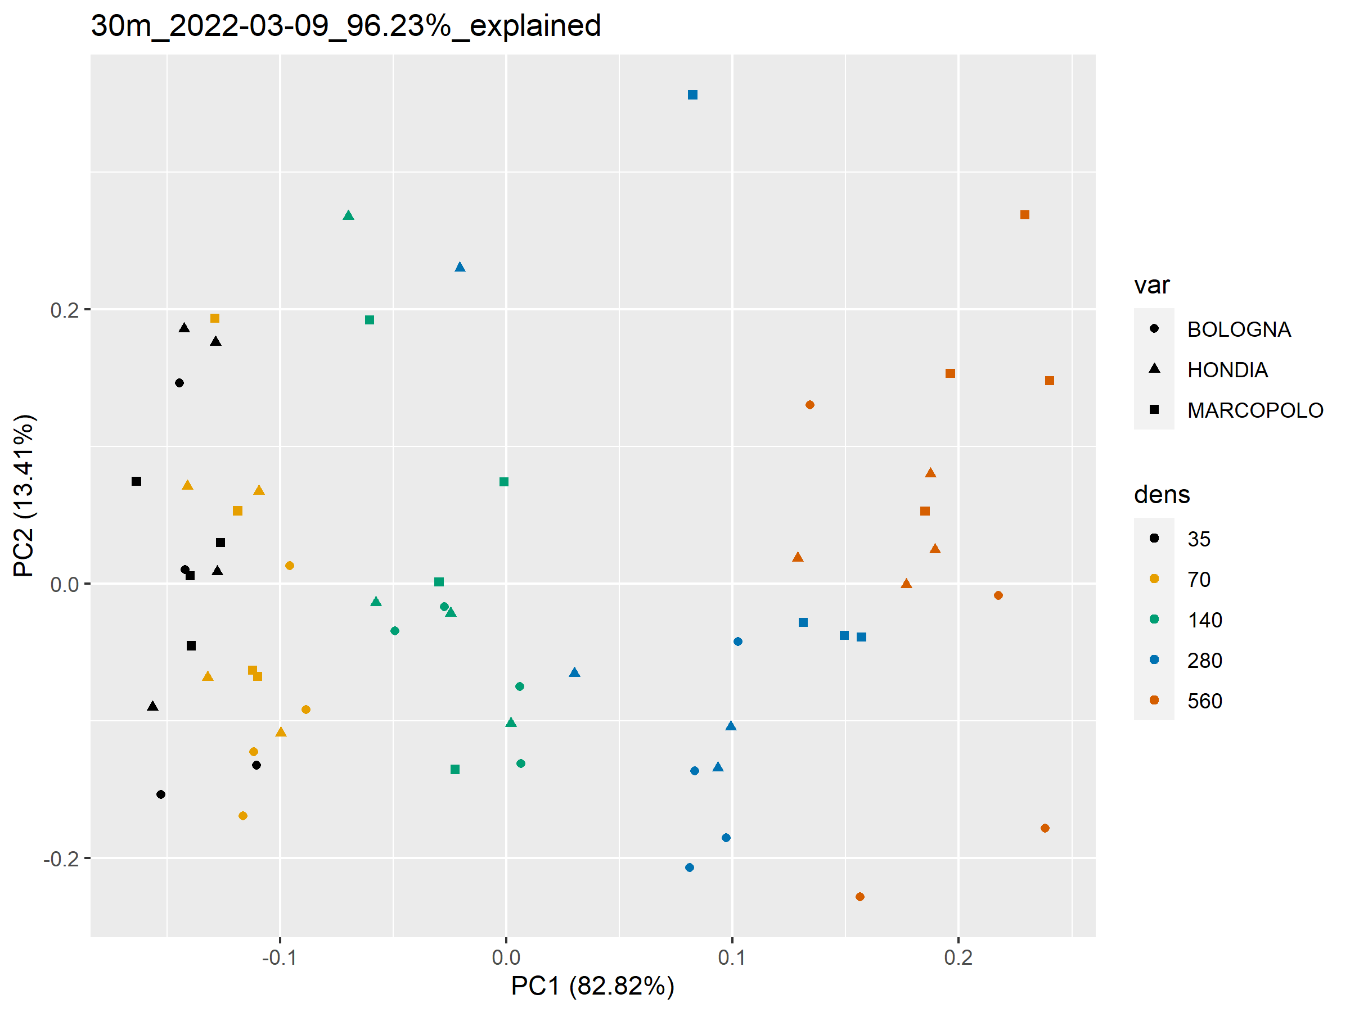
30m
03-09

Slide 8
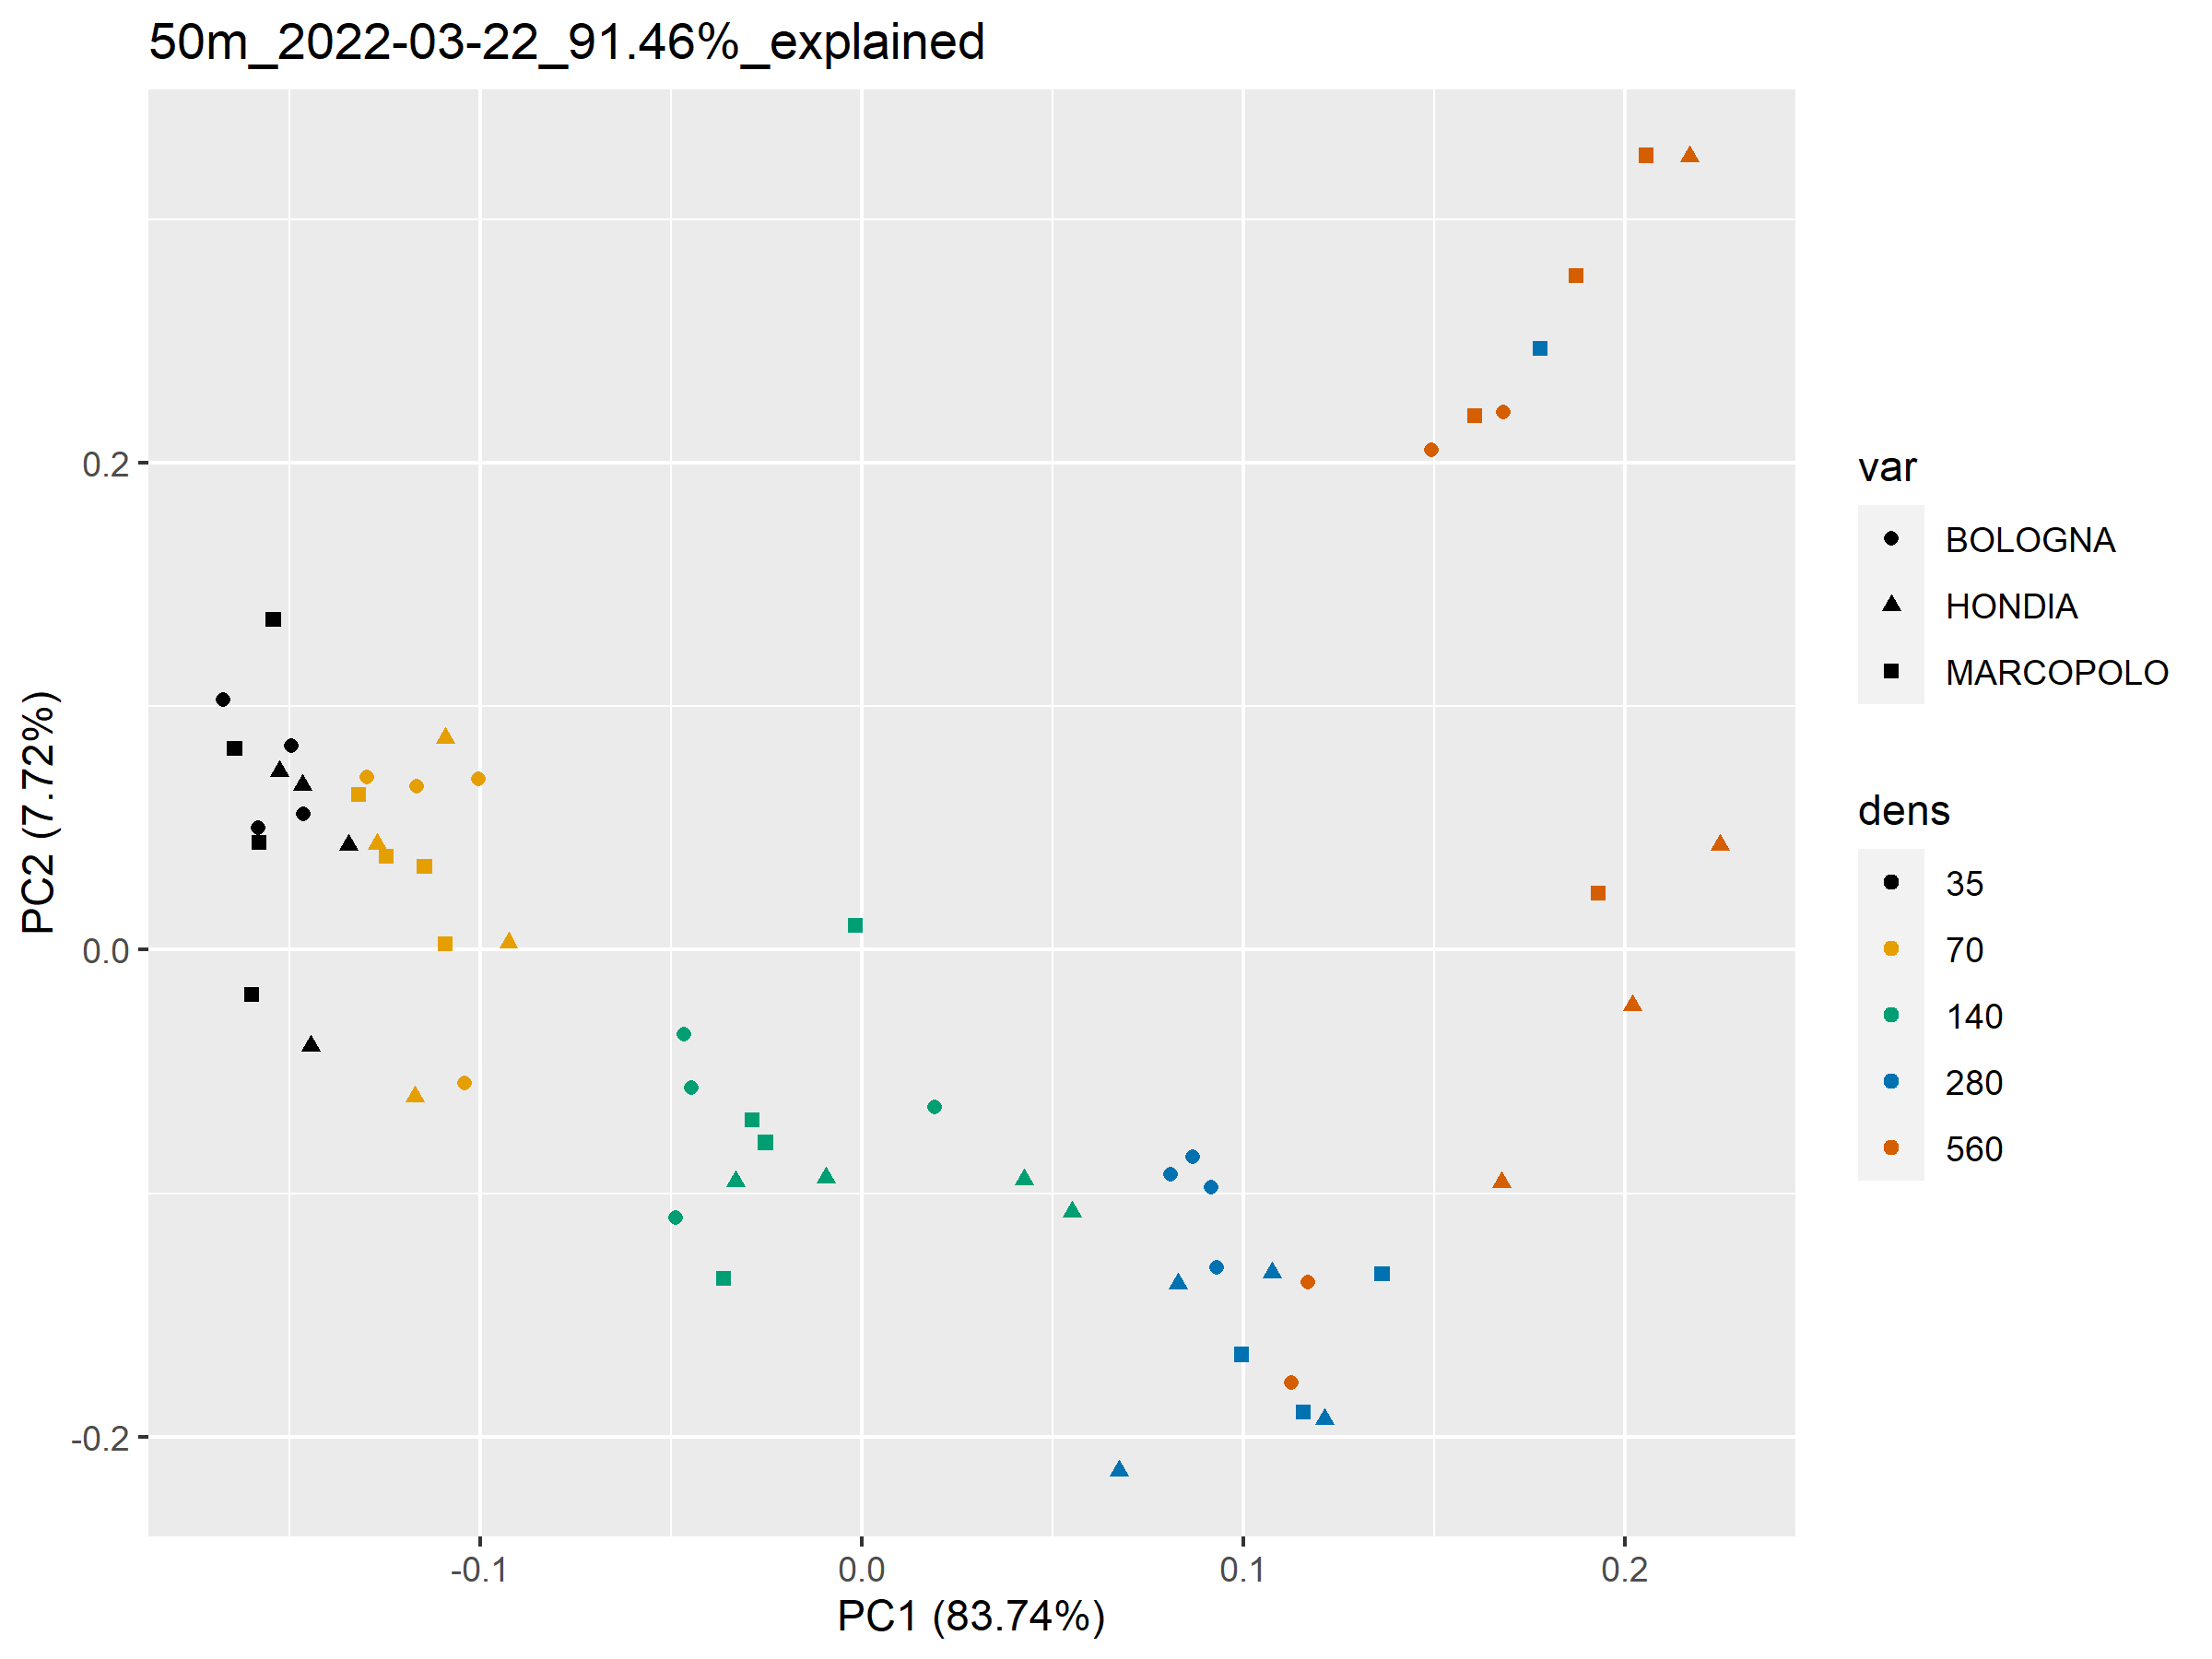
50m
03-22

Slide 9
Classification
Data partition:
Per date and altitude, separating data per flight
Per date, combining data taken in different flights, including flight Altitude as predictor in the model
Model:
Using raw variables
Using Principal Components

Slide 10
CART trees (rpart)
10-fold Cross-Validation with 10 repeats
Model trained with entire dataset
Model trained in 80% of the data, accuracy tested in 20% holdout

Slide 11
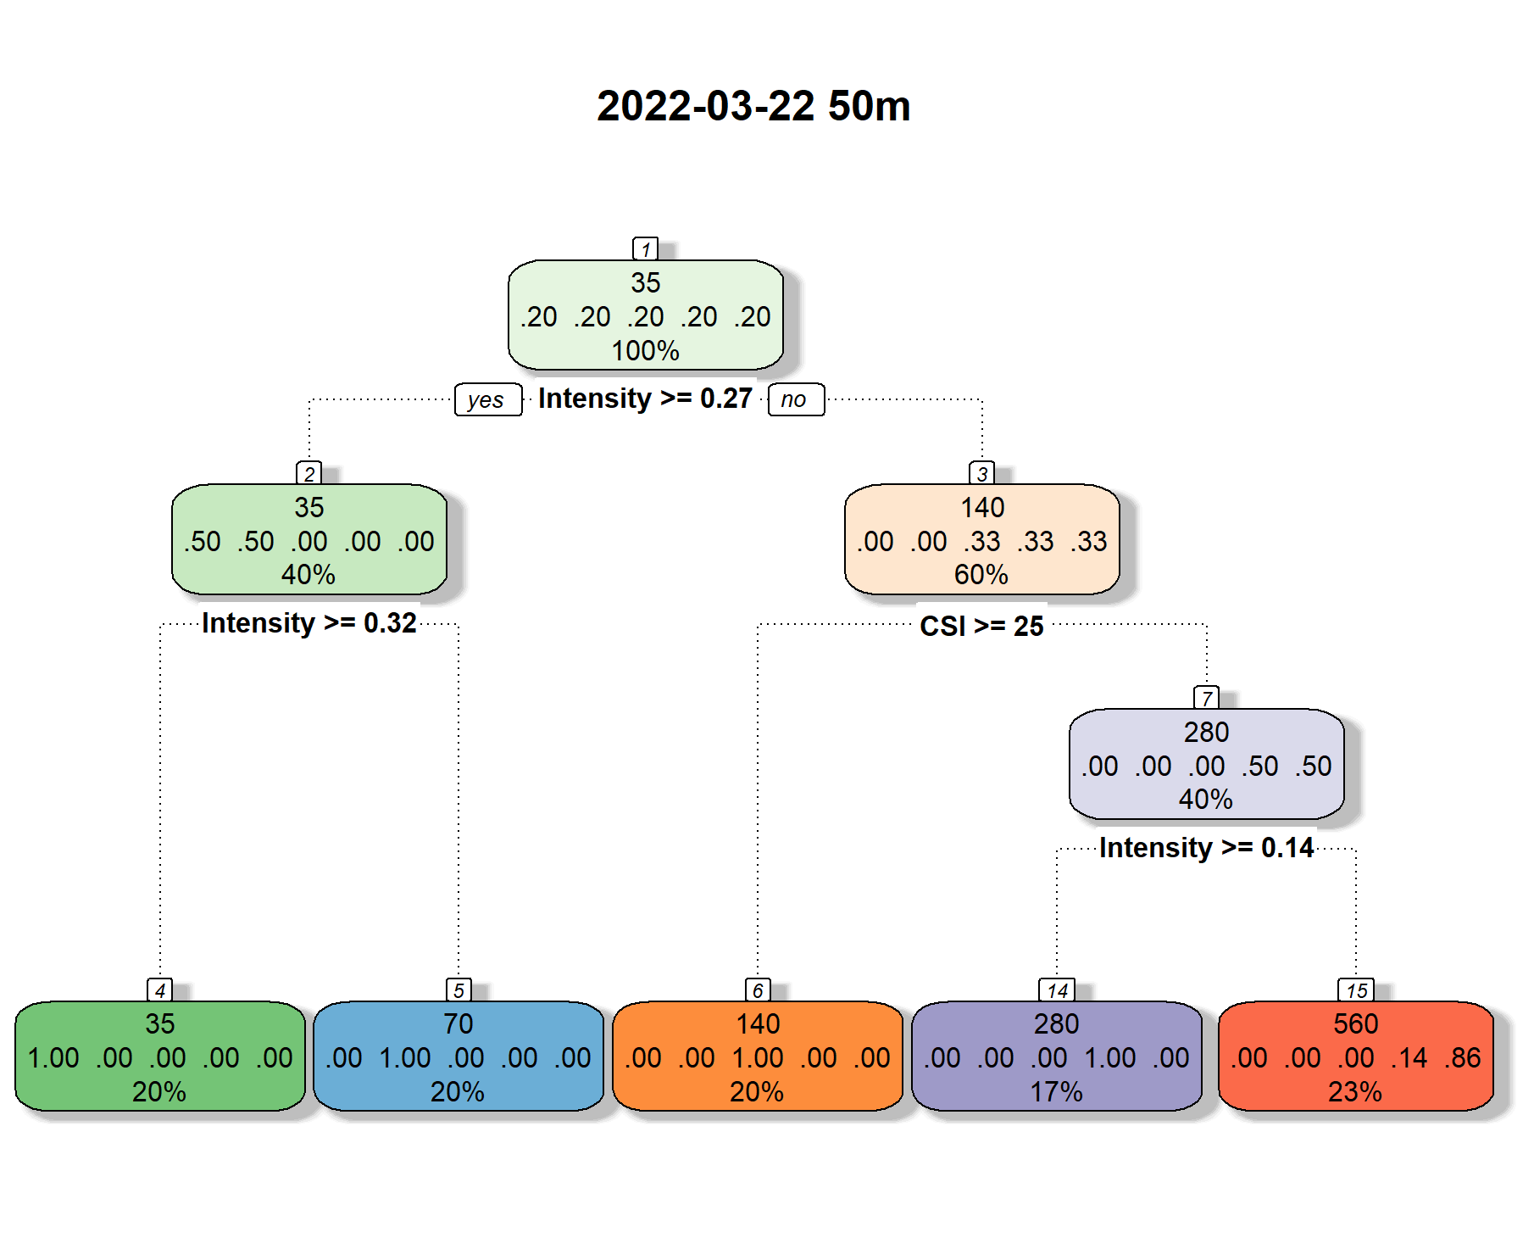
CART trees (rpart)
1) Trained with entire dataset (not validated)
Best performance : 03-22 at 50m w/o PC
Mean accuracy: 88 % (sd:
Mean Kappa: 84.5 % (sd:

Slide 12
CART trees (rpart)
2) Trained in 80% of the data, accuracy tested in 20% holdout
Best performance : 03-22 at 50m w/o PC
Mean accuracy: 88 % (sd:
Mean Kappa: 84.5 % (sd:

Slide 13
Conditional Inference (ctree)
10-fold Cross-Validation with 10 repeats
Model trained with entire dataset
Model trained in 80% of the data, accuracy tested in 20% holdout

Slide 14
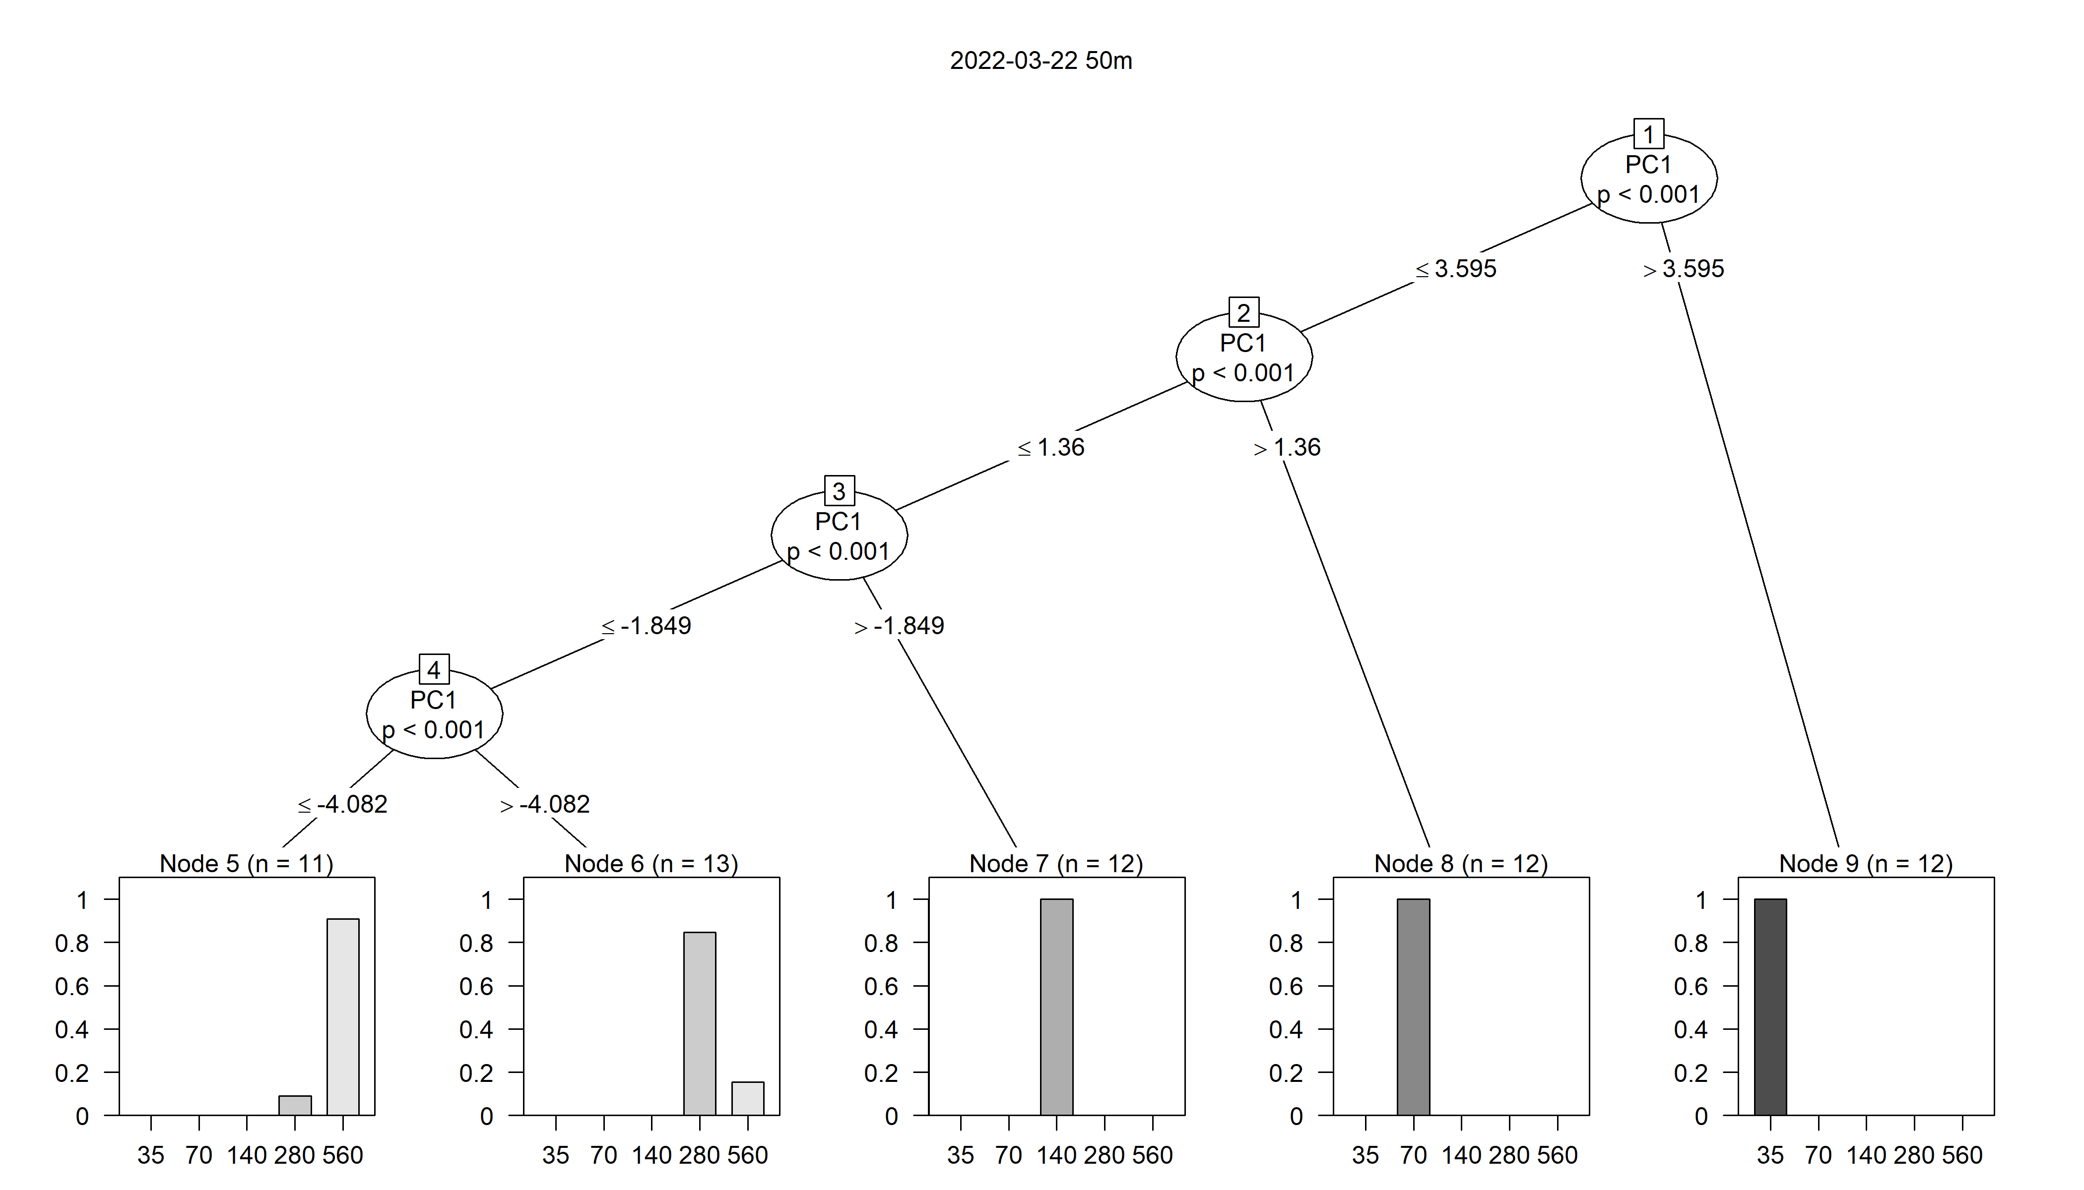
Conditional Inference (ctree)
1) Trained with entire dataset (not validated)
Best performance : 03-22 at 50m with PC
Mean accuracy : 85% (sd:
Mean Kappa : 80 % (sd:

Slide 15
Conditional Inference (ctree)
2) Trained in 80% of the data, accuracy tested in 20% holdout
Best performance : 03-22 at 50m with PC
Mean accuracy : 85% (sd:
Mean Kappa : 80 % (sd:

Slide 16
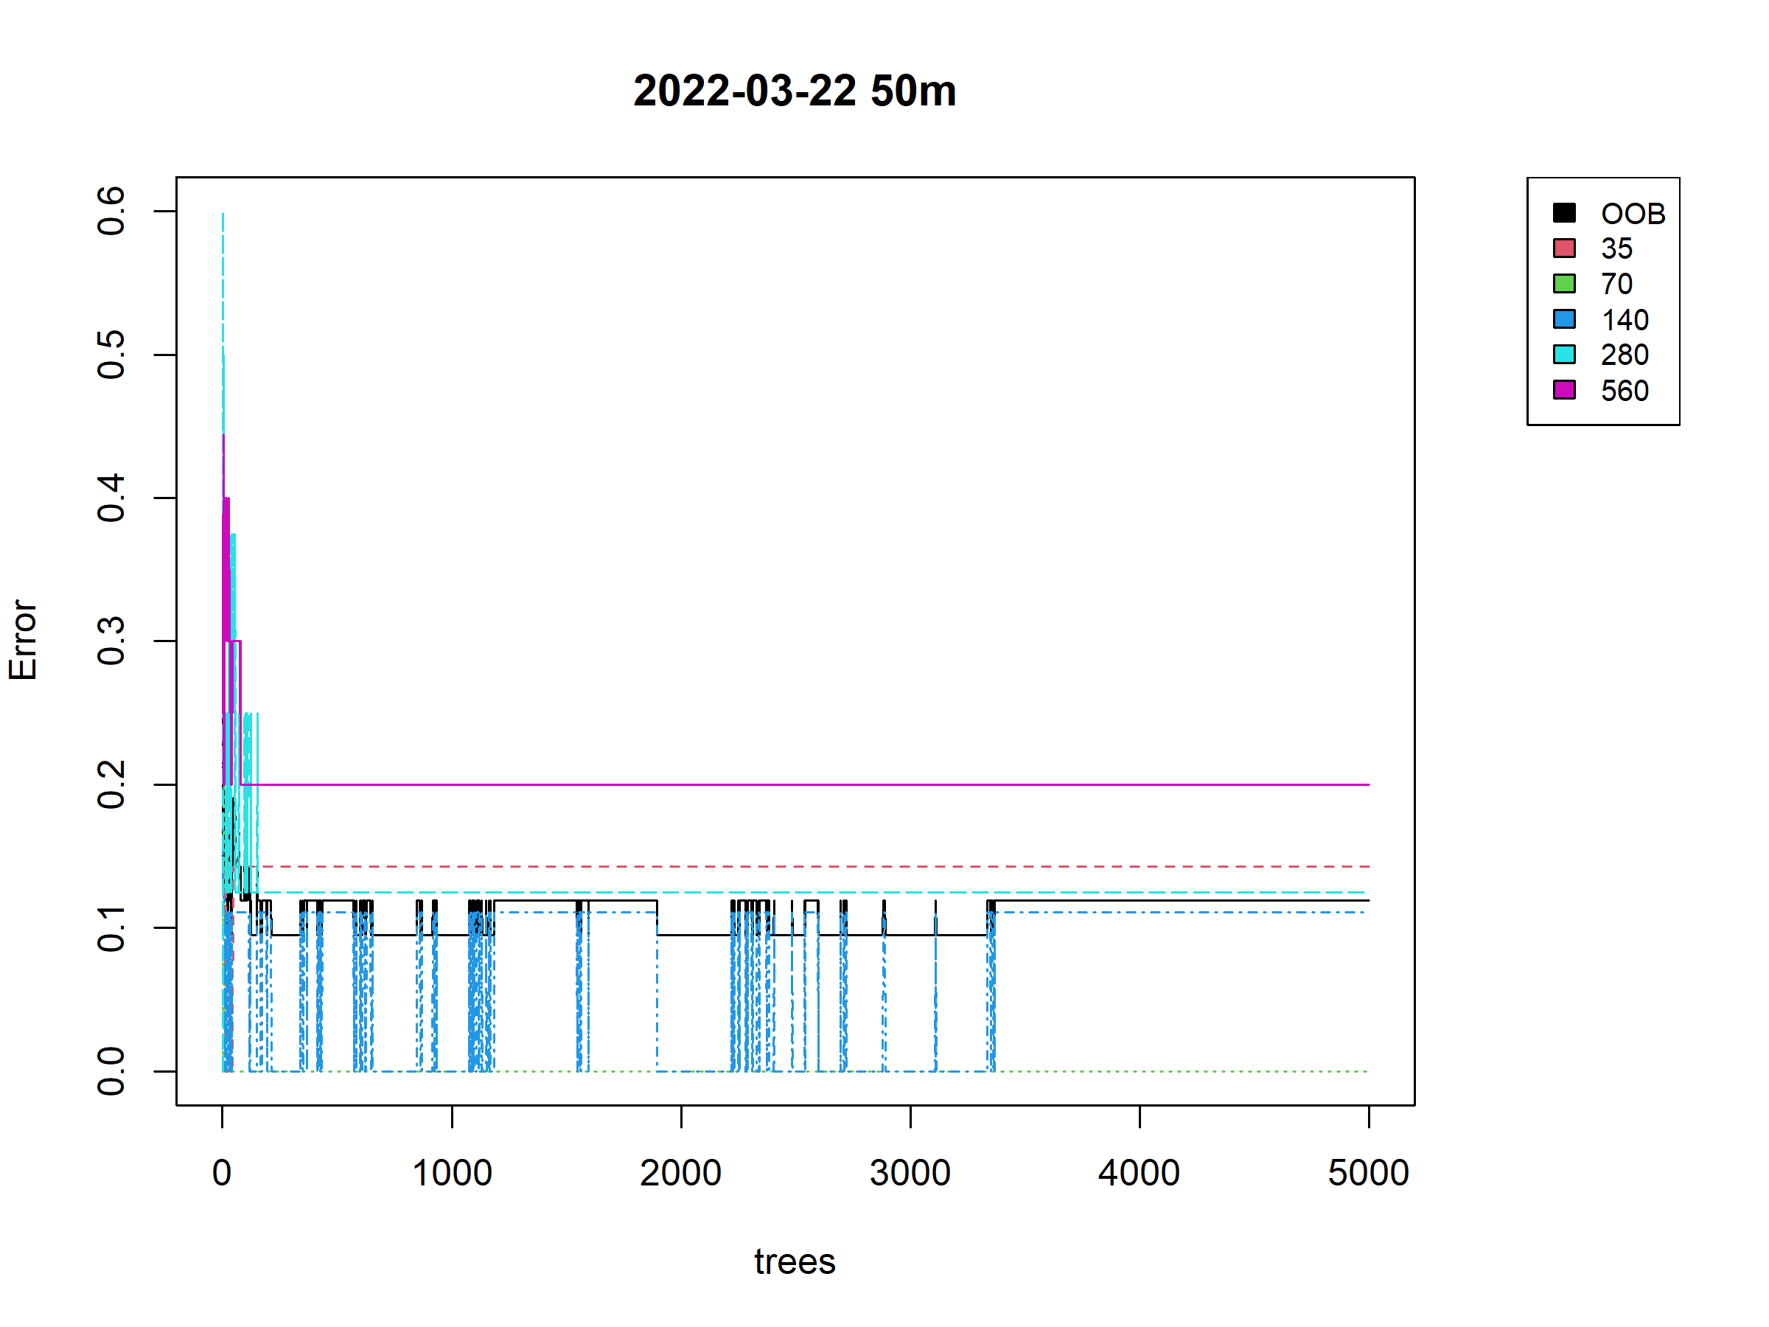
Random Forests
70 - 30 % train - test split
5000 trees
Best performance :
03-22 at 50m without PC

Slide 17
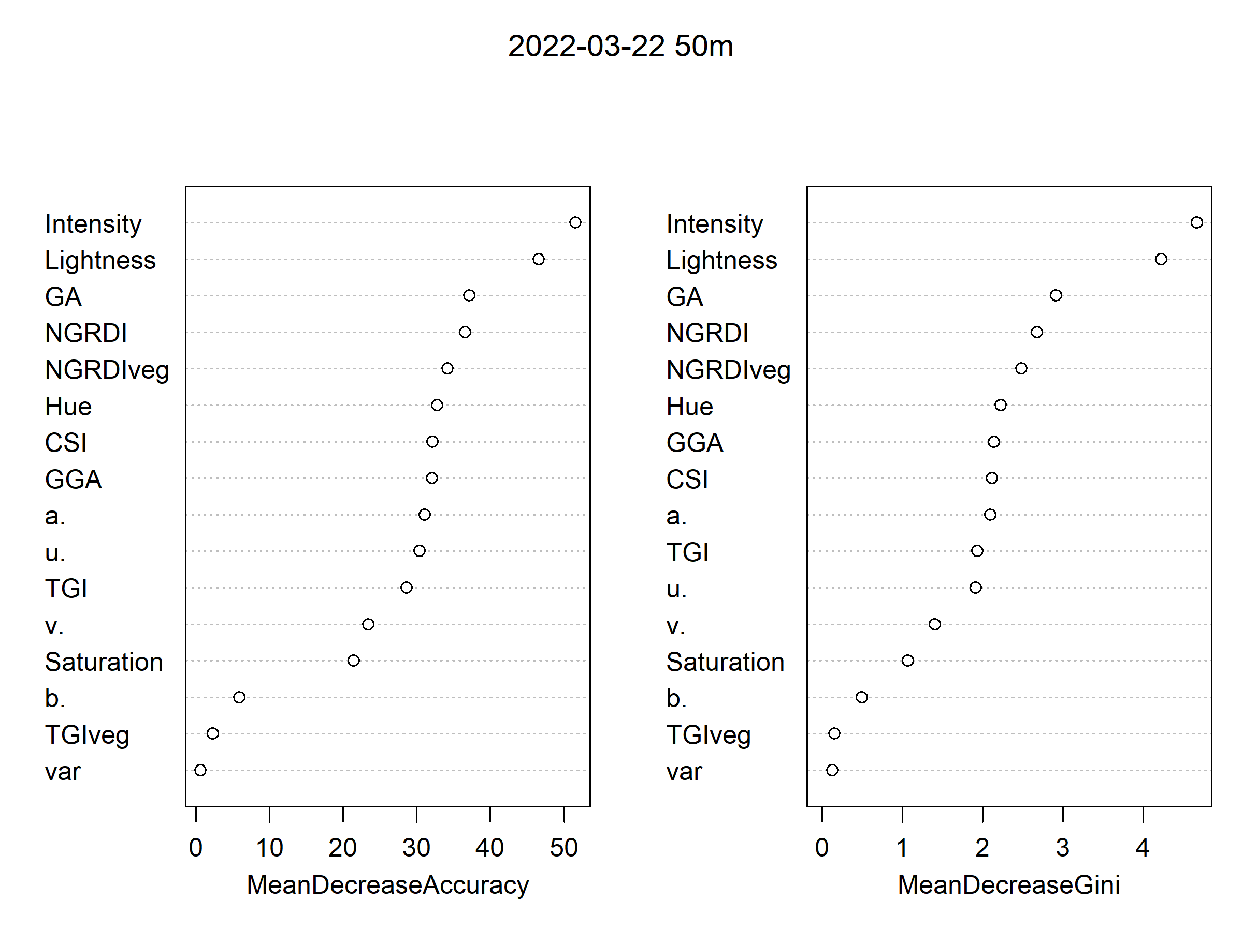
Random Forests
70 - 30 % train - test split
5000 trees
Best performance :
03-22 at 50m without PC

