Slide 1
ETTh1
Long-Duration Forecasting of
Transformer Oil Temperatures
Johannes Aurich |
04 Sep 2026 |
Results Update |

Slide 2
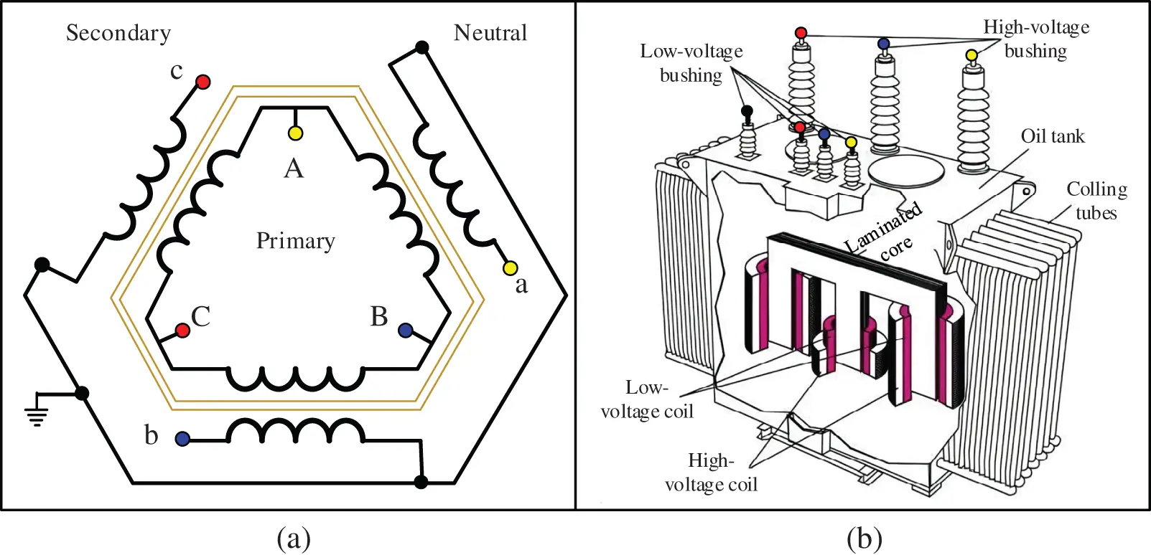
Background: Oil in Electrical Power Transformers
What is it used for?
Electrical insulation to prevent arcs and shorts
Cooling of windings and core
Limits moisture and air exposure to prevent aging
Why keep track of oil temperature?
Optimizing asset performance
Spikes can indicated faults and overload
Oil can decompose and fail at too high temperatures
(Source Link)

Slide 3
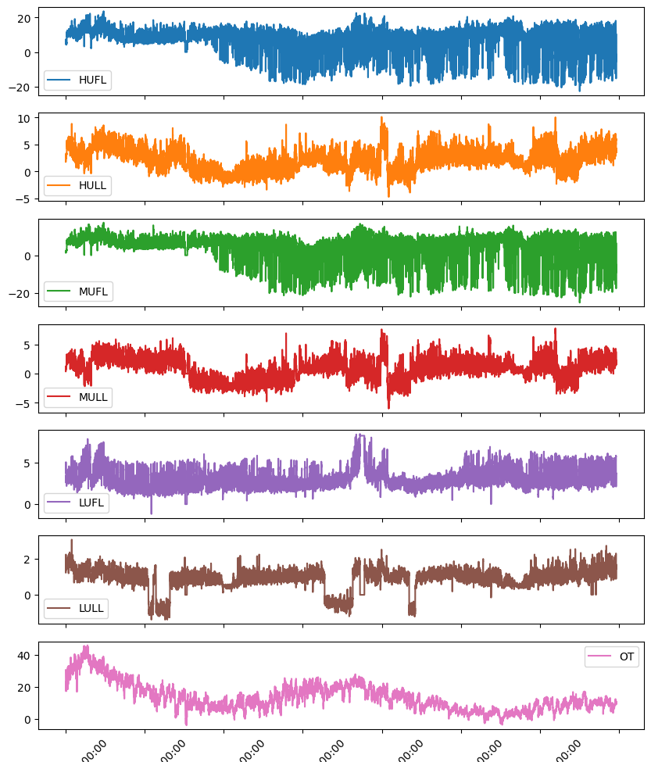
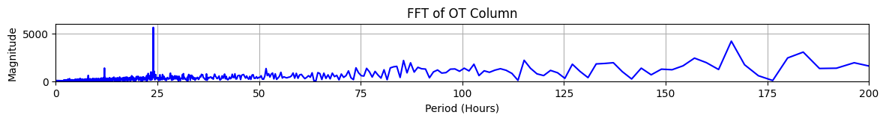
DATA For Long-Duration FORECASTS
Electrical substation data from China (pub. 2021)
https://github.com/zhouhaoyi/ETDataset
ETTh1 dataset
24 months of data | 1h increments
7 channels of transformer measurements
Typ. lookback & forecasting combinations: 96 – 192 – 336 – 720 h
Temporal variation of frequencies, trends, amplitudes, correlations
  Significant seasonalities, particularly 24h (test split below)
Chosen modeling problem
16 h forecast, 96 h lookback horizon/context
Multivariate input to univariate one-shot forecast of OT time series

Slide 4
Splitting and Preparation
Using established splits
12 training – 4 validation – 4 test (months) | 60/20/20% split
Discard the remaining 4 months
Data set definition
Rolling-window | stride =1 | 64 samples per batch (133 total)
training_set = training_split
validation_set = training_split[-context :] + validation_split
test_set = validation_split[-context:] + test_split
Scaling
MinMaxScaler(), feature_range [-1,1]
Separate scaler per channel, stored for later inverse_transform()
Per channel: fit on training split, apply to all splits of that channel
TRAINING
VALIDATION
TEST

Slide 5
Model Overview: Multi-to-Univariate Squence-to-Sequence
7 Channels
R^{Tx7}
unscaled
Scaler 1
7 Channels
R^{Tx7}
scaled
Dataset()
DataLoader()
Model
MSE loss criterion
Adam optimizer
Scaler 2
X
y
Train/Val/Test samples:
Last ŷ of each sample
training
...
X = [xi, …, xi+C]
R^{Cx7}
Scaler 7
y = [x(7)i+C, …, x(7)i+C+H]
ŷ = [ŷi+C, …, ŷi+C+H]
R^{Hx1}
R^{Hx1}
rescaling y and ŷ
Collect rescaled y and ŷ for all
test batches
Model Overview:
7 input features (one per channel)
LSTM 1x48: depth 1, width 48
Linear output layer of 96 output features (= ŷ)
Rational: compute & time constraints
Future: run hyperparameter study, test other models (S4/Mamba, xLSTM)
Evaluation
mean_squared_error(y, ŷ)
mean_absolute_error(y, ŷ)
x(7): oil temperature channel
i: sample index
C: context length
H: forecast horizon

Slide 6
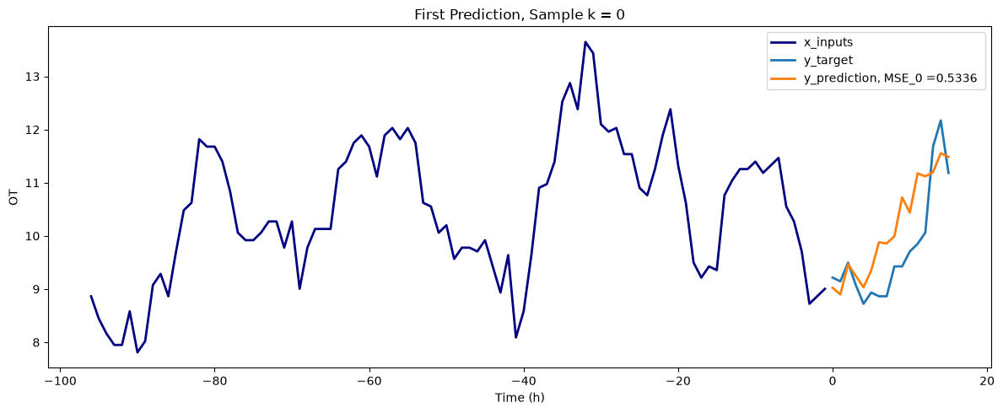
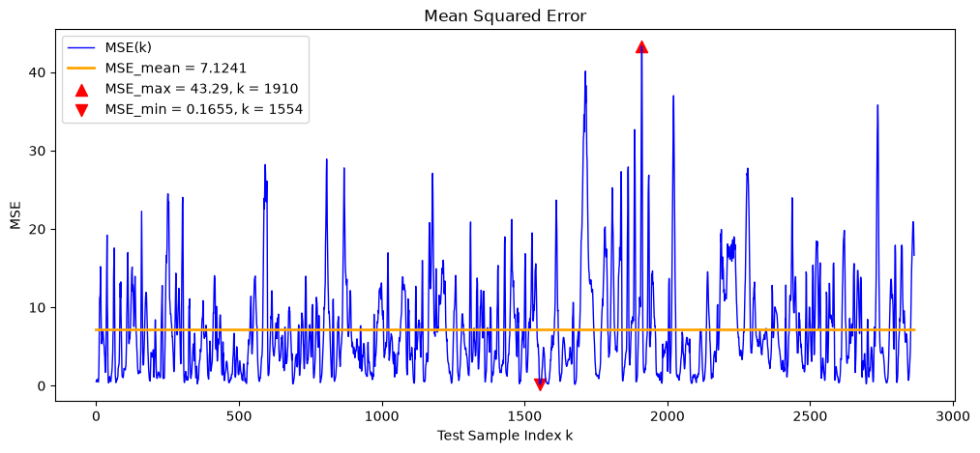
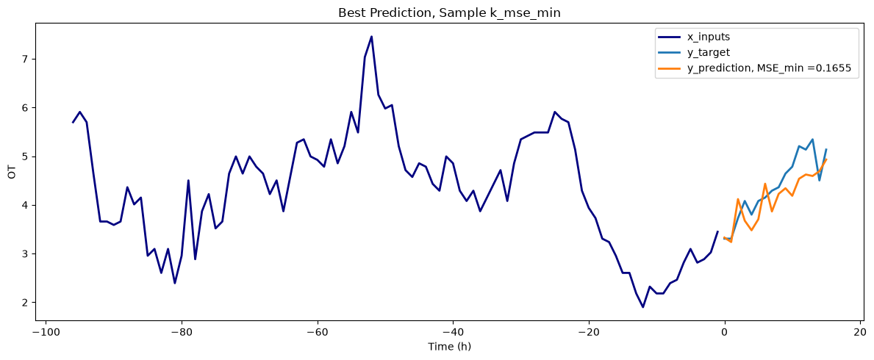
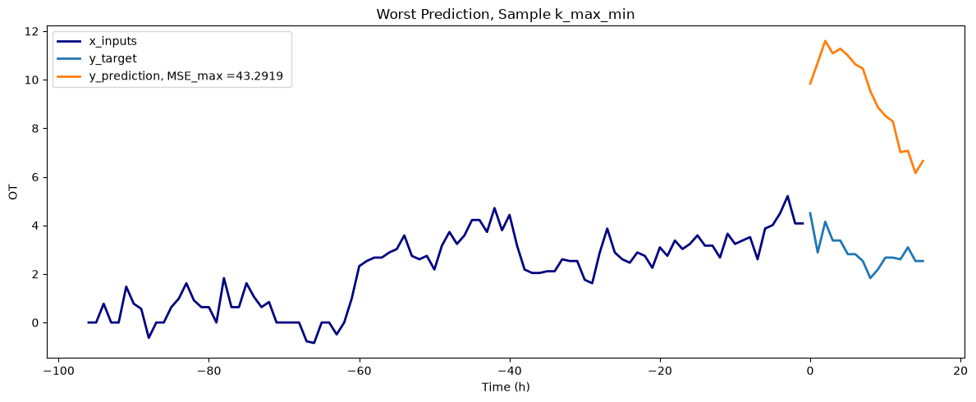
Forecasting Results
96h → 16h | LSTM 1x48
Overview | 11,728 trainable parameters
Test set average MSE: 7.12 | MAE: 2.20
MSE model performace over the test set fluctuates strongly (see MSE variability above)
Best test samples achieve MSE ≈ 0.17, showing good reproduction of trend, OT amplitude, and decent fluctuations
Worst test samples are in the range of MSE ≈ 40, somewhat capturing the general trend but failing on amplitude

Slide 7
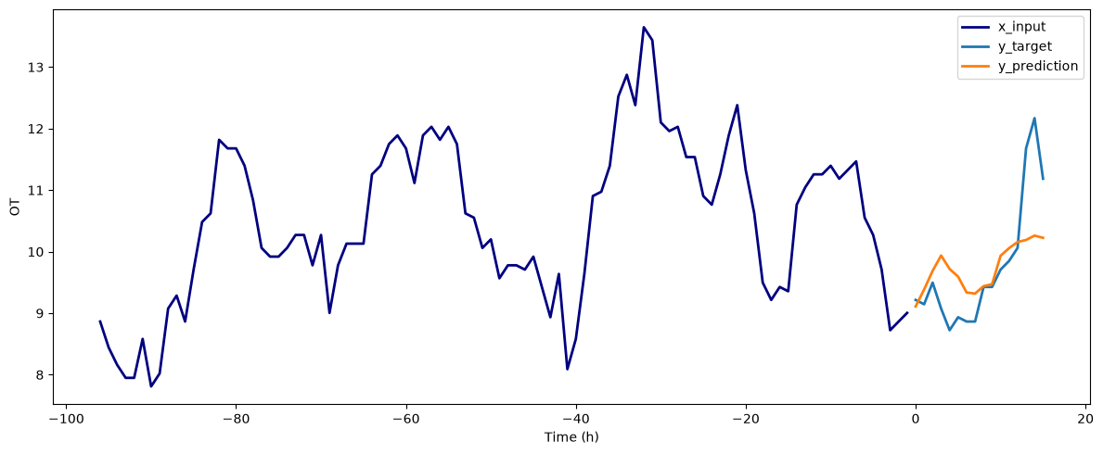
Forecasting Results
96h → 16h | ARIMA Baseline
ARIMA = Auto-Regressive Moving Average
Based on linear differential equations (= may approximate non-linear processes like ETTh1 at best)
Most useful for short-term predictions
Typical performance of models in the literature: MSE, MAE ≤ O(1) covering transformers (very large) to linear baselines (small)
→ 2022 Paper: “Are Transformers Effective for Time Series Forecasting?”
auto_arima()
Evaluated for the first test sample only
m = 24 h seasonality considered
MSE: 0.60
MAE: 0.56
Captures the general trend partially
Visible approach of the long-term mean, bad reproduction of amplitudes
→ aligned with typical long-term behavior

Slide 8
Conclusion & Next Steps
Current models needs further improvement
LSTM performance fluctuates strongly and requires further measures to stablize test results (...)
  Best results are on par with literature values, worst ones significantly underperform; average performance is still insufficient
ARIMA baseline performas reasonably well on MSE, MAE metrics for the first test sample, but mean MSE/MAE over all test samples is tbd
More analysis of LSTM network architecture and data handling approach required → hyperparameter optimization
  Compared to previous experiments: increased lookback-to-forecast horizon ratio helpful, but ideal ratios to be investigated
  Ideal LSTM configuration: depth and width of network to be investigated, broad networks with at least the output feature range seem beneficial
Alternative modelling approaches to explore
ARIMA captures long-term trends better, LSTMs has significant performance variation in amplitudes
  Try decomposition approaches: DLinear → DLSTM or STL-based = small & simple but limited by primitive seasonality coverage?
  Use State Space Models (inherent trend and dynamics coverage w/o cutoffs like in FITS): S4/Mamba
Main problem: strong temporal shift in signal dynamics = f(externalities)
  Use forecast-correction strategies with recursive loops to for dynamic updates
  Try to reverse-engineer physical causalities within the system to reduce noise (ambient conditions, heat transfer,...)

