Slide 1


Characterization of plasmonic disordered metasurfaces for biosensing applications under realistic conditions
PhD Protocol Summary
Jonathan Alexis Urrutia Anguiano
Facultad de Ciencias
UNAM
jaurrutia.95@ciencias.unam.mx
Notes:
Click to add Notes

Slide 2
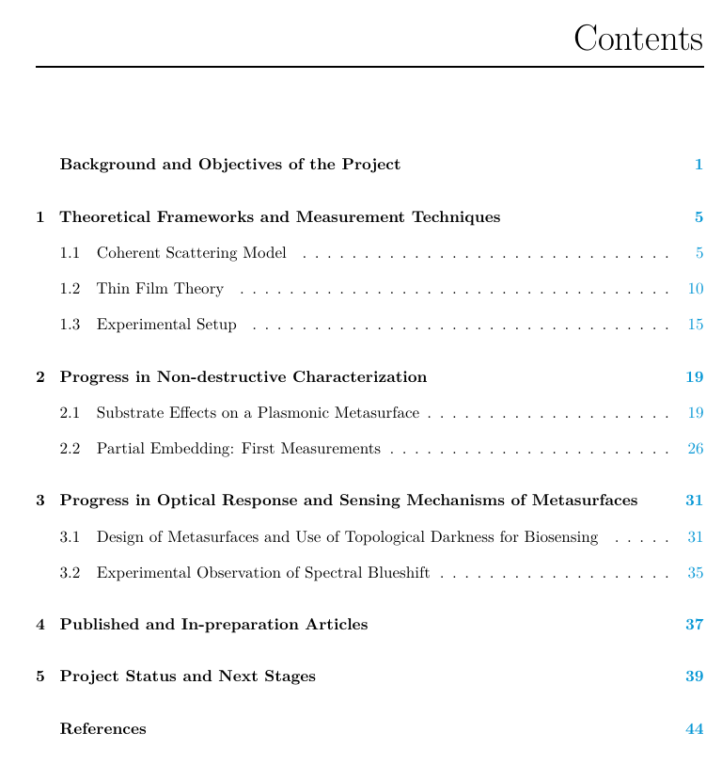
Committee & Contents
Principal Tutor
  Dr. Alejandro Reyes Coronado
  Facultad de Ciencias, UNAM
Committee Members
  Dr. Rubén García Ramos
  Instituto Nacional de Astrofísica, Óptica y Electrónica (INAOE)
  Dr. W. Luis Mochán Backal
  Instituto de Ciencias Físicas, UNAM

Slide 3
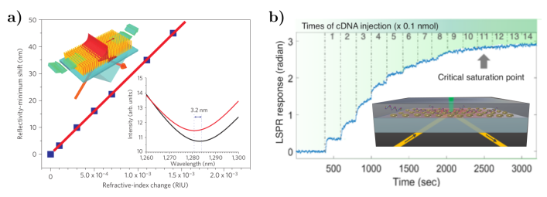
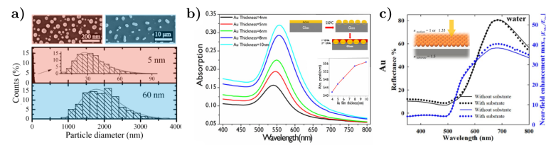
Background and Objectives
Theoretical-Experimental Collaboration between FC-UNAM & INAOE
Disordered metasurfaces aimed for Biosensing Applications
  Implementation of Analytical and Numerical Techniques
    Multiple Scattering Theories
    Finite Element Method
    Parameter Fitting Method: Descent Gradient
  Quantification of Multiple Scattering and Substrate Effects
  Design proposal and spectral analysis of biosensing-aimed metasurfaces
A. V. Kabashin et al.
Nature Mater.
8(11):867-871, 2009.
G. Qiu et al.
ACS Nano.
14(5):5268-5277, 2020.
D. Wang et al.
Beilstein J. Nanotechnol.
8:318-326, 2011.
R.S. Moirangthem et al.
Biomed. Opt. Express.
3(5):899, 2012.
R. Borah et al.
Sci. Rep.
12(1):15738, 2022.

Slide 4

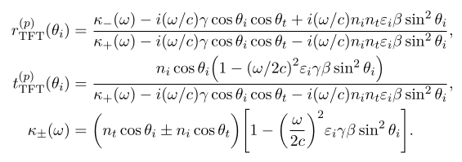
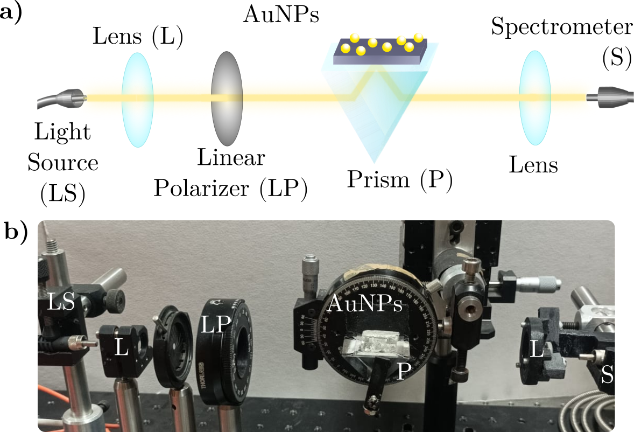
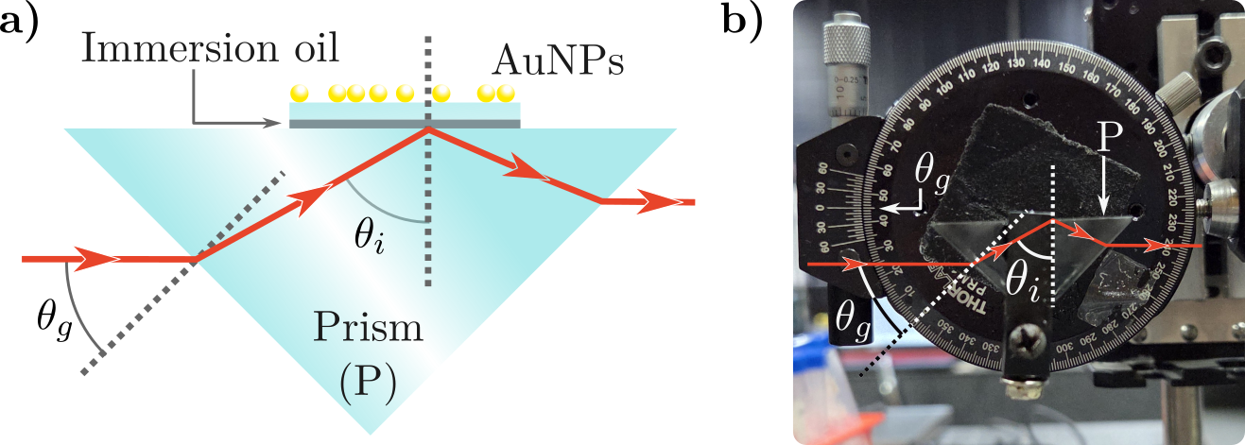
Theoretical Frameworks and Measurement Techniques
Coherent Scattering Theory
Thin Film Theory
O. vázquez-Estrada et al.
J. Opt. Soc. Am. A.
31(4):745, 2014.
D. Bedeaux and J. Vlieger.
Optical properties of surfaces.
Imperial College Press, London 2nd Ed. , 2004
Reflectivity Spectra Setup at INAOE

Slide 5
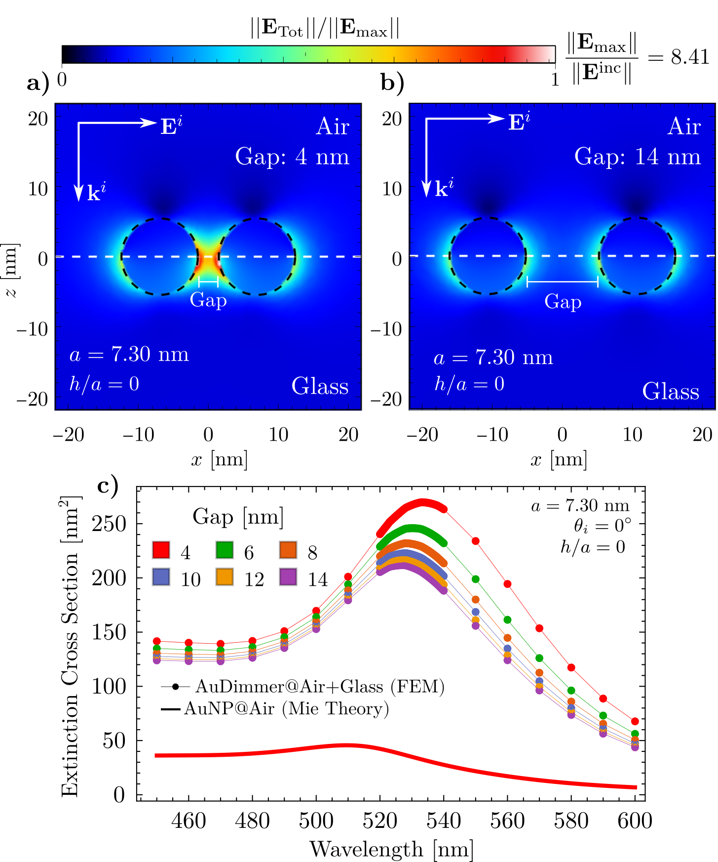
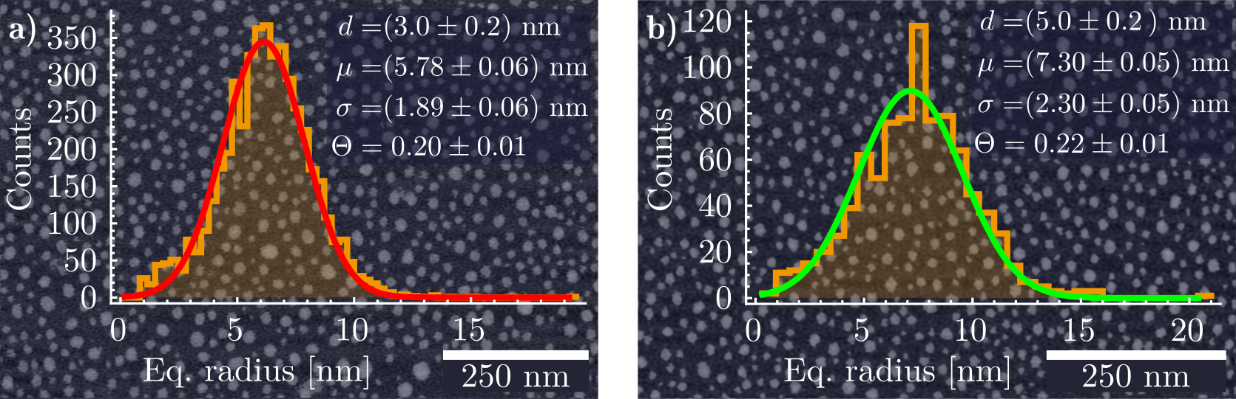
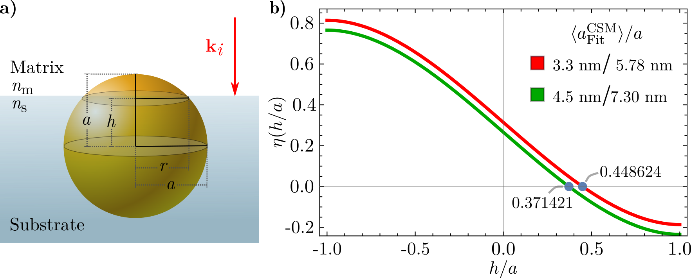
Progress in Non-destructive Characterization
Partial embedding of the metasurface

Slide 6
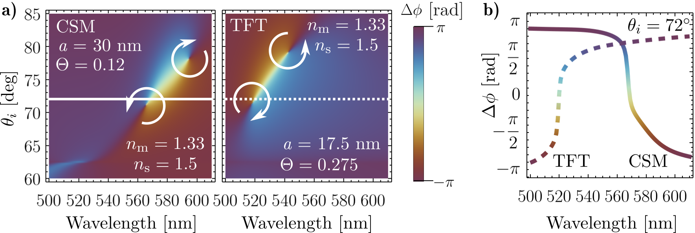
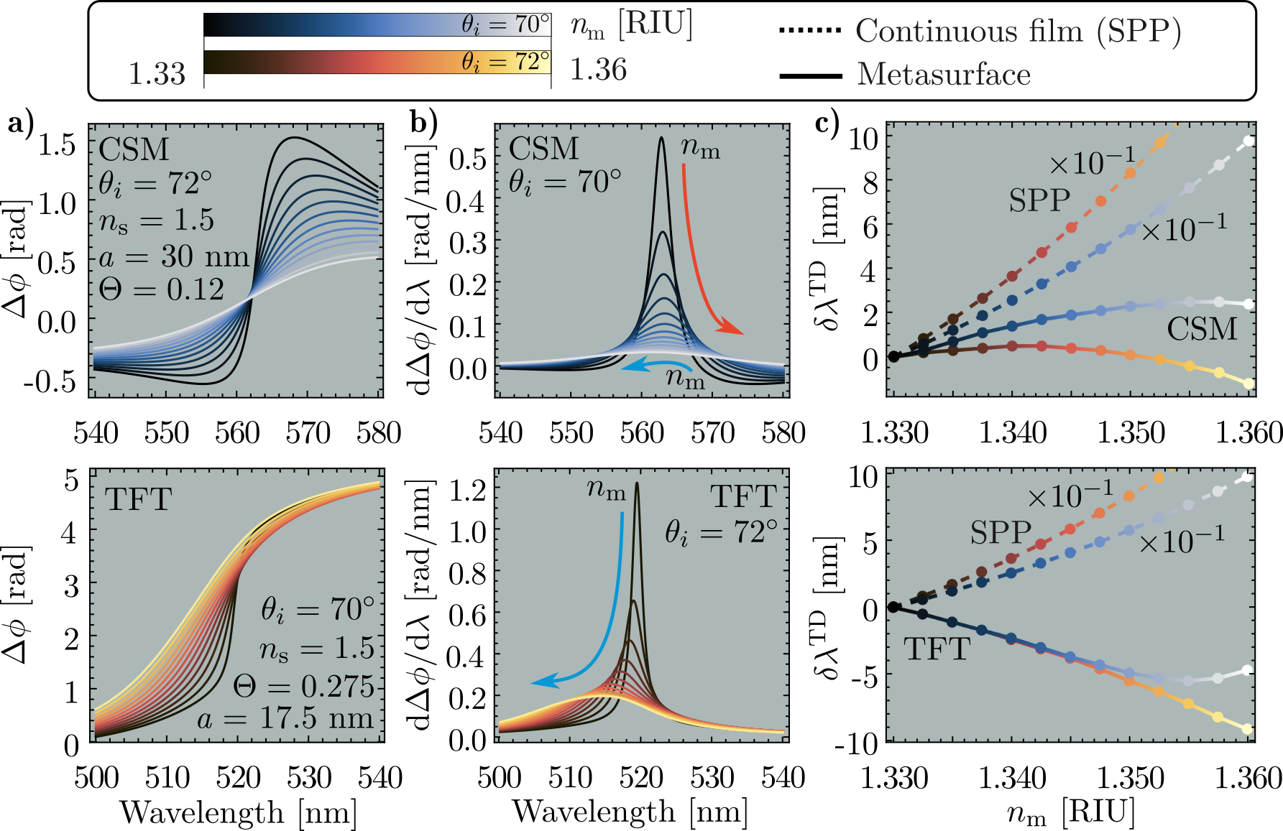
Progress in Optical Response and Sensing Mechanisms of Metasurfaces
Topological Darkness Phenomenon
Phase-based sensing schema for refractive index change
G. Ermolaev et al.
Nat. Commun.
13(1):2049, 2022.

