Slide 1
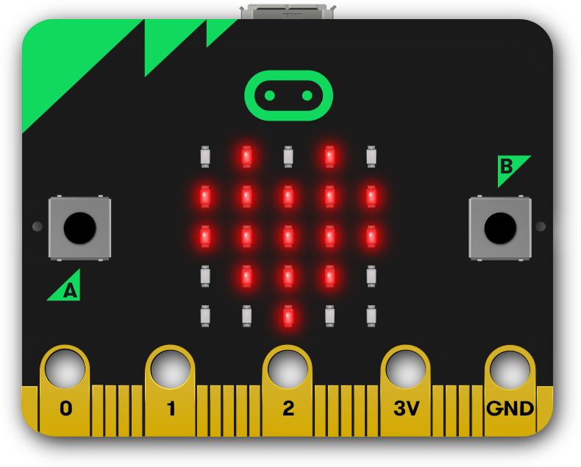
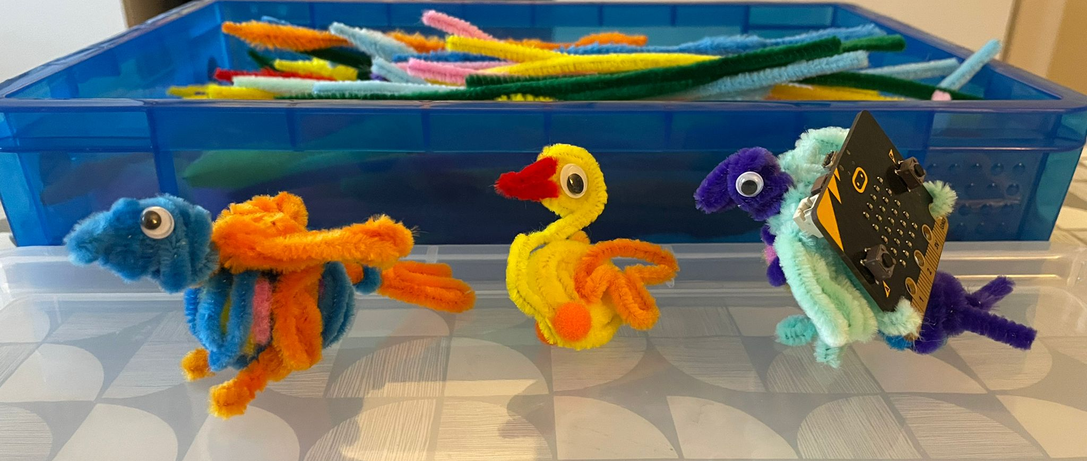
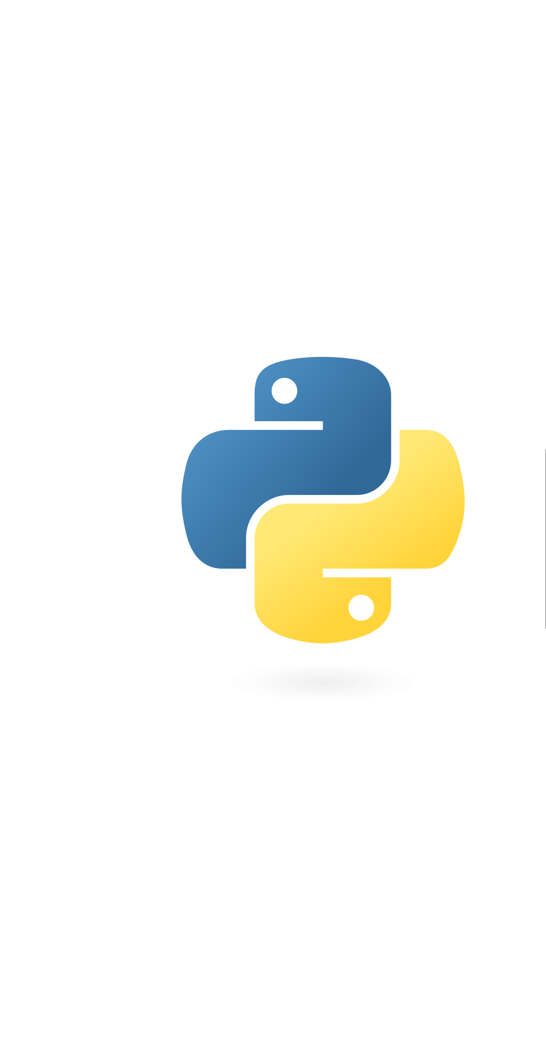
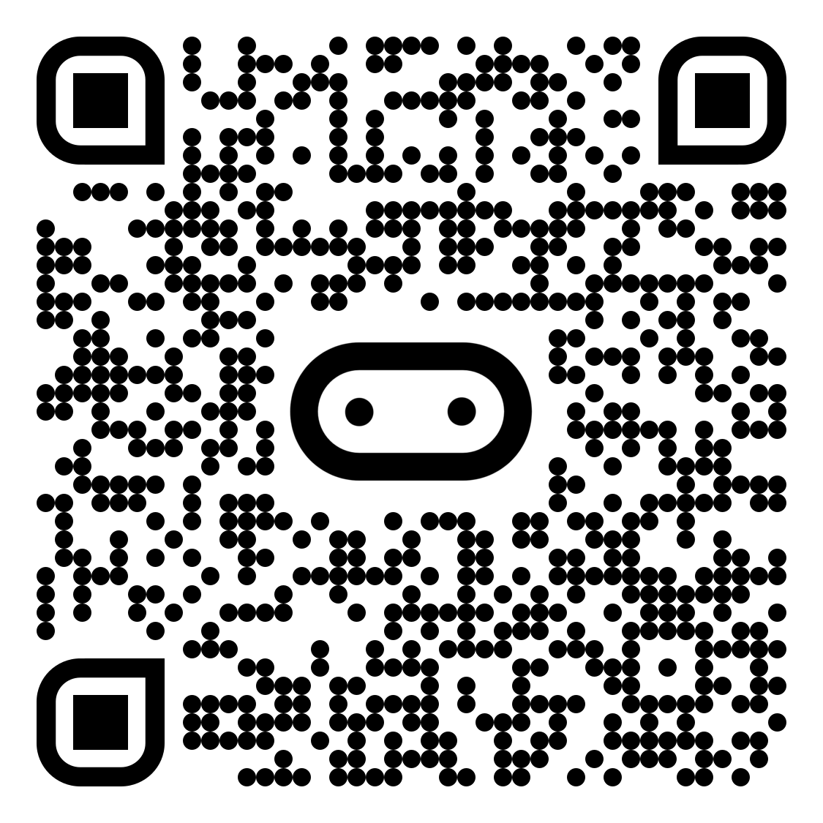


Hello!
Welcome to the micro:bit flock!
If it walks like a bird and chirps like a bird…
Then you must be a bird!
Ever wondered what life is like as a bird? Find out with the micro:bit.
The micro:bit is a small programmable computer, designed to make learning and teaching easy and fun.
It can be programmed with multiple languages, including Python, and we also have a
Python Editor to try out!
Follow this link, or the QR code, and let’s start!
https://mbit.io/t-bird
🔊
Get creative with sound
We are developing a new way to generate sound with the micro:bit and MicroPython, and we’d love to hear you make some noise!
Follow the instructions in the activity and submit your sound creations.
📢

Slide 2
Hello!
Welcome to the micro:bit flock!
If it walks like a bird and chirps like a bird…
Then you must be a bird!
Ever wondered what life is like as a bird? Find out with the micro:bit.
The micro:bit is a small programmable computer, designed to make learning and teaching easy and fun.
It can be programmed with multiple languages, including Python, and we also have a
Python Editor to try out!
Follow this link, or the QR code, and let’s start!
https://mbit.io/t-bird
🔊
Get creative with sound
We are developing a new way to generate sound with the micro:bit and MicroPython, and we’d love to hear you make some noise!
Follow the instructions in the activity and submit your sound creations.
📢

