Slide 1
Camera Ready
Dear Authors,
We would like to congratulate you for the acceptance of your article. Your contribution will be very important for the academic community. However, to formalize the publication of your document on IEEEXplore, you need to comply with 4 phases, and submit your final version until 10/08/2025:
Paper style adjustment according to the IEEE template
PDF eXpress verification
Final version submission on EasyChair.
Copyright agreement signature.
Next, each of the phases will be detailed, keeping the order:

Slide 2
Phase 1. Paper style adjustment according to the IEEE template
At this stage it is needed to adjust the paper style according to the IEEE format. Those papers using the LaTeX sources, must replace the phrase Index Terms with Keywords. Likewise, be attentive to the information of the authors and affiliations. Additionally, the Copyright notice must be included in the document. Papers must not exceed six pages in length. Ignore the header, and please do not number your pages.
Word template
Latex template
Copyright notice, included in the templete (must be included manually by authors):
For papers in which all authors are employed by the US government, the copyright notice is: U.S. Government work not protected by U.S. copyright
For papers in which all authors are employed by a Crown government (UK, Canada, and Australia), the copyright notice is: 979-8-3503-9158-9/24/$31.00 ©2024 Crown
For papers in which all authors are employed by the European Union, the copyright notice is: 979-8-3503-9158-9/24/$31.00 ©2024 European Union
For all other papers the copyright notice is: 979-8-3503-9158-9/24/$31.00 ©2024 IEEE

Slide 3
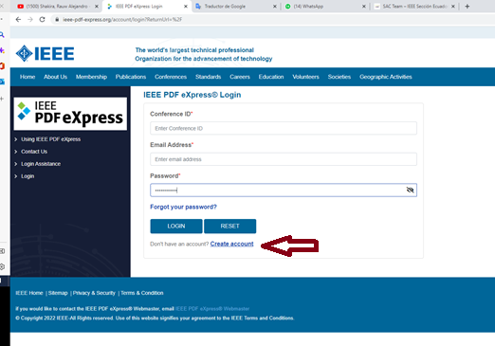
Phase 2. PDF eXpress verification
Create Account for the ETCM conference using 63562X as conference ID
https://ieee-pdf-express.org/account/login?ReturnUrl=%2F

Slide 4
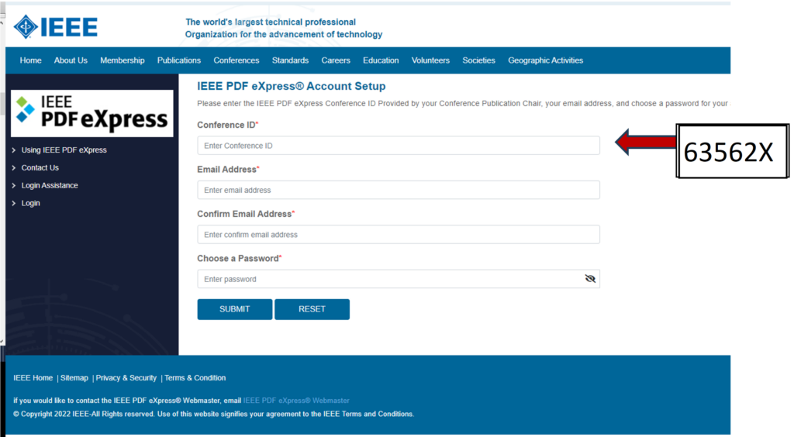

Slide 5
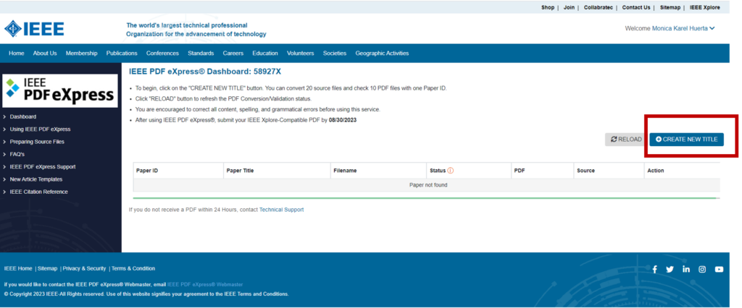

Slide 6
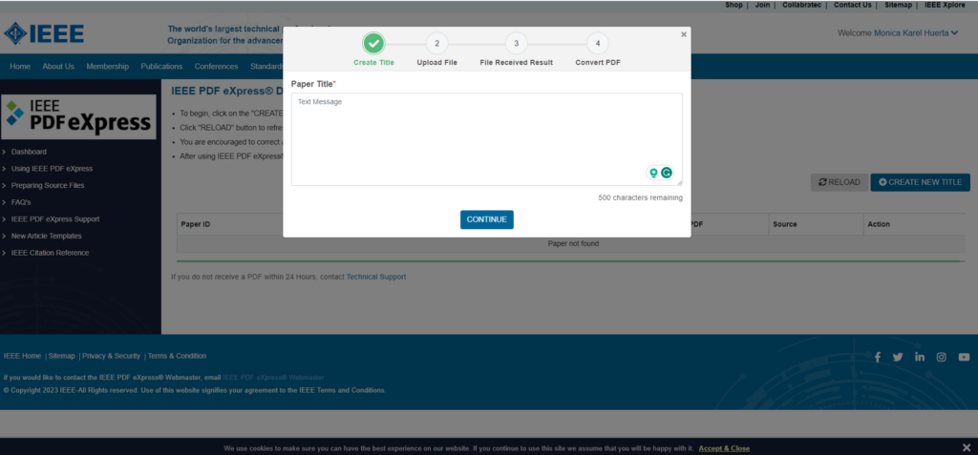

Slide 7
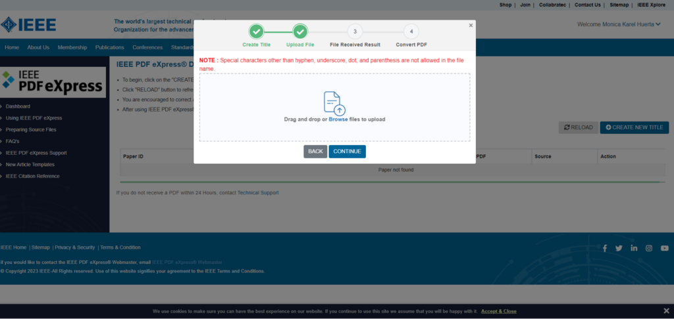

Slide 8
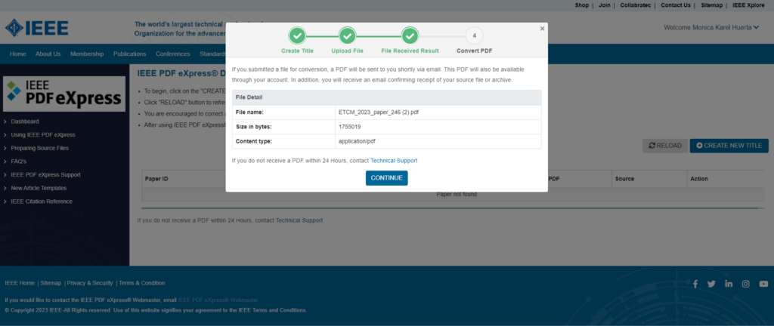

Slide 9
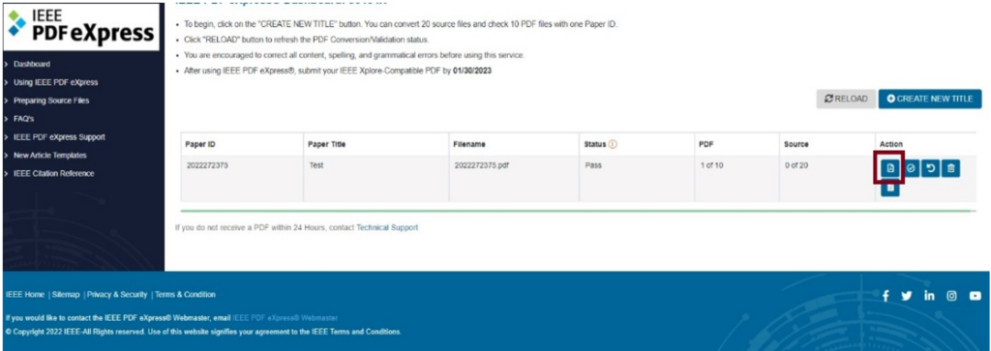
Authors will receive an email with the PDF generated by PDFeXpress. You can also download it from the icon highlighted in red.

Slide 10
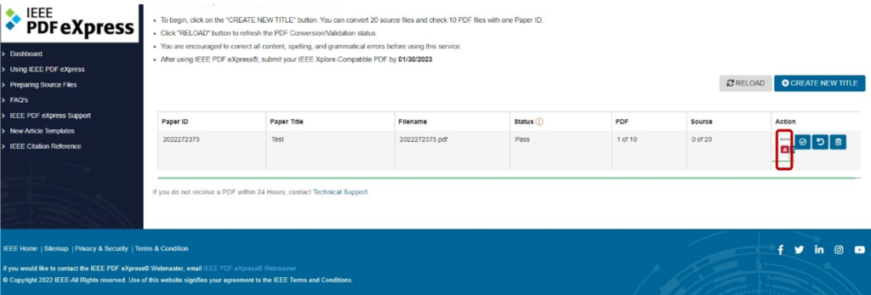
If Failed, you have to download PDF Check report and resolve marked errors, then you must Try Again until Passed report. You have a limit of intents; try to resolve all errors at the same time.

Slide 12
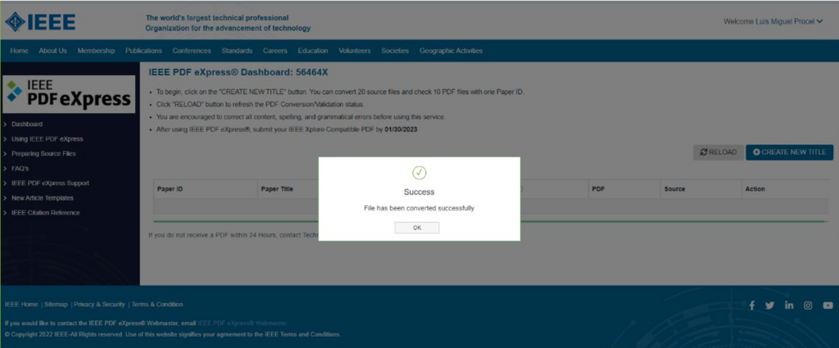
Passed result. Select Approve for Colletion, download PDF (in title link), and update it on easychair website.

Slide 13
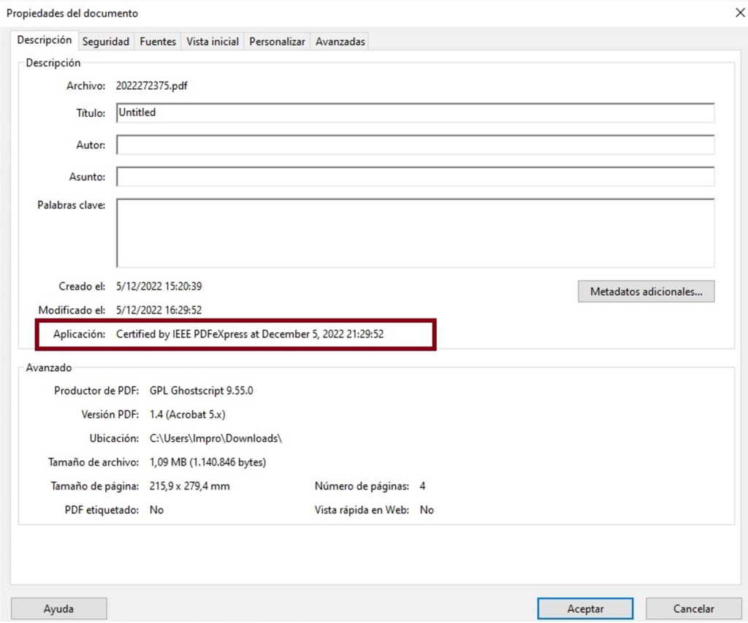
Authors can check if they did this phase correctly: document properties — Application certified by IEEE PDFeXpress —date

Slide 14
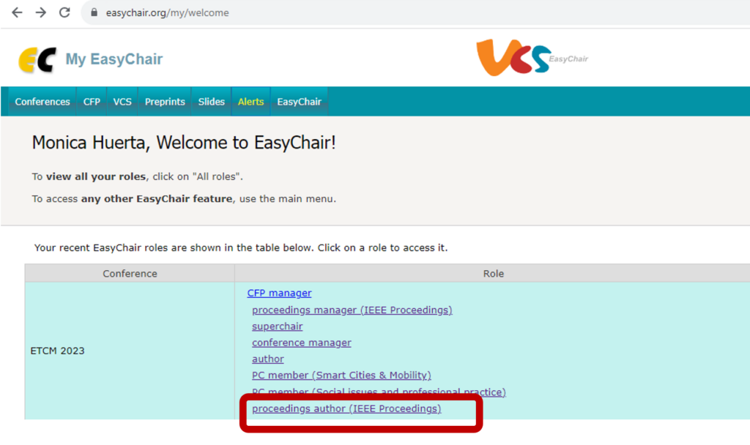
Phase 3. Final version submission on EasyChair.
The document generated in phase 2 must be uploaded to the Easychair platform. To do so, enter in Easychair and go to Final Version menu.
Accepted papers have Final Version Access Link from My Submissions menu or directly using “proceedings author (IEEE Proceedings)” role.

Slide 15
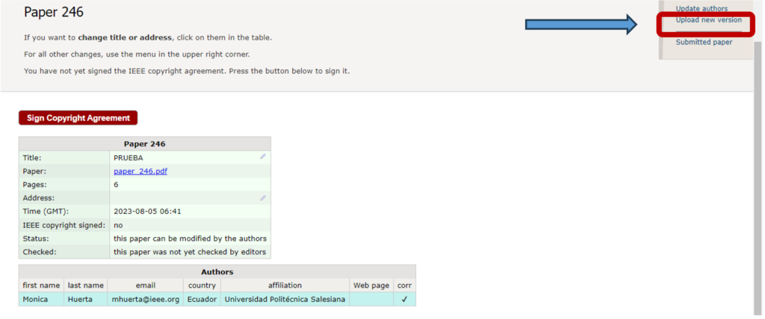
If you need, also you can update paper title or authors details.

Slide 16
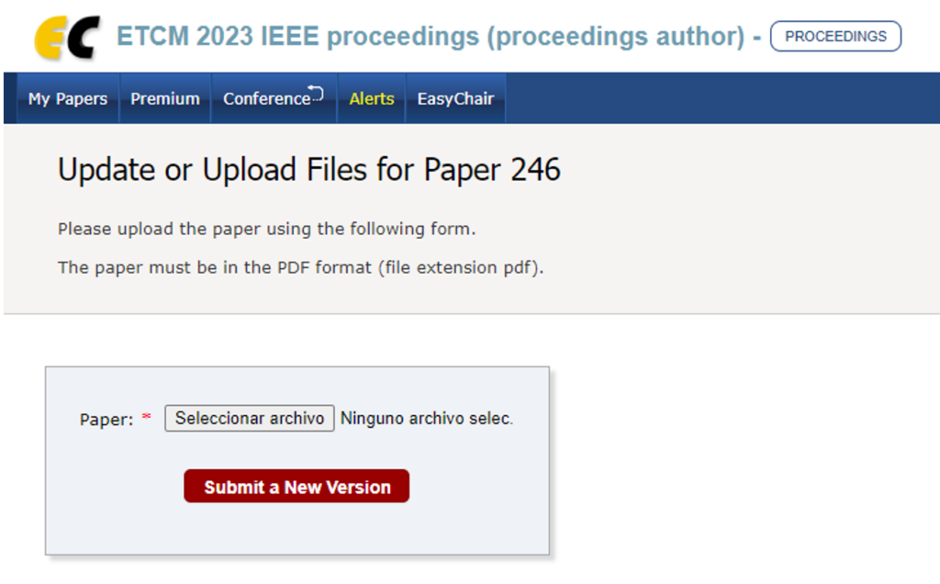

Slide 17
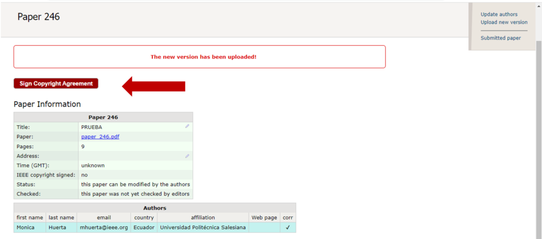
Phase 4. Copyright agreement signature.
Finally, appealing to the principles of transparency of the congress, we also kindly ask for filling the copyright section.

Slide 18
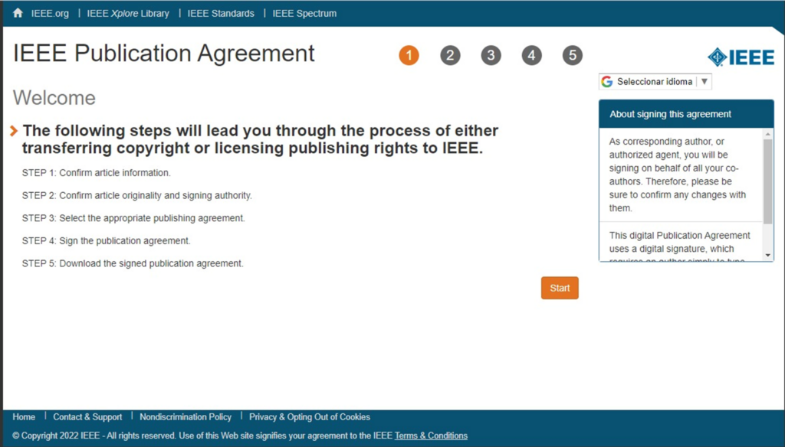

Slide 19
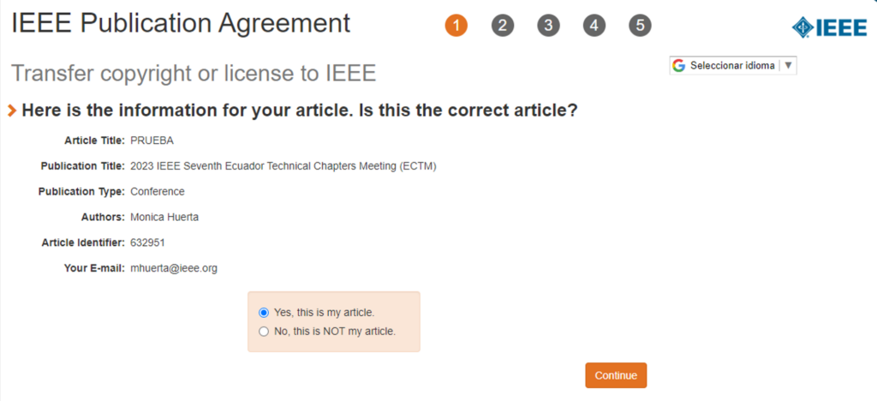

Slide 20
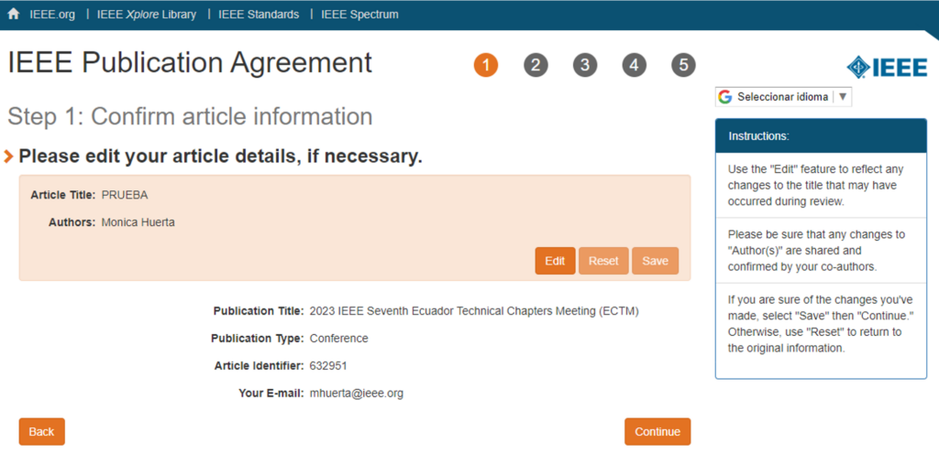
Article Title and Authors must be the same as in Easychair, in case of error, please update it in Easychair platform first and then start copyright form again.

Slide 21
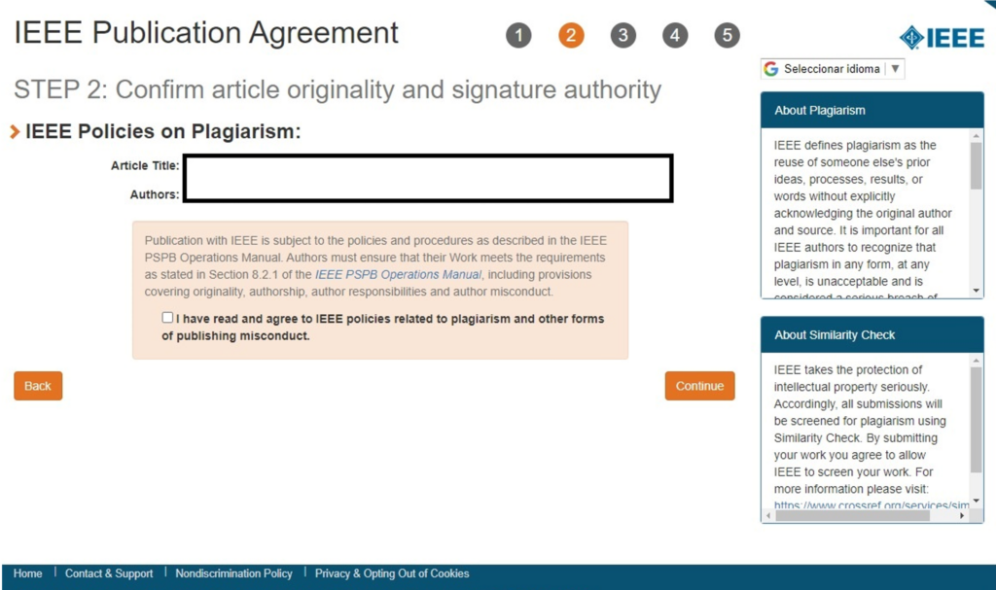

Slide 22
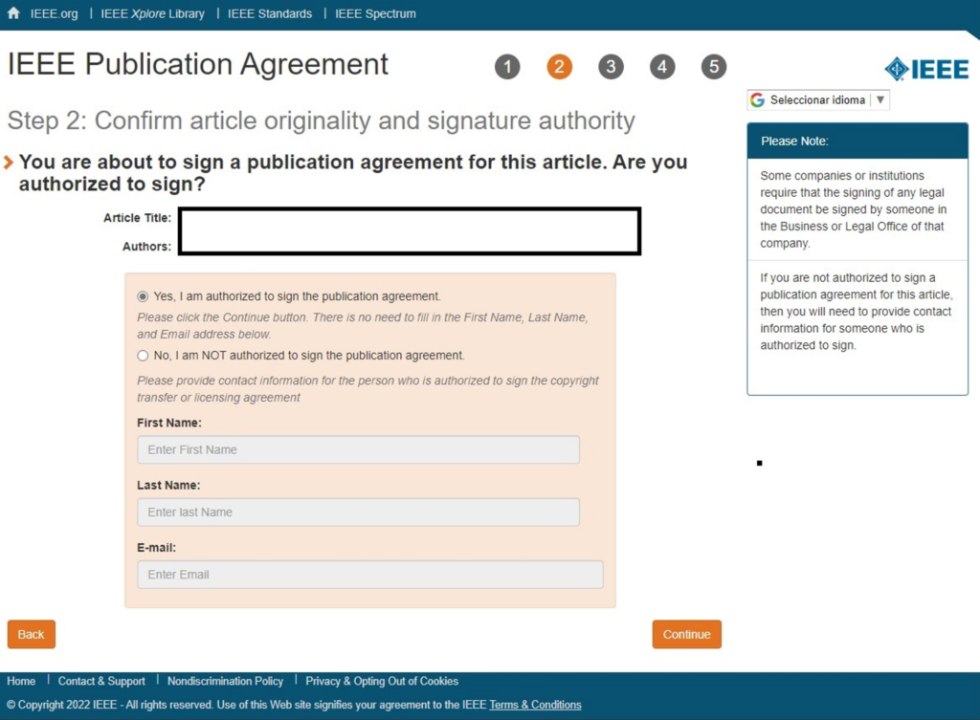

Slide 23
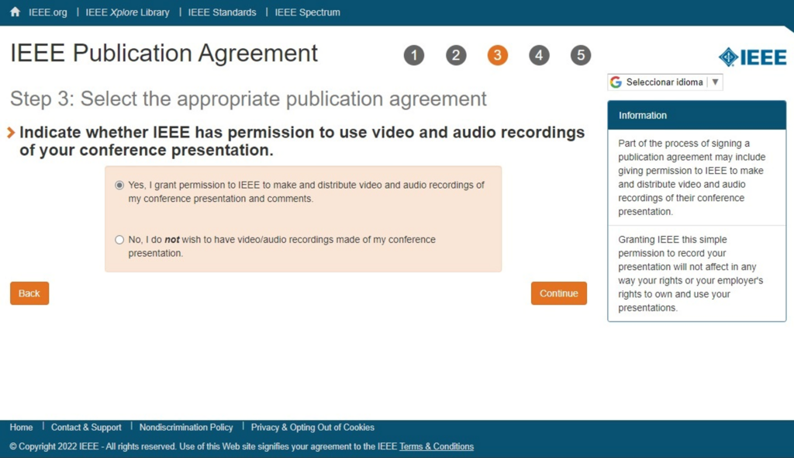

Slide 24
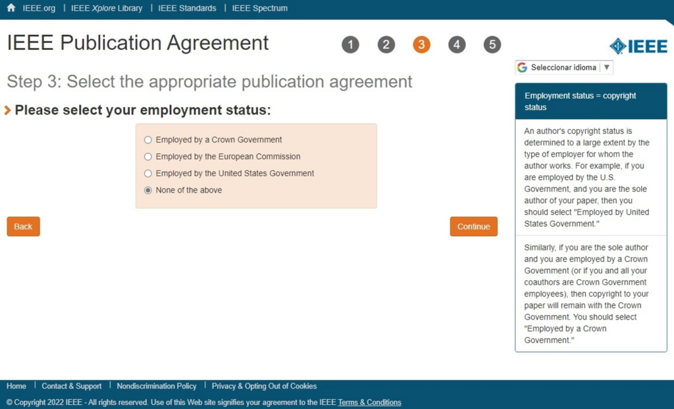

Slide 25
