Slide 1
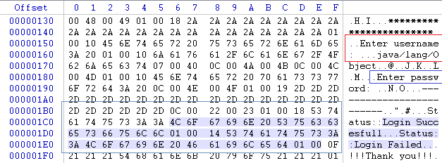
Bytecode & JVM

Slide 2
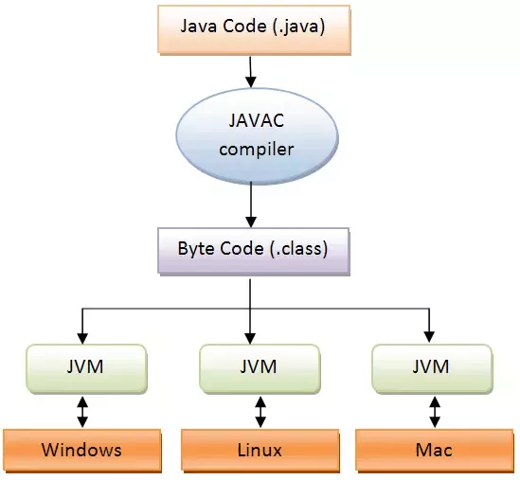
JVM
JVM = Implementation of:
Java Virtual Machine Specification
For each platform specific JVM must be created based on Java Virtual Machine Specification “interface”.

Slide 3
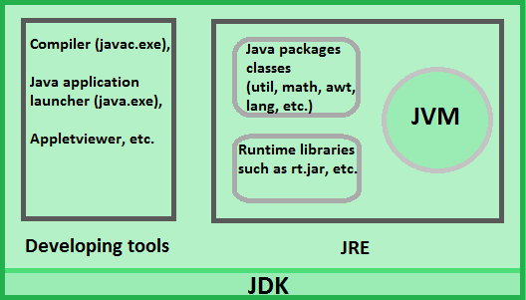
What is bytecode?
Result of the compilation of a Java program, an intermediate representation of that program which is machine independent.
Bytecode is executable on the platform where JRE is installed
Bytecode is run by JVM.
JRE = Java API + JVM
http://www.letustweak.com/wp-content/uploads/2015/12/JDK.png

Slide 4
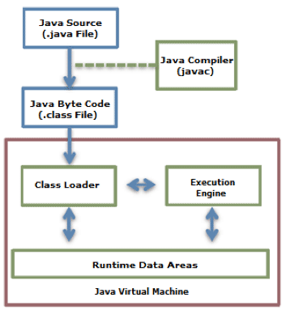
Java Code Execution Process.
Java compiler ->

Slide 5
Compiler
Transform source code into bytecode
.java -> .class
curiosity: Java compiler is written in… Java =)
runtime in ANSI C
info from: https://web.archive.org/web/20080222200518/http://java.sun.com/docs/overviews/java/java-overview-1.html
class loader ->

Slide 6
Class loader
A class loader loads the compiled Java Bytecode to the Runtime Data Areas.
Java provides a dynamic load feature; it loads and links the class when it refers to a class for the first time at runtime, not compile time. JVM's class loader executes the dynamic load.
There are many class loader rules, but let’s stay with the basics.
Runtime Data Areas ->

Slide 7
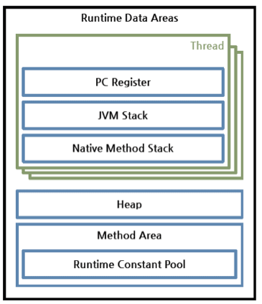
Runtime Data Areas
Runtime Data Areas are the memory areas assigned when the JVM program runs on the OS. The runtime data areas can be divided into 6 areas.
Per thread: PC Register, JVM Stack, and Native Method Stack are created.
For all threads: Heap, Method Area, and Runtime Constant Pool.
Each area shortly->

Slide 8
Each area shortly
PC register ->

Slide 9
PC register
PC (Program Counter) has the address of a JVM instruction being executed now by the processor.
JVM Stack->

Slide 10
JVM Stack
exists for each thread
saves various stack frames
The JVM just pushes or pops the stack frame to it.
If any exception occurs, each line of the stack trace shown as a method such as printStackTrace() expresses one stack frame.
JVM Stack frame ->

Slide 11
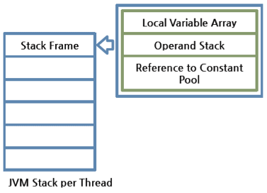
Stack frame - veeery important!
One stack frame is created whenever a method is executed in the JVM. When the method is ended, the stack frame is removed.
Each stack frame has the reference for local variable array, Operand stack, and runtime constant pool of a class where the method being executed belongs. The size of local variable array and Operand stack is determined while compiling, what you will see soon.
Local variable array in frame ->

Slide 12
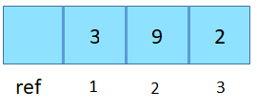
Local Variable Array
It has an index starting from 0. 0 - reference of a class instance where the method belongs.
From 1, the parameters sent to the method are saved.
After the method parameters, the local variables of the method are saved.
Operand Stack ->

Slide 13
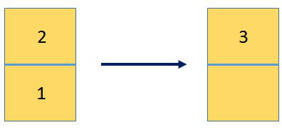
Operand Stack
An actual workspace of a method. Each method exchanges data between the Operand stack and the local variable array, and pushes or pops other method invoke results. The necessary size of the Operand stack space can be determined during compiling. Therefore, the size of the Operand stack can also be determined during compiling.
Reference to constant pool ->

Slide 14
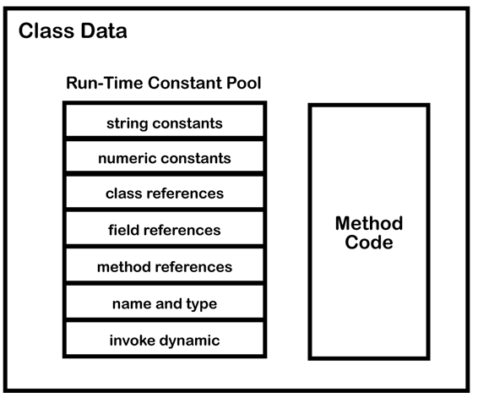
Reference to Constant Pool
getfield #15
invokevirtual #23
invokestatic #6
ldc #3
where are we with inception ->

Slide 15
Where are we right now with our inception?
Native method stack ->

Slide 16
Native method stack
Native method stack: A stack for native code written in a language other than Java.
It is a stack used to execute C/C++ codes.
According to the language, a C stack or C++ stack is created.
Heap ->

Slide 17
Heap
Container for objects shared by all threads
Garbage Collection runs on the heap memory to free the memory used by objects that doesn’t have any reference.
Any object created in the heap space has global access and can be referenced from anywhere of the application.
method area ->

Slide 18
Method Area
Method area is shared by all threads, created when the JVM starts.
It stores runtime constant pool, field and method information, static variable, and method bytecode for each of the classes and interfaces read by the JVM.
execution engine ->

Slide 19
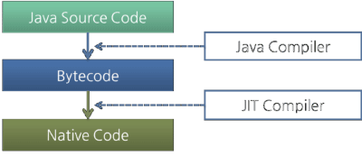
Execution engine
Place where bytecode assigned to the runtime data areas is executed
Every simple instruction is executed here one by one
Bytecode is written in human language - execution engine transforms it into machine language
Can be changed to machine code in two ways:
Interpreter
JIT (Just-In-Time) compiler
where are we with inception ->

Slide 20
Let’s practice

Slide 21
javap tool and ASM
Options of javap tool:
-c -prints out disassembled code
-p -shows all classes and members. -v -(verbose)prints stack size, number of locals and args for methods.
-l -prints out line and local variable tables.
javap:
The javap command disassembles a class file.
The javap command displays information about the fields,constructors and methods present in a class file.
ASM Bytecode outline - IntelliJ plugin
Displays verbose bytecode for Java classes

Slide 22
Exercise 1
Create empty class, compile it, and disassemble compiled file by javap -p. What can you notice?
You can find the solution on exercise1 branch.

Slide 23
Example 1: Test class
public class Test {
public static void main(String[] args) {
int a = 1;
int b = 2;
int c = a + b;
}
}

Slide 24
Bytecode disassembled from Test.class
Example 1: Test class
Compiled from "Test.java"
public class Test {
public Test();
Code:
0: aload_0
1: invokespecial #1 // Method java/lang/Object."<init>":()V
4: return
public static void main(java.lang.String[]);
Code:
0: iconst_1
1: istore_1
2: iconst_2
3: istore_2
4: iload_1
5: iload_2
6: iadd
7: istore_3
8: return
}
public class Test {
public static void main(String[] args) {
int a = 1;
int b = 2;
int c = a + b;
}
}

Slide 25
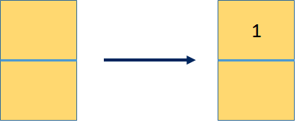
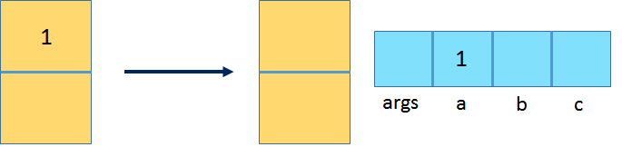
iconst_1: Push the integer constant 1 onto the operand stack.
istore_1: Pop the top operand (an int value) and store it in local variable at index 1, which corresponds to variable a.

Slide 26

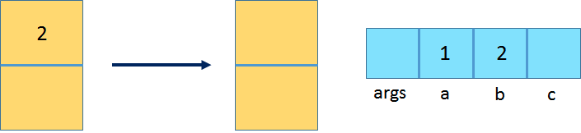
iconst_2: Push the integer constant 2 onto the operand stack.
istore_2: Pop the top operand int value and store it in local variable at index 2, which corresponds to variable b.

Slide 27
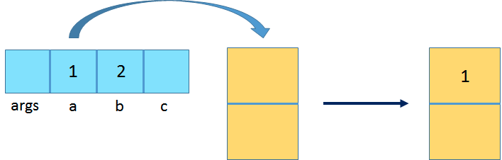
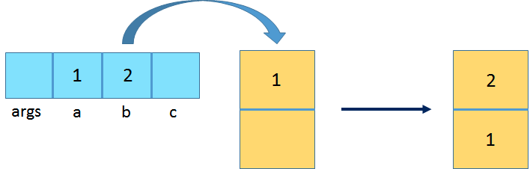
iload_1: Load the int value from local variable at index 1 and push it onto the operand stack.
iload_2: Load the int value from the local variable at index 1 and push it onto the operand stack.

Slide 28
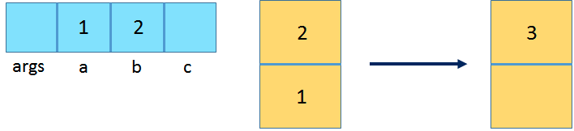
iadd: Pop the top two int values from the operand stack, add them, and push the result back onto the operand stack.
return: Return from the void method.

Slide 29
Exercise 2
Write programme saying hello to user. As application parameter take name. Show generated bytecode. What interesting can you notice?
You can find the solution on exercise2 branch.

Slide 30
Exercise 3
Write below bytecode in Java:
public class exercises.Exercise3 {
public exercises.Exercise3();
Code:
0: aload_0
1: invokespecial #1 // Method java/lang/Object."<init>":()V
4: return
public int someMethod(int);
Code:
0: bipush 22
2: istore_2
3: iload_1
4: iload_2
5: iadd
6: ireturn
}
You can find the solution on exercise3 branch.

Slide 31
JVM languages
public class SampleClass {
public SampleClass();
Code:
0: aload_0
1: invokespecial #1 // Method java/lang/Object."<init>":()V
4: return
public int met();
Code:
0: iconst_5
1: istore_1
2: bipush 7
4: istore_2
5: iload_1
6: iload_2
7: iadd
8: istore_3
9: iload_3
10: ireturn
}
used to produce computer software that runs on the Java virtual machine (JVM)
code of those languages is compiled to Java bytecode
Examples: Kotlin, Scala, JRuby, Jython

Slide 32
public class SampleClass {
public SampleClass();
Code:
0: aload_0
1: invokespecial #1 // Method java/lang/Object."<init>":()V
4: return
public int met();
Code:
0: iconst_5
1: istore_1
2: bipush 7
4: istore_2
5: iload_1
6: iload_2
7: iadd
8: istore_3
9: iload_3
10: ireturn
}
Java
public class SampleClass {
public int met() {
int a = 5;
int b = 7;
int c = a + b;
return c;
}
}
Kotlin
class SampleClass { fun met(): Int { val a = 5 val b = 7 return a + b } }
Scala
class SampleClass {
def met(): Int = {
val a: Int = 5
val b: Int = 7
val c: Int = a + b
c
}
}

Slide 33
Example 2: Calculator class
public class Calculator {
public static void main(String[] args) {
int a = 1;
int b = 2;
int c = calc(a, b);
}
static int calc(int a, int b) {
return (int) Math.sqrt(Math.pow(a, 2) + Math.pow(b, 2));
}
}
Compiled from "Calculator.java" public class Calculator { public Calculator(); Code: 0: aload_0 1: invokespecial #1 // Method java/lang/Object."<init>":()V 4: return public static void main(java.lang.String[]); Code: 0: iconst_1 1: istore_1 2: iconst_2 3: istore_2 4: iload_1 5: iload_2 6: invokestatic #2 // Method calc:(II)I 9: istore_3 10: return static int calc(int, int); Code: 0: iload_0 1: i2d 2: ldc2_w #3 // double 2.0d 5: invokestatic #5 // Method java/lang/Math.pow:(DD)D 8: iload_1 9: i2d 10: ldc2_w #3 // double 2.0d 13: invokestatic #5 // Method java/lang/Math.pow:(DD)D 16: dadd 17: invokestatic #6 // Method java/lang/Math.sqrt:(D)D 20: d2i 21: ireturn }

Slide 34
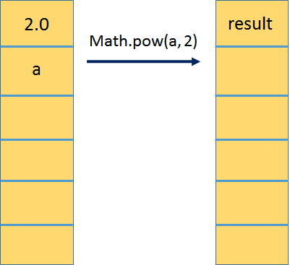
static int calc(int a, int b) {
return (int) Math.sqrt(Math.pow(a, 2) + Math.pow(b, 2));
}
}
Math.pow(a, 2)
static int calc(int, int); Code: 0: iload_0 1: i2d 2: ldc2_w #3 // double 2.0d 5: invokestatic #5 // Method java/lang/Math.pow:(DD)D 8: iload_1 9: i2d 10: ldc2_w #3 // double 2.0d 13: invokestatic #5 // Method java/lang/Math.pow:(DD)D 16: dadd 17: invokestatic #6 // Method java/lang/Math.sqrt:(D)D 20: d2i 21: ireturn
Notes:
The next instruction pushes a double constant 2.0d (taken from the constant pool) onto the operand stack. Then the static Math.pow method is invoked with the two operand values prepared so far (the first argument to calc and the constant 2.0d). When the Math.pow method returns, its result will be stored on the operand stack of its invoker. This can be illustrated below.

Slide 35
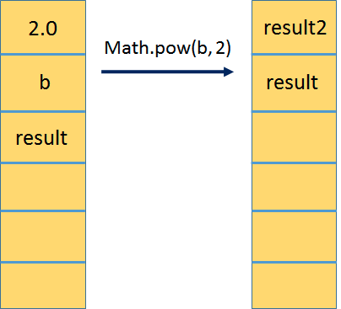
static int calc(int a, int b) {
return (int) Math.sqrt(Math.pow(a, 2) + Math.pow(b, 2));
}
}
Math.pow(b, 2)
static int calc(int, int); Code: 0: iload_0 1: i2d 2: ldc2_w #3 // double 2.0d 5: invokestatic #5 // Method java/lang/Math.pow:(DD)D 8: iload_1 9: i2d 10: ldc2_w #3 // double 2.0d 13: invokestatic #5 // Method java/lang/Math.pow:(DD)D 16: dadd 17: invokestatic #6 // Method java/lang/Math.sqrt:(D)D 20: d2i 21: ireturn
Notes:
The next instruction, dadd, pops the top two intermediate results, adds them, and pushes the sum back to the top. Finally, invokestatic invokes Math.sqrt on the resulting sum, and the result is cast from double to int using narrowing conversion (d2i). The resulting int is returned to the main method, which stores it back to c (istore_3).

Slide 36
Conditions

Slide 37
if-else condition
public class IfElse {
public int greaterThen(int intOne, int intTwo) {
if (intOne > intTwo) {
return 0;
} else {
return 1;
}
}
}
Compiled from "IfElse.java"
public class IfElse {
public IfElse();
Code:
0: aload_0
1: invokespecial #1 // Method java/lang/Object."<init>":()V
4: return
public int greaterThen(int, int);
Code:
0: iload_1
1: iload_2
2: if_icmple 7
5: iconst_0
6: ireturn
7: iconst_1
8: ireturn
}

Slide 38
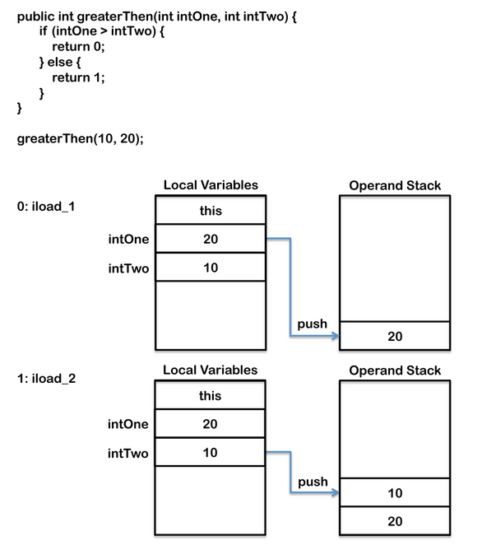
public class IfElse {
public int greaterThen(int intOne, int intTwo) {
if (intOne > intTwo) {
return 0;
} else {
return 1;
}
}
}
public int greaterThen(int, int);
Code:
0: iload_1
1: iload_2
2: if_icmple 7
5: iconst_0
6: ireturn
7: iconst_1
8: ireturn
}

Slide 39
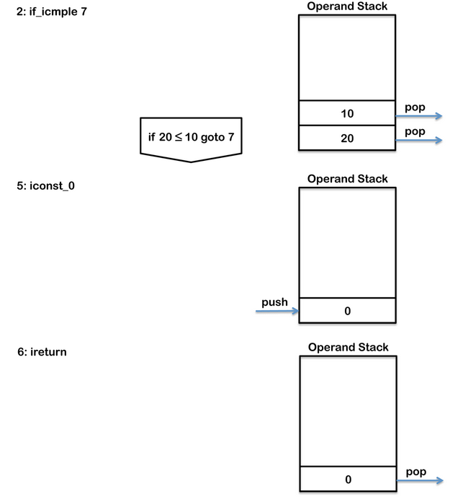
public class IfElse {
public int greaterThen(int intOne, int intTwo) {
if (intOne > intTwo) {
return 0;
} else {
return 1;
}
}
}
public int greaterThen(int, int);
Code:
0: iload_1
1: iload_2
2: if_icmple 7
5: iconst_0
6: ireturn
7: iconst_1
8: ireturn
}

Slide 40
Switch condition
Compiled from "Switch.java"
public class conditions.Switch {
public conditions.Switch();
Code:
0: aload_0
1: invokespecial #1 // Method java/lang/Object."<init>":()V
4: return
public int simpleSwitch(int);
Code:
0: iload_1
1: tableswitch { // 0 to 4
0: 36
1: 38
2: 42
3: 42
4: 40
default: 42
}
36: iconst_3
37: ireturn
38: iconst_2
39: ireturn
40: iconst_1
41: ireturn
42: iconst_m1
43: ireturn
}
public class Switch {
public int simpleSwitch(int intOne) {
switch (intOne) {
case 0:
return 3;
case 1:
return 2;
case 4:
return 1;
default:
return -1;
}
}
}

Slide 41
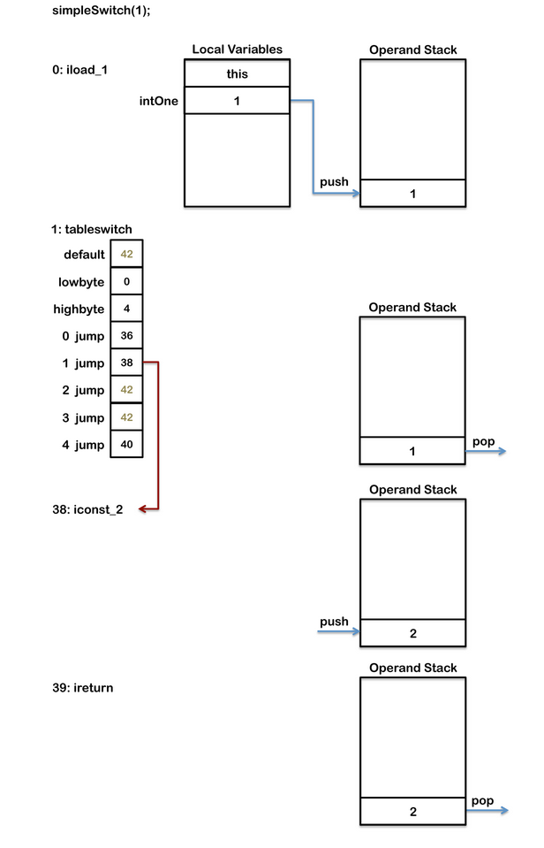
public class Switch {
public int simpleSwitch(int intOne) {
switch (intOne) {
case 0:
return 3;
case 1:
return 2;
case 4:
return 1;
default:
return -1;
}
}
}
public int simpleSwitch(int);
Code:
0: iload_1
1: tableswitch { // 0 to 4
0: 36
1: 38
2: 42
3: 42
4: 40
default: 42
}
36: iconst_3
37: ireturn
38: iconst_2
39: ireturn
40: iconst_1
41: ireturn
42: iconst_m1
43: ireturn
}
Notes:
The tableswitch instruction has values for 0, 1 and 4 to match the case statement provided in the code which each point to the byte code for their prospective code block.
The tableswitch instruction also has values for 2 and 3, as these are not provided as case statements in the Java code they both point to the default code block.
When the instruction is executed the value at the top of the operand stack is checked to see if it is between the minimum and maximum. If the value is not between the minimum and maximum execution jumps to the default branch, which is byte code 42 in the above example.

Slide 42
Loops

Slide 43
While loop
public class While {
public void whileLoop() {
int i = 0;
while (i < 2) {
i++;
}
}
}
Compiled from "While.java"
public class loops.While {
public loops.While();
Code:
0: aload_0
1: invokespecial #1 // Method java/lang/Object."<init>":()V
4: return
public void whileLoop();
Code:
0: iconst_0
1: istore_1
2: iload_1
3: iconst_2
4: if_icmpge 13
7: iinc 1, 1
10: goto 2
13: return
}

Slide 44
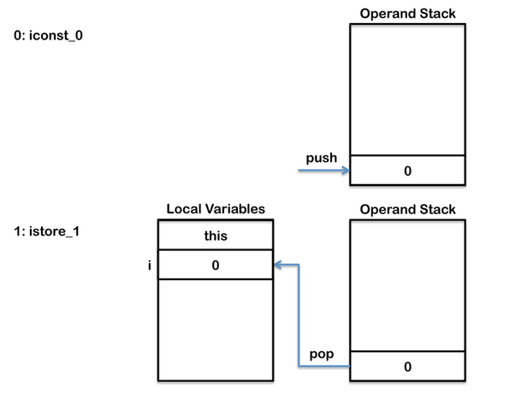
public class While {
public void whileLoop() {
int i = 0;
while (i < 2) {
i++;
}
}
}
public void whileLoop();
Code:
0: iconst_0
1: istore_1
2: iload_1
3: iconst_2
4: if_icmpge 13
7: iinc 1, 1
10: goto 2
13: return

Slide 45
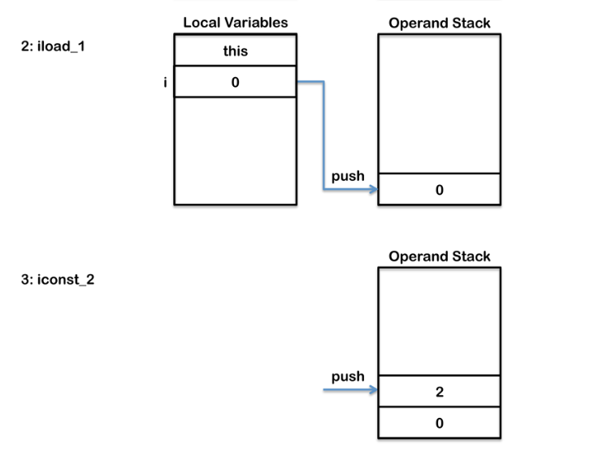
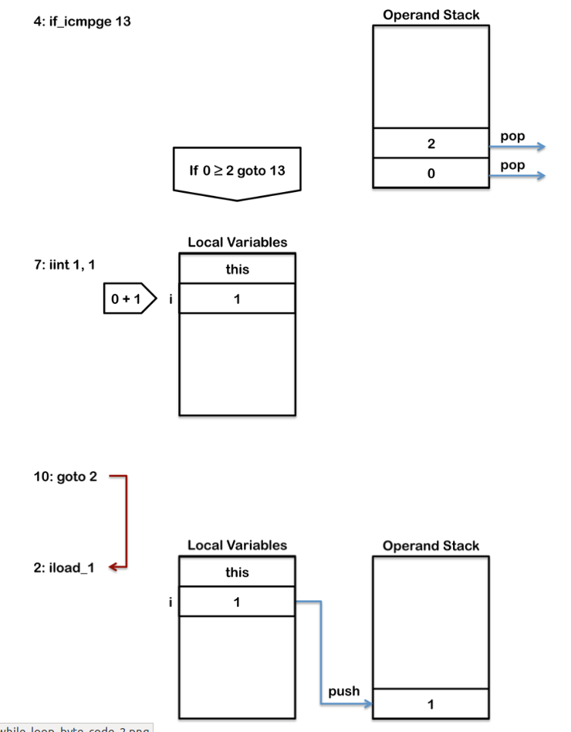
public class While {
public void whileLoop() {
int i = 0;
while (i < 2) {
i++;
}
}
}
public void whileLoop();
Code:
0: iconst_0
1: istore_1
2: iload_1
3: iconst_2
4: if_icmpge 13
7: iinc 1, 1
10: goto 2
13: return

Slide 46
For loop
Compiled from "ForLoop.java"
public class loops.ForLoop {
public loops.ForLoop();
Code:
0: aload_0
1: invokespecial #1 // Method java/lang/Object."<init>":()V
4: return
static void forLoop();
Code:
0: iconst_0
1: istore_0
2: iload_0
3: iconst_5
4: if_icmpge 13
7: iinc 0, 1
10: goto 2
13: return
}
public class ForLoop {
static void forLoop() {
for (int i = 0; i < 5; i++) {
}
}
}

Slide 47
Exercise 4 Do-While
Rewrite and Compile below class. Explain how generated bytecode works.
public class Exercise4 {
public void doWhileLoop() {
int i = 0;
do {
i++;
} while (i < 2);
}
}
You can find the solution on exercise4 branch.

Slide 48
Compiled from "DoWhile.java"
public class loops.DoWhile {
public loops.DoWhile();
Code:
0: aload_0
1: invokespecial #1 // Method java/lang/Object."<init>":()V
4: return
public void doWhileLoop();
Code:
0: iconst_0
1: istore_1
2: iinc 1, 1
5: iload_1
6: iconst_2
7: if_icmplt 2
10: return
}
Do-While loop
public class Exercise4 {
public void doWhileLoop() {
int i = 0;
do {
i++;
} while (i < 2);
}
}

Slide 49
Exercise 5
Anonymous vs lambda
Compile following class. See the difference between opcode generated by implementation of anonymous class and lambda.
You can find the solution on exercise5 branch.
public class Exercise4 {
void anonymousImpl() {
Thread t1 = new Thread(new Runnable() {
@Override
public void run() {
}
});
}
void lambdaImpl() {
Thread t2 = new Thread(() -> {
});
}
}

Slide 50
Compiled from "TryCatchFinally.java"
public class objectOriented.TryCatchFinally {
public objectOriented.TryCatchFinally();
Code:
0: aload_0
1: invokespecial #1 // Method java/lang/Object."<init>":()V
4: return
public void tryCatchCatchFinally(int);
Code:
// try block
0: iconst_2
1: istore_1
// finally block - no exception
2: iconst_4
3: istore_1
4: goto 20
// catch block
7: astore_2
8: iconst_3
9: istore_1
// finally block - after catch block
10: iconst_4
11: istore_1
12: goto 20
// finally block - after exception not caught in catch block
15: astore_3
16: iconst_4
17: istore_1
18: aload_3
19: athrow
20: return
Exception table:
from to target type
// jump to catch block for RuntimeException
0 2 7 Class java/lang/RuntimeException
// jump to finally block if any exception (other than RuntimeException)
0 2 15 any
// jump to finally block if exception in catch block
7 10 15 any
}
Try-catch-finally
public class TryCatchFinally {
public void tryCatchCatchFinally(int i) {
try {
i = 2;
} catch (RuntimeException e) {
i = 3;
} finally {
i = 4;
}
}
}

Slide 51
Synchronized block vs synchronized method
public class SynchronizedBlock {
public void synchronizedBlock(int i) {
synchronized (this) {
i = 1;
}
}
}
public class SynchronizedMethod {
public synchronized void synchronizedMethod(int i) {
i = 1;
}
}
Please look at objectOriented branch.

Slide 52
public class objectOriented.SynchronizedBlock {
public objectOriented.SynchronizedBlock();
Code:
0: aload_0
1: invokespecial #1 // Method java/lang/Object."<init>":()V
4: return
public void synchronizedBlock(int);
Code:
0: aload_0
1: dup
2: astore_2
3: monitorenter
4: iconst_1
5: istore_1
6: aload_2
7: monitorexit
8: goto 16
11: astore_3
12: aload_2
13: monitorexit
14: aload_3
15: athrow
16: return
Exception table:
from to target type
4 8 11 any
11 14 11 any
}
Compiled from "SynchronizedMethod.java"
public class objectOriented.SynchronizedMethod {
public objectOriented.SynchronizedMethod();
Code:
0: aload_0
1: invokespecial #1 // Method java/lang/Object."<init>":()V
4: return
public synchronized void synchronizedMethod(int);
Code:
0: iconst_1
1: istore_1
2: return
}

Slide 53
Project Lombok
Maven dependency
<dependency>
<groupId>org.projectlombok</groupId>
<artifactId>lombok</artifactId>
<version>1.16.20</version>
<scope>provided</scope>
</dependency>
2. Intellij Lombok plugin
Please look at lombok branch.

Slide 54
Lombok and Vanilla Java
@AllArgsConstructor
@ToString
public class PersonWithLombok {
private String firstName;
}
public class PersonVanillaJava {
private String firstName;
public PersonVanillaJava(String firstName) {
this.firstName = firstName;
}
@Override
public String toString() {
return "PersonVanillaJava(firstName=" + this.firstName + ")";
}
}

Slide 55
Vanilla Java:
Lombok:
Compiled from "PersonVanillaJava.java"
public class lombok.PersonVanillaJava {
public lombok.PersonVanillaJava(java.lang.String);
Code:
0: aload_0
1: invokespecial #1 // Method java/lang/Object."<init>":()V
4: aload_0
5: aload_1
6: putfield #2 // Field firstName:Ljava/lang/String;
9: return
public java.lang.String toString();
Code:
0: new #3 // class java/lang/StringBuilder
3: dup
4: invokespecial #4 // Method java/lang/StringBuilder."<init>":()V
7: ldc #5 // String PersonVanillaJava(firstName=
9: invokevirtual #6 // Method java/lang/StringBuilder.append:(Ljava/lang/String;)Ljava/lang/StringBuilder;
12: aload_0
13: getfield #2 // Field firstName:Ljava/lang/String;
16: invokevirtual #6 // Method java/lang/StringBuilder.append:(Ljava/lang/String;)Ljava/lang/StringBuilder;
19: ldc #7 // String )
21: invokevirtual #6 // Method java/lang/StringBuilder.append:(Ljava/lang/String;)Ljava/lang/StringBuilder;
24: invokevirtual #8 // Method java/lang/StringBuilder.toString:()Ljava/lang/String;
27: areturn
}
Compiled from "PersonWithLombok.java"
public class lombok.PersonWithLombok {
public lombok.PersonWithLombok(java.lang.String);
Code:
0: aload_0
1: invokespecial #1 // Method java/lang/Object."<init>":()V
4: aload_0
5: aload_1
6: putfield #2 // Field firstName:Ljava/lang/String;
9: return
public java.lang.String toString();
Code:
0: new #3 // class java/lang/StringBuilder
3: dup
4: invokespecial #4 // Method java/lang/StringBuilder."<init>":()V
7: ldc #5 // String PersonWithLombok(firstName=
9: invokevirtual #6 // Method java/lang/StringBuilder.append:(Ljava/lang/String;)Ljava/lang/StringBuilder;
12: aload_0
13: getfield #2 // Field firstName:Ljava/lang/String;
16: invokevirtual #6 // Method java/lang/StringBuilder.append:(Ljava/lang/String;)Ljava/lang/StringBuilder;
19: ldc #7 // String )
21: invokevirtual #6 // Method java/lang/StringBuilder.append:(Ljava/lang/String;)Ljava/lang/StringBuilder;
24: invokevirtual #8 // Method java/lang/StringBuilder.toString:()Ljava/lang/String;
27: areturn
}

Slide 56
Disable annotation processor
add to pom.xml:
<build>
<plugins>
<plugin>
<groupId>org.apache.maven.plugins</groupId>
<artifactId>maven-compiler-plugin</artifactId>
<configuration>
<source>8</source>
<target>8</target>
</configuration>
<executions>
<execution>
<id>default-compile</id>
<configuration>
<compilerArgument>-proc:none</compilerArgument>
</configuration>
</execution>
</executions>
</plugin>
</plugins>
</build>

Slide 57
After disabling annotation processor
Lombok:
Vanilla Java:
Compiled from "PersonWithLombok.java"
public class lombok.PersonWithLombok {
public lombok.PersonWithLombok();
Code:
0: aload_0
1: invokespecial #1 // Method java/lang/Object."<init>":()V
4: return
}
Compiled from "PersonWithLombok.java"
public class lombok.PersonWithLombok {
public lombok.PersonWithLombok(java.lang.String);
Code:
0: aload_0
1: invokespecial #1 // Method java/lang/Object."<init>":()V
4: aload_0
5: aload_1
6: putfield #2 // Field firstName:Ljava/lang/String;
9: return
public java.lang.String toString();
Code:
0: new #3 // class java/lang/StringBuilder
3: dup
4: invokespecial #4 // Method java/lang/StringBuilder."<init>":()V
7: ldc #5 // String PersonWithLombok(firstName=
9: invokevirtual #6 // Method java/lang/StringBuilder.append:(Ljava/lang/String;)Ljava/lang/StringBuilder;
12: aload_0
13: getfield #2 // Field firstName:Ljava/lang/String;
16: invokevirtual #6 // Method java/lang/StringBuilder.append:(Ljava/lang/String;)Ljava/lang/StringBuilder;
19: ldc #7 // String )
21: invokevirtual #6 // Method java/lang/StringBuilder.append:(Ljava/lang/String;)Ljava/lang/StringBuilder;
24: invokevirtual #8 // Method java/lang/StringBuilder.toString:()Ljava/lang/String;
27: areturn
}

Slide 58
Refs:
https://www.cubrid.org/blog/understanding-jvm-internals/
https://dzone.com/articles/introduction-to-java-bytecode

Slide 59
Authors
@epam
Krzysztof Dzioba
@epam
Krzysztof Sroczyk

